Slide 1
Chapter Three Java Database Connectivity (JDBC)
Objectives
To become familiar with the JDBC API
To learn how to load a driver, connect to a database, execute statements, and process result sets using JDBC
To use the prepared statements to execute precompiled SQL statements
To handle transactions in the Connection interface
To explore database metadata using the DatabaseMetaData and ResultSetMetaData interfaces.

Slide 2
Why Java for Database Programming?
First, Java is platform independent. You can develop platform-independent database applications using SQL and Java for any relational database systems.
Second, the support for accessing database systems from Java is built into Java API, so you can create database applications using all Java code with a common interface.
Third, Java is taught in almost every university either as the first programming language or as the second programming language.

Slide 3
JDBC
JDBC is the Java API for accessing relational database.
JDBC is the Java API for developing Java database applications.
JDBC provides Java programmers with a uniform interface for accessing and manipulating a wide range of relational databases.
Using the JDBC API, applications written in the Java programming language can execute SQL statements, retrieve results, present data in a user-friendly interface, and propagate changes back to the database.
The JDBC API can also be used to interact with multiple data sources in a distributed, heterogeneous environment.
The JDBC API is a set of Java interfaces and classes used to write Java programs for accessing and manipulating relational databases.

Slide 4
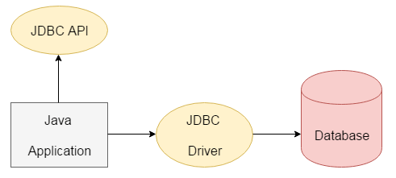
General Structure of JDBC

Slide 5
JDBC
Since a JDBC driver serves as the interface to facilitate communications between JDBC and a proprietary database, JDBC drivers are database specific and are normally provided by the database vendors.
You need MySQL JDBC drivers to access the MySQL database, and Oracle JDBC drivers to access the Oracle database.
For the Access database, use the JDBC-ODBC bridge driver included in the JDK.
ODBC is a technology developed by Microsoft for accessing databases on the Windows platform. An ODBC driver is preinstalled on Windows.
The JDBC-ODBC bridge driver allows a Java program to access any ODBC data source.
The relationships between Java programs, JDBC API, JDBC drivers, and relational databases are shown in Figure below.

Slide 6
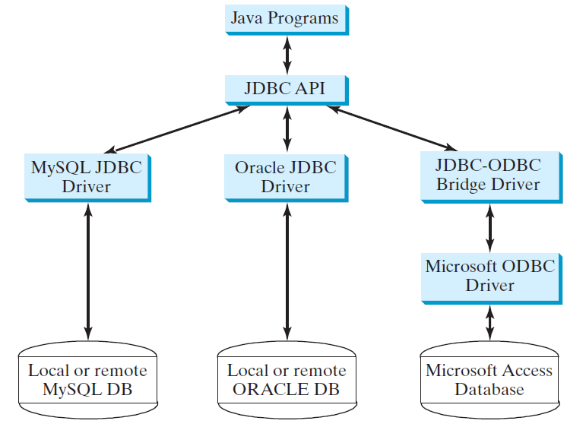
The Architecture of JDBC

Slide 7
Developing Database Applications Using JDBC
The JDBC API is a Java application program interface to generic SQL databases that enables Java developers to develop DBMS-independent Java applications using a uniform interface.
The JDBC API consists of classes and interfaces for establishing connections with databases, sending SQL statements to databases, processing the results of SQL statements, and obtaining database metadata.
Four key interfaces are needed to develop any database application using Java: Driver, Connection, Statement, and ResultSet.
These interfaces define a framework for generic SQL database access.
The JDBC API defines these interfaces, and the JDBC driver vendors provide the implementation for the interfaces.

Slide 8
Developing Database Applications Using JDBC
The relationship of these interfaces is shown in the next slide.
A JDBC application loads an appropriate driver using the Driver interface, connects to the database using the Connection interface, creates and executes SQL statements using the Statement interface, and processes the result using the ResultSet interface if the statements return results.
Note that some statements, such as SQL data definition statements and SQL data modification statements, do not return results.

Slide 9
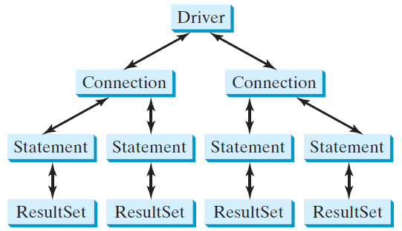
The JDBC Interfaces
The JDBC interfaces and classes are the building blocks in the development of Java database programs. A typical Java program takes the following steps to access a database.
Loading drivers
Establishing connections
Creating and executing statements
Processing ResultSet

Slide 10
Developing JDBC Programs
Loading drivers
Establishing connections
Creating and executing statements
Processing ResultSet
Statement to load a driver:
Class.forName("JDBCDriverClass");
A driver is a class. For example:
Database Driver Class Source
Access sun.jdbc.odbc.JdbcOdbcDriver Already in JDK
MySQL com.mysql.jdbc.Driver Website
Oracle oracle.jdbc.driver.OracleDriver Website
The JDBC-ODBC driver for Access is bundled in JDK.
MySQL driver class is in mysqljdbc.jar
Oracle driver class is in classes12.jar
To use the MySQL and Oracle drivers, you have to add mysqljdbc.jar and classes12.jar in the class path.

Slide 11
Developing JDBC Programs
Loading drivers
Establishing connections
Creating and executing statements
Processing ResultSet
Connection connection = DriverManager.getConnection(databaseURL);
Database: URL Pattern
Access : jdbc:odbc:dataSource
MySQL: jdbc:mysql://hostname:port# /dbname, username, password
Oracle: jdbc:oracle:thin:@hostname:port#:oracleDBSID, username, pwd
Examples:
For Access:
Connection connection = DriverManager.getConnection
("jdbc:odbc:ExampleMDBDataSource");
For MySQL:
Connection connection = DriverManager.getConnection
("jdbc:mysql://localhost/test");
For Oracle:
Connection connection = DriverManager.getConnection
("jdbc:oracle:thin:@liang.armstrong.edu:1521:orcl", "scott", "tiger");

Slide 12
Developing JDBC Programs
Loading drivers
Establishing connections
Creating and executing statements
Processing ResultSet
Creating statement:
Statement statement = connection.createStatement();
Executing statement (for update, delete, insert):
statement.executeUpdate ("create table Temp (col1 char(5), col2 char(5))");
Executing statement (for select):
// Select the columns from the Student table
ResultSet resultSet = statement.executeQuery
("select firstName, mi, lastName from Student where lastName "
+ " = 'Smith'");

Slide 13
Developing JDBC Programs
Loading drivers
Establishing connections
Creating and executing statements
Processing ResultSet
Executing statement (for select):
// Select the columns from the Student table
ResultSet resultSet = stmt.executeQuery
("select firstName, mi, lastName from Student where lastName "
+ " = 'Smith'");
Processing ResultSet (for select):
// Iterate through the result and print the student names
while (resultSet.next())
System.out.println(resultSet.getString(1) + " " + resultSet.getString(2)
+ ". " + resultSet.getString(3));

Slide 14
Developing JDBC Programs
The getString(1) , getString(2) , and getString(3) methods retrieve the column values for firstName, mi , and lastName, respectively.
Alternatively, you can use getString("firstName") , getString("mi") , and getString("lastName") to retrieve the same three column values.
The first execution of the next() method sets the current row to the first row in the result set, and subsequent invocations of the next() method set the current row to the second row, third row, and so on, to the last row.

Slide 15
Simple JDBC Example
import java.sql.*;
public class SimpleJdbc {
public static void main(String[] args) throws SQLException, ClassNotFoundException {
// Load the JDBC driver
Class.forName("sun.jdbc.odbc.JdbcOdbcDriver");
System.out.println("Driver loaded");
// Establish a connection
Connection connection = DriverManager.getConnection
("jdbc:odbc:exampleMDBDataSource");
System.out.println("Database connected");
// Create a statement
Statement statement = connection.createStatement();
// Execute a statement
ResultSet resultSet = statement.executeQuery
("select firstName, mi, lastName from Student where lastName " + " = 'Smith'");
// Iterate through the result and print the student names
while (resultSet.next())
System.out.println(resultSet.getString(1) + "\t" +
resultSet.getString(2) + "\t" + resultSet.getString(3));
connection.close();
}
}

Slide 16
Processing Statements
Once a connection to a particular database is established, it can be used to send SQL statements from your program to the database.
JDBC provides the Statement, PreparedStatement, and CallableStatement interfaces to facilitate sending statements to a database for execution and receiving execution results from the database.

Slide 17
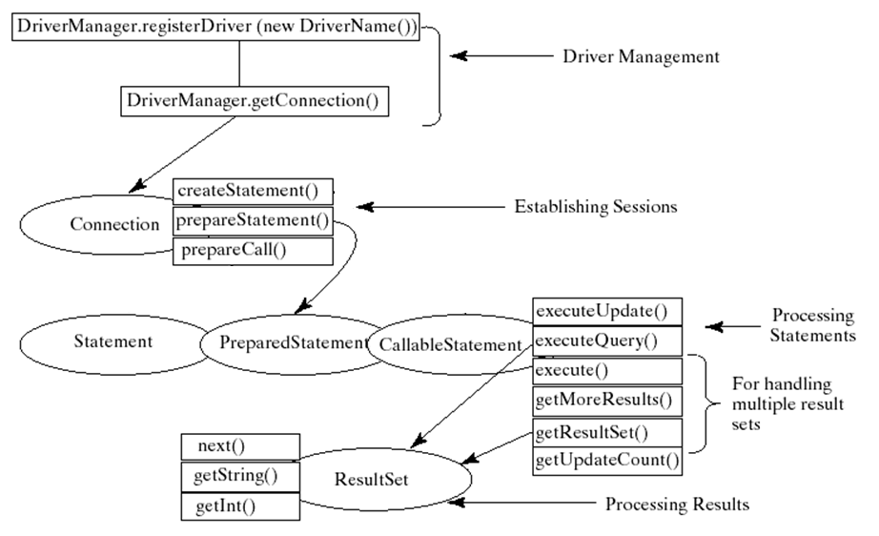
Processing Statements Diagram

Slide 18
The execute(), executeQuery(), and executeUpdate() Methods
The methods for executing SQL statements are execute(), executeQuery(), and executeUpdate(), each of which accepts a string containing a SQL statement as an argument.
This string is passed to the database for execution.
The execute() method should be used if the execution produces multiple result sets, multiple update counts, or a combination of result sets and update counts.

Slide 19
The execute(), executeQuery(), and executeUpdate() Methods
The executeQuery() method should be used if the execution produces a single result set, such as the SQL select statement.
The executeUpdate() method should be used if the statement results in a single update count or no update count, such as a SQL INSERT, DELETE, UPDATE, or DDL statement.

Slide 20
PreparedStatement
PreparedStatement enables you to create parameterized SQL statements.
Once a connection to a particular database is established, it can be used to send SQL statements from your program to the database.
The Statement interface is used to execute static SQL statements that don’t contain any parameters.
The PreparedStatement interface, extending Statement, is used to execute a precompiled SQL statement with or without parameters.
Since the SQL statements are precompiled, they are efficient for repeated executions.
A PreparedStatement object is created using the preparedStatement method in the Connection interface.
For example, the following code creates a PreparedStatement for an SQL insert statement:
Statement preparedStatement = connection.prepareStatement ("insert into Student (firstName, mi, lastName) " + "values (?, ?, ?)");

Slide 21
PreparedStatement
This insert statement has three question marks as placeholders for parameters representing values for firstName, mi , and lastName in a record of the Student table.
As a sub-interface of Statement, the PreparedStatement interface inherits all the methods defined in Statement.
It also provides the methods for setting parameters in the object of PreparedStatement.
These methods are used to set the values for the parameters before executing statements or procedures. In general, the set methods have the following name and signature:
setX(int parameterIndex, X value);
where X is the type of the parameter, and parameterIndex is the index of the parameter in the statement. The index starts from 1.
For example, the method setString(int parameterIndex, String value) sets a String value to the specified parameter.

Slide 22
PreparedStatement
The following statements pass the parameters "Jack", "A", and "Ryan” to the placeholders for firstName, mi , and lastName in preparedStatement:
preparedStatement.setString(1, "Jack");
preparedStatement.setString(2, "A");
preparedStatement.setString(3, "Ryan");
After setting the parameters, you can execute the prepared statement by invoking executeQuery() for a SELECT statement and executeUpdate() for a DDL or update statement.
The executeQuery() and executeUpdate() methods are similar to the ones defined in the Statement interface except that they don’t have any parameters, because the SQL statements are already specified in the preparedStatement method when the object of PreparedStatement is created.

Slide 23
Example: PreparedStatement to Execute Dynamic SQL Statements
import javax.swing.*; import java.sql.*; import java.awt.*; import java.awt.event.*;
public class FindGradeUsingPreparedStatement extends JApplet { private JTextField jtfSSN = new JTextField(9); private JTextField jtfCourseId = new JTextField(5); private JButton jbtShowGrade = new JButton("Show Grade"); // PreparedStatement for executing queries private PreparedStatement preparedStatement; /** Initialize the applet */ public void init() { // Initialize database connection and create a Statement object initializeDB(); jbtShowGrade.addActionListener(new ActionListener() { @Override public void actionPerformed(ActionEvent e) { jbtShowGrade_actionPerformed(e); }
}); JPanel jPanel1 = new JPanel(); jPanel1.add(new JLabel("SSN")); jPanel1.add(jtfSSN); jPanel1.add(new JLabel("Course ID")); jPanel1.add(jtfCourseId); jPanel1.add(jbtShowGrade);

Slide 24
Example: PreparedStatement to Execute Dynamic SQL Statements
add(jPanel1, BorderLayout.NORTH); } private void initializeDB() { try { // Load the JDBC driver Class.forName("com.mysql.jdbc.Driver"); // Class.forName("oracle.jdbc.driver.OracleDriver"); System.out.println("Driver loaded"); // Establish a connection Connection connection = DriverManager.getConnection ("jdbc:mysql://localhost/javabook", "scott", "tiger");
System.out.println("Database connected"); String queryString = "select firstName, mi, " + "lastName, title, grade from Student, Enrollment, Course " + "where Student.ssn = ? and Enrollment.courseId = ? " + "and Enrollment.courseId = Course.courseId"; // Create a statement preparedStatement = connection.prepareStatement(queryString); }

Slide 25
Example: PreparedStatement to Execute Dynamic SQL Statements
catch (Exception ex) { ex.printStackTrace(); } }
private void jbtShowGrade_actionPerformed(ActionEvent e) { String ssn = jtfSSN.getText(); String courseId = jtfCourseId.getText(); try { preparedStatement.setString(1, ssn); preparedStatement.setString(2, courseId); ResultSet rset = preparedStatement.executeQuery();
if (rset.next()) { String lastName = rset.getString(1); String mi = rset.getString(2); String firstName = rset.getString(3); String title = rset.getString(4); String grade = rset.getString(5); // Display result in a dialog box JOptionPane.showMessageDialog(null , firstName + " " + mi + " " + lastName + "'s grade on course " + title + " is " + grade); } else { // Display result in a dialog box JOptionPane.showMessageDialog(null , "Not found"); } } catch (SQLException ex) { ex.printStackTrace(); } }
}

Slide 26
CallableStatement
The CallableStatement interface is designed to execute SQL-stored procedures.
The procedures may have IN, OUT or IN OUT parameters.
An IN parameter receives a value passed to the procedure when it is called.
An OUT parameter returns a value after the procedure is completed, but it doesn’t contain any value when the procedure is called.
An IN OUT parameter contains a value passed to the procedure when it is called, and returns a value after it is completed.
For example, the following procedure in Oracle PL/SQL has IN parameter p1, OUT parameter p2, and IN OUT parameter p3.
create or replace procedure sampleProcedure (p1 in varchar, p2 out number, p3 in out integer) is begin /* do something */ end sampleProcedure; /

Slide 27
Retrieving Database Metadata
The database metadata such as database URL, username, JDBC driver name can be obtained using the DatabaseMetaData interface and result set metadata such as table column count, column names and column type can be obtained using the ResultSetMetaData interface.
Database metadata is the information that describes database itself.
JDBC provides the DatabaseMetaData interface for obtaining database-wide information, and the ResultSetMetaData interface for obtaining information on the specific ResultSet.
To obtain an instance of DatabaseMetaData for a database, use the getMetaData method on a Connection object like this:
DatabaseMetaData dbMetaData = connection.getMetaData();

Slide 28
Example: Retrieving Database Metadata
import java.sql.*; public class TestDatabaseMetaData { public static void main(String[] args) throws SQLException, ClassNotFoundException { // Load the JDBC driver Class.forName("com.mysql.jdbc.Driver"); System.out.println("Driver loaded"); // Connect to a database Connection connection = DriverManager.getConnection ("jdbc:mysql://localhost/javabook", "scott", "tiger"); System.out.println("Database connected"); DatabaseMetaData dbMetaData = onnection.getMetaData(); System.out.println("database URL: "+ dbMetaData.getURL()); System.out.println("database username: " + dbMetaData.getUserName());

Slide 29
Example: Retrieving Database Metadata
System.out.println("database product name: " + dbMetaData.getDatabaseProductName()); System.out.println("database product version: " + dbMetaData.getDatabaseProductVersion()); System.out.println("JDBC driver name: " + dbMetaData.getDriverName()); System.out.println("JDBC driver version: " + dbMetaData.getDriverVersion()); System.out.println("JDBC driver major version: " + dbMetaData.getDriverMajorVersion()); System.out.println("JDBC driver minor version: " + dbMetaData.getDriverMinorVersion()); System.out.println("Max number of connections: " + dbMetaData.getMaxConnections()); System.out.println("MaxTableNameLength: " + dbMetaData.getMaxTableNameLength()); System.out.println("MaxColumnsInTable: " + dbMetaData.getMaxColumnsInTable()); // Close the connection connection.close(); } }

Slide 30
Obtaining Database Tables
You can identify the tables in the database through database metadata using the getTables method.
The following program displays all the user tables in the test database on a local MySQL database.

Slide 31
Example: Obtaining Database Tables
import java.sql.*; public class FindUserTables { public static void main(String[] args) throws SQLException, ClassNotFoundException { // Load the JDBC driver Class.forName("com.mysql.jdbc.Driver");
System.out.println("Driver loaded"); // Connect to a database Connection connection = DriverManager.getConnection ("jdbc:mysql://localhost/javabook", "scott", "tiger"); System.out.println("Database connected"); DatabaseMetaData dbMetaData = connection.getMetaData(); ResultSet rsTables = dbMetaData.getTables(null , null , null , new String[] {"TABLE"}); System.out.print("User tables: "); while (rsTables.next()) System.out.print( rsTables.getString(“TABLE_NAME”)+ " "); // Close the connection connection.close(); } }

Slide 32
Result Set Metadata
The ResultSetMetaData interface describes information pertaining to the result set.
A ResultSetMetaData object can be used to find the types and properties of the columns in a ResultSet.
To obtain an instance of ResultSetMetaData, use the getMetaData method on a result set like this:
ResultSetMetaData rsMetaData = resultSet.getMetaData();
You can use the getColumnCount() method to find the number of columns in the result and the getColumnName(int) method to get the column names.
The following program displays all the column names and contents resulting from the SQL SELECT statement select * from Enrollment.

Slide 33
Example: Result Set Metadata
import java.sql.*; public class TestResultSetMetaData { public static void main(String[] args) throws SQLException, ClassNotFoundException { // Load the JDBC driver Class.forName("com.mysql.jdbc.Driver"); System.out.println("Driver loaded");
// Connect to a database Connection connection = DriverManager.getConnection ("jdbc:mysql://localhost/javabook", "scott", "tiger"); System.out.println("Database connected"); // Create a statement Statement statement = connection.createStatement(); // Execute a statement ResultSet resultSet = statement.executeQuery ("select * from Enrollment"); ResultSetMetaData rsMetaData = resultSet.getMetaData(); for (int i = 1; i <= rsMetaData.getColumnCount(); i++) System.out.printf("%-12s\t", rsMetaData.getColumnName(i)); System.out.println(); // Iterate through the result and print the students' names while (resultSet.next()) { for (int i = 1; i <= rsMetaData.getColumnCount(); i++) System.out.printf("%-12s\t", resultSet.getObject(i)); System.out.println(); } // Close the connection connection.close(); }
}

Slide 34
DatabaseMetadata, cont.
The DatabaseMetaData interface provides more than 100 methods for getting database metadata concerning the database as a whole.
These methods can be divided into three groups: for retrieving general information, for finding database capabilities, and for getting object descriptions.

Slide 35
General Information
The general information includes the URL, username, product name, product version, driver name, driver version, available functions, available data types and so on.

Slide 36
Examples
DatabaseMetaData dbMetaData = connection.getMetaData();
System.out.println("database URL: " + dbMetaData.getURL());
System.out.println("database username: " +
dbMetaData.getUserName());
System.out.println("database product name: " +
dbMetaData.getDatabaseProductName());
System.out.println("database product version: " +
dbMetaData.getDatabaseProductVersion());
System.out.println("JDBC driver name: " +
dbMetaData.getDriverName());
System.out.println("JDBC driver version: " +
dbMetaData.getDriverVersion());
System.out.println("JDBC driver major version: " +
new Integer(dbMetaData.getDriverMajorVersion()));
System.out.println("JDBC driver minor version: " +
new Integer(dbMetaData.getDriverMinorVersion()));
System.out.println("Max number of connections: " +
new Integer(dbMetaData.getMaxConnections()));
System.out.println("MaxTableNameLentgh: " +
new Integer(dbMetaData.getMaxTableNameLength()));
System.out.println("MaxColumnsInTable: " +
new Integer(dbMetaData.getMaxColumnsInTable()));
connection.close();

Slide 37
Sample Run
Driver loaded
database URL: jdbc:odbc:exampleMDBDataSource
database username: admin
database product name: ACCESS
database product version: 04.00.0000
JDBC driver name: JDBC-ODBC Bridge (odbcjt32.dll)
JDBC driver version: 2.0001 (04.00.6304)
JDBC driver major version: 2
JDBC driver minor version: 1
Max number of connections: 64
MaxTableNameLentgh: 64
MaxColumnsInTable: 255

Slide 38
MVC Model for developing three-tier applications
Stands for "Model-View-Controller."
MVC is an application design model comprised of three interconnected parts.
They include the model (data), the view (user interface), and the controller (processes that handle input).
The MVC model or "pattern" is commonly used for developing modern user interfaces.
It is provides the fundamental pieces for designing a programs for desktop or mobile, as well as web applications.
It works well with object-oriented programming, since the different models, views, and controllers can be treated as objects and reused within an application.

Slide 39
MVC Model for developing three-tier applications
Model
A model is data used by a program. This may be a database, file, or a simple object, such as an icon or a character in a video game.
The model does not initiate actions: it accepts commands from the controller and processes them.
View
View represents the visualization of the data that model contains.
A view is the means of displaying objects within an application. Examples include displaying a window or buttons or text within a window.
This coordinates the appearance of the GUI (labels, text fields, buttons, etc.). It includes anything that the user can see.
Controller
Controller acts on both model and view. It controls the data flow into model object and updates the view whenever data changes.
A controller updates both models and views. It accepts input and performs the corresponding update.

Slide 40
The End!!

