Slide 1
Introduction

Slide 2
Why Telecom Study
Communication over a distance is essential to civilization and this communication is increasingly provided by electronic means.
In Order to transport large amount information quickly, telcom services are extensively used in business, in social life & for entertainment.

Slide 3
Who provides telecom service & Who are the participants?
Telecom service are provided by public Telecom operators (Eg: Ethio telecom) through telecom Networks.
Telecom networks provides traffic by means of transmission links connected by switching system.
Participants: Business of telecom involves many participants.
  Public telecom operator(PTO)
  Providers of service that involve also the equipment & component manufacturer (for both h/w & s/w)
  Financial Investors (Government or private)
  Users, also called as subscribers or customers

Slide 4
Development of Telecom
Most of our activities depends on using information like human speech, written & printed document & computer data.
Similarly information can be processed, stored & transmitted by means of technology.
For transporting these information over a long distance, Telecommunication is used by converting these information into electrical signals.
Electrical communications started with the invention of telegraph by weatstone & Morse in 1837

Slide 5
Contd…
1837- Invention of telegraph
1870- telephony, telex,facsimile
(1876- 1878)Alexander Grahambel invented 1st telephone exchange
1970- Radio phone
1990- Home banking, cardless calling, cell phone, messaging
2000- pocket phone,voice recognition, digital end to end services,satellite business services etc.
-------------------------------------------------
Network Structure :***Refer to handout attached***

Slide 6
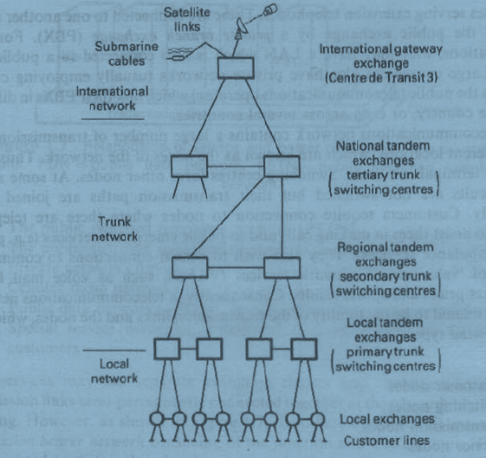
National telecommunication network

Slide 7
A national public switched telecommunications network (PSTN) is in the Fig.
1. Local networks which connect customers’ stations to their local exchanges.
(These are also called subcribers’ distribution networks, customer access Networks or the customer loop)
2. Junction networks which interconnect a group of local exchanges serving an area and a tandem or trunk exchange
3. The trunk network or toll network which provides long distance circuits between local areas through out the country
The totality of ‘2’ &’3’ is some times called the core network . The inner core consisting of trunk network and the outer core consisting of Junction network.
Above the hierarchy, there is international network, which provides circuits linking the national networks of different countries.
The national network is connected to the international network by one or more international gateway exchange

Slide 8
Private branch exchange(PBX)
Below the hierarchy of the National public network, some customers have internals lines serving extension telephones.
These are connected to one another and to lines from the public exchange by a private branch exchange(PBX).
For data communications, they may have a LAN which is also connected to a public data network.
Large companies also have private networks (Usually employing circuits leased from the public telecommunications operator) which link their PBXs in different parts of the country or even across several countries.

Slide 9
Nodes
Nodes are the transmission links joining different locations in a telecommunication networks.
Thus customer’s terminal is a node switching centers form other nodes.
Customer require connections to nodes where there are telephone operators to assist them in making calls and to public emergency services (eg: police, fire and ambulance services).
They also wish to obtain service connections to commercial providers of “Value added network services”(VANS), such as voice mail boxes, stock market prices and sports results etc..

Slide 10
Contd…
Hence the telecom network can be considered to be the totality of the transmission links and the nodes, which are of the following types.
Customer nodes
Switching nodes
Transmission nodes
Service nodes

Slide 11
Signalling
In order to setup a connection to the required destination and to clear it when the conversation is over, The connection that passes through several exchanges and such information must be sent between all exchanges on a route. This interchange of information is called ‘signalling’.

Slide 12
Interacting Subsystems of telecom
A telecom network may consists of system with the following interacting systems
Transmission systems
Switching systems
Signalling systems

Slide 13
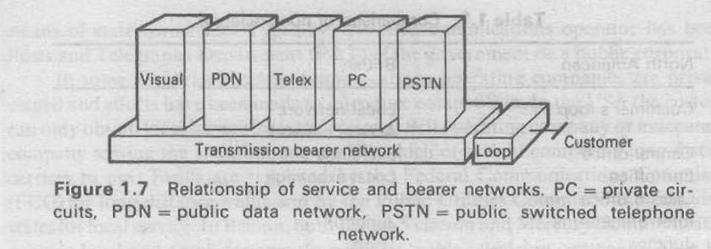
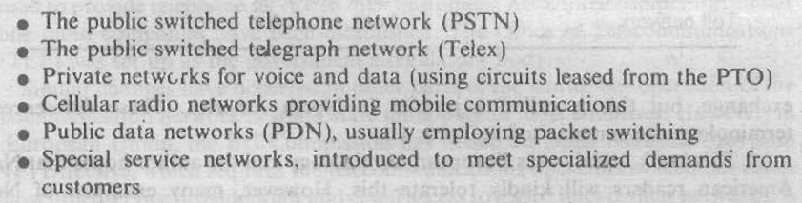
Network services

Slide 14
Contd…
These services may use separate switching centers
Private circuits use transmission links semi-permanently connected together at the network nodes without switching.
However all these different services use a common transmission bearer network consisting of the junction and trunk circuits.
Customers are connected to this at their local exchanges via local access network.
Thus the services are divided into 2 types
  Teleservices
  Bearer services

Slide 15
Contd…
Teleservices , in which provision of service depends on particular terminal apparatus.
Eg: telephone , teleprinter
Bearer services: which present the customer with transmission capacity that can be used for any desired function
Eg: private circuits

Slide 16
Terminology
Different names for the various networks and their switching centers in different languages and also in different English speaking countries.
The table in the next slide shows the comparison of nomenclature between north American and British

Slide 17
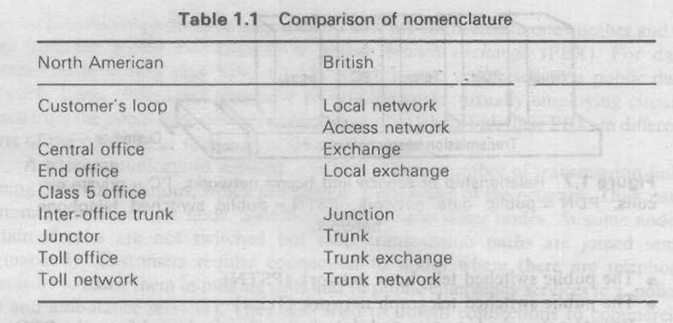
Contd….

Slide 18
Contd…
But Internationally, trunk exchange are called primary centers, secondary centers and tertiary centers.
Having primary centers at the lowest level at the trunk hierarchy and it interfaces with the local exchanges.
In ITU(International telecommunication Union) terminology, an international gateway exchange is called a centre de transit 3(CT3). International exchanges CT2 and CT1 connect only international circuits.
Exchanges CT2 switch traffic between regional group countries and CT1 exchanges switch traffic between continents.

Slide 19
standards
ITU: the standardisation which has made an international network possible is carried out through the International telecommunications Union founded in 1865.
It was founded as International telegraph Union and is an oldest of the specialized agencies of the United nations.
The work of ITU is carried out through two main bodies
  ITU-T
  ITU-R

Slide 20
Contd…
ITU-T (ITU- telecommunications)
Which was formerly the comite consultatif international telegraphique et telephonique(CCITT).
Its duties include the study of technical questions, operating methods and tariffs for telephony, telegraphy and data communications

Slide 21
Contd…
ITU-R(ITU – Radio communications) sector..
Which was formerly the comite consultatif international des radio communications(CCIR).
It studies all technical and operating questions relating to radio communications including
  Point to point communications
  Mobile services
  And broadcasting

Slide 22
Contd…
IFRB (International frequency registration board)
Is associated with ITU-R, which regulates the assignment of radio frequencies to prevent interference between different transmissions.

