Slide 1
Chapter-3
Hydraulics of pipe flow (closed conduit flow)

Slide 2
Contents
General introduction
Energy equation
Head loss equations
Head discharge relationships
Solving pipe network problems

Slide 3
3.Closed conduit flow
3.1) Introduction
This type of flow is also known as internal flow where the pipe is assumed to be completely filled with the fluid.
The pressure may be above or below atmospheric pressure & it may vary from section to section along the length of the conduit.
The fluid motion is generated by pressure difference between two points and is constrained by the pipe walls. The direction of the flow is always from a point of high pressure to a point of low pressure.
If the fluid does not completely fill the pipe, such as in a concrete sewer, the existence of any gas phase generates an almost constant pressure along the flow path.
If the sewer is open to atmosphere, the flow is known as open-channel flow.

Slide 4
General Introduction
Pipe flows are mainly due to pressure difference between two sections
Here also the total head is made up of pressure head, datum head and velocity head
The principle of continuity, energy, momentum is also used in this type of flow.
For example, to design a pipe, we use the continuity and energy equations to obtain the required pipe diameter
Then applying the momentum equation, we get the forces acting on bends for a given discharge
In the design and operation of a pipeline, the main considerations are head losses, forces and stresses acting on the pipe material, and discharge.

Slide 5
Energy equation
The design of conduit should be such that it needs least cost for a given discharge
The hydraulic aspect of the problem require applying the one dimensional steady flow form of the energy equation:
Where p/γ =pressure head
αV²/2g =velocity head
z =elevation head
h_{p}=head supplied by a pump
h_{L} =head loss between 1 and 2

Slide 6
Energy equation

Slide 7
Energy equation
Velocity head
In αV²/2g, the velocity V is the mean velocity in the conduit at a given section and is obtained by V=Q/A, where Q is the discharge, and A is the cross-sectional area of the conduit.
The kinetic energy correction factor is given by α usually assumed to be unity for ease of application in pipe flow, and the velocity head is then simply V²/2g.

Slide 8
Energy equation cont…
Head-loss term
The head loss term h_{L} accounts for the actual amount of energy that can be harnessed/ connected from flowing water is reduced due to different factors.
May occur due to friction between the fluid and the pipe wall and turbulence within the fluid
Further the head loss also depends on whether the pipe is hydraulically smooth, rough or somewhere in between
In water distribution system , head loss is also due to bends, valves and changes in pipe diameter

Slide 9
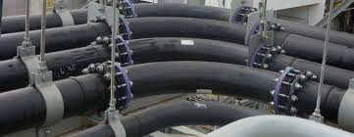
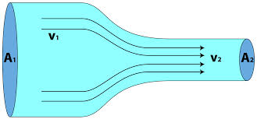
Pipe bends
Valves
Change in pipe diameter

Slide 10
pipeline design and analysis equations
Darcy-Weisbach method
Hazen-Williams method
Hardy-Cross method
And others

Slide 11
3.2 Laminar & Turbulent flow
Flow in pipes can be divided into two different regimes, i.e. laminar and turbulence.
The experiment to differentiate between both regimes was introduced in 1883 by Osborne Reynolds (1842–1912), an English physicist who is famous in fluid experiments in early days.

Slide 12
Laminar flow: - flow in which the fluid moves in layers, or laminas.
Characteristics
Re less than 2000.
It occurs at Low velocity.
The viscous forces predominate over the inertial forces.
Rare in practice in water system.
Simple mathematical analysis possible.

Slide 13
Turbulent flow: - has very erratic motion of fluid particles, with a violent transverse interchange of momentum.
It had completely disrupted the orderly movement of laminar flow.
Re greater than 4000.
The losses are directly proportional to the average velocity.
mathematical analysis is very difficult.

Slide 14
Laminar and Turbulent Flows---
Reynolds apparatus
Transition at Re of 2000(2100)

Slide 15
3.2 Laminar & Turbulent flow----
Figure 3.1 Reynold’s Experiment for Differentiating Flow Regime

Slide 16
3.2 Laminar & Turbulent flow----
From Fig. 3.1, the dye is used to mark the flow path of the fluid. In order to demonstrate the transition between laminar and turbulent regime, the - Q is varied.
For a constant diameter pipe, the cross sectional area is also constant. Thus, by virtue of mass conservation (Q=A.V), the velocity V is directly proportional to Q.
For laminar regime, the flow velocity is kept small, thus the generated flow is very smooth which is shown as a straight tiny line formed by the dye.
When the flow velocity is increased, the flow becomes slightly unstable such that it contains some temporary velocity fluctuation of fluid molecules and this mark the transition regime between both regimes. Then, the velocity can be increased further so that the fluid flow is completely unstable and the dye is totally mixed with the surrounding fluid. This phenomenon is known as turbulence.

Slide 17
3.2 Laminar & Turbulent flow
Laminar flow has a smooth velocity and Turbulent flow has a fluctuated velocity.
Clearly, one of the main critical parameters that determines the flow regimes is the velocity.
This parameter, together with fluid properties, namely density ρ and dynamic viscosity μ, as well as pipe diameter D, forms the dimensionless Reynolds number, that is
From Reynolds’ experiment, he suggested that
Re <= 2000(Or 2100): for laminar flows
Re=> 4000: for turbulent flows.
2100 <Re< 4000 :represents transitional flows.

Slide 18
3.2 Velocity distribution in pipe flow
In many cases of pipe flows, it may begin from a tank as shown in Fig. 3.3.
The common velocity profile for laminar pipe flow is parabolic. However, at a position in the pipe where the fluid just exits from the reservoir, the velocity profile is almost uniform.
Laminar
Turbulent
slope
slope
τ_{w}
τ_{w}
Fig.3.2:velocity distribution in fully developed pipe flow

Slide 19
3.2 Velocity dist.---
This uniform flow can also be seen as a representation of inviscid flow since the fluid molecules has no relative motion from one to another. The transition from the initially uniform flow and a fully developed parabolic occurred in the entrance region. In this region, the flow is formed by a mixture between the following two regions:
1.Inviscid core, where the velocity profile is uniform and the viscous effect is negligible,
2.Boundary layer, where it allows velocity variation from pipe walls with no-slip condition to the core and the viscous effect is dominant.

Slide 20
3.2 Laminar & Turbulent flow---
Fig.3.3:Velocity distribution at the Entrance and Fully Developed Regions

Slide 21
3.2 Velocity dist.---
fig.3.4:velocity distribution in pipe flow

Slide 22
3.3 Major & minor losses
Introduction
There are two types of pressure loss; the first is known as friction or major loss and is caused by friction which reduces the fluid pressure linearly with gradient -Δp/ , and the second is known as minor loss and is generated by sudden change in flow direction as in the entrance flow.
The friction loss is proportional to the pipe length, while minor losses can be emulated by sudden pressure drop. In this case, we can summarise that minor losses represent pressure losses in developing flow which is experiencing disturbances and changes in internal pipe geometry.
Now, we can apply the modified Bernoulli equation with head loss h_{L} between two points along a horizontal pipe of length  with constant diameter D. The modified Bernoulli equation can be written as
For constant diameter and horizontal pipe, V₁ = V₂ and z₁= z₂. Then, the head loss can be formulated as

Slide 23
Major & minor losses
There are two types of pressure loss; the first is known as friction or major loss and is caused by friction which reduces the fluid pressure linearly with gradient -Δp/ , and the second is known as minor loss and is generated by sudden change in geometry of the pipe (flow direction).
1) Major loss (head loss)
Referring to the Figure for equilibrium in steady flow, the summation of forces acting on any fluid element must be equal to zero, i.e.

Slide 24
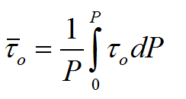
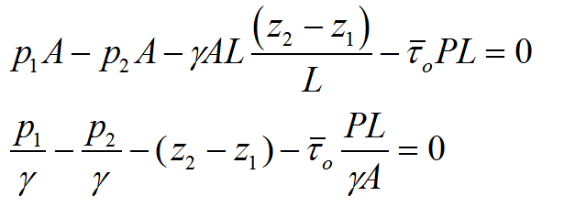
- average shear stress (average shear force per unit area) at the conduit wall, is defined by:
is the local shear stress acting over a small incremental portion dP of the wetted perimeter

Slide 25
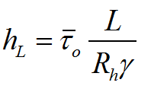
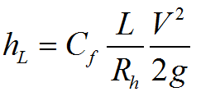
for rough pipes
for smooth walled conduits

Slide 26
1) Major loss (head loss)
Head loss is due to friction.
i) Laminar flow
It’s is called Darcy- Weisbach equation. f is known as the Darcy friction factor.===>>>>> f=64/Re
It is applicable for both smooth-walled and rough walled conduits
For laminar flow in rough pipes, the friction factor f is dominantly caused by viscous friction due to molecular interaction.

Slide 27
ii) Major loss (head loss) in turbulent flow
For turbulent flow, the major head loss mainly depends upon the diameter, D, the pipe length, L,the average velocity, , the fluid density ρ, the fluid viscosity μ and on the nature of the pipe roughness ∈:
Smooth
Rough
Transition b/n smooth and rough
The roughness of a pipe is measured in length which is defined as equivalent roughness ε.

Slide 28
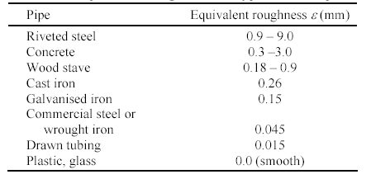

Slide 29
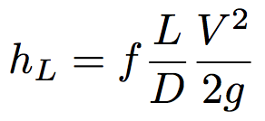
ii)Major loss---
smooth pipe law (von Karman, 1930 )
how would you determine h_{f}?

Slide 30
Major head---
Rough pipe law (von Karman, 1930)
Transition function for both smooth and rough pipe laws
(Colebrook White)

Slide 31
ii) Major loss---
Therefore
Laminar flow: f = 64/Re (exact)
Turbulent flow: Use charts or empirical equations (Moody Chart, a famous plot of f vs. Re and ε/D

Slide 32
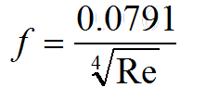
there were two types of pipe friction in turbulent flow
Smooth pipes :where the viscosity effects predominate so that the friction factor is dependent solely on the Reynolds number (f=φ (Re)
Blasius expression for the friction in smooth pipes:

Slide 33
Rough pipes :where the viscosity & roughness effects influence the flow & the friction factor (f) is dependent both on the Reynolds number & a parameter of relative roughness (^{ε}/_{D}).
L.F Moody prepared a chart for determining friction factor for rough pipes experimentally by plotting f versus Re curve
for each value of .

Slide 34
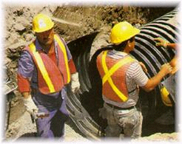
Using moody diagram
Two important parameters to use The Moody Diagram
-Re - Laminar or Turbulent
- e/D - Rough or Smooth

Slide 41
3.3.2 Minor Losses
Apart from major loss due to friction, there are also other forms of losses which are caused by changes in internal pipe geometries and by fitted components. These types of losses are referred to as minor losses. There are four types of minor losses:
1. Sudden or gradual flow expansion and flow contraction,
2. Entrance and exit flows to and from reservoirs or tanks,
3. Bends, elbows, junctions and other fittings,
4. Valves, including those completely opened or partially closed.
Minor loss is denoted by h_{m} and is expressed as proportional to the velocity head, i.e.
where K is the loss coefficient for each case. This coefficient K can either be derived analytically or taken from experimental or commercial data.

Slide 42
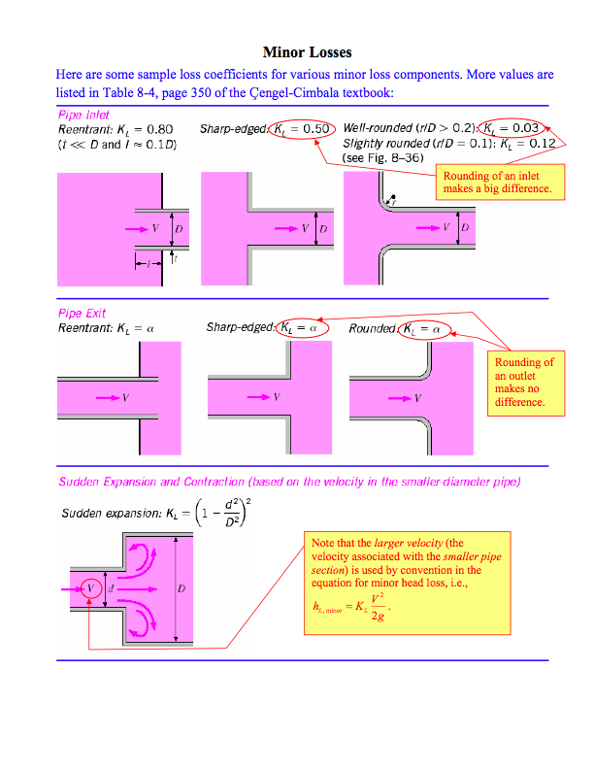
2) Minor Losses
caused by changes in internal pipe geometries and by fitted components. There are six types of minor losses:
Loss of head at entrance
A poorly designed inlet to a pipe can cause an appreciable head loss.
A cross section with maximum velocity and minimum pressure at B. This minimum flow area is known as the vena contracta.

Slide 44
It is seen that the loss of energy at entrance is distributed along the length AC, The increased turbulence in this portion of the pipe cause the friction loss to be much greater than in a corresponding length where the flow is normal of this total loss, a small portion h_{f} would be due to the normal pipe friction

Slide 45
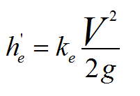
The loss of head at entrance may be expressed as:
Loss of head at leave of pipe, (h_{d’})
When the fluid with a velocity V is discharged from the end of a pipe in to a large reservoir, (v = 0), the entire kinetic energy of the coming flow is dissipated.
Where V is the mean velocity in the pipe, and is the loss coefficient

Slide 46
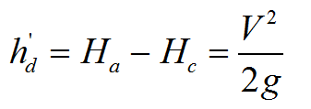

Slide 47
Loss due to contraction (h_{c})
a) Sudden contraction
There is a marked drop in pressure due to increase in velocity and to the loss of energy in turbulence. The loss of head for sudden contraction may be represented by

Slide 49
b) Gradual contraction
In order to reduces high losses, abrupt changes of cross section should be avoided. This is accomplished by changing from one diameter to the other by means of a smoothly curved transition which can reduce the loss coefficient k_{c} as small as 0.05.
Loss due to Expansion (h_{e})
Sudden Expansion
After the flow enters expanded pipe, there is excessive turbulence and formation of eddies which causes loss of energy greater than that of the contraction.

Slide 50
The loss due to sudden enlargement in a pipe line system can be calculated with:

Slide 51
Example 5.3: At a sudden enlargement of water main from 240 mm to 480mm diameter, the hydraulic gradient rises 10mm. determine the rate of flow.
Solution: D1= 240 mm=0.24, D2=480 mm=0.48m
rise of hydraulic gradient, i.e.

Slide 52
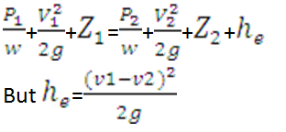
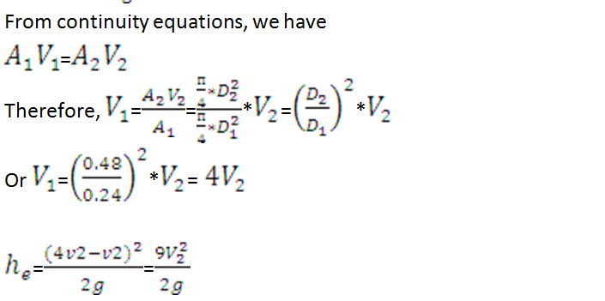
Applying Bernoulli’s equation to small and large pipe section (1-1) and (2-2)

Slide 54
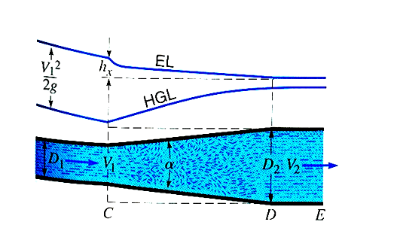
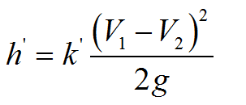
b) Gradual Expansion
Loss due to a gradual enlargement is expressed as:
Where K’ loss coefficient

Slide 55
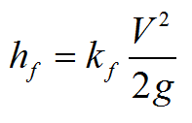
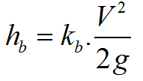
Loss in pipe fittings
The loss of head in pipe fittings is expressed as
The head loss produced by a bend or elbow is:
Losses in bend & Elbow
k_{b} - depends on the ratio of curvature r to pipe diameter D.

Slide 56
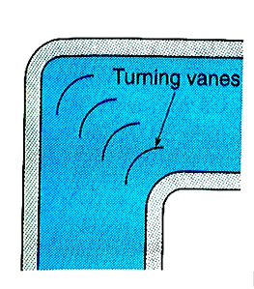
Solution of single-pipe flow problems
In single pipe flow loss of energy is caused by both the wall roughness of the pipes and by pipe fittings that disturb the flow (minor losses).
The total head losses between two points is the sum of the pipe friction loss plus the minor losses

Slide 57
Guidelines for solving single pipe problems
Check whether flow is laminar or turbulent
Total head loss is the sum of the major and minor losses.
If minor losses are negligible, as they often are, pipe flow problems may be solved by the most common methods;
Hazen-Williams equation,
the Manning equation
Darcy-Weisbach equation

Slide 58
The Darcy-Weisbach equation is to be preferred, since it will provide greater accuracy because its application utilizes the basic parameters that influence pipe friction, namely, Reynolds Number Re and the relative roughness .

Slide 59
Hazen-Williams
used for major head loss estimation in pipe flows.
very popular and the friction coefficient (C_{hw} or C) is not a function of velocity or duct (pipe) diameter.
Hazen-Williams is simpler than Darcy-Weisbach for calculations where one can solve for flow-rate, velocity, or diameter.

Slide 60
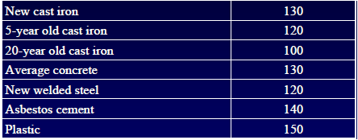
Hazen-Williams coefficient(C) for different pipe materials

Slide 61
Example
Water flows from the ground floor to the second level in a three-storey building through a 20 mm diameter pipe (drawn-tubing, ε = 0.0015 mm) at a rate of 0.75 liter/s. The layout of the whole system is illustrated in Figure below. The water flows out from the system through a faucet with an opening of diameter 12.5 mm. Calculate the pressure at point (1).

Slide 62
Example(Hazen-Williams)
Estimate the head loss in 1000m length of new cast iron pipeline having a diameter of 500mm that is discharging 0.25m³/sec.

Slide 64
Example (Design of pipelines)

Slide 71
Pipeline system Pipes in Series
When two pipes of different sizes or roughness are so connected that the fluid flows through one pipe& then through the other, they are said to be connected in series.
Two equations that must be satisfied are:

Slide 72
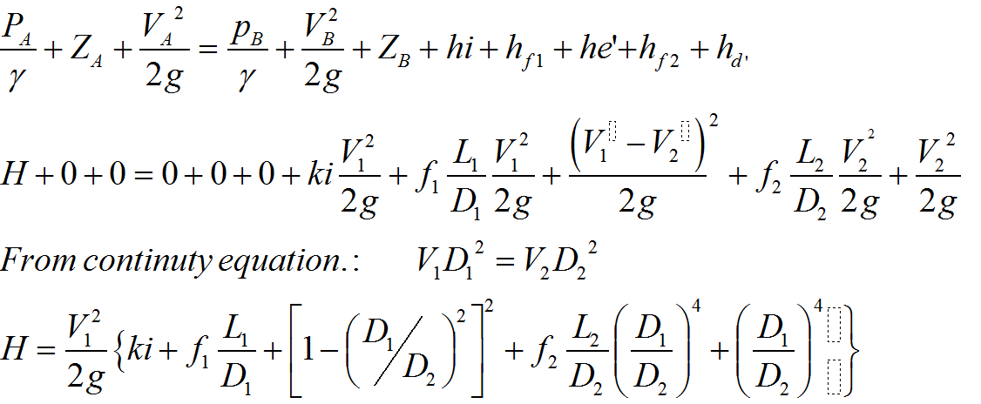
Applying the energy equation from A to B, including all losses, gives:

Slide 73
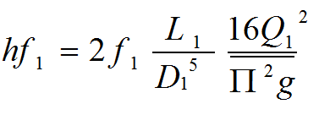
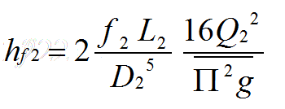
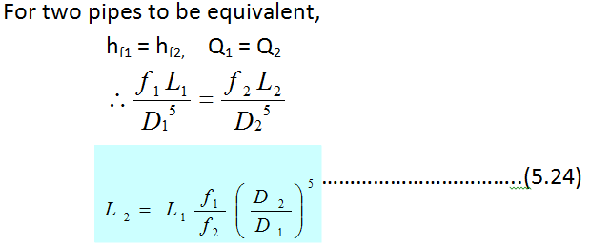
Equivalent pipes
Series pipes can be solved by the method of equivalent lengths. Two pipe systems are to be equivalent when the same head loss produces the same discharge in both systems.
for 2nd pipe

Slide 74
Pipes in Parallel
A combination of two or more pipes connected as in figure below so that the flow is divided among the pipes and then is joined again, is a parallel – pipe system.
In series pipe system the same fluid flows through all the pipes and the head losses are cumulative, but in parallel pipe – system the head losses are the same in each of the lines the discharge are cumulative.

Slide 75
Two types of problems occur:
If the head loss b/n A & B is given, Q is determined.
2) If the total flow Q is given, then the head loss & distribution of flow are determined

Slide 76
The procedure is:
Assume discharge Q’₁ through pipe 1,
Solve for h’f₁, using assumed discharge,
Using h’f₁, find Q’₂ & Q’₃
With the three discharges for a common head loss, now assume that the given Q is split up among the pipes in the same proportion as Q’₁, Q’₂ & Q’_{3,} Thus,
Check the correctness of these discharges by computing hf_{1,} hf₂, & hf₃ for the computed Q₁ , Q₂ & Q₃
→ Q –Q₁ – Q₂ – Q₃ = 0

Slide 77
Branching pipes

Slide 78
Therefore, for the situation of the above figure, we have the following governing conditions:
Q₁ = Q₂ + Q₃ or Q₁ + Q₂ = Q₃
Elevation of p is common to all.
Length, diameter, & friction factors are required.
The flow is steady & minor losses neglected
Three basic equations to solve these problems are:-
Continuity equations
Bernoulli’s equation
Darcy- Weisbech equation
Total rate of in flow at junction = total rate of out flow (continuity equation)

Slide 79
There are three types of problem fouling of branching pipes :-
Case 1: Given all pipes data (L, D, f, Z_{1,} Z₂ & Q₁), find Z_{3,} Q₂ & Q₃?
Case 2: Given a pipe data, the surface elevation of two reservoirs (A& C) and the flow the second pipe, Q₂, find Z₂ and Q_{1,} Q₃?
Case:3 Given a pipe lengths , diameters, and the elevation of all the three reservoirs , find Q₁ Q₂, Q₃,

Slide 80
Example:(flow through the branched pipes):the water level in the two reservoir A and B are 104.5m and 100m respectively above the datum. A pipe joints each to a common points D, where a pressure is 98.1KN/m² gauge and height is 83.5 m above the datum. Another pipe connects D to another tank C. what will be the height of water level in C assuming the same value diameters of the pipes AD, BD and CD are 300 mm, 450 mm 600 mm respectively and their length are 240m, 270m, 300m respectively

Slide 83
2) The following figure shows three reservoirs connected by pipes. Each pipe is 300 mm in diameter and 1500 m long. Assuming coefficient of friction for f=0.01. Find the discharge in each pipe
Solution: Diameter in each pipe $D_{1}{=D}_{2}=D_{3}$=300mm=0.3m length of each pipe $L_{1}{=L}_{2}=L_{3}$=1500m f=0.01

Slide 84
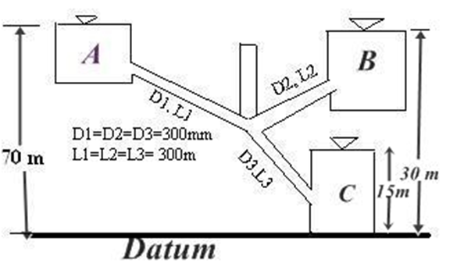
Discharge in each pipe:
To find over the direction of flow in pipe 2, let us assume that no flow occurs in pipe 2.that is, the piezometric level is 30m.
Therefore, head loss in pipe 1,
hf=70m- 30m= 40m

Slide 89
3) Find the discharge in each pipe of the network shown in the figure the value of the constant K corresponding to the head loss equation $h_{f}$=K$Q^{2}$ are also shown in the figure.
Solution: for the first trial, the discharge as shown in figure (b) is assumed. The calculation for the correction ∆Q and the correction discharge are given in the table below.

Slide 90
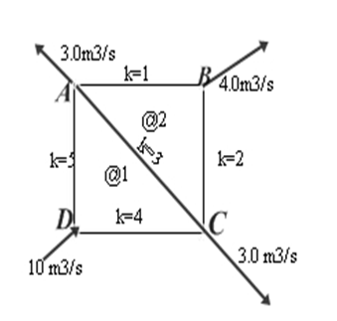
It may be noted that if the ∆Q is positive, it is to be added to the assumed flows. Thus a clock wise flow will increase and a counter clock wise flow decrease in magnitude.

Slide 92
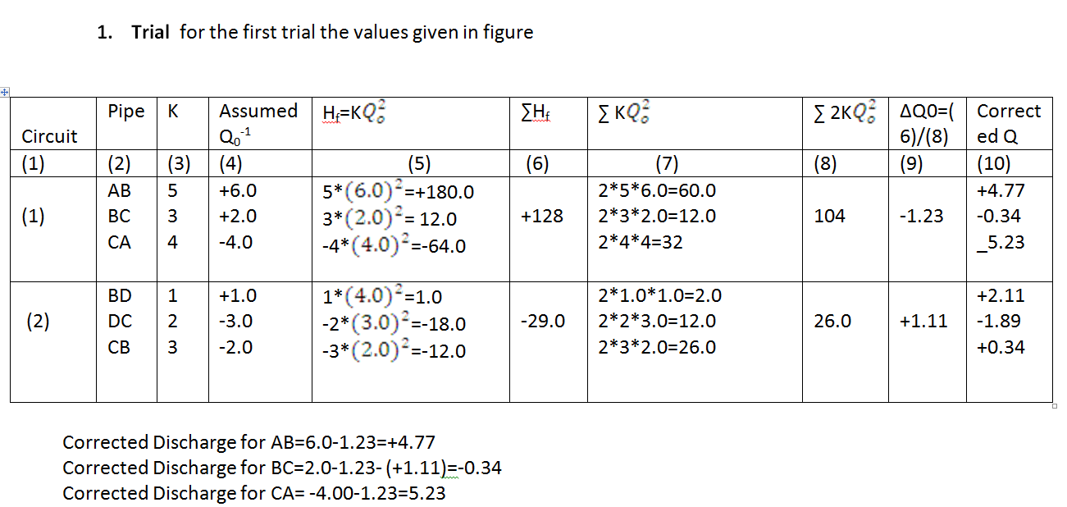

Slide 93
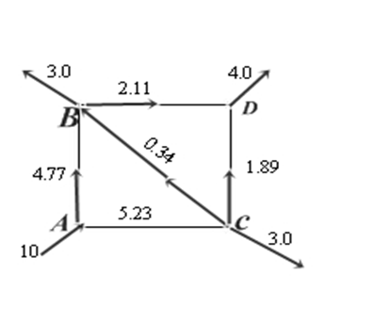
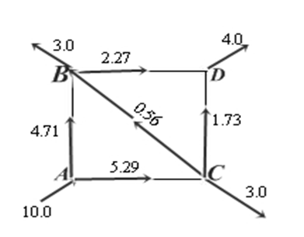

Slide 96
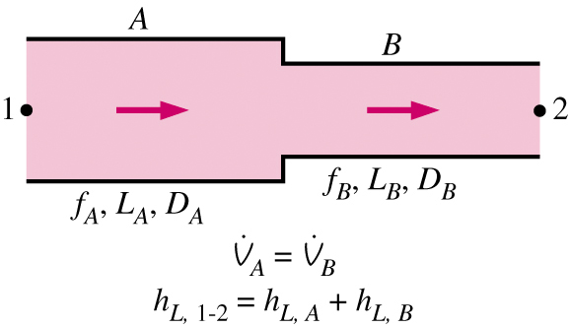
Pipe network analysis
Types of networks
(i) Pipes in series
Fluid flows through one pipe then through the other
Discharge (the same)=>> Q1 = Q2 = Q3 = const
Two or more pipes of different size/roughness
Total head loss (sum of losses) ==➔hf1+hf2+hf3=hf

Slide 97
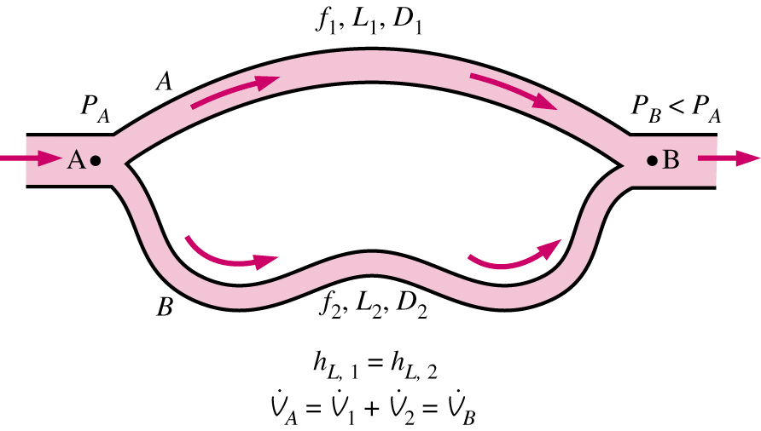
Pipe network analysis---
(ii) Pipes in parallel
Volume flow rate is the sum of the components
Pressure loss across all branches is the same

Slide 98
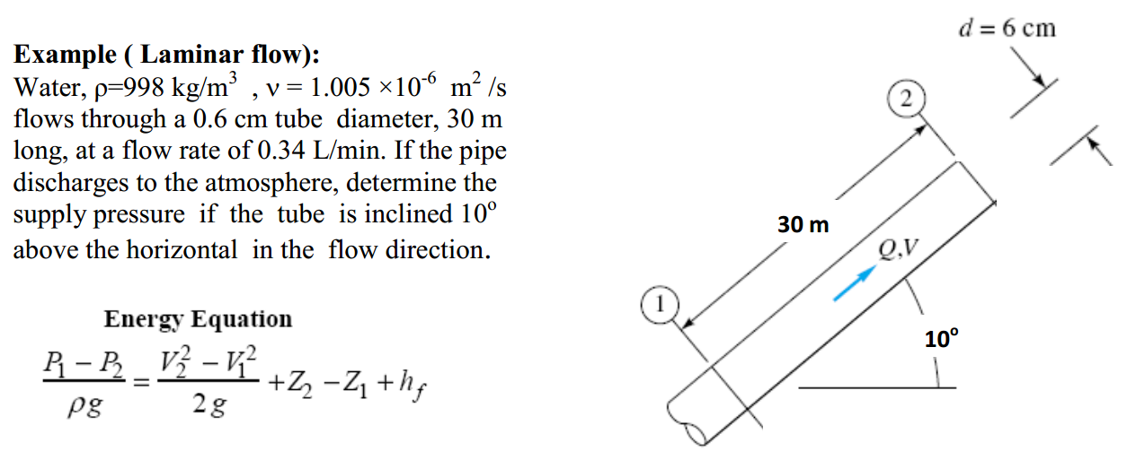

Slide 99
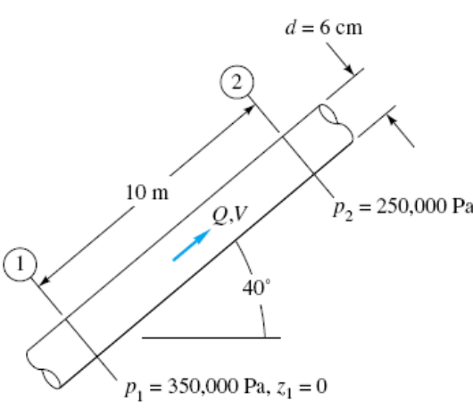

Slide 100
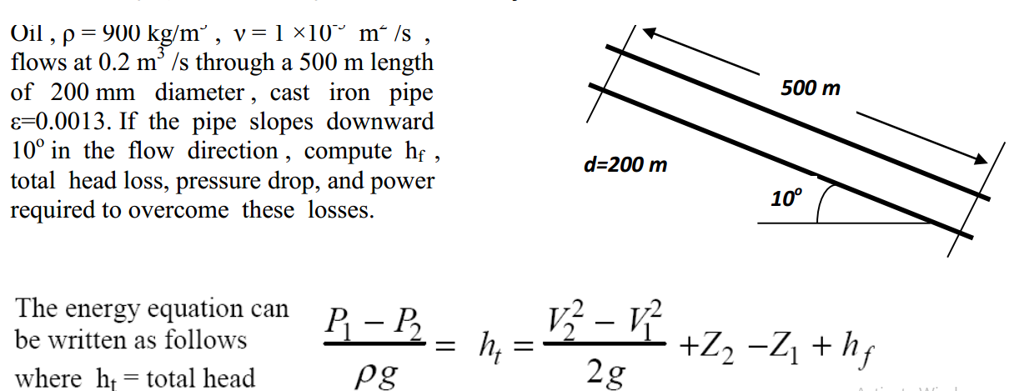

Slide 101
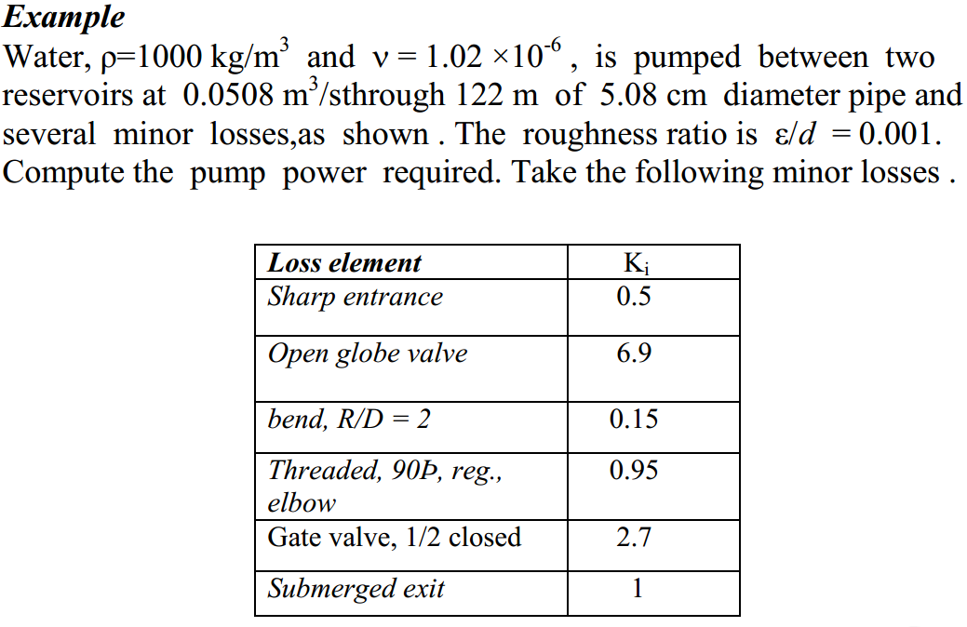

Slide 102
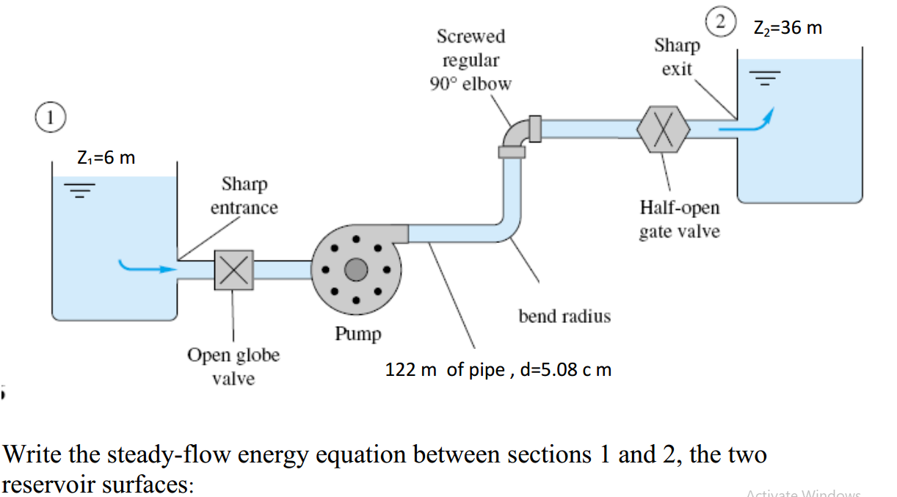

Slide 103
