Slide 1
Chapter two
Background, Problem statement and objective
Objectives of the chapter
Defining a problem
Characteristics of a problem
Clarifying and stating a problem
Evaluating the problem
Objective of the study

Slide 2
1. Introduction
1.1. back ground of the study
1.2. Statement of the problem
1.3. objectives of the study
1.3.1. general objective of the study
1.3.2. specific objectives of the study
1.4 research question
1.5.scope and limitation of the study
1.6. significance of the study

Slide 3
2. review of related literature
2.1. conceptual framework
3. Methodology
3.1. description of study area
3.2. research approach and design
3.3. population ,sample size and sample technique
3.4. Data sources
3.5. Data Collection instruments
3.6 . Data collection procedures
3.7. Method of data analysis

Slide 4
Time frame and budget
References

Slide 5
Research questions and hypothesis
Define research problem
Understand characteristics of research problem
Write statement of the problem
Evaluate research problems
Understand objective of the study
Understand how to write research questions and hypothesis

Slide 6
Contents of research proposal
Preliminary page
Title page
Acknowledgement
Declaration page
List of tables and figures
Acronym
Abstract
Table of content

Slide 7
Selecting a research topic
What is research topic ?
Research Topic: The broad general area expected to investigate.
It is a broad idea or concept from which many problems may be delineated.
Research Problem: A situation or circumstance that requires a solution to be described, explained, or predicted. It is an unsatisfactory situation that wants you to confront.

Slide 8
Research topic
a matter dealt with in a text, discourse, or conversation; a subject.
Or research topic is a subject/matter/problem under investigation or the problem we want to investigate systematically and scientifically /problem to be solved
It is what you are going to study

Slide 9
How to select research topic
The identification of a research topic for a new researcher can be broken down into a five-step process:
Step1: identify an area of interest,
Step 2: browse through the literature,
Step3: pick a topic,
Step 4: conduct a literature search,
Step5: identify a research question

Slide 10
Step 1:
Identify an Area of Interest: What subfield of tourism interests you?
E.g. sustainable tourism
Ecotourism
Destination management and development
Tourism statistics
Tourist behavior
Hospitality

Slide 11
Customer service
Heritage management
Ethnography
Tourism economics
Tourism marketing
Tourism publicity and promotion
d/t types of tourism

Slide 12
Step 3
Step 2 – Browse the Literature: What has been done?
Simply by browsing through abstracts of journals you interested in and you will learn not only about what has been studied, but what has been studied a lot and what has been somewhat ignored.
Just browse through journal articles until you come across something that interests you.

Slide 13
Step 3
Pick a Topic: In one word or less, what do you want to study?
As you browse through past issues of key journals, write down everything you find interesting.

Slide 14
Step 4
Conduct a Literature Search: Does the existing literature address the topic?
: put one leg on either side of the fence and find a way to sit comfortably
Read several literatures \book, journal article, news paper, reports, thesis , magazines …
together this information from several related studies provides a map – you get to see where the research has been, and what others think its next logical destination might be.

Slide 15
Step 5
Identify a Research Question: What are your variables going to be?

Slide 16
Qualities of good research title /topic
A research is a comprehensive task and it requires great effort as a researcher on your part.
The first thing that determines the success of your research is your research topic.
A good research topic should have the following qualities.

Slide 17
Qualities of good research topic
Clarity
Well-defined and well-phrased
The language of the research topic should have to be simple
The titling of the research problem should follow the rules of titling
Current importance

Slide 18
Clarity
It is the most important quality of any research topic.
The topic should have to be clear so that others can easily understand the nature of your research.
The research topic should have a single interpretation so that people cannot get distracted.
The topic should have to be very clear in your mind so that you can properly undertake it.
The research topic should have to be free of any ambiguity.
Clarity also means that the research topic should have to be directional and it should set the whole research methodology.

Slide 19
Well-defined and well-phrased
Well-defined and well-phrased research topic is a half guarantee of a successful research. Sometimes researchers phrase the research topic in such a way that it gives a double- barrelled impression.
The research topic should have to be well-defined and well-phrased and it should have to be easy to understand.
it should have a single meaning.

Slide 20
Clear and simple language should be used
The language of the research topic should have to be simple. You should use technical terms only when it is necessary, otherwise use simple words so that everyone can understand it. keep the ethics of writing in your mind to avoid any unethical term or sentence. Do not introduce any sort of bias directly or indirectly, willingly or unwillingly in the research problem or research topic.

Slide 21
The rule of titling should be applied
The titling of the research problem should follow the rules of titling.
there are various rules of titling. You can either use a sentence case or a title case but most of the titles follow title case.
Read the rules of titling titles before writing it down.

Slide 22
Current Importance
Current importance should also be the consideration of the researcher while selecting a research topic.
An obsolete topic will not be beneficial for anyone the topic should have current importance.
You should also assess how much the topic will provide benefit to the field in which you are conducting the study.

Slide 23
Informative
Identify one or two main points in the paper to communicate to the audience;
a good title is capable of conveying those points.
Be as specific as possible without adding unnecessary details.
Titles that are too vague or too general do not help the reader distinguish your work from others.
Choose words carefully,

Slide 24
Accuracy
The title should be truthful about the contents of the paper.
Do not overpromise the results of the paper in the title

Slide 25
Concise
Short titles are instantly recognizable and jump of the page.
Every word should have a reason for being present, and each word should contribute to the message of the title.

Slide 26
Researchable
the topic can be investigated through collecting and analyzing data

Slide 27
Manageable
a good topic is manageable
topics chosen should match the current level of research skill possessed by the researcher other considerations include the availability of resources, time, appropriate participants, and measuring instruments

Slide 28
Ethical
a good topic is ethical research should not harm participants either physically or emotionally negative examples include the stanford prison experiment and milgram's study

Slide 29
Factors to consider when you select your research title
Economic Considerations
Environmental Factors ; controversial titles are not recommendable ; the researcher should be knowledgeable about the domain area \geographic location
Technical Considerations
Human Considerations

Slide 30
Research problem
What is a problem ?

Slide 31
A research problem is a statement about an area of concern, a condition to be improved upon, a difficulty to be eliminated, or a troubling question that exists in scholarly literature, in theory, or in practice that points to the need for meaningful understanding and deliberate investigation.

Slide 32
In other words, ‘a research problem is an area of concern where there is a gap in the knowledgebase needed for professional practices

Slide 33
Research problem is a question that researcher wants to answer or a problem that a researcher wants to solve
Selection of research problem depends on several factors such as
Researcher’s knowledge,
Skills,
Interest,
Expertise,
Motivation &creativity with respect to the subject of inquiry

Slide 34
Sources of a research problem
Previous and personal experience
Practical experience
Critical Appraisal of literature
Existing theories
Social issues
Field
Sociopolitical and cultural changes
Technology
Consultations/Discussions
Critical observations
Reading

Slide 35
Criteria for the Selection a Research Problem
Researcher/personal inclination
Resources availability
Relative importance of the problem
Researcher knowledge
Practicability (practical usefulness of the problem)
Timelines of the problem
Data availability
Urgency
Feasibility
Area culture

Slide 36
Developing a research problem
Steps
Selection of the research topic:
write down general areas of interest
At this stage, it doesn’t matter if the terms used are broad or specific, abstract or concrete.,
The important point is to put ideas on papers.

Slide 37
Step1: selecting a research topic
Then a list of ideas can be classified into Interesting topics.
Familiar topics.
Perplexing topics
Feasible/not feasible topics
And then, choose the most suitable one to work in

Slide 38
Step 2: contemplate the ideas : then explore the phenomena by examining the following eight areas
The topic’s / situation’s /problem’s precipitating factors.
How it is exactly viewed or perceived by the researcher.
What are the responses of others who are involved in the situation?
The personal involvement in the situation.

Slide 39
Emotions felt.
Values and biases inherent in or related to the topic/situation.
Risk factors associated with searching this topic/situation/problem.
What contribution the research would offer.

Slide 40
Step 3: Narrowing the topic
Once a research topic has been specified and contemplate, the researcher must then narrow it down in order to develop a research problem.
This is done through generating questions from the research topic.
List of questions can be developed from the research topic, and then investigated in relation to its feasibility to research.

Slide 41
Step4 : reviewing a literature
Reviewing the related literature at this stage may throw light on:
Theoretical framework.
Methodology.
Data collection methods.
Data collection tools

Slide 42
Data collection techniques.
Sampling method…etc.
Review of literature will also help to identify what is known and what is not known about the research problem.
Therefore, the research problem could be specified and stated at this point.

Slide 43
Step 5: Writing the statement of the research problem :
Expressed in a statement
This statement serves as a guide to the researcher in the course of designing the study.

Slide 44
The problem statement should have the following characteristics:
Identify the key variables in the study.
Express a relationship between two or more variables. (If not descriptive).
Specify the study population.
Imply the type of the research.
Identify the study setting

Slide 45
The problem statement could be done in two forms:
Declarative: “The relationship between the nurses’ job satisfaction and tendency to leave work”
Interrogative: “ Is there a relationship between the nurses’ job satisfaction and tendency to leave work?”

Slide 46
Evaluation of a research problem
Time: enough time will be available for the various steps of the research.
Timing :When the timing requirement of a task do not match
Money : the researcher should ask the following questions:
Will I have enough money to complete this research?
Will be any sources for funding the research?
Does the anticipated cost outweigh the value of the expected findings?

Slide 47
Contd …
Availability of research participants:
Ethical consideration
Facilities and equipment
Co operation of the others
Qualifications and experience of the researcher
Significance of the problem

Slide 48
Criteria for the Selection of a Research Problem
Novelty, urgency and avoidance of unnecessary duplications.
Importance for the field represented and implementation.
Interest, intellectual curiosity, and drive.
Training and personal qualifications and competence.
Availability of data and method.
Approachability of the sample.
Cost and returns.

Slide 49
Defining/stating a Research Problem
It is just to pinpoint the problem

Slide 50
The need for defining or stating a research problem
sets the direction of the study
Reveals the methodology or procedure of the study
Helps the researcher to control subjectivity or biases of the researcher
Suggests and specifies the variables to be taken up into the investigation
Makes the research work practicable

Slide 51
Precautions to be made when identifying a Research Problem
The words used for defining a problem should have a single meaning
It must be brief but comprehensive
The assumptions are to be recognized for the study.
The problem should have practical importance in the field of tourism.
The definition or the statement of the problem should have certain rationale

Slide 52
Ways to Define the Problem
1. Analyze the major problems or problems in terms of subordinate problems.
2. Statement delimits the scope of the study.
3. Orientation of the problem in a unique direction:
(a) A historical account, remote or recent.
(b) A survey of previous study or related studies.
(c) An analysis of previous studies or related subjects.
(d) Preliminary survey.

Slide 53
4. Description of the general nature of the problem.
(a) Type.
(b) Source.
(c) procedure
Statement of limitations of the technique employed.
6. Recognitions of assumptions and Implications.
7. Importance-value or significance of the study of education.
8. Definition of terms.

Slide 54
Key components of statement of the problem
Problem statements often have three elements:
1. The problem itself, stated clearly and with enough contextual detail to establish why it is important
2. The method of solving the problem, often stated as a claim or a working thesis
3. The purpose, statement of objective and scope of the project being proposed.

Slide 55
How to write the statement of the problem
The problem statement implies some question that your research will be answering.
Sometimes it is necessary to draft or pre-write for a while to discover what that point will be (and often writers are unsure of their point until they have written the draft proposal and discover the point near the end of the proposal).

Slide 56
When you set up to write a statement problem you should know that you are looking for something wrong… or something that needs close attention.
Your problem statement is the statement that makes a point about the issues and information you are discussing, and is what the rest of the proposal hinges upon.
It is not just your topic, but what you are saying about your topic.
In other words there must be very good communication between your topic and the statement problem.

Slide 57
Components of the statements of the Problem
1. lead-in;
2. declaration of originality (e.g., mentioning a knowledge void, which would be supported by the literature review);
3. indication of the central focus of the study; and
4. explanation of study significance or the benefits to be derived from an investigation of the problem.

Slide 58
Back ground of the study/Introduction
The background study for a research includes:
a review of the area being researched,
Provides background information about the study
current information surrounding the issue,
previous studies on the issue, and
relevant history on the issue.

Slide 59
Ideally, the study should effectively set forth the history and background information on your research problem.
The purpose of a background study is to help you to prove the relevance of your thesis question and to further develop your research problem.

Slide 60
provides a brief rationale for why the proposed study is worth pursuing.

Slide 61
Research Objectives

Slide 68
Examples of general and specific objectives

Slide 71
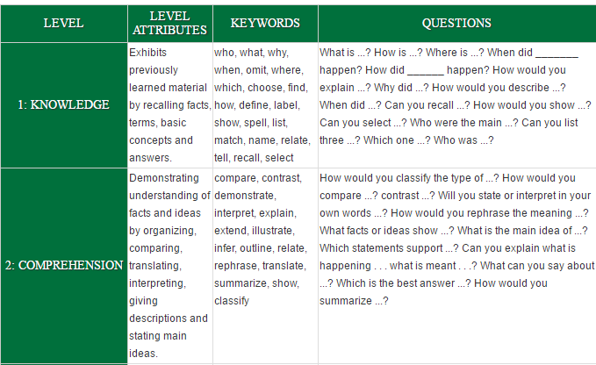
Action verbs to write specific objectives of the study

Slide 72
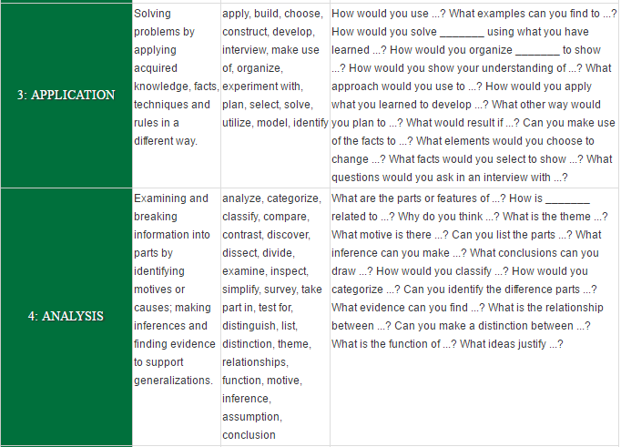

Slide 73
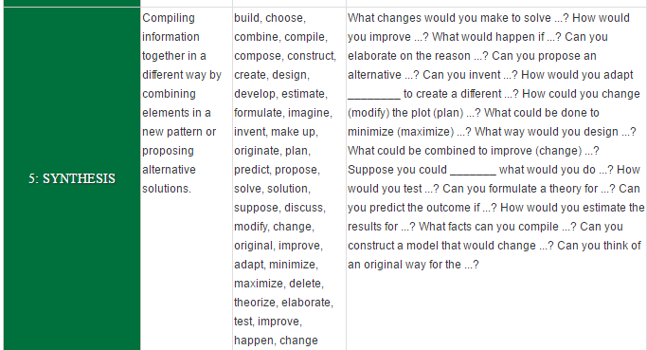

Slide 74
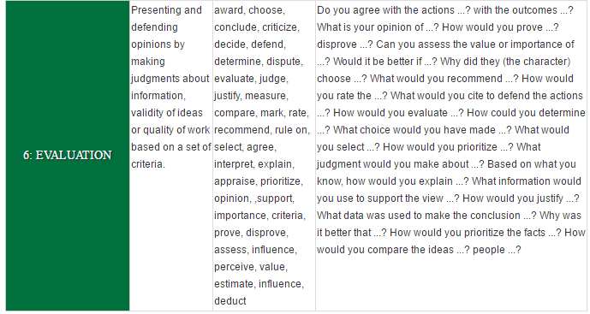

Slide 75
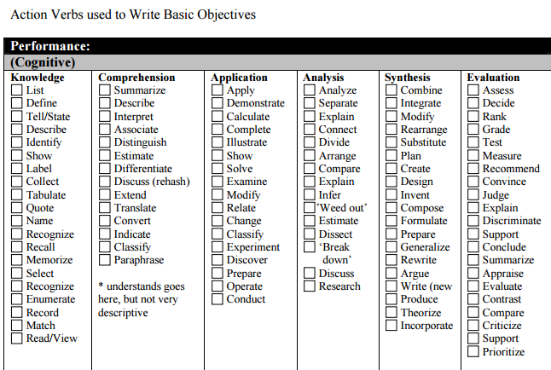

Slide 76
Research Questions and Hypothesis
A research question is the fundamental core of a research project, study, or review of literature.
It focuses the study, determines the methodology, and guides all stages of inquiry, analysis, and reporting.
It is a research problem/ question that the research will going to answer /the research problem to be solved.
A research question is the question that the research project sets out to answer.

Slide 77
Purpose of the Research Question
It determines where and what kind of research the writer will be looking for.
It identifies the specific objectives the study or paper will address.

Slide 78
Research Hypothesis
A hypothesis is not a question, but rather it is a statement about the relationship between two or more variables
The hypothesis translates the research question into a prediction of expected outcomes.

Slide 79
Research question
Hypothesis
A research question is a highly focused question that addresses one concept or component of the hypothesis
The hypothesis whereas the hypothesis itself is used to state the relationship between two or more variables

Slide 80
A hypothesis is a tentative prediction about the nature of the relationship between two or more variables.
A hypothesis represents an educated guess about what will happen in an experiment
Hypotheses are always held tentatively
A research question is simply a hypothesis stated in question form.

Slide 81
Should I use a hypothesis or a research question?
Hypotheses
Useful if there is an established line of research
Useful if a likely outcome can be anticipated in advance
Useful to test a specific theory or model
Can inhibit flexibility or blind a researcher to unanticipated results
Research Questions
Useful if there is little previous research on the topic
Allows a researcher to conduct more open-ended inquiries.
A wider range of outcomes can be reported
May encourage excessive manipulation of findings or “fishing expeditions.”

Slide 82
Types of Hypothesis
1. Null Hypothesis
2. Alternative Hypothesis

Slide 83
Null Hyphothesis
It is a statistical hypothesis, used to determine whether the results of an experiment are statistically significant.
It posits that there is “no relationship” between two variables, or “no difference” between two groups
The null hypothesis is “supported,” if the results are statistically non-significant
The null hypothesis is “rejected,” in favor of the experimental hypothesis, if the results are statistically significant

Slide 84
Alternative Hypothesis
A prediction that there will be statistically significant findings
significant differences or correlations between groups or among variables

Slide 85
Characteristics of hypothesis

Slide 86
Characteristics

Slide 87
analyse argue break-down classify combine compare contract define demonstrate describe discuss evaluate explain formulate manipulate

Slide 88
identify justify list name organise predict recall recognise record relate reproduce underline
load

Slide 90
measure open operate remove repair tune turn off turn offaccept associate be aware change decide derive determine develop influence listen perceive receive reject state Thank to R. Michell for providing this example from: Technisearch Ltd. (1997). Train the computer trainer. Melbourne: RMIT.List of action terms for use in preparing performance objectives
Adapted from Bloom's Taxonomy of Educational Objectives (1956)
Knowledge
Comprehension
Application
define fill in the blank identify indicate know label list locate match memorize name recall record relate repeat select spell state tell underline
classify convert describe discuss explain express identify interpret locate paraphrase put in order recognize report restate review rewrite suggest summarize tell to tell in your own words trace translate
apply compute conclude construct demonstrate determine dramatise dramatize draw employ find out give and example illustrate illustrate interpret interpret investigate make operate operate operate organize practice predict schedule schedule shop show sketch solve state a rule or principle use
Analysis
Synthesis
Evaluation
analyze appraise calculate categorize classify compare contrast criticise debate deduce determine determine the factors diagnose diagram differentiate dissect distinguish examine experiment infer inspect inventory question relate solve specify test

