Slide 1
Examples – Part II
Chapter Four
2D – Steady State Conduction
Prepared By: Dawit M.

Slide 2
Outline
Example 1: Use of Finite Difference Equation by Energy Method (with volumetric heat generation and no convection)
Example 2: Use of Finite Difference Equation (with convection and no internal heat generation)

Slide 3
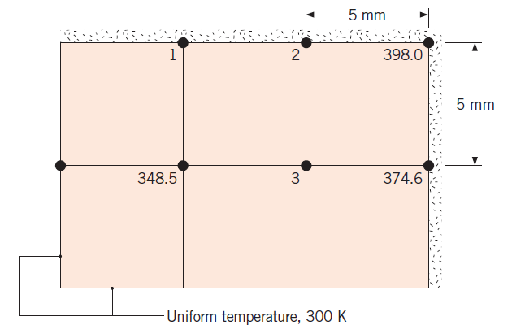
Example 1: Use of Finite Difference Equation by Energy Method (with volumetric heat generation and no convection)
Steady-state temperatures (K) at three nodal points of a long rectangular rod are as shown. The rod experiences a uniform volumetric generation rate of 5 (10)⁷ W/m³ and has a thermal conductivity of 20W/m K. Two of its sides are maintained at a constant temperature of 300 K, while the others are insulated.

Slide 4
Cont’d …
Determine the temperatures at nodes 1, 2, and 3.
Calculate the heat transfer rate per unit length (W/m) from the rod using the nodal temperatures. Compare this result with the heat rate calculated from knowledge of the volumetric generation rate and the rod dimensions.

Slide 5
Example 2: Use of Finite Difference Equation (with convection and no internal heat generation)
2. Consider the square channel shown in the sketch operating under steady-state conditions. The inner surface of the channel is at a uniform temperature of 600 K, while the outer surface is exposed to convection with a fluid at 300K and a convection coefficient of 50W/m².K. From a symmetrical element of the channel, a two-dimensional grid has been constructed and the nodes labeled. The temperatures for nodes 1, 3, 6, 8, and 9 are identified.
Beginning with properly defined control volumes, derive the finite-difference equations for nodes 2, 4, and 7 and determine the temperatures T₂, T₄, and T₇ (K).
Calculate the heat loss per unit length from the channel.

Slide 6
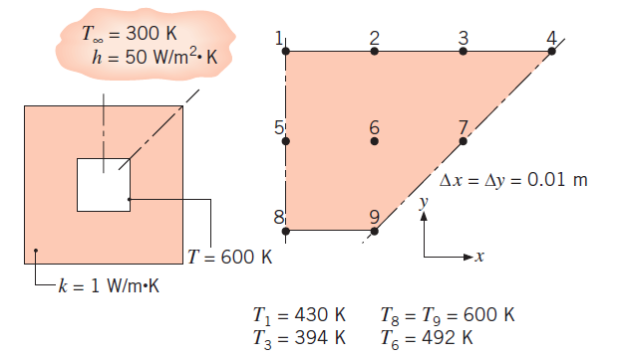
Cont’d …

Slide 7
Any Question? Thank You!

