Slide 1
Fluid Machines for Chemical Engineering
Chapter-1
Introduction
By: Eng Mesfin B.

Slide 2
Contents:
1. Introduction
2. Fluid Machines in Chemical Process Industries
3. Basic Concepts and Terminologies
4. Application of Fluid Machines

Slide 3
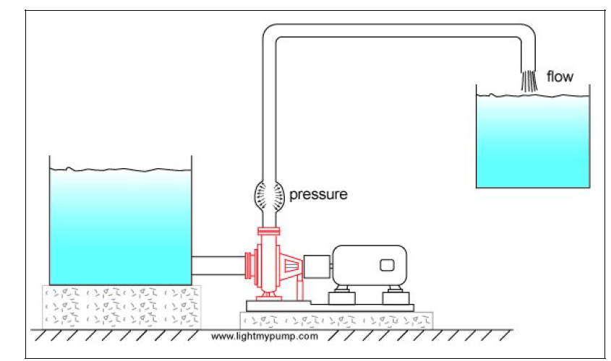

Slide 5
INTRODUCTION
objective:- to study
the purpose of fluid machines and their application in process industries
the role of the chemical engineer with respect to fluid machines.
In addition some basic relevant concepts and terminologies are explained.

Slide 6
FLUID MACHINES IN CPI
In CPI it is usually required to increase the mechanical energy of fluids.
Mechanical energy (to account for increase in potential energy, velocity energy, pressure energy and losses due to fluid friction).
Transport liquid Mechanical energy of gasses
Fluid Machine
Fans, Blowers and Compressors
Pump

Slide 7
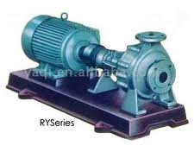
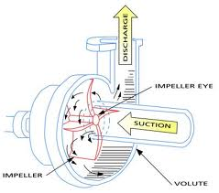
Pumps are used to transport process and service liquids.
Fans are used in:
ventilating buildings
aerating workstations
exhausting or introducing air or other gasses into process reactors, dryers, cooling towers, kilns, etc., at relatively low pressure
Fans are also used in some air-cooled heat exchangers.

Slide 8
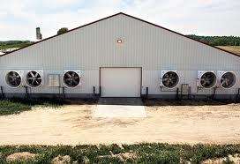
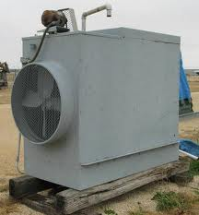
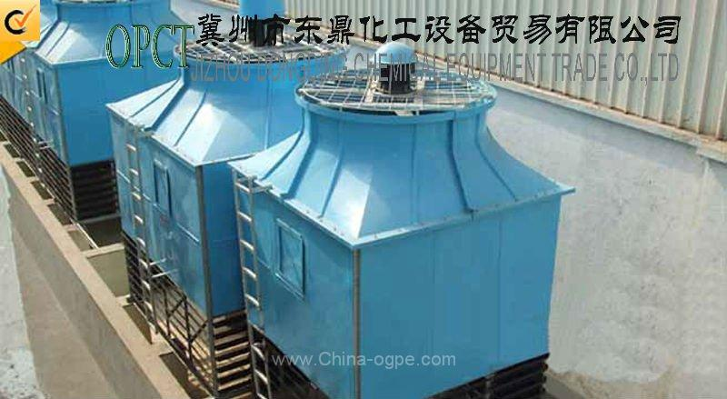
ventilating buildings
air-cooled heat exchangers
cooling towers
aerating workstations

Slide 9
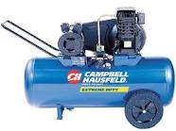
Blowers and compressors are used to:
compress process gas
supplying plant with compressed air
convey solid material in suspension
exhausting or introducing air into process reactor at higher pressures and similar processes.
Example:- ammonia gas phase rxn

Slide 10
The Chemical Engineer is involved in:-
Operating
Selecting
Installing
Testing
V Maintaining

Slide 11
To do this effectively the engineer has to know:-
the system where the fluid machine is to be used
the operating principles
capability
limitations of the different types of fluid machines.

Slide 12
BASIC CONCEPTS AND TERMINOLOGIES
Mechanical Energy
Specific Work
Total Head
Total Pressure
Useful Power

Slide 13
Mechanical Energy of a flowing fluid is part of the total energy of the fluid that can be directly and completely converted to work.
The specific work of a fluid machine is the useful energy (work) that the machine transfers or can transfer to the flow medium per unit mass of the fluid. The SI unit of specific energy is J/kg or m²/s².
The total head transferred to a flow medium is the specific energy transferred to the fluid divided by the gravitational acceleration and is the measure of the amount of useful energy (mechanical energy or work) of the flow medium.
H= Y/g Where:- H=Head,
Y= Specific Work
g=gravitational acceleration.

Slide 14
Useful Power :- the rate at which useful energy is transferred to the flow medium.
The useful power is calculated using Equations:
Since mass flow rate is the product of density and volume flow rate.

Slide 15
The Total Pressure: Used for fans and positive displacement.

Slide 16
Mechanical Energy
E
Specific Work
Y=E/m
Total Head
H=Y/g
Total Pressure
P=p*Y
Useful Power
N=m*Y

Slide 17
Remark
All of them are the measure of the energy.
Total Head
Specific Work
Equivalent Term
Total Pressure

Slide 18
Pulsation and Priming
Pulsation:-The capacity of some fluid machines is not uniform, it varies with time. Pulsation is this non uniformity of the capacity fluid machines.
Priming:-Some pumps require that the air in the suction line should be replaced by liquid before they start pumping. The process of replacing the air in the suction pipe with liquid is known as priming.
Loss of Head is loss of the useful head of the flow medium due to fluid friction or the turbulence that occurs when the fluid passes an obstruction, sudden contraction or sudden expansion, etc.

Slide 19
Pressure
Absolute pressure (static) of a fluid on a surface is the normal force exerted by the fluid per unit area of the surface.
Gauge Pressure is the pressure above the atmospheric pressure.
Absolute Pressure = Gauge Pressure + Atmospheric Pressure
Vacuum Pressure is the pressure below the atmospheric pressure.
Absolute Pressure = Atmospheric Pressure - Vacuum Pressure

Slide 20
A₁
A₂
Input
Process
Output
Figure 1.1 The continuity equation

Slide 21
For a steady state process (no accumulation)
Rate of mass input = Rate of mass output
For incompressible fluid
Where :-
=mass flow rate [kg/s] Q=Volume flow rate [m³/s]
c= velocity of the flow medium A= Flow Area

Slide 22
APPLICATION OF FLUID MACHINES

Slide 23
Fans
There are various industrial processes that involve movement of air and other gasses without significant increase in the static pressure.
To achieve such movement of gasses energy should be added to the gas in the form of mechanical energy to cover for the net increases in energy due to difference in potential energy, kinetic energy, pressure energy and energy loss in the form of fluid friction.
The calculation of total pressure (specific energy requirement) and power requirement of systems for moving gasses with fans is similar to pumps.

Slide 24
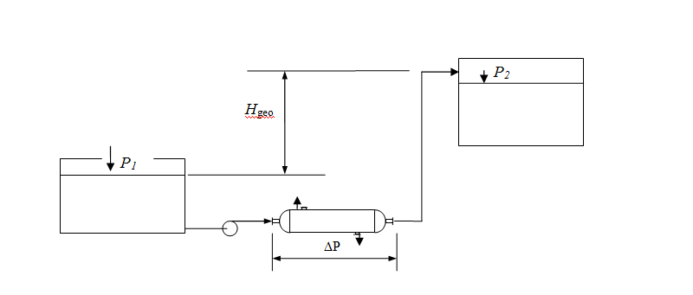
Pumps

Slide 25
The amount of energy required by a flow medium
where:-
Y= The specific energy
P₂ - P₁= The static pressure difference between the suction and discharge
c₁, c₂ = The average flow velocities at point 1 and 2 respectively.
e = the elevation difference between 1 and 2.
F = Energy loss due to fluid friction
ρ = Density of the flow medium at the flow condition

Slide 26
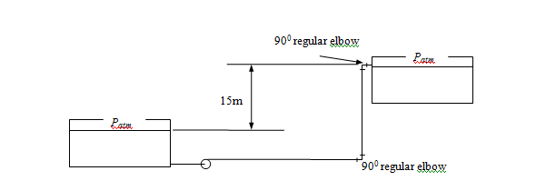
Example 1
Water at 20⁰C should be pumped from Tank 1 to Tank 2 at the rate of 120m³/hr. The total length of the straight pipe is 45m. Determine the specific mechanical energy, head and power that should be transferred to the flow medium to move the water.(Take 12.32J/kg for total loss due to friction.)

Slide 27
Example 2
A fan is used to deliver 200m³/hr (measured at the inlet) of methane. The specific energy requirement of the system is calculated to be 5.4 kJ/kg. The inlet temperature and pressure are 12⁰C and 100 kPa respectively. Determine the total pressure and the useful power that should be transferred to the flow medium.

Slide 28
Compressors and blowers
The energy requirement in compression process depends on the type of compression.
Types of Ideal Compression
Isothermal Compression
T=const
Adiabatic Compression

Slide 29
Adiabatic Compression
The adiabatic compression specific energy for compressing a gas from a suction temperature T₁ and pressure P₁ is given by Equation
Yad= The adiabatic compression specific energy requirement
R= Universal gas constant = 8314.3 J/kg K
T₁= The suction temperature
M= Molecular weight of the gas to be compressed
P₂= Final pressure
P₁=Initial pressure
P₁/P₂= compression ratio
k=ratio of specific heats

Slide 30
Isothermal Compression
T=const
<
Compression Energy
Isothermal Compression
Adiabatic Compression

Slide 31
Example 3
It is required to compress 0.02 k mol/s of air from 1 atm and 25⁰C to 6 atm. Calculate the specific energy requirement and the compression power:
(i) for adiabatic compression
(ii) for isothermal compression.

