Slide 1
Chemotherapy of Parasitic Diseases
(Antiparasitic Agents)
By
Takele Beyene
E-mail: takele.beyene@aau.edu.et
takelebeyene@gmail.com

Slide 2
Learning Objectives
At the end of this chapter you should be able to know:
The General principles of antiparasitic therapy
Identify the targets enzymes of parasites
Know different antinematodal, antitrematodal, & anticestodal drugs with their MOA
Understand the MOA of drugs used as insecticides
Know commonly used antiprotozoal agents with their MOA

Slide 3
Overview
Parasites
Organisms that live within, upon or at expense of another organism to survive
Include helminths, protozoa, scabies and pediculi
Endoparasites
Ectoparsites
The economic importance of helminth infections in livestock has long been recognized
Although alternative methods have been developed, chemically based treatments are the most important tool to control parasitism.

Slide 4
Helminthiasis
Infestation with parasitic worms
Some types of worms penetrate body tissues or produce larvae that migrate to blood, lymph, lungs, liver or other sites
Anthelmintics (AHs) are used in all animal species and man.
A significant part of the economic impact of parasitism in animal production is represented by the investment in control measures.
A more complete understanding of the pharmacological properties of existing antiparasitic drugs should assist with more effient parasite control both in livestock and companion animals.
However, the investment in control measures does not always result in the expected therapeutic success.

Slide 5
Factors responsible for therapeutic failure of AHs:
Inadequate integration between management strategies and chemotherapy;
Incorrect use of AHs drugs due to insufficient knowledge of their pharmacological features; and
Insufficient understanding of the relationship between pharmacological properties and several host-related factors that could lead to modifiations of the PK behavior and to a decreased antiparasitic efficacy of the chosen drug.
The availability of many compounds with a common mode of action and
The indiscriminate use of these drugs have accounted for the widespread development of drug resistance, mainly in parasites of sheep and goats, but also in parasites of pigs, horses, and cattle.

Slide 6
Overview
Endoparasites
live within the body of the host and cause internal parasite infections
Helminths are divided into two major groups:
Nematodes: cylindrical, non-segmented worms commonly called roundworms
Platyhelminths: flattened worms that are subdivided into two groups-
Cestodes (tapeworms) & Trematodes (flukes)
Ectoparasites
live on the body surface of the host and cause external parasite infestations
Parasitic infestations of the skin
Scabies caused by the itch mite called the Sarcoptes, psoroptes, chorioptes, demodex
Scabies caused by lice: pediculosis; flea

Slide 7
Overview
Protozoa
Single celled, usually contracted by:
oral-fecal route, contaminated water or bite of an insect.
Include:
Coccidiosis
Babesiosis,
Trypanosomiasis
Toxoplasmosis
Trichomoniasis
Anaplasmosis
Giardiasis
Amebiasis

Slide 8
General principles of antiparasitic therapy
A rational approach to antiparasitic chemotherapy
requires comparative biochemical and physiologic investigations of host and parasite:
To discover differences in essential processes that will permit selective inhibition in the parasite and not in the host
The parasite must have defense mechanisms in order to survive
To defend itself against immunologic attack, proteolytic digestion, etc,
The great evolutionary distance between host and parasite
resulted in sufficient differences among individual enzymes or functional pathways to allow selective inhibition of the parasite.

Slide 9
Targets of chemotherapy
Three major types of potential targets for chemotherapy of parasitic diseases:
Unique essential enzymes found only in the parasite;
Similar enzymes found in both host and parasite but indispensable only for the parasite; and
Common biochemical functions found in both parasite and host but with different pharmacologic properties.

Slide 10
1. Unique essential enzymes
Targets | Parasites | Inhibitors
Enzymes for dihydropteroate synthesis | Apicomplexa (plasmodium, toxoplasma, eimeria) | Sulfones and sulfonamides
Pyruvate:ferrodoxin oxidoreductase | Anaerobic protozoa (entamoeba, giardia, Trichomonas) | Nitroimidazoles
Pyruvate phosphate dikinase | Anaerobic protozoa | None
Nucleoside phosphotransferase | Flagellated protozoa | Allopurinol riboside and formycin B
Trypanothione reductase and peroxidase | Kinetoplastida | Nifurtimox

Slide 11
2. Indispensable enzymes
Targets | Parasites | Inhibitors
Purine phosphoribosyl transferase | Protozoa | Allopurinol
Lanosterol C-14 demethylase | Leishmania Trypanosoma | Azoles
Purine nucleoside kinase | Trichomonas Entamoeba | None
Ornithine decarboxylase | trypanosomes | Difluoromethylornithine
(S)Adenosylmethionine decarboxylase | trypanosomes | Diamidines
Glycolytic enzymes | Kinetoplastida | Glycerol plus Salicylhydroxamic acid Suramin

Slide 12
3. Common indispensable biochemical functions with different pharmacologic properties
Targets | Parasites | Inhibitors
Dihydrofolate reductase-thymidylate synthase bifunctional enzyme | Apicomplexa and Kinetoplastida | Pyrimethamine
Thiamine transporter | Coccidia | Amprolium
Mitochondrial electron transporter | Apicomplexa | 4-OH-quinolines and 2-OH-naphthoquinones
Microtubules | Helminth | Benzimidazoles
Nervous synaptic transmission | Helminth and ectoparasite | Levamisole, piperazine, milbemycins, and avermectins

Slide 13
Antiparasitic Agents
Anthelmintic Drugs
Ectoparasiticides
Antiprotozoals

Slide 14
Anthelmintic Drugs
Classification
Antinematodal drugs
Anticestodes
Atitrematodes

Slide 15
Antinematodals
I. Benzimidazoles (BZD):
Widely used in Vet and human medicine
MOA:
Inhibit tubulin polymerization
Progressively deplete energy reserves and inhibit excretion of waste products and protective factors from parasite cells
work by interfering with energy metabolism of the worm
Recognized by –azole ending in drug name
Their AH activity depends on
its binding to β-tubulin,
their ability to reach high and sustained concentrations at the site of parasite location, which allow the delivery of effective concentrations of the compound at the receptor within the parasite cells, in sufficient time, to cause the therapeutic effect.

Slide 16
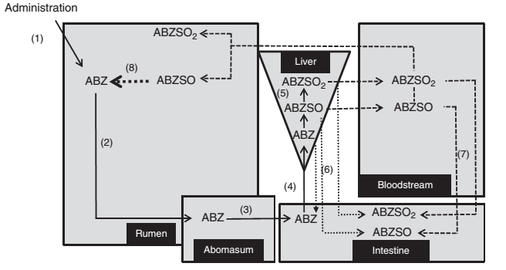
Fig. Schematic representation of the main PK features taking place after oral/intraruminal administration of BZD AHs in ruminants.

Slide 17
Benzimidazoles:
Albendazole
A benzimidazole carbamate
Formulated as a suspension or bolus for oral administration in cattle and sheep at the recommended dose of 7.5 & 5 mg/kg, respectively.
A broad-spectrum oral anthelmintic: hydatidosis and cysticercosis, pinworm infection, ascariasis, trichuriasis, strongyloidiasis, and hookworms, cutaneous larva migrans
It also used cyst excreted by Giardia infected calves (20 mg/kg once /3 days) and dogs (25 mg/kg 2x a day for 2 days.
Effect better than Mebendazole.
Administered on an empty stomach when used against intraluminal parasites but with a fatty meal when used against tissue parasites

Slide 18
Benzimidazoles:
Mebendazole
A synthetic benzimidazole
has a wide spectrum of anthelmintic activity:
Pinworm, Ascaris, Trichuris, Hookworm, and Trichostrongylus, Other infections: intestinal capillariasis, trichinosis, taeniasis, strongyloidiasis, et al.
Orally to horses (8.8mg/kg), sheep and goats (15 mg/kg), birds, dogs (22 mg/kg for 3 days), chicken
a low incidence of adverse effects.
Only 10% is absorbed systemically
Absorption is increased with a fatty meal.
liver toxicity side effects

Slide 19
Benzimidazoles:
Fenbendazole:
Wide spectrum of activity; given for three consecutive days
Oral administration in cattle, sheep, and goats at the recommended dose of 10 mg/kg (cattle) and 5 mg/kg (sheep, goats).
indicated for the removal and control of tapeworms (heads and segments), abomasal and intestinal nematodes (adults and fourth stage larvae), and lungworms (adults and larval stages).
Have ovicidal activity.
Horses :
at 5 mg/kg used to control large strongyles (Strongylus vulgaris, S. edentatus, S. equinus), small strongyles (cyathostomes), and pinworms (Oxyuris equi).
Higher doses (10 mg/kg) are required for ascarids (Parascaris equorum) control.
10 mg/kg for 5 consecutive days, for control of arteritis caused by the fourth stage larvae of S. vulgaris
Effective for the treatment of Giardia infections in calves
Oxibendazole:
orally to cattle (4.5 mg/kg), sheep (5 mg/kg), and horses (10 mg/kg)
liver toxicity in dogs
Febantel: a probenzimidazole that is metabolized in the animal to a true benzimidazole

Slide 20
Benzimidazoles:
Thiabendazole:
treatment and control of GI roundworms in horses, cattle, sheep, and goats, and the control of lungworms in sheep
Dose: 66-110 mg/kg
Usually used with piperazine to increase the efficacy against ascarids and immature Oxyurus spp.
Ineffective against cestodes and treamtodes
has antifungal and anti-inflammatory effects as well
Others: Refer the textbook for Oxfendazole, flubendazole, netobim, recobendazole, Febantel, etc

Slide 21
Factors Affecting the Disposition Kinetics and Efficacy of BZD Anthelmintics
ruminant esophageal groove closure
reduced GI transit time
the type of diet
nutritional status and parasite infection

Slide 22
Antinematodals …cont’d
II. Imidazothiazoles
Work by stimulating (agonist) the nematode’s cholinergic nervous system, leading to paralysis of the parasite
Effective against ascarids, Strongyles (Heamonchus, ostertagia, cooperia, nematodirus, etc), whipworms, and hookworms
An example is levamisole, tetramisole
Levamisole
A synthetic imidazothiazole derivative and the L isomer of D,L-tetramisole.
Highly effective in eradicating ascaris and trichostrongylus and moderately effective against species of hookworm.
Inhibiting succinic dehydrogenase → energy↓ → flaccid paralysis ( interfer CHO metabolism)
Has Immunomodulating effect.

Slide 23
Antinematodals …cont’d
Levamisole …(cont’d)
Effective against mature and immature forms of helminths within the intestinal tract but not against migratory stages in the tissues or against ova.
Effective against both mature & immature larval stages of lung worms
Dogs: GI nematodes and Diroflaricides
Inhibition of cholinesterase (a depolarizing neuromuscular blocking agent) → spastic paralysis
Rate of absorption differs with the route of adminstration.
Fast absorption via IM or SC
Used with caution in patients with liver dysfunction.
Signs of toxicity: salivation, defecation and respiratory distress

Slide 24
Antinematodals …cont’d
III. Tetrahydropyrimidines
Mimic the action of ACh and cause paralysis of the worm
Effective against ascarids, pinworms, strongyles, and hookworms
Examples include pyrantel pamoate, pyrantel tartrate, and morantel tartrate
Pyrantel
A broad-spectrum anthelmintic, safe at dose of 7x
Moderately effective against hookworms.
Not effective in trichuriasis or strongyloidiasis.
Oxantel, an analog of pyrantel, is effective against in trichuriasis; the two drugs have been combined for their broad-spectrum anthelmintic activity.

Slide 25
Antinematodals …cont’d
IV. Organophosphates
Inhibit cholinesterase activity, causing ACh to remain active in the neuromuscular junction of the parasite= spastic paralysis
Are neurotoxic to parasites; some cause neurologic side effects in the host
Both endoparasitic and ectoparasitic activity
Narrow range of safety; not for use in heartworm-positive dogs
Effective against bots and a variety of nematodes
Examples include dichlorvos, coumarphos, haloxon, naphtalophos, trichlorfon

Slide 26
Antinematodals …cont’d
V. Piperazine
Belongs to the hetrocyclic group: phenothiazine
Blockage of transmission at neuromuscular junction, producing flaccid paralysis (by blocking acetylcholine at the myoneural junction).
It also blocks succinate production by the worm.
The parasites, paralyzed and depleted of energy, are expelled by peristalsis
Effective only against ascarids (Toxocara, Toxascaris)
No longer recommended for treatment of pinworm infection, because a 7-day course of treatment is required.
Not useful in hookworm infection, trichuriasis, or strongyloidiasis.
Neurotoxic adverse effects.

Slide 27
Antinematodals …cont’d
VI. Avermectins (macrocyclic lactones)
Potentiation of Inhibitory NT (GABA).
Bind to certain chloride channels (by binding to glutamate-gated chloride channel receptors) in the parasite nerve and muscle cells, causing paralysis and death of the parasite
Prototype: ivermectin,
used for a wide variety of endo- and ectoparasites
May be combined with other antiparasitic agents to broaden its spectrum of activity
Used for heartworm prevention
Another example in this group:
moxidectin, abamectin, doramectin, milbemycin oxime, eprinomectin, selamectin
Not effective against cestodes or trematodes

Slide 28
Resistance to nematicides
Resistance appears when drugs are intensively used against parasites
Nematodes develop cross-resistance to a mode of activity
Once use of the anthelmintic class stops, reversion back to sensitivity is low
Drugs should be rotated and the frequency of treatment should also be considered

Slide 29
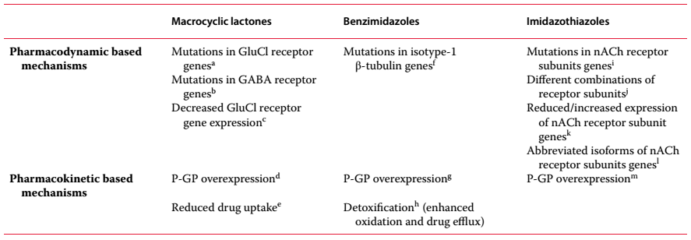
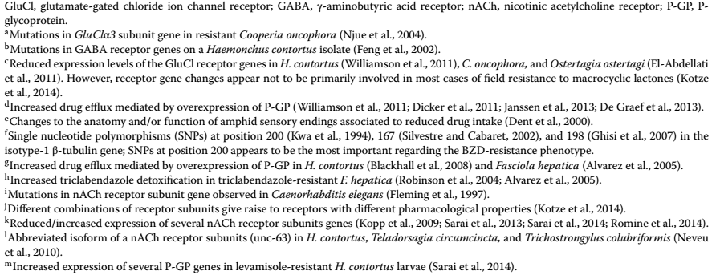
Table: Summary of the main anthelmintic resistance mechanisms described in helminth parasites for the most important chemical families: macrocyclic lactones (ivermectin, moxidectin, etc.), benzimidazoles (albendazole, fenbendazole, etc.), and imidazothiazoles (levamisole)

Slide 30
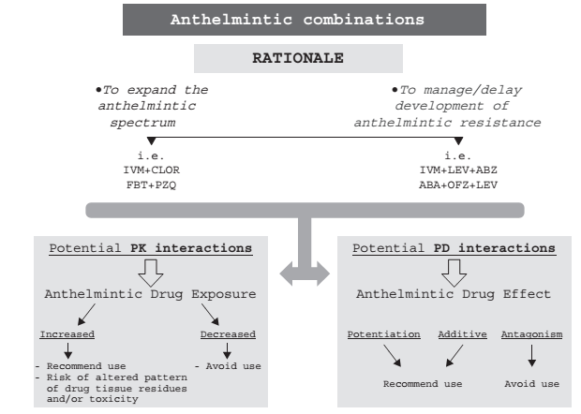
Combined use of anthelmintic drugs. Rationale and potential PK and PD drug to drug interactions. IVM, ivermectin, CLOR, clorsulon, FBT, febantel, PZQ, praziquantel,LEV, levamisole, ABZ, albendazole, ABA,abamectin, OFZ, oxfendazole.

Slide 31
Anticestodal agents
Praziquantel
Works by increasing the cestode’s cell membrane permeability (this disintegrates the worm’s outer tissue covering)
Works on adult stages of all cestode species (also used to eliminate fleas)
Both human and veterinary use
Epsiprantel
Causes disintegration of the cestode
Effective against Taenia and Dipylidium, and also Echinococcus
Fenbendazole
Covered previously
Effective against Taenia species

Slide 32
Anticestodals … cont’d
Niclosamide
A salicylamide derivative
nterference with glucose absorption, uncouplers of oxidative phosphorylation and stimulation of adenosine triphosphatase activity at mitochondrial level.
Treatment of most tapeworm infection:
ruminants Moniezia spp. and Thysanosoma spp.
horses it may be used for the treatment of Anoplocephala spp.
poor efficy against Dipylidium spp. and E. granulosus
Pharmacologic Effects
Scolexes and segments of cestodes —but not ova
are rapidly killed on contact with Niclosamide due to the drug’s inhibition of oxidative phosphorylation or to its ATPase-stimulating property.
With the death of the parasite, digestion of scoleces and segments begins.

Slide 33
Anticestodals … cont’d
Clinical Uses
Given in the morning on an empty stomach.
The tablets must be chewed thoroughly and are then swallowed with water.
Niclosamide can be used as an alternative drug for the treatment of intestinal fluke infections.
Adverse Effects
Infrequent, mild and transitory.
Nausea, vomiting, diarrhea, and abdominal discomfort.

Slide 34
Anticestodals … cont’d
Bunamidine
is a taeniacidal drug that disrupts the tapeworm’s tegument and reduces glucose uptake. Consequently, subtegumental tissues are exposed and destroyed by the host digestive enzymes. Taenia spp., Dipylidium spp., Mesocestoides spp., and Diphyllobothrium spp. (oral treatment at 25–50 mg/kg). However, efficacy against D. caninum may be erratic.
Effectiveness ranging from 85.9 to 98.8% (immature stages) and 100% (mature stages) of E. granulosus have been reported

Slide 35
Antitrematodals
Benzimidazoles
Albendazole, Netobimin
Effective for all adult stages
Triclabendizole
Effective for all stages of immature and adult fluke
Salicylaniides (closantel, oxyclozanide, rafoxanide)
All stages, some nematodes & nasal bot fly
Proton ionophores
Uncouples oxidative phosphorylation

Slide 36
Antitrematodal agents
Benzenesulfonamides (Clorsulon)
Works by inhibiting the trematode’s enzyme systems for energy production (the glycolytic pathway)
Effective against adult Fasciola hepatica
Nitroxynil
Adult flukes
Uncouples oxidative phosphorylation
Phenoxyalkanes (Diamphenethide)
Exceptionally effective against early immature flukes from 1 day to 6 weeks of age. Praziquantel
Covered previously
Also effective against lung trematodes in dogs and cats

Slide 37
Antifilariasis
Heartworm Disease
is caused by the filarial nematode Dirofilaria immitis
Three stages of management of heartworm disease
Preventing third-stage larvae from reaching maturity (preventative)
Adulticide therapy
Eradication of circulating microfilariae after infection

Slide 38
Antifilariasis ...cont’d
Heartworm Disease
Preventing third-stage larvae from reaching maturity (preventative)
Daily oral preventative
Diethylcarbamazine (DEC)
Given during mosquito season and two months after
Patient must be heartworm negative
Once-monthly oral preventatives
Ivermectin
Milbemycin
Once-monthly topical preventative
Selamectin
Six-month injectable preventative
Moxidectin

Slide 39
Antifilariasis ...cont’d
Adulticide therapy
Melarsomine
A trivalent arsenical cpd, Given in the epaxial muscles
Less toxic than former drug (thiacetarsamide)
Side effects include nephrotoxicity and hepatotoxicity
Active against immature (>4-month-old) and adult heartworms in dogs
Eradication of circulating microfilariae after infection
Ivermectin (given at higher dose as a microfilaricide)
Milbemycin
Levamisole (infrequently used)

Slide 40
Anti-filariasis ...cont’d
Human lymphatic filariasis
Epidemic in ------:
Wuchereria bancrofti , Brugia malayi and B.timori
Parasitize in lymphatic system.
Rx: Diethylcarbamazine
A synthetic piperazine derivative.
Rapidly absorbed from the GIT;
Immobilizes microfilariae (which results in their displacement in tissues) and alters their surface structure, making them more susceptible to destruction by host defense mechanisms.
Adult parasites are killed more slowly.
Against adult worms is unknown.

Slide 42
Antiparasitic Agents
Ectoparasiticides

Slide 43
Ectoparasiticides
Ectoparasites can be controlled using a variety of different drugs in a variety of different formulations:
Sprays
Dips
Pour-ons
Shampoos
Dusts or powders
Oral products
Spot-ons
Injectables

Slide 44
Ectoparasiticides
Most these drugs are neurotoxins, exerting their effect on the nervous system of the target parasite.
Can be grouped according to structure and MOA into:
organochlorines, organophosphates and carbamates,
pyrethrins and pyrethroids,
avermectins and milbemycins,
Formamidines, insect growth regulators
Ectoparasite nervous system
acetylcholinesterase (AChE) inhibitors
Na+ channel blockers
nicotinic acetylcholine receptor (nAChR) inhibitors
γ amino butyric acid (GABA)/glutamate receptor
Cl− channel inhibitors
Ectoparasite repellant
Insect growth and development

Slide 45
Organochlorines
withdrawn in many parts of the world due to concerns regarding environmental persistence.
However, some compounds, including lindane (γ benzene hexachloride) and methoxychlor, are still used.
3 main groups:
Chlorinated ethane derivatives:
DDT (dichlorodiphenyltrichloroethane), DDE (dichlorodiphenyldichloroethane), and DDD (dicofol, methoxychlor);
Cyclodienes:
chlordane, aldrin, dieldrin, hepatochlor, endrin, and tozaphene; and
Hexachlorocyclohexanes:
benzene hexachloride (BHC), which includes the g-isomer, lindane.

Slide 46
Organochlorines
Chlorinated ethanes
cause inhibition of sodium conductance along sensory and motor nerve fibers by holding sodium channels open, resulting in delayed repolarization of the axonal membrane
cyclodienes
inhibition of GABA-stimulated Cl⁻ flux in to the neuron and
interference with Ca²⁺ flux.
partial depolarization of the postsynaptic membrane and vulnerability to repeated discharge.
Lindane:
binds to the picrotoxin side of GABA receptors, resulting in an inhibition of GABA-dependent Cl⁻ flux into the neuron

Slide 47
Organophosphates (OP)
Inhibit the action of AChE at cholinergic synapses and at muscle endplates.
accumulating ACh at the postsynaptic membrane, leading to neuromuscular paralysis
Extremely toxic in animals and humans, causing an inhibition of AChE and other cholinesterases
Topically used include:
Coumaphos, diazinon, dichlorvos, famphur, fenthion, malathion, trichlorfon, stirofos, phosmet, and propetamphos.
generally active against fly larvae, flies, lice, ticks, and mites on domestic livestock
Diazinon and propetamphos dip formulations for the control of psoroptic mange in sheep

Slide 48
Organophosphates
OP poisoning
Antidote:
Atropine sulfate 0.1-1mg/kg Im
Pralidoxime – break the bond between organophosphate and acetylcholine-estrase.
Dose of 2-PAM: 20mg/kg, BID

Slide 49
Carbamates
Closely related to OP
Inhibit AChE activity but reversible
Two main carbamate cpds used are:
carbaryl and propoxur.
Carbaryl has low mammalian toxicity
Efficacy: lice, ticks, keds and fleas
Toxicosis:
antidote: atropine sulfate 0.1-1mg/kg.
not use PAM because it binds reversibly.

Slide 50
Pyrethrins and Synthetic Pyrethroids
MOA:
Interference with sodium channels of the parasite nerve axons, resulting in delayed repolarization, incoordination and convulsion and eventual paralysis
Preparation:
Available as pour-on, spot-on, spray, and dip formulations
Activity:
Activie against biting and nuisance flies, lice, and ticks on a domestic livestock.
Flumethrin and high cis-cypermethrin are also active against mange mites

Slide 51
Pyrethrins and Synthetic Pyrethroids
Are lipophilic molecules
Cross resistance with DDT present
Provide excellent knockdown (rapid kill) but have poor residual activity due to instability
Generally safe in mammals and birds but are highly toxic to fish and aquatic invertebrate
common pyrethroids used include
bioallethrin, cypermethrin, deltamethrin, fenvalerate, flumethrin, lambdacyhalothrin, phenothrin, and permethrin

Slide 52
Macrocyclic Lactones ( Avermectins and Milbemycins)
Activity
active against a wide range of nematodes and arthropods and, are often referred to as endectocides
Preparation
Given PO, parenterally, or topically (as pour-ons)
are highly lipophilic
reduced absorption and bioavailability of ivermectin given PO in cattle
due to its metabolism in the rumen.
Its affinity for fat explains their persistence in the body and the extended periods of protection afforded against internal and external parasites.

Slide 53
Macrocyclic Lactones
MOA:
Act on GABA neurotransmission in nematodes,
blocking interneuronal stimulation of EMN, leading to flaccid paralysis.
by stimulating the release of GABA from nerve endings and by enhancing the binding of GABA to its receptor on the postsynaptic membrane (PSM) of an excitatory motor neuron(EMN) =results in an increased flow of Cl⁻ ions into the cell, leading to hyperpolarization.
In mammals, GABA neurotransmission is confined to the CNS; the lack of effect of ivermectin on mammalian NS at therapeutic concentrations is probably because it does not readily cross BBB.
Recent evidence: its effect through action on glutamate-gated Cl⁻ ion conductance at the PSM or NMJ

Slide 54
Formamidines
Amitraz
is the only formamidine used as an ectoparasiticide.
MOA
act by inhibition of the enzyme monoamine oxidase (MAO) that metabolizes amine neurotransmitters in ticks and mites and
as an agonist at octopamine receptors
octopamine is thought to modify tonic contractions in parasite muscles.
results in accumulation of nor-epinephrine and serotonin and when the insect in contact with this drug they become quiescent (unable to move) finally die

Slide 55
Amitraz
Amitraz has a relatively wide safety margin in mammals
SE:
sedation- associated with an agonist activity of on α₂ -receptors in mammalian species.
available as a spray or dip for use against mites, lice, and ticks in domestic livestock.
It is contraindicated in horses.
Dose: 0.005%-0.1% spray, dipping

Slide 56
Insect Growth Regulators
Do not kill the target parasite directly but interfere with growth and development.
act mainly on immature parasite stages
not usually suitable for the rapid control of established adult parasite populations.
Based on their mode of action, it can be divided into:
chitin synthesis inhibitors (benzoylphenyl ureas),
chitin inhibitors (triazine/pyrimidine derivatives), and
juvenile hormone analogs

Slide 57
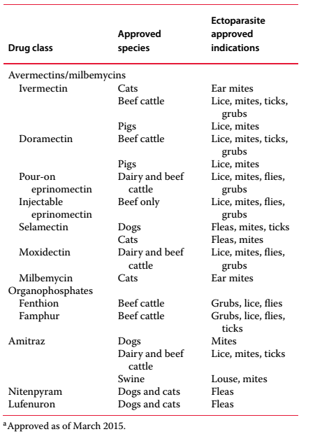
US FDA approved Ectoparasiticides

Slide 58
Resistance to Ectoparasiticides
Resistance has been widely reported for many popular ectoparasiticides such the avermectins, pyrethroids, and OPs.
Resistance also tends to occur where there is intensive use of antiparasitic drugs
There is some concern that as the newer insecticides such as the neonicotinoids become more frequently and inappropriately used, resistance can potentially emerge. However, there is little or no evidence of fleas developing resistance to the increasing and popular use of imidacloprid.
Mechanisms of resistance may be related to
decreased penetration,
increased detoxification enzyme activity, and
Decreased sensitivity of the target site.
Pyrethroid resistance amongst insects has been associated with mutations in the sodium channel genes reducing the ability of the insecticide to bind to the sodium channel. A
Cross resistance for a specific target site is indeed very common within individual insecticide classes.

Slide 59
Antiparasitic Agents
Antiprotozoal Drugs

Slide 60
Objectives
Know the name of drugs commonly used to treat protozoal diseases
Understand the MOA of antiprotozoal drugs
Identify the effectiveness of the drugs (prophylactic/curative use)

Slide 61
Antiprotozoals
Anticoccidials
Antibabesiosis
Antitrypanosomosis
Antitrichomoniasis
Others (Reading assignment)
Antigiardiasis
Antiameobiasis

Slide 62
I. Anticoccidials
Coccidiosis
is a protozoal infection that causes intestinal disorders
Anticoccidial drugs are
coccidiostats (do not actually kill the parasite, so hygiene is crucial)
Sulfadimethoxine
Reduces the number of oocysts shed, thus reducing spread of disease
Thymidylate synthase inhibitor
Trimethoprim
DHFR inhibitor
Others (work mainly by affecting the protozoan’s metabolism)
Amprolium
Monensin
Nicarbazine
Robenidine

Slide 63
Anticoccidials…cont’d
Amprolium
A structural analogue of thiamine (vitamin B1)
Competitively inhibits thiamine utilization by the parasite.
Prolonged high dosages can cause thiamine deficiency in the host and excessive thiamine in the diet can reduce or reverse the anticoccidial activity of the drug
Good activity against and used as a therapeutic agent
E. tenella, E. acervulina in poultry
It has weak activity against E. maxima, E. mivati, E. necatrix, or E. brunetti.
In cattle, amprolium has approval for the treatment and prevention of E. bovis and E. zurnii in cattle and calves
Treatment of coccidiosis in dogs and cats

Slide 64
Anticoccidials…cont’d
Monensin:
An ionophore, causing osmotic imbalance by interfering transport of ions
Effective for all spps.
Growth promotion effect in cattle
Dose: 100-120ppm for chicken.
16-33ppm for cattle (calf).
11-33ppm for sheep
Characteristics:
Lipid soluble, biodegradable (within the host / environment),
Act as contact, stomach, systemic poison mainly for equine

Slide 65
Anticoccidials…cont’d
Benzeacetonitrils
Diclazuril-
Coccidostatic agent
used for chicken to treat E.maxima, E.burnetti, E.acervulina, given with feed1ppm
highly potent drug (for toxoplasmosis, Neospora caninum and sarcocyst)
Benzyl purines
Arprinocids
used for poultry
MOA: Inhibit DNA synthesis.
Effective for all spps of emeria.
Dose: 60ppm in feed
Carbanilides
Nicarbazine
affect the second asexual generation (schizonts).
Dose: 125ppm in feed.

Slide 66
Anticoccidials…cont’d
Guanidines- Robenidine
Active against first generation schizont of E. tenella
MOA:
Inhibit DNA replication,
Affect energy metabolism. i.e. oxidative phosphorylation.
Used in prevention in chickens
Dose: 33ppm.For theileriosis – In cattle
Parvaquone – Im, 20mg/kg stat dose
Buparuquone – Im, 2.5mg/kg
1-2 times curative treatment in cattle
Ionophores
MOA:
Cause osmotic imbalance by interfering transport of ions
In cattle: used as growth promoter
It acts at two stages i.e. sporozoite and merozoite Therefore used as preventive and treatment.

Slide 67
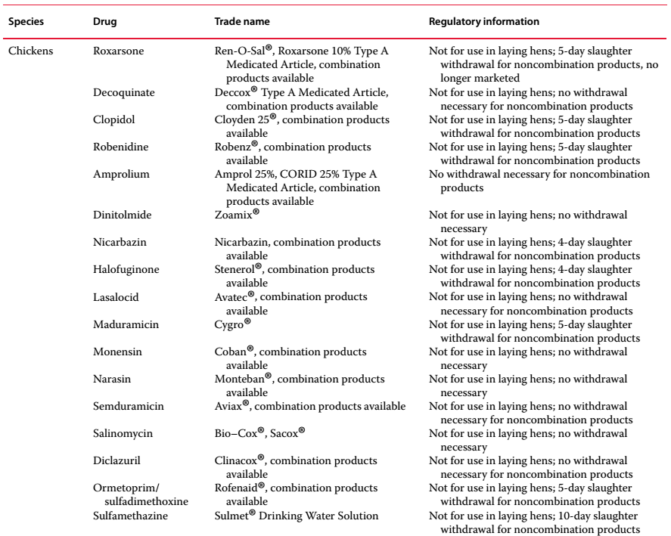
Drugs licensed for the treatment of coccidiosis in food animals

Slide 68
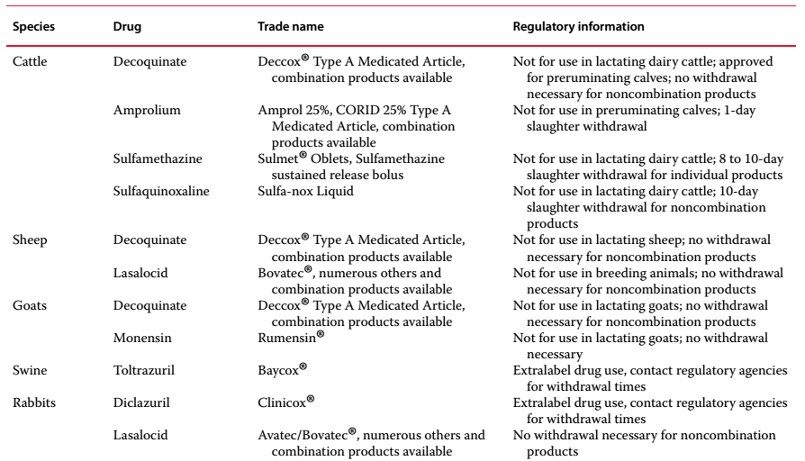
Drugs licensed for the treatment of coccidiosis in food animals

Slide 69
II. Anti-Babesiosis
Blood protozoan Babesia sp. is transmitted by ticks
Tick prevention
Urea complex drugs are commonly used
Amicarbalid isothionate
Imidocarp dipropionate
Quinoronium sulfate
Diminazene diaceturate
Pentamidine
Phenamidine isothionate

Slide 70
Antibabesial drugs
Amicarbalid isothionate
MOA: Inhibition of DNA replication –
Not completely remove the parasite but help to develop preimmunity. So the animals carry the parasite through out the life.
Effective against bovine babesiosis
Route: Sc, Im, Iv, Dose: 5-10mg/kg
Imidocarb dipropionate = Imizol
Diamidine of the carbanalide series of antiprotozoal
MOA:
inhibit cellular repair and replication of babesia
Dose: 1-2mg/kg horse, 2-4mg/kg dogs
more effective against bovine babesiosis ( but B. canis than B. gibsoni), B caballi (equine),
Mostly used as a prophylactic drug given Im and Sc

Slide 71
Antibabesial drugs
Quinorunium sulfate
® acaprin, acapron, babesan
Curative drug.
Dose:
0.3-0.5mg/kg horses,
0.5mg/kg cattle, sheep and pig,
0.25mg/kg dogs.
Route: SC.

Slide 72
III. Anti-trypanosomial drugs
Isomethamedium = ®samorin
MOA:
inhibit cell division and growth of parasite.
Active against T. vivax and T. congolense, T.evansi
Have prophylactic effect for 6 month.
Dose: 0.5mg/kg, 1-2mg/kg in resistant areas.

Slide 73
Anti-trypanosomial drugs
Quinapyramines ®=Antrycide
Quinapramine chloride – as prophylaxis –
Quinapramine sulfate – curative drug
Effective –
T.congolense, T.vivax, T.equiperdium, T.evansi
For all, but mainly used in equine and camel
Dose: prophylaxis: 0.025mg/kg of 10%.
Therapeutic: 3-5mg/kg s/c

Slide 74
Anti-trypanosomial drugs
Suramin:
curative drug
MOA:
Inhibit cell division
Active for
T.evansi, T.bruci, T.equiperdum
but not for T.vivax and T. congolense
Dose: 7-12mg/kg of 10%,
best drug for dourine,
used in horse and camel

Slide 75
Individual assignment
Briefly discuss about drugs commonly used to control (prevention & treatment) bovine trypanosomiasis in Ethiopia
Detail mechanisms of action
Level of Resistance development
Mechanism of how resistance developed by trypanosomes
Date of submission: 14th week of the semester
Via email: takele.beyene@aau.edu.et

Slide 76
IV. Anti-trichomoniasis Drugs
Trichomoniasis
Vaginal infection caused by Trichomonas
Contracted sexually
Treat both sexes
R_{x}:
Metronidazole
Acetarsol

Slide 77
Others
Antigiardiosis
Giardiosis is a protozoal disease caused by the parasite Giardia
Antiprotozoal drugs
Metronidazole
(enters the protozoal cell and interferes with its ability to function and replicate)
Fenbendazole (covered previously)
Albendazole (covered previously)
Vaccines for human
On development

Slide 78
Anti-amebiasis
Amebiasis
is infection with Entamoeba spp.
is transmitted through GIT
Ameba has two stages of development:
cyst and trophozoite.
Cysts → small intestine → little trophozoites (ileocecum)
cysts (colon) —— asymptomatic intestinal infection, source of infection
big trophozoites (tissues of intestine) —— intestinal amebiasis
→ extraintestinal infection

Slide 79
Anti-amebiasis
Metronidazole, Tindazole
A nitroimidazole antibacterial and antiprotozoal agent.
The nitro group of metronidazole is chemically reduced in anaerobic bacteria and sensitive protozoans.
Reactive reduction products appear to be responsible for antimicrobial activity.
Pharmacological Effects and Clinical Uses
Anti-amebiasis:
kills trophozoites but not cysts.
Treatment of all tissue infections.
No effect against luminal parasites
Anti-trichomoniasis:
Anti-giardiasis
Anti-anaerobic bacteria:

Slide 80
Anti-amebiasis
Emetine, an alkaloid derived from ipecac, and
dehydroemetine, a synthetic analog,
are effective against tissue trophozoites
kills E histolytic trophozoites of histolytic tissues but no effection against luminal trophozoites.
used to treat amebic dysentery for the minimum period because of toxicity.
Occasionally as alternative therapies for amebic liver abscess
MOA
Inhibiting peptidyl-tRNA transposition → inhibiting elongation of peptide chain → inhibiting protein synthesis → interfering cleavage and breeding of trophozoites
low selection → also inhibiting protein synthesis of eukaryocyte.
Toxicity increase with length of therapy

Slide 81
Anti-amebiasis
Diloxanide
is a dichloroacetamide derivative.
Effective against luminal amebicide but is not active against tissue trophozoites.
The unabsorbed diloxanide in the gut is the active antiamebic substance.
It is used with a tissue amebicide: metronidazole.

Slide 82
Anti-ameobiasis
Paromomycin
Aminoglycoside antibiotic.
Not significantly absorbed from the GIT.
Only as a luminal amebicide effect
inhibiting protein synthesis → kill trophozoites;
inhibiting symbiosis flora → indirectly inhibiting ameba protozoa.
Chloroquine
reaches high liver concentrations → treatment of amebic liver abscess.
Not effective for intestinal or other extrahepatic amebiasis.

Slide 83
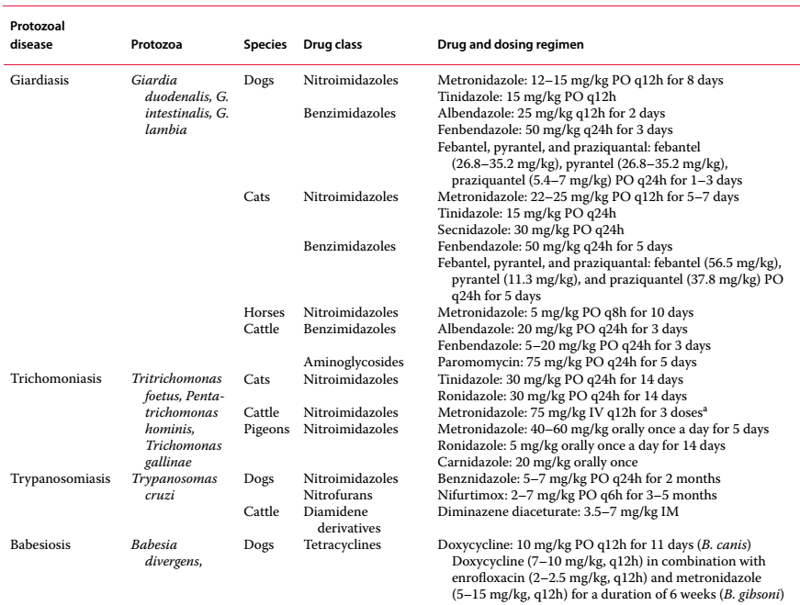
Summary of drugs used to treat selected protozoal diseases in animals

Slide 84
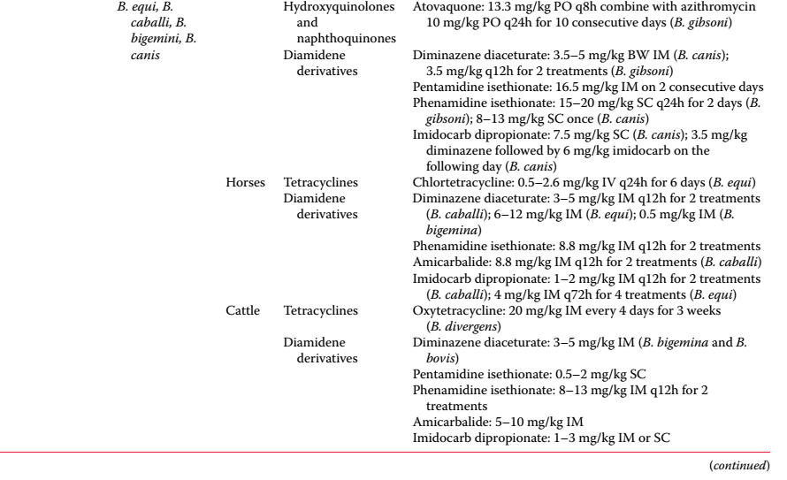

Slide 85
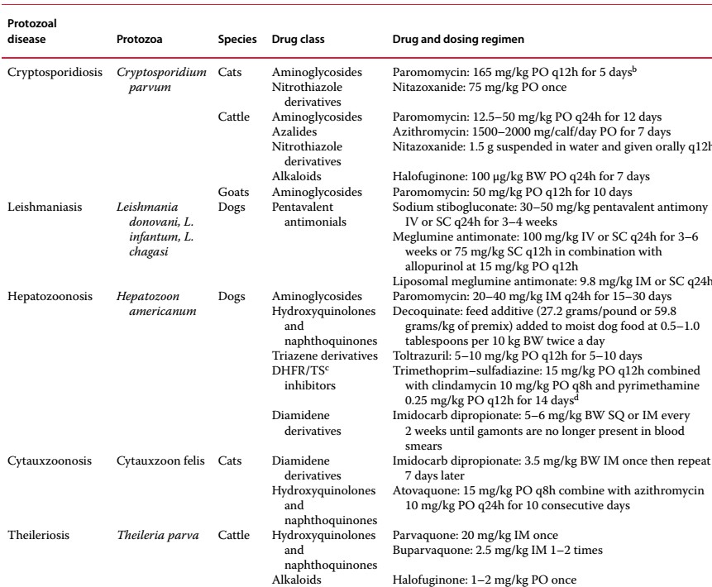

Slide 86
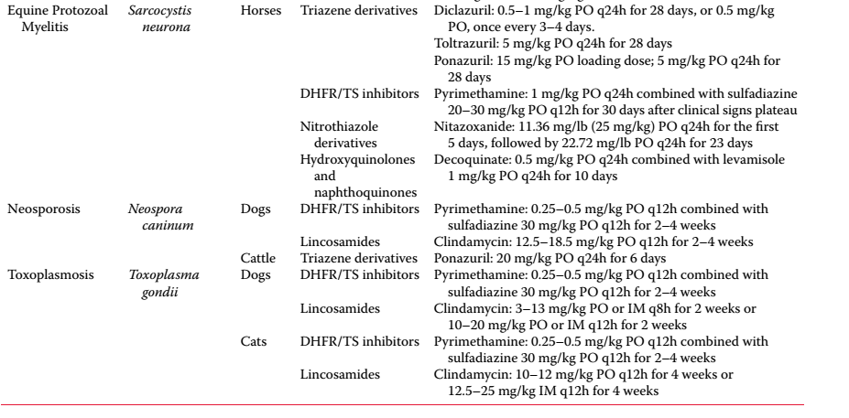

Slide 87
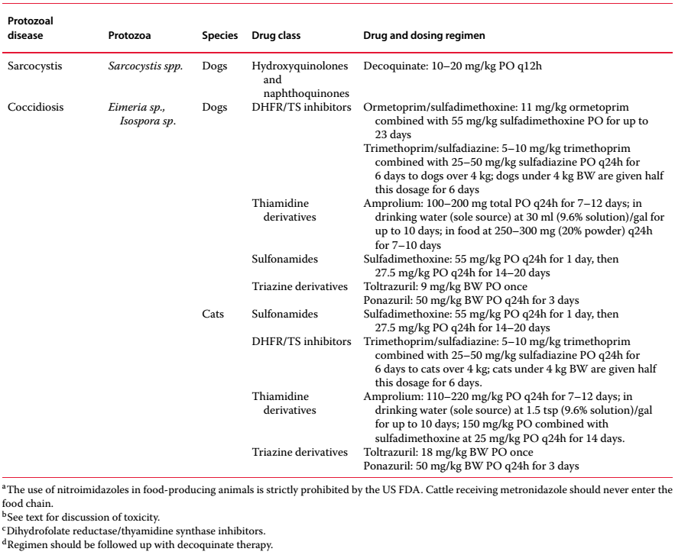

Slide 89
Reading materials
Textbook
Rivire JE and Papich MG (2018): Veterinary Pharmacology and therapeutics 10th ed.
OR
Rivire JE and Papich MG (2016): Veterinary Pharmacology and therapeutics 9th ed.

