Slide 1
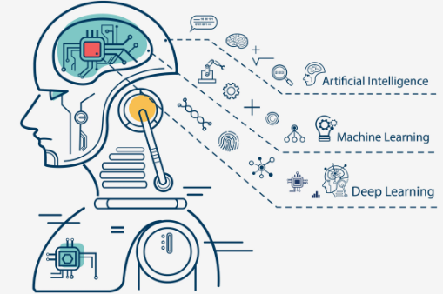
Chapter -5 machine learning

Slide 2
contents
What is machine learning
Types of machine learning
Applications of machine learning
Supervised learning(classification)
Decision tree algorithm
Bayesian classification algorithm
Unsupervised learning(clustering)
K-means clustering algorithm

Slide 3
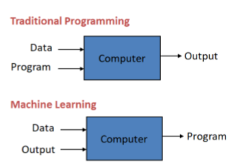
What is machine learning?
Machine learning: "Field of study that gives computers the ability to learn without being explicitly programmed"

Slide 4
types of learning algorithms
o Supervised learning ▪ Teach the computer how to do something, then let it use it;s new found knowledge to do it
o Unsupervised learning ▪ Let the computer learn how to do something, and use this to determine structure and patterns in data o Reinforcement learning

Slide 5
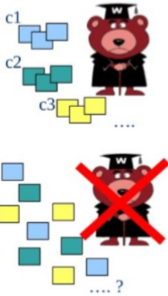
Supervised vs unsupervised
e.g: decision tree , Bayesian classification algorithms
e.g: k-means clustering algorithm

Slide 6
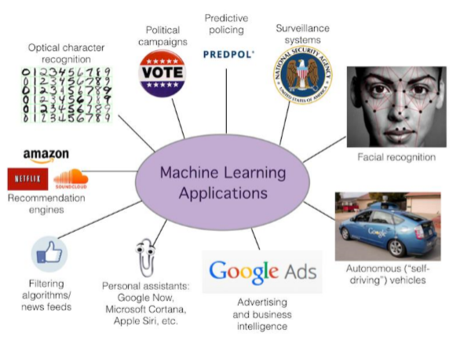
Applications of machine learning

Slide 7
Decision tree(DT)
A decision tree has three types of nodes:
A root node that has no incoming edges and zero or more outgoing edges.
Internal nodes, each of which has exactly one incoming edge and two or more outgoing edges.
Leaf or terminal node, each of which has exactly one incoming and no outgoing edges.
Solving the classification problem using DT is a two-step process:
Decision Tree Induction- Construct a DT using training data
For each t_{i} є D, apply the DT to determine its class

Slide 8
Decision tree(DT)- example
categorical
categorical
continuous
Splitting Attributes
class
Refund
Yes
No
NO
MarStatus
Single, Divorced
Married
TaxIncome
NO
< 80K
> 80K
NO
YES
Model: Decision Tree
Training Data

Slide 9
Decision tree(DT) example
categorical
categorical
continuous
class
MarSt
Single, Divorced
Married
NO
Refund
Yes
No
NO
TaxInc
< 80K
> 80K
NO
YES
There could be more than one tree that fits the same data!

Slide 10
Decision Tree –An Example (contd..)
Apply Model to Test Data
Test Data
Start from the root of tree.
Refund
Yes
No
NO
MarSt
Single, Divorced
Married
TaxInc
NO
< 80K
> 80K
NO
YES

Slide 11
Decision Tree –An Example (contd..)
Test Data
Apply Model to Test Data
Refund
Yes
No
NO
MarSt
Single, Divorced
Married
Assign Cheat to “No”
TaxInc
NO
< 80K
> 80K
NO
YES

Slide 12
Decision tree – another example
Training dataset for ‘buys_computer’ example

Slide 13
Decision tree – another example
Output: A Decision Tree for “buys_computer”
age?
<=30
overcast
>40
31..40
student?
yes
credit rating?
no
yes
excellent
fair
no
yes
no
yes

Slide 14
Decision tree induction algorithms
Many Algorithms:
Hunt’s Algorithm (one of the earliest)
ID3(Induction Decision Tree ver. 3),
C4.5, C5.0 by Ross Quinlan et.al.
CART (Classification And Regression Tree)
CHAID (Chi-square Automatic Interaction Detection)

Slide 15
Decision tree induction algorithms

Slide 16
Naïve Bayesian Classification
Let D be a training set of tuples and their associated class labels, and each tuple is represented by an n-D attribute vector X = (x₁, x₂, …, x_{n})
Suppose there are m classes C₁, C₂, …, C_{m}.
Classification is to derive the maximum posteriori, i.e., the maximal P(C_{i}|X)
This can be derived from Bayes’ theorem
Since P(X) is constant for all classes, only
needs to be maximized

Slide 17
Naive Bayesian Classifier Example
play foot ball?

Slide 18
Naive Bayesian Classifier Example
9
5

Slide 19
Naive Bayesian Classifier Example
Given the training set, we compute the probabilities:
We also have the probabilities
P = 9/14
N = 5/14

Slide 20
Naive Bayesian Classifier Example
To classify a new sample X:
outlook = sunny
temperature = cool
humidity = high
windy = false
Prob(P|X) = Prob(P)*Prob(sunny|P)*Prob(cool|P)* Prob(high|P)*Prob(false|P) = 9/14*2/9*3/9*3/9*6/9 = 0.01
Prob(N|X) = Prob(N)*Prob(sunny|N)*Prob(cool|N)* Prob(high|N)*Prob(false|N) = 5/14*3/5*1/5*4/5*2/5 = 0.013
Therefore X takes class label N

Slide 21
Naive Bayesian Classifier Example
Second example X = <rain, hot, high, false>
P(X|p)·P(p) = P(rain|p)·P(hot|p)·P(high|p)·P(false|p)·P(p) = 3/9·2/9·3/9·6/9·9/14 = 0.010582
P(X|n)·P(n) = P(rain|n)·P(hot|n)·P(high|n)·P(false|n)·P(n) = 2/5·2/5·4/5·2/5·5/14 = 0.018286
Sample X is classified in class N (don’t play)

Slide 22
Clustering algorithms-Partitioning method
Partitioning method: Construct a partition of a database D of n objects into a set of k clusters
Given a k, find a partition of k clusters that optimizes the chosen partitioning criterion
Heuristic methods: k-means and k-medoids algorithms
k-means (MacQueen’67): Each cluster is represented by the center of the cluster
k-medoids or PAM (Partition around medoids) (Kaufman & Rousseeuw’87): Each cluster is represented by one of the objects in the cluster

Slide 23
The K-Means Clustering Method
Given k, the k-means algorithm is implemented in 4 steps:
Partition objects into k nonempty subsets
Compute seed points as the centroids of the clusters of the current partition. The centroid is the center (mean point) of the cluster.
Assign each object to the cluster with the nearest seed point.
Go back to Step 2, stop when no more new assignment.

Slide 24
The K-Means Clustering Method
Example

Slide 25
APACHE MAHOUT

Slide 26
SPARK MLib

Slide 27
Introduction to HADOOP
ANY QUESTIONS / DOUBTS
???

