Slide 1
Casting Defects

Slide 2
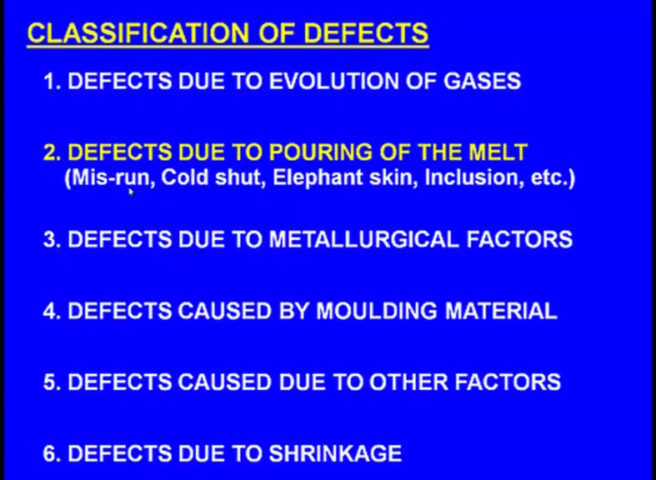

Slide 3
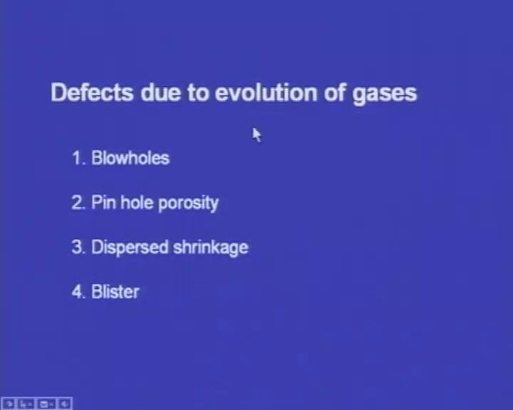

Slide 4
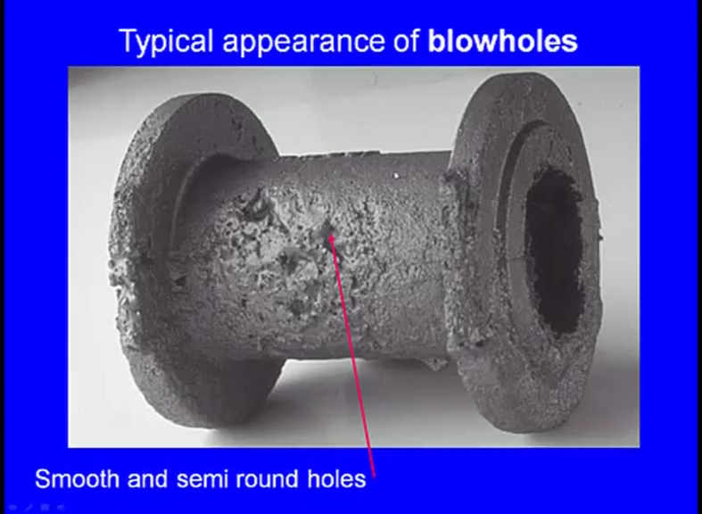
You can see smooth and semi round holes on the surface of the casting. So, this is a casting you can see these are all the what say a smooth and semi round holes on the surface of the casting. So, certainly this cannot be tolerated and ultimately the casting has to be rejected.
So, this is one of the severe defects that arise among the castings now why this blowholes is arising causes.

Slide 5
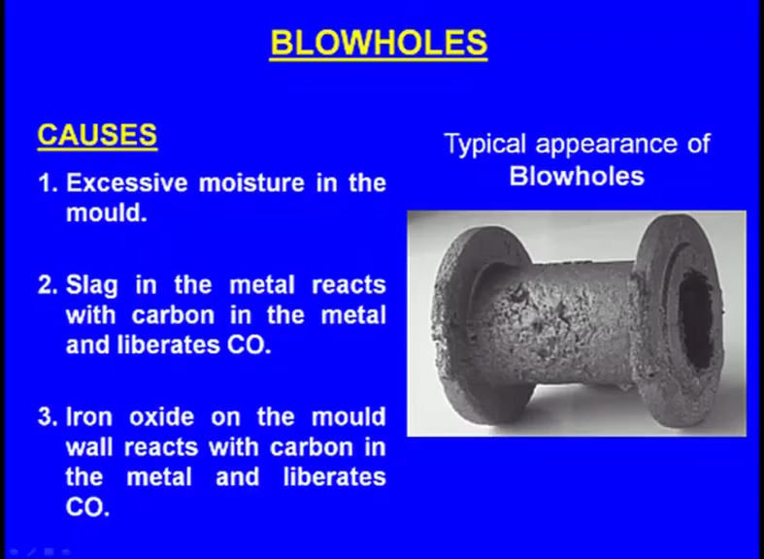

Slide 6
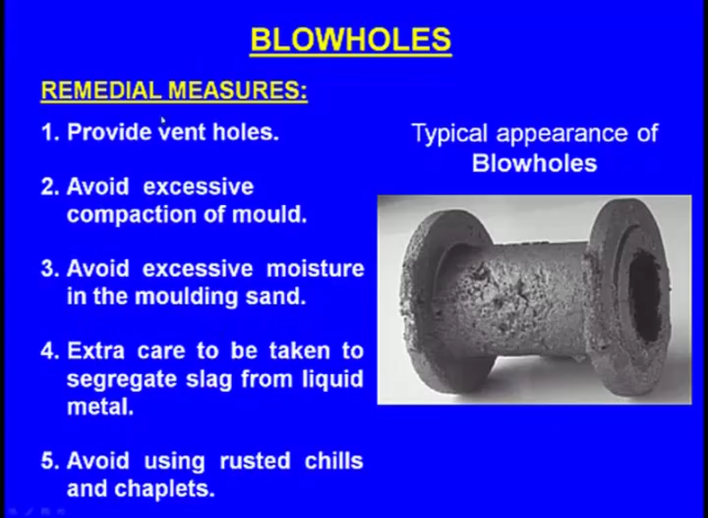

Slide 7
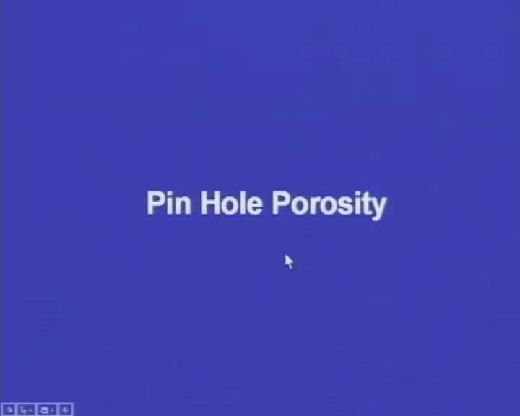

Slide 8
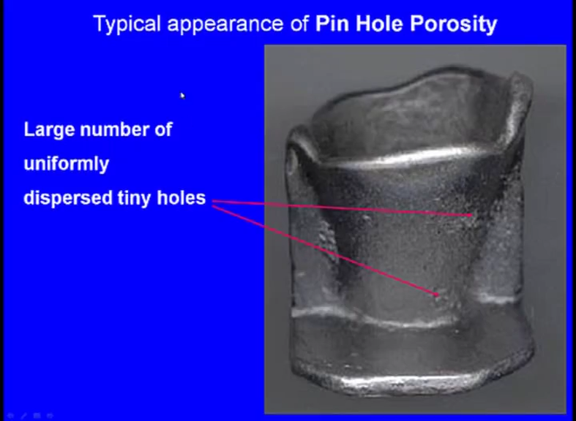

Slide 9
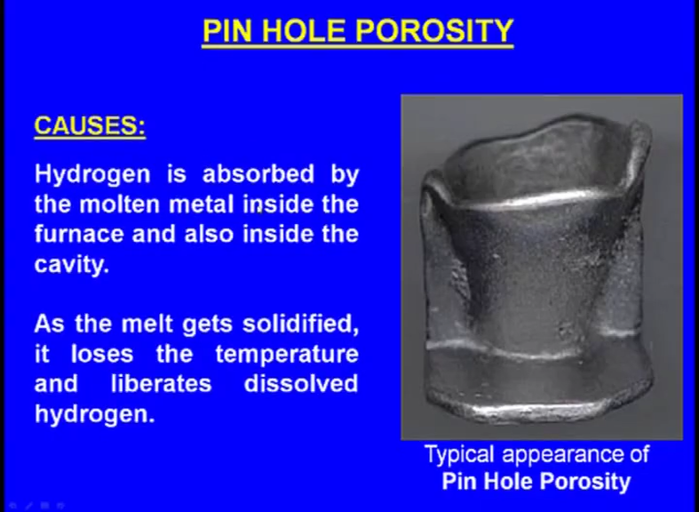

Slide 10
Hydrogen is absorbed by the molten metal inside the furnace and also inside the cavity. So, this is the main reason for the what say evolution of the pinhole porosity the main factor that influences the formation of the pinhole porosity is the hydrogen. This hydrogen is absorbed by the molten metal inside the furnace what is happening when we are melting the metal, inside in the open atmosphere the at hydrogen is present in the atmosphere.
The hydrogen present in the atmosphere readily comes and reacts with the molten metal. Now the molten metal rapidly absorbs the hydrogen, now when we pour it inside the cavity that time also it can absorb the hydrogen, now as the melt gets solidified as the molten material gets solidified then what happens whatever hydrogen it has absorbed it slowly liberates outside it sends outside then what happens it they dissolved hydrogen will be liberated outside, then it comes on the surface of the casting.
Now, small holes are created because of the presence of the hydrogen. So, this is the a cause of the pinhole porosity now how to prevent this what are the remedial measures to prevent the pinhole porosity.

Slide 11
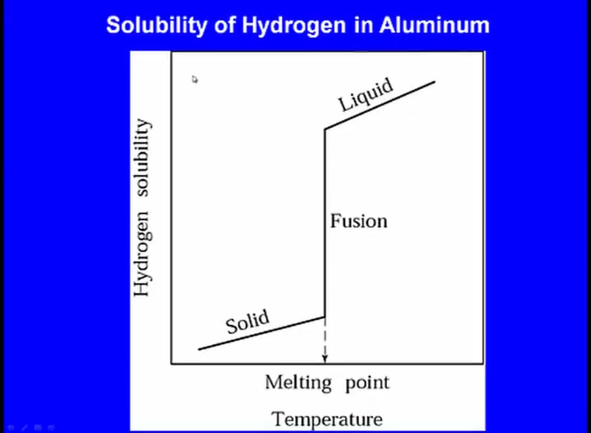

Slide 12
Before that let us see the solubility of hydrogen in aluminum, now if you see here this is the x axis indicates the melt what say temperature whereas, y axis indicates the hydrogen solubility now in the solid state you can see this is the solubility this much is the solubility.
Now, at the melting point you can see here the solubility is almost 4 times than it is solubility in the what say solid state. So, in the liquid state it is what say hydrogen solubility is drastically increasing, now these are the remedial measures. One is the vacuum melting instead of a melting the metal in the open atmosphere, if we melt it in the vacuum then no what say atmospheric hydrogen will come and interact with the molten metal, but this vacuum melting is quite expensive. Next one vacuum degassing.

Slide 13
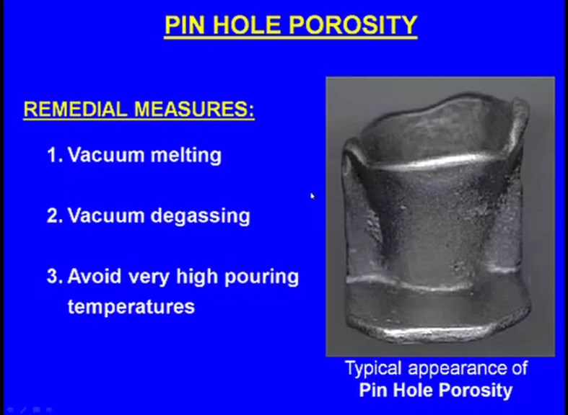

Slide 14

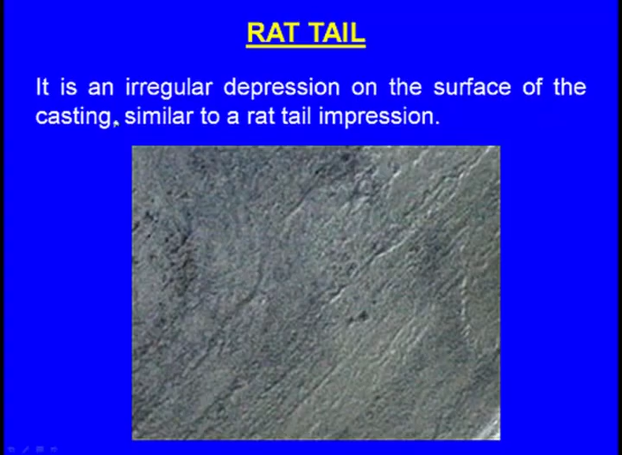
So, this is the surface of the casting and here we can see something like the tail of a rat what say tail impression if a rat is crawling on some surface, then we can detect some impression of it is tail and here we can see a similar impression on the surface of the casting this is known as the rat tail.
Now what are the factors influencing rat tail.

Slide 15
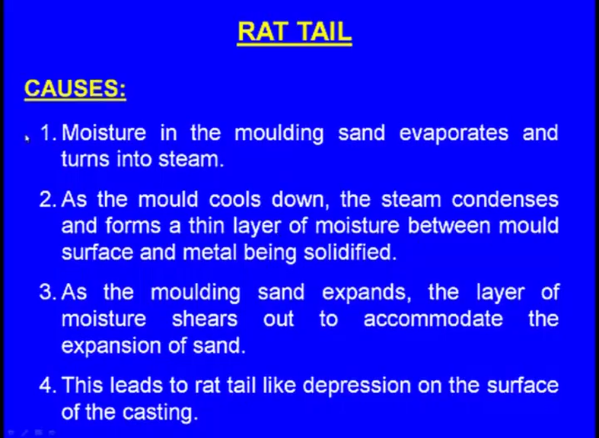

Slide 16
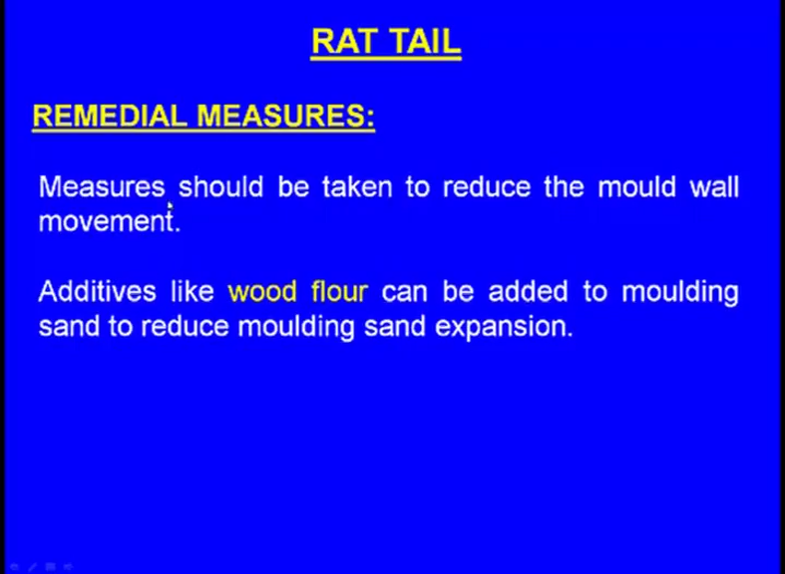

Slide 17
Defects in Sand Casting

Slide 18
Common Defects in Casting

Slide 19
Common Defects in Casting

