Slide 1
CHApter-5 curve fitting

Slide 2
1. Introduction
Curve Fitting- The process of approximating function values.
TECHNIQUES- REGRESSION and INTERPOLATION
REGRESSION- the process of finding another curve that would closely match the target functions values
INTERPOLATION- the process of approximating points on a given function by using existent data found in the neighborhood of these points.

Slide 3
2. Least Squares Regression
Fitting a straight line to a set of observations:
(x1, y1), (x2, y2),…, (xn, yn)
Mathematically:
y=ao+a1x+e
ao, a1 --- Coefficients
e --- Error/Residual
Objectives: calculating ao, a1, e

Slide 4
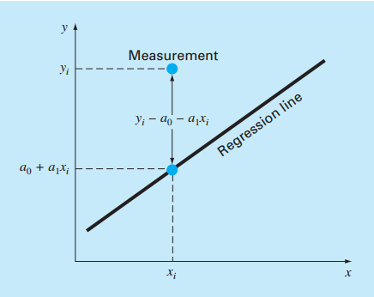
2. Least Squares Regression

Slide 5
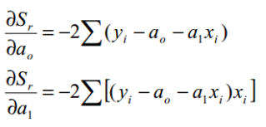
2. Least Squares Regression
Minimization of the square of the residuals

Slide 6
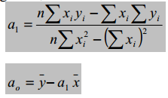
2. Least Squares Regression
Rearranging
Solving for ao and a1 simultaneously:

Slide 7
2. Least Squares Regression
Goodness of Fit
Goodness of fit only tells you that the curve accurately approximates the data
However, it doesn’t necessarily mean that a relationship between the dependent and the independent variables exists.

Slide 8
2. Least Squares Regression
LINEARIZATION of NON-LINEAR RELATIONSHIPS
Exponential Functions
Power Functions
Growth Rate Equations

Slide 9
2. Least Squares Regression
[EXAMPLE]
Xi | Yi
1 | 0.5
2 | 2.5
3 | 2.0
4 | 4.0
5 | 3.5
6 | 6.0
7 | 5.5

Slide 10
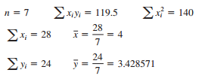
2. Least Squares Regression

Slide 11
2. Least Squares Regression
[EXAMPLE 2]- Linearization –
Log y= b Log(x)+ Log(a)
Xi | Yi
1 | 0.5
2 | 1.7
3 | 3.4
4 | 5.7
5 | 8.4

Slide 12
2. Least Squares Regression
Linearized data
Xi | Yi | Log (xi) | Log(yi)
1 | 0.5 | 0 | -0.301
2 | 1.7 | 0.301 | 0.226
3 | 3.4 | 0.477 | 0.534
4 | 5.7 | 0.602 | 0.753
5 | 8.4 | 0.699 | 0.922

Slide 13
2. Least Squares Regression
POLYNOMIAL REGRESSION
Example: Quadratic Polynomial

Slide 14
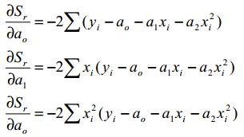
2. Least Squares Regression
Quadratic Regression General Formulation

Slide 15
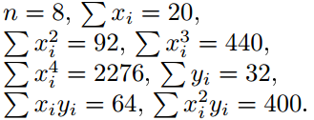
2. Least Squares Regression
Example: Find the least squares parabola for the following data:
(-1,10), (0, 9), (1, 7), (2, 5), (3, 4), (4, 3), (5, 0), (6, -1)

Slide 16
2. Least Squares Regression
Solve:

Slide 17
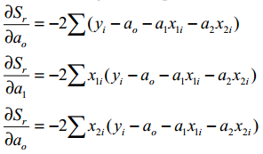
Multiple Linear Regression
A dependent variable may be a function of more than one variable.

Slide 18
Multiple Linear Regression
Solving
yields the least squares 3D surface that best fits the given data.
This formulation can be extended to m variables (dimensions).

Slide 19
General Least Squares Regression
[READING ASSIGNMENT]

Slide 20
Interpolation
The process of computing intermediate data points between known data points.
Newton’s Interpolation Polynomials
Lagrange Interpolation Polynomials

Slide 21
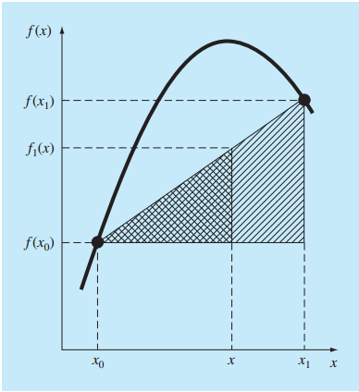
Interpolation
Linear Interpolation

Slide 22
Interpolation
[EXAMPLE]: Linear Interpolation
Estimate ln(2)= 0.693147 using linear interpolation:
A, initial points: (1, 0) and (6, 1.791759)
B, initial points: (1, 0) and (4, 1.386294)

Slide 23
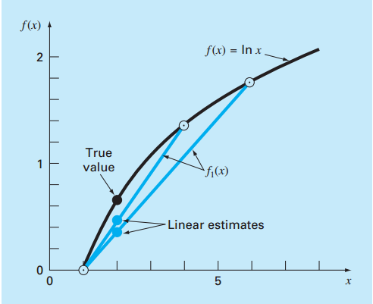
Interpolation
Linear Interpolation of Ln(2)

Slide 24
Interpolation
Quadratic Interpolation
By setting x=x0.
By setting x=x1, b0=f(x0)
By setting x=x2, b0, b1[ASSIGNMENT]

Slide 25
Interpolation
[EXAMPLE]: Quadratic Interpolation
X0=1 f(0)=0
X1=4 f(4)=1.386294
X2=6 f(6)=1.791759

Slide 26
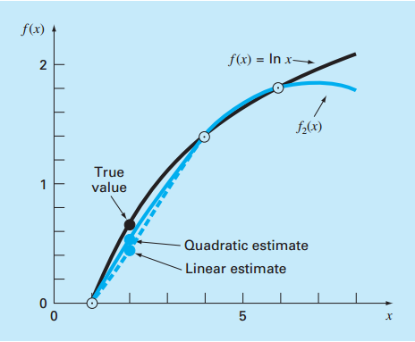
Interpolation
Quadratic Interpolation

Slide 27
Interpolation
General form of Newton’s Interpolating polynomial
Divided Differences:
FIRST ORDER:
SECOND ORDER:
THIRD ORDER:

Slide 28
Interpolation
[EXAMPLE] General form of Newton’s Interpolating polynomial
Evaluate ln(2) using a third order divided difference
polynomial
X0=0, f(0) = 0
X1=4, f(4) = 1.386294
X2=6, f(6) = 1.791759
X3=5, f(5) = 1.609438

Slide 29
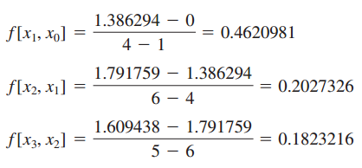
Interpolation
Third order polynomial
First divided differences

Slide 30
Interpolation
Second divided differences
Third divided difference

Slide 31
Interpolation
b1, b2 and b3 represent
Thus

Slide 32
Interpolation
Lagrange polynomials
A direct reformulation of Newton’s divided difference polynomials[READING ASSIGNMENT]
Avoid the computation of divided differences

Slide 33
Interpolation
[EXAMPLE]: Lagrange Interpolating Polynomials
First Order
Second Order

Slide 34
SPLINES

Slide 35
Splines
Curves that approximate functions using low order polynomials fitted between consecutive sets of data points.
Depending on the problem, splines can be superior in accuracy than interpolating polynomials

Slide 36
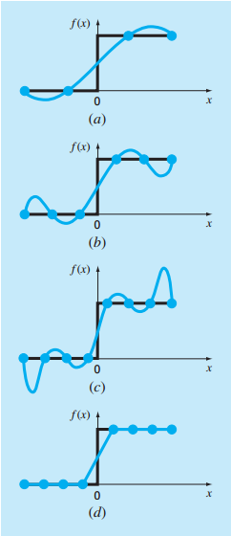
Splines

Slide 37
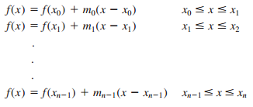
Splines
First Order/Linear Splines
Where

Slide 38
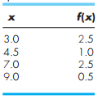
Splines
[EXAMPLE] First Order Splines
Fit first order splines for the following data and compute the value at x=5

Slide 39
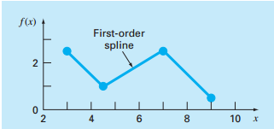
Splines
[EXAMPLE] First Order Splines
Between x=4.5 and x=7, m= (2.5-1/7.0-4.5)=0.6
f(5)=1+0.6*(5-4.5)=1.3

Slide 40
Splines
Limitations
Abrupt Changes in slope
Discontinuity in evaluating derivatives

Slide 41
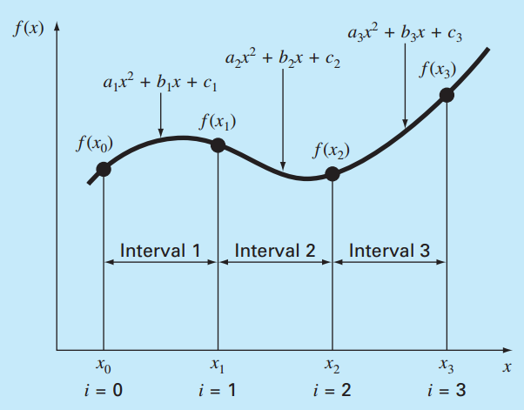
QUADRATIC SPLINES
Second order equations

Slide 42
QUADRATIC SPLINES
(1)
(2)
(3)
(4)

Slide 43
QUADRATIC SPLINES
[EXAMPLE]: Fit quadratic splines for the following data

Slide 44
QUADRATIC SPLINES
Condition 1: Function values at interior points connecting polynomials are equal.
Condition 2: First and Last functions must pass through end points.

Slide 45
QUADRATIC SPLINES
Condition 3: First derivatives at interior points are equivalent.
Condition 4: a1 = 0
These equations result in a linear system of eight equations and eight unknowns(b1, c1, a2, b2, c2, a3, b3, c3).

Slide 46
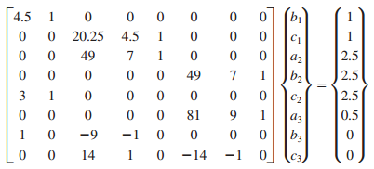
QUADRATIC SPLINES

Slide 47
QUADRATIC SPLINES
Solving the system yields:
Finally:

Slide 48
Any Questions ?

