Slide 1
Communities
Social Network Analysis, Lecture 4
E&K Ch 3.6
AAIT ITSC
Instructor: Dr. Sunkari

Slide 2
What is community?
Finding communities
CONCOR
Edge removal (Girvan-Newman)

Slide 3
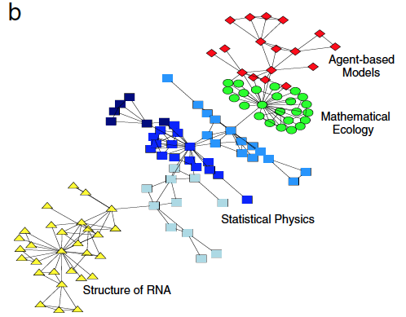
Group Discussion:
How would you define a community/cluster/partition in a network?

Slide 4
Structural equivalence
Dfn: Two nodes i and j are structurally equivalent for graph G if:
I.e., relationships to all other nodes are identical!
In practice: too rigid
Group into equivalence classes
edges are the same
all other nodes

Slide 5
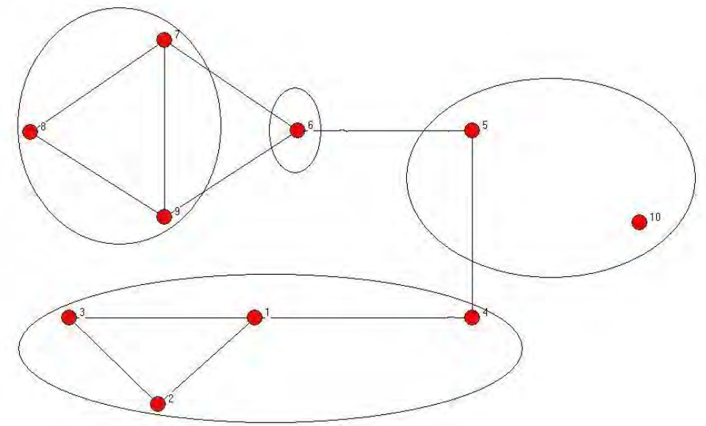
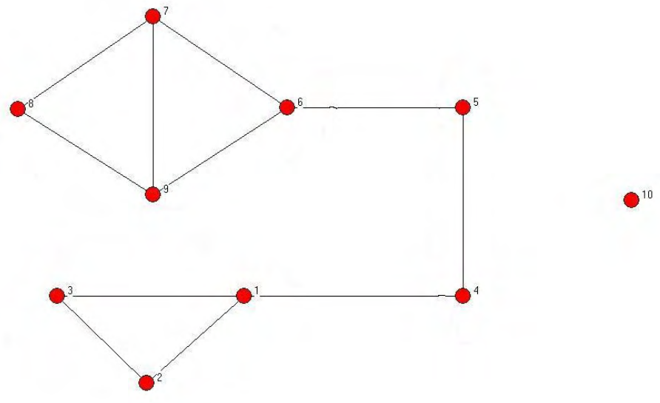
Community structure
defined on nodes/vertices
Dfn: A community structure, ∏, is a collection of disjoint subsets of V (i.e., a partition) whose union is V.

Slide 6
Why find communities?
Improve web client performance
Recommender systems
Efficient graph storage/access
Study node relationships

Slide 7
Community Detection/ Graph Partitioning
CONCOR, edge removal

Slide 8
Group Discussion:
How would you find communities/clusters/partitions in a network?
Why are you looking?
Literature: no consensus!
(Un-)observed node traits?
Influence on node behavior
Observable network structure?
Link formation properties?

Slide 9
CONCOR
CONvergance of iterated CORrelations

Slide 10
CONCOR Intuition
In a partition, nodes are similar (w.r.t. edges)
Find similar nodes via correlation
Pattern of edges: adjacency matrix

Slide 11
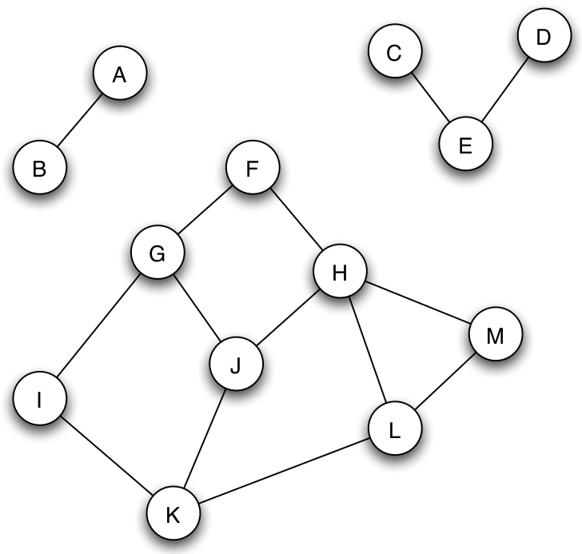
Review: Adjacency Matrix
N(v) pre-calc
 | A | B | C | D | E | F | G | H | I | J | K | L | M
A | 0 | 1 | 0 | …
B | 1 | 0 | 0 | …
C | 0 | 0 | ... |  | 1
D | … | … |  |  | 1
E |  |  | 1 | 1
F |  |  |  |  |  |  | 1 | 1
G |  |  |  |  |  | 1 |  |  | 1 | 1
H |  |  |  |  |  | 1 |  |  |  | 1 |  |  | 1
I |  |  |  |  |  |  | 1 |  |  |  | 1
J |  |  |  |  |  |  | 1 | 1 |  |  | 1
K |  |  |  |  |  |  |  |  | 1 | 1 |  | 1
L |  |  |  |  |  |  |  |  |  |  | 1 |  | 1
M |  |  |  |  |  |  |  | 1 |  |  |  | 1

Slide 12
Background: Pearson Correlation
How related are variables X and Y?
+1: positively related
0: not related
-1: inversely related
How to calculate it (for a sample)?
covariance of X and Y
mean value of Y sample
standard deviation of Y sample

Slide 13
CONCOR Intuition
In a partition, nodes are similar (w.r.t. edges)
Find similar nodes via correlation
Pattern of edges: adjacency matrix
2D adjacency matrix -> 2D correlation matrix
Iterate!... Will become stable…

Slide 14
Iterated Correlation Matrices
A
 | A | B | C | D | E | F | G | H | I | J | K | L | M
A | 0 | 1 | 0 | 0 | 0 | 0 | 0 | 0 | 0 | 0 | 0 | 0 | 0
B | 1 | 0 | 0 | 0 | 0 | 0 | 0 | 0 | 0 | 0 | 0 | 0 | 0
C | 0 | 0 | 0 | 0 | 1 | 0 | 0 | 0 | 0 | 0 | 0 | 0 | 0
D | 0 | 0 | 0 | 0 | 1 | 0 | 0 | 0 | 0 | 0 | 0 | 0 | 0
E | 0 | 0 | 1 | 1 | 0 | 0 | 0 | 0 | 0 | 0 | 0 | 0 | 0
F | 0 | 0 | 0 | 0 | 0 | 0 | 1 | 1 | 0 | 0 | 0 | 0 | 0
G | 0 | 0 | 0 | 0 | 0 | 1 | 0 | 0 | 1 | 1 | 0 | 0 | 0
H | 0 | 0 | 0 | 0 | 0 | 1 | 0 | 0 | 0 | 1 | 0 | 0 | 1
I | 0 | 0 | 0 | 0 | 0 | 0 | 1 | 0 | 0 | 0 | 1 | 0 | 0
J | 0 | 0 | 0 | 0 | 0 | 0 | 1 | 1 | 0 | 0 | 1 | 0 | 0
K | 0 | 0 | 0 | 0 | 0 | 0 | 0 | 0 | 1 | 1 | 0 | 1 | 0
L | 0 | 0 | 0 | 0 | 0 | 0 | 0 | 0 | 0 | 0 | 1 | 0 | 1
M | 0 | 0 | 0 | 0 | 0 | 0 | 0 | 1 | 0 | 0 | 0 | 1 | 0
C⁽⁰⁾
 | A | B | C | D | E | F | G | H | I | J | K | L | M
A | 1.00 | -0.08 | -0.08 | -0.08 | -0.12 | -0.12 | -0.16 | -0.16 | -0.12 | -0.16 | -0.16 | -0.12 | -0.12
B | -0.08 | 1.00 | -0.08 | -0.08 | -0.12 | -0.12 | -0.16 | -0.16 | -0.12 | -0.16 | -0.16 | -0.12 | -0.12
C | -0.08 | -0.08 | 1.00 | 1.00 | -0.12 | -0.12 | -0.16 | -0.16 | -0.12 | -0.16 | -0.16 | -0.12 | -0.12
D | -0.08 | -0.08 | 1.00 | 1.00 | -0.12 | -0.12 | -0.16 | -0.16 | -0.12 | -0.16 | -0.16 | -0.12 | -0.12
E | -0.12 | -0.12 | -0.12 | -0.12 | 1.00 | -0.18 | -0.23 | -0.23 | -0.18 | -0.23 | -0.23 | -0.18 | -0.18
F | -0.12 | -0.12 | -0.12 | -0.12 | -0.18 | 1.00 | -0.23 | -0.23 | 0.41 | 0.78 | -0.23 | -0.18 | 0.41
G | -0.16 | -0.16 | -0.16 | -0.16 | -0.23 | -0.23 | 1.00 | 0.57 | -0.23 | -0.30 | 0.57 | -0.23 | -0.23
H | -0.16 | -0.16 | -0.16 | -0.16 | -0.23 | -0.23 | 0.57 | 1.00 | -0.23 | -0.30 | 0.13 | 0.27 | -0.23
I | -0.12 | -0.12 | -0.12 | -0.12 | -0.18 | 0.41 | -0.23 | -0.23 | 1.00 | 0.78 | -0.23 | 0.41 | -0.18
J | -0.16 | -0.16 | -0.16 | -0.16 | -0.23 | 0.78 | -0.30 | -0.30 | 0.78 | 1.00 | -0.30 | 0.27 | 0.27
K | -0.16 | -0.16 | -0.16 | -0.16 | -0.23 | -0.23 | 0.57 | 0.13 | -0.23 | -0.30 | 1.00 | -0.23 | 0.27
L | -0.12 | -0.12 | -0.12 | -0.12 | -0.18 | -0.18 | -0.23 | 0.27 | 0.41 | 0.27 | -0.23 | 1.00 | -0.18
M | -0.12 | -0.12 | -0.12 | -0.12 | -0.18 | 0.41 | -0.23 | -0.23 | -0.18 | 0.27 | 0.27 | -0.18 | 1.00
C^{(t)}
 | A | B | C | D | E | F | G | H | I | J | K | L | M
A | 1 | 1 | 1 | 1 | 1 | -1 | 1 | 1 | -1 | -1 | 1 | -1 | -1
B | 1 | 1 | 1 | 1 | 1 | -1 | 1 | 1 | -1 | -1 | 1 | -1 | -1
C | 1 | 1 | 1 | 1 | 1 | -1 | 1 | 1 | -1 | -1 | 1 | -1 | -1
D | 1 | 1 | 1 | 1 | 1 | -1 | 1 | 1 | -1 | -1 | 1 | -1 | -1
E | 1 | 1 | 1 | 1 | 1 | -1 | 1 | 1 | -1 | -1 | 1 | -1 | -1
F | -1 | -1 | -1 | -1 | -1 | 1 | -1 | -1 | 1 | 1 | -1 | 1 | 1
G | 1 | 1 | 1 | 1 | 1 | -1 | 1 | 1 | -1 | -1 | 1 | -1 | -1
H | 1 | 1 | 1 | 1 | 1 | -1 | 1 | 1 | -1 | -1 | 1 | -1 | -1
I | -1 | -1 | -1 | -1 | -1 | 1 | -1 | -1 | 1 | 1 | -1 | 1 | 1
J | -1 | -1 | -1 | -1 | -1 | 1 | -1 | -1 | 1 | 1 | -1 | 1 | 1
K | 1 | 1 | 1 | 1 | 1 | -1 | 1 | 1 | -1 | -1 | 1 | -1 | -1
L | -1 | -1 | -1 | -1 | -1 | 1 | -1 | -1 | 1 | 1 | -1 | 1 | 1
M | -1 | -1 | -1 | -1 | -1 | 1 | -1 | -1 | 1 | 1 | -1 | 1 | 1
C⁽¹⁾
 | A | B | C | D | E | F | G | H | I | J | K | L | M
A | 1.00 | -0.08 | -0.08 | -0.08 | -0.12 | -0.12 | -0.16 | -0.16 | -0.12 | -0.16 | -0.16 | -0.12 | -0.12
B | -0.08 | 1.00 | -0.08 | -0.08 | -0.12 | -0.12 | -0.16 | -0.16 | -0.12 | -0.16 | -0.16 | -0.12 | -0.12
C | -0.08 | -0.08 | 1.00 | 1.00 | -0.12 | -0.12 | -0.16 | -0.16 | -0.12 | -0.16 | -0.16 | -0.12 | -0.12
D | -0.08 | -0.08 | 1.00 | 1.00 | -0.12 | -0.12 | -0.16 | -0.16 | -0.12 | -0.16 | -0.16 | -0.12 | -0.12
E | -0.12 | -0.12 | -0.12 | -0.12 | 1.00 | -0.18 | -0.23 | -0.23 | -0.18 | -0.23 | -0.23 | -0.18 | -0.18
F | -0.12 | -0.12 | -0.12 | -0.12 | -0.18 | 1.00 | -0.23 | -0.23 | 0.41 | 0.78 | -0.23 | -0.18 | 0.41
G | -0.16 | -0.16 | -0.16 | -0.16 | -0.23 | -0.23 | 1.00 | 0.57 | -0.23 | -0.30 | 0.57 | -0.23 | -0.23
H | -0.16 | -0.16 | -0.16 | -0.16 | -0.23 | -0.23 | 0.57 | 1.00 | -0.23 | -0.30 | 0.13 | 0.27 | -0.23
I | -0.12 | -0.12 | -0.12 | -0.12 | -0.18 | 0.41 | -0.23 | -0.23 | 1.00 | 0.78 | -0.23 | 0.41 | -0.18
J | -0.16 | -0.16 | -0.16 | -0.16 | -0.23 | 0.78 | -0.30 | -0.30 | 0.78 | 1.00 | -0.30 | 0.27 | 0.27
K | -0.16 | -0.16 | -0.16 | -0.16 | -0.23 | -0.23 | 0.57 | 0.13 | -0.23 | -0.30 | 1.00 | -0.23 | 0.27
L | -0.12 | -0.12 | -0.12 | -0.12 | -0.18 | -0.18 | -0.23 | 0.27 | 0.41 | 0.27 | -0.23 | 1.00 | -0.18
M | -0.12 | -0.12 | -0.12 | -0.12 | -0.18 | 0.41 | -0.23 | -0.23 | -0.18 | 0.27 | 0.27 | -0.18 | 1.00
+1, -1: Two communities!

Slide 15
CONCOR Summary
Node similarity by correlation
Iterate to stability, bisect graph
Repeat!
Issues:
Meaningful bisection?
How many bisections?

Slide 16
Edge Removal: Girvan-Newman Method

Slide 17
Edge Removal (Girvan-Newman 2002)
Local bridges connect weakly interacting parts of network
Remove local bridges (weak ties)!
Questions:
Many bridges?
No bridges?
Betweenness
(Or centrality, etc.)

Slide 18
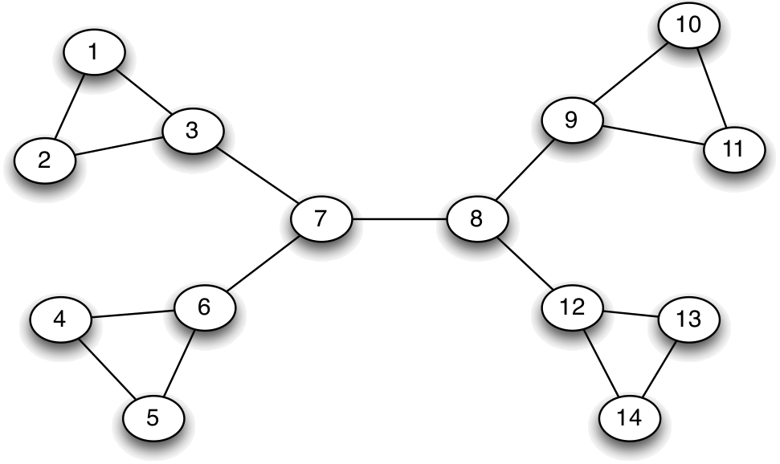
Edge Removal: Betweenness
The flow between v and u is 1
Divide flow between shortest paths
Dfn: The betweenness of edge e is the total flow for all pairs.

Slide 19
Individual Exercise:
What is the betweenness for
Edge 7-8?
Edge 8-9?

Slide 20
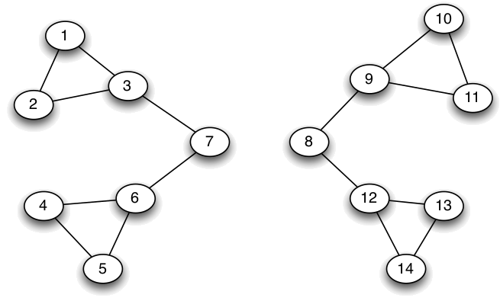
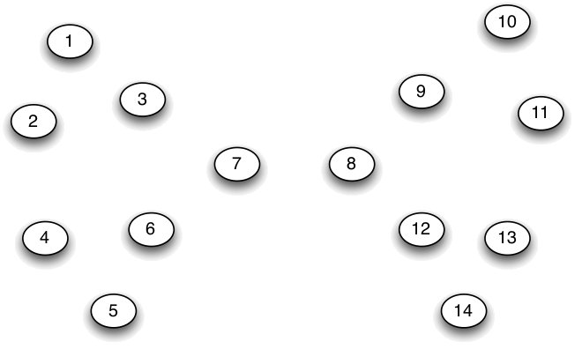
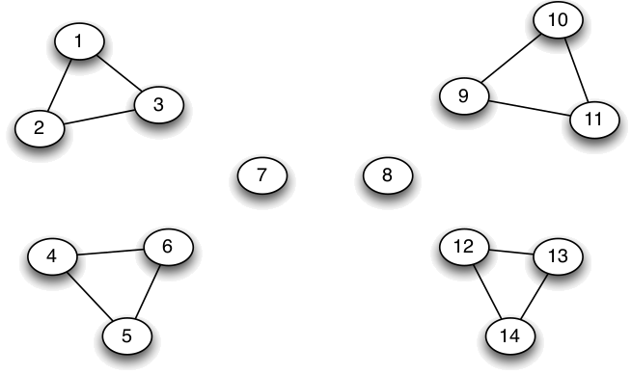
Girvan-Newman Method
Calculate betweenness of all edges
Cut (remove max betweenness)
Repeat!

Slide 21
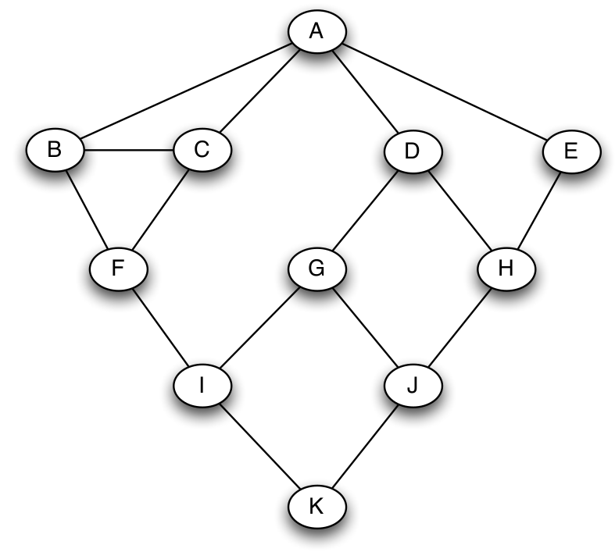
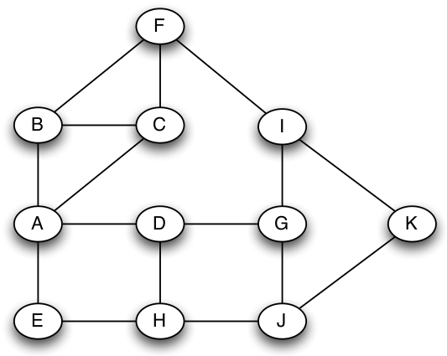
Computing Betweenness E&K 3.6.B
BFS from v

Slide 22
Computing Betweenness E&K 3.6.B
BFS from v
# shortest paths from v to each node
1
1
1
1
2
1
2
3
3
6

Slide 23
Computing Betweenness E&K 3.6.B
Repeat for each
node (not just A)
Sum flow on an edge
BFS from each v
# shortest paths from v to each node
Propagate flow
2
2
4
2
1
1
1
1
Flow +1
Flow +1
Flow +1
Flow +1
1
1
2
1
1
2
1
2
Flow +1
Flow +1
Flow +1
1
1/2
1/2
1
3
3
Flow +1
Flow +1
1/2
1/2
6
Flow +1
A. Count flow from below + 1 at each node
B. Split flow up among parent nodes
according to # of shortest paths

Slide 24
Girvan-Newman Method
Calculate betweenness of all edges
Cut (remove max betweenness)
Repeat!
When do
we stop???

Slide 25
Modularity (Stopping Criterion)
Intuition: More edges inside a community than random chance
the community v and u are assigned to; 1 if equal
1_{v,u} = 1 if there is an edge v, u
divide over all edges m
Expected edges in a random version (preview)

Slide 26
Edge removal summary
Remove edges
E.g., pick by betweenness
This bisects the graph
Modularity as stopping criterion
In practice:
Ok for several thousand nodes
Bigger – need to approximate betweenness

Slide 27
Today…
Hierarchical clustering
Stochastic Block Models
Brief review of probability theory

Slide 28
Intuition: Hierarchical Clustering
Node similarity (distance) metric
Find communities on blank nodes
Apply threshold t₀ and add edges
Draw graph of communities G^{(t0)}
Community = Component of G^{(t0)}
Decrease (increase) threshold & repeat, yielding G^{(tn+1)}

Slide 29
Group Discussion:
How would you calculate/represent the similarity between two friends to get:
a) Clusters in which friends who know each other are close
b) Clusters like a), but take ethnic group into account

Slide 30
Hier. Clustering Example (1)
exclude
2 nodes
Node distance: Manhattan distance
 | 1 | 2 | 3 | 4 | 5 | 6 | 7 | 8 | 9 | 10
1 | 1 | 1 | 1 | 1 | 0 | 0 | 0 | 0 | 0 | 0
2 | 1 | 1 | 1 | 0 | 0 | 0 | 0 | 0 | 0 | 0
3 | 1 | 1 | 1 | 0 | 0 | 0 | 0 | 0 | 0 | 0
4 | 1 | 0 | 0 | 1 | 1 | 0 | 0 | 0 | 0 | 0
5 | 0 | 0 | 0 | 1 | 1 | 1 | 0 | 0 | 0 | 0
6 | 0 | 0 | 0 | 0 | 1 | 1 | 1 | 0 | 1 | 0
7 | 0 | 0 | 0 | 0 | 0 | 1 | 1 | 1 | 1 | 0
8 | 0 | 0 | 0 | 0 | 0 | 0 | 1 | 1 | 1 | 0
9 | 0 | 0 | 0 | 0 | 0 | 1 | 1 | 1 | 1 | 0
10 | 0 | 0 | 0 | 0 | 0 | 0 | 0 | 0 | 0 | 1
7
8
6
5
9
10
3
1
4
2
G
G⁽⁰⁾
Π⁽⁰⁾
A
Distance = 0

Slide 31
Hier. Clustering Example (2)
exclude
2 nodes
Node distance: Manhattan distance
 | 1 | 2 | 3 | 4 | 5 | 6 | 7 | 8 | 9 | 10
1 | 1 | 1 | 1 | 1 | 0 | 0 | 0 | 0 | 0 | 0
2 | 1 | 1 | 1 | 0 | 0 | 0 | 0 | 0 | 0 | 0
3 | 1 | 1 | 1 | 0 | 0 | 0 | 0 | 0 | 0 | 0
4 | 1 | 0 | 0 | 1 | 1 | 0 | 0 | 0 | 0 | 0
5 | 0 | 0 | 0 | 1 | 1 | 1 | 0 | 0 | 0 | 0
6 | 0 | 0 | 0 | 0 | 1 | 1 | 1 | 0 | 1 | 0
7 | 0 | 0 | 0 | 0 | 0 | 1 | 1 | 1 | 1 | 0
8 | 0 | 0 | 0 | 0 | 0 | 0 | 1 | 1 | 1 | 0
9 | 0 | 0 | 0 | 0 | 0 | 1 | 1 | 1 | 1 | 0
10 | 0 | 0 | 0 | 0 | 0 | 0 | 0 | 0 | 0 | 1
7
8
6
5
9
10
3
1
4
2
G⁽⁰⁾
G⁽¹⁾
Π⁽¹⁾
A
Distance = 1

Slide 32
Individual exercise:
What is Π⁽²⁾?
 | 1 | 2 | 3 | 4 | 5 | 6 | 7 | 8 | 9 | 10
1 | 1 | 1 | 1 | 1 | 0 | 0 | 0 | 0 | 0 | 0
2 | 1 | 1 | 1 | 0 | 0 | 0 | 0 | 0 | 0 | 0
3 | 1 | 1 | 1 | 0 | 0 | 0 | 0 | 0 | 0 | 0
4 | 1 | 0 | 0 | 1 | 1 | 0 | 0 | 0 | 0 | 0
5 | 0 | 0 | 0 | 1 | 1 | 1 | 0 | 0 | 0 | 0
6 | 0 | 0 | 0 | 0 | 1 | 1 | 1 | 0 | 1 | 0
7 | 0 | 0 | 0 | 0 | 0 | 1 | 1 | 1 | 1 | 0
8 | 0 | 0 | 0 | 0 | 0 | 0 | 1 | 1 | 1 | 0
9 | 0 | 0 | 0 | 0 | 0 | 1 | 1 | 1 | 1 | 0
10 | 0 | 0 | 0 | 0 | 0 | 0 | 0 | 0 | 0 | 1
7
8
6
5
9
10
3
1
4
2

Slide 33
Hier. Clustering Example (3)
exclude
2 nodes
Node distance: Manhattan distance
 | 1 | 2 | 3 | 4 | 5 | 6 | 7 | 8 | 9 | 10
1 | 1 | 1 | 1 | 1 | 0 | 0 | 0 | 0 | 0 | 0
2 | 1 | 1 | 1 | 0 | 0 | 0 | 0 | 0 | 0 | 0
3 | 1 | 1 | 1 | 0 | 0 | 0 | 0 | 0 | 0 | 0
4 | 1 | 0 | 0 | 1 | 1 | 0 | 0 | 0 | 0 | 0
5 | 0 | 0 | 0 | 1 | 1 | 1 | 0 | 0 | 0 | 0
6 | 0 | 0 | 0 | 0 | 1 | 1 | 1 | 0 | 1 | 0
7 | 0 | 0 | 0 | 0 | 0 | 1 | 1 | 1 | 1 | 0
8 | 0 | 0 | 0 | 0 | 0 | 0 | 1 | 1 | 1 | 0
9 | 0 | 0 | 0 | 0 | 0 | 1 | 1 | 1 | 1 | 0
10 | 0 | 0 | 0 | 0 | 0 | 0 | 0 | 0 | 0 | 1
7
8
6
5
9
10
3
1
4
2
G⁽²⁾
G⁽¹⁾
Π⁽²⁾
A
Distance = 2

Slide 34
Cluster Dendrogram
Clusters merge over time
Issues:
When do you stop?
(Just report the tree? Stopping criteria?)
Ignoring structure of G^{(t)}

Slide 35
Stochastic Block Models
Clusters
Probabilities!

Slide 36
Generative vs. Discriminative
Given network G, find best partition Π*
Π* = max P(Π | G)
Π
Generative Models
Discriminative Models
Use Bayes’ Rule
P(Π | G) = P(G | Π) ·P(Π) / P(G)
Model the generation of G
Estimate parameters for the model from data
Directly calculate
P(Π | G)
Discriminate between possible Π values
Define features, find patterns implying Π

Slide 37
General formulation
prob. of edges observed in G
possible partition
likelihood function;
i.e., prob. assuming params η
parameters: probabilities of edges
prob. of not producing edges (that weren’t observed in G)
1 prob. per i,j pair!
TOO ABSTRACT!

Slide 38
Think-Pair-Share:
Why do we care about defining the likelihood?
Choose the best model parameters!

Slide 39
Simplify: In- or Out-block
General: η → 1 prob per i,j pair
Copic/Jackson/Kirman: η → p_{in}, p_{out}
P_{in}: prob. of link within community
P_{out}: prob. of link outside community
pairs in same community
# links in communities under Π

Slide 40
Maximum Likelihood Algorithm
i and j within community
i and j not in community
Take log of both sides… rearrange…
Simple calculation: # pairs in communities
# links in communities

Slide 41
Implementing ML: Issues
Estimate p_{in} and p_{out} alongside Π
Solution: Pick p_{in} and p_{out}, build Π, then estimate p_{in} and p_{out}… iterate!
Exponential blowup of possible Π… can’t test all
Solution: Approximate which Π to explore

Slide 42
Latent Space Estimation
Copic/Jackson/Kirman: η → p_{in}, p_{out}
Other bases for probabilities?
Define space S
Any info about nodes, links, groups!
L(G | S)

