Slide 1
RECONNAISSANCE

Slide 2
RECONNAISSANCE
During the Reconnaissance phase, the attacker gathers information from public sources to learn about the target
People and culture
Terminology
Technical infrastructure
IT is recommend allocating at least one staff day to recon, and more if the budget allows

Slide 3
RECONNAISSANCE
To be successful at reconnaissance, you must have a strategy
Active reconnaissance
includes interacting directly with the target
Passive reconnaissance
we are not interacting directly with the target

Slide 4
Maintain Inventory
As you discover targets during a test , make sure you add them to an inventory
Update the inventory of targets as you learn more about them
Use a spreadsheet , with one line per target
Plus , one additional page per target with significant findings
IP Addr | Name | OS | How Discovered | Port | Known Vulns | Admin Accts/passwds | Other Accts/Passwds | Misc notes

Slide 5
Inventory - How Discovered
The "How Discovered" column is vital to make your work understandable and reproducible
Possible methods of discovery include:
Revealed by target organization personnel
Discovered by Google search
Discovered by DNS Zone Transfer
Discovered by DNS reverse lookups
Discovered during network sweep: ICMP type, TCP port(s), UDP port(s)
Discovered during wireless assessment or physical assessment
Discovered by compromise of one host, allowing scans to find other targets
Numerous other methods

Slide 6
Gather Competitive Intelligence
Using search engines, determine target organization's:
Major businesses
Major products or services
Corporate officers and other VIPs
Major competitors
Physical locations
Recent press releases

Slide 7
Using Search Engines to Discover Targets
First , look for company name in search engines, such as Google
Discovering domain names of potential target machines
Then, use the “site:” directives to find additional targets
The – (minus) operator can be used to tell Google to omit certain items from search results
Then you can pare down the results and learn of additional targets

Slide 8
Google Hacking
Google Directives
To properly use a Google directive, you need three things:
the name of the directive you want to use
A colon
the term you want to use in the directive
Example
site:aau.edu.et
Site:aau.edu.et –mail.aau.edu.et

Slide 9
Google Dork
Go to http://exploit-db.com/google-dorks
Choose a query. Here is a random entry:
intitle:Admin inurl:login.php site:.co.in
Enter it into Google.com with the following modifications
inurl:login site:aau.edu.et

Slide 10
Inventory of Discoverable Flaws Via Google
"GoogleDorks" individually, or the Google Hacking Database (GHDB) collectively has over 1,000 entries in this database in the following
categories:
Advisories and vulnerabilities - Network or vuln data
Error messages - Sensitive directories
Files containing juicy info - Sensitive on-line shopping info
Files containing passwords - On-line devices
Files containing usernames - Vulnerable files
Footholds - Vulnerable servers
Login portals - Web server version detection

Slide 11
Google directives
intitle, allintitle
inurl, allinurl
filetype
allintext
site
link
inanchor
daterange
cache
info
numrange
related
phonebook
rphonebook
bphonebook
author
group
msgid
insubject
stocks
define

Slide 12
Google directives
site: search only for pages that are hosted on a specific server or in a specific domain
Inurl and Allinurl: finds a text in the URL
Intitle and Allintitle: Search Within the Title of a Page
Allintext: Locate a String within the Text of a Page
Filetype: Search a Specific Files Type (pdf,doc…)
Link: Search for Links to a Page
Inanchor: Locate Text Within Link Text
Cache: Show the Cached Version of a Page
There are a lot of Google directives

Slide 13
Google Search Operators
Google searches are not case sensitive
For literal matching, use double quotes"
Example: “addis ababa"...
Use a * to indicate a wildcard string in part of the literal
Example: "Windows * buffer overflow"
To filter out pages with info you don't want, use minus (-) for unwanted terms
Example: site:aau.edu.et -mail.aau.edu.et
To force Google to search for common words (called stop
words) omitted from searches by default, use +
a, and, where, the, how...

Slide 14
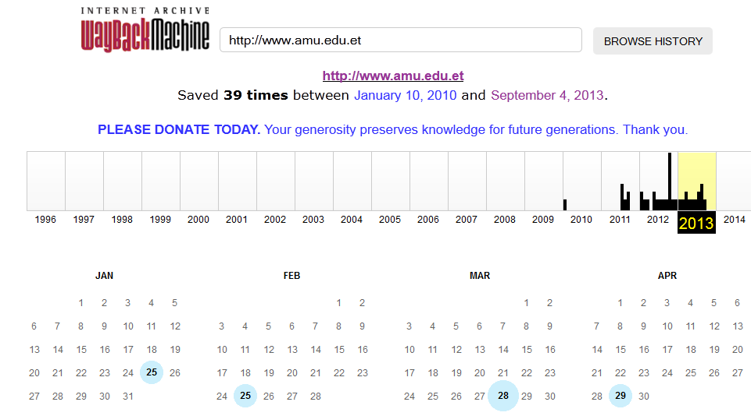
Looking at older Versions of Websites
You can view earlier versions of a website using wayback machines at web.archive.org

Slide 15
Look for Open Job Requisition
Job requisitions can help us get information about the
information technology products used in a target organization
Web server type
Web application dev environment
Firewall type
Routers
Google searches to find job reqs:
Also, searches of job-related sites:
www.ethiojobs.com - Search on
www.employethiopia.com

Slide 16
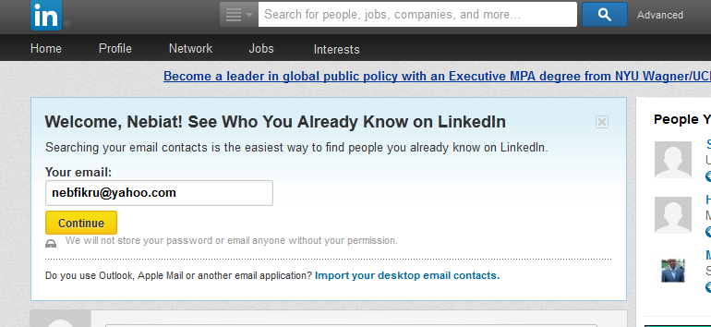
Searching for Relevant People
Social Networking Sites
Look up target
Organization’s name
LinkedIn
Facebook
MySpace
Twitter
Yahoo people search:
People.yahoo.com
Google phonebook
Phonebook: [name] [state]

Slide 17
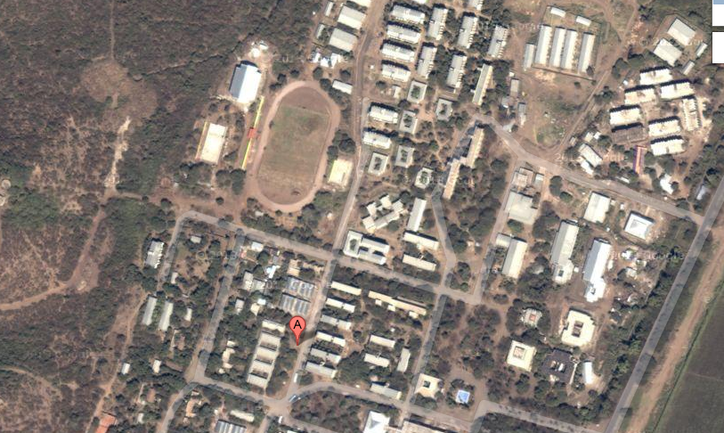
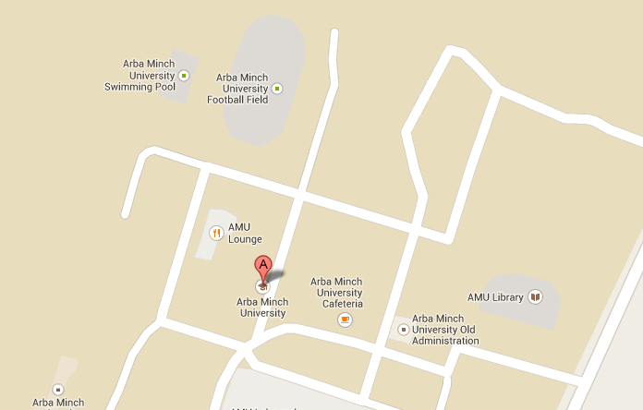
Searching for Maps
Use mapping sites such as maps.google.com to help plan physical tests and wireless assessments

Slide 18
Discovering and leveraging e-mail addresses
The Harvester: catalog both e-mail addresses and subdomains that are directly related to our target
theHarvester –d syngress.com –l 10 –b google
-d domain
-l limit number of results
-b public repository (google, bing, PGP,LinkedIn..)
http://groups.google.com

Slide 19
Discovering and leveraging e-mail addresses ….
E-mail servers can provide a wealth of information for hackers and penetration testers
Assuming your target is hosting their own e-mail server, this is often a great place to attack
remember, “You can’t block what you must let in.”
gather significant pieces of information by interacting directly with the e-mail sever
Eg. send blank exe file and see who the mail server responds and gather the information

Slide 20
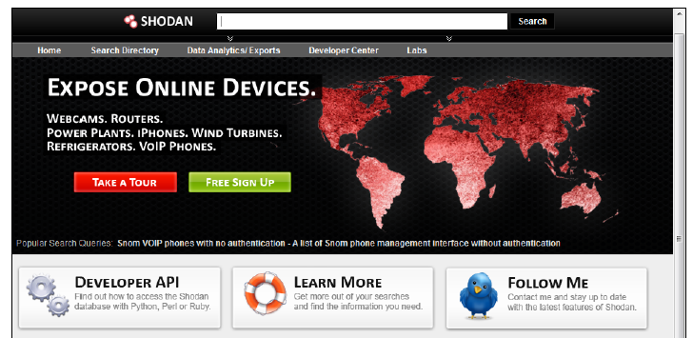
SHODAN
It is a search engine specialized in indexing the information found in banners served by devices attached to the Internet
indexes finding from HTTP,Telnet, SSH, and FTP banners http://www.shodan.io
With Shodan you can find information on devices connected to the Internet

Slide 21
SHODAN
Rather than to locate specific content on a particular search term, SHODAN is designed to help the user find specific nodes (desktops, servers, routers, switches, etc.) with specific content in their banners
Optimizing search results requires some basic knowledge of banners

Slide 22
SHODAN
BASIC OPERATIONS

Slide 23
SHODAN
BASIC OPERATIONS
Search terms are entered into a text box (seen below)
Quotation marks can narrow a search
Boolean operators + and –can be used to include and exclude query terms (+ is implicit default)

Slide 24
SHODAN
Basic Operations: Login
Create and login using a SHODAN account; or
Login using one of several other options (Google, Twitter, Yahoo, AOL, Facebook, OpenID
Login is not required, but country and netfilters are not available unless you login
Export requires you to be logged in

Slide 25
SHODAN
Basic Operations: Login

Slide 26
SHODAN
Basic Operations: Filters
country: filters results by two letter country code
hostname: filters results by specified text in the hostname or domain
net: filter results by a specific IP range or subnet
os: search for specific operating systems
port: narrow the search for specific services
Version: provides the version of the system/device

Slide 27
SHODAN:Examples
apache countrty:et finds all ‘apache’ servers in Ethiopia
apache hostname:.aait.edu.et finds ‘apache’ servers in .aait.edu.et domain
Iis-5.0 hostname:.edu finds ‘iis-5.0’ servers in .edu domain
The ‘default password’ locates servers that have those words in the banner
webcamxp city:new york
webcamxp geo:-37.81,144.96
searches for internet enables webcams ( there mant types of webcams such as webcamXP, Axis,Sony …)

Slide 28
DNS recon
Domain Name System (DNS) can provide valuable data during the reconnaissance phase
the information you are able to gather includes:
CNAME: Alias, used to tie many names to a single IP
A : Used to translate a domain or subdomain name
to IP address. It can also store additional useful information.
MX :Ties a domain name to associated mail servers
NS: Nameserver record
RP: responsible person record
PTR: Pointer for inverse lookups record
And other …
Notes:
“if it isn’t broke, don’t touch it”

Slide 29
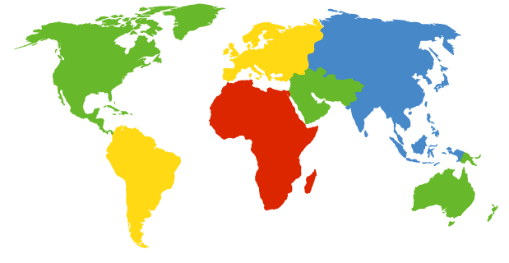
DNS DB
DNS: a distributed, hierarchical database the information you are able to gather includes:
client wants IP for www.mekina.com
Root DNS Servers
com DNS servers
org DNS servers
edu DNS servers
yahoo.com
DNS servers
pbs.org
DNS servers
poly.edu
DNS servers
umass.edu
DNS servers
amazon.com
DNS servers
Notes:
13 root name “servers” worldwide

Slide 30
Nslookup
nslookup is a DNS querying tool that can be used to resolve IP addresses from domain names or vice versa.
# nslookup example.com
Server: 8.8.8.8
Address: 8.8.8.8#53
Non-authoritative answer:
Name: example.com
Address: 127.1.72.107

Slide 31
Using nslookup Interactively
Within nslookup interactive mode , we can :
Resolve individual name or IP address
> [name or IP]
Use different DNS server
> server [server IP or name]
Choose record type
>set type=[record type]
Perform a zone transfer of all records for a given domain
>ls –d [domain]> [file_name]
View file
>view [file_name]

Slide 32
Nslookup Recurse vs. Norecurse
If a DNS server does not have the information we request, it can forward that request to other DNS servers to retrieve the information in a process known as a recursive lookup.
By default, nslookup will ask for recursion from the name servers it queries
The nslookup command can be configured to create queries that do not request recursion using the "set norecurse" syntax,
This technique is “DNS cache snooping”
Notes:
we can determine the records that a DNS server has loaded in its
cache. We are given back a set of root name servers, implying that the name
server didn't have the information we requested

Slide 33
Domain Information Groper (Dig)
Another great tool for extracting information from DNS is “dig.”
# dig example.com
; <<>> DiG 9.7.0-P1 <<>> example.com
;; global options: +cmd
;; Got answer:
;; ->>HEADER<<- opcode: QUERY, status: NOERROR, id: 56376
;; flags: qr rd ra; QUERY: 1, ANSWER: 1, AUTHORITY: 0, ADDITIONAL: 0
;; QUESTION SECTION:
;example.com. IN A
;; ANSWER SECTION:
example.com. 78294 IN A 10.1.1.1
;; Query time: 32 msec
;; SERVER: 8.8.8.8#53(8.8.8.8)
;; WHEN: Sun *** * **:**:** ****
;; MSG SIZE rcvd: 45
dig –x [IP Address] ➔reverse loook up
Dig @[server] VERSION.BIND ➔ bind version

Slide 34
Zone transfers using Dig
Zone transfers (AXFR) will allow you to pull an entire record set down from a nameserver at once.
If successful, you will be provided with a listing of all information on the nameserver
# dig @[server] [name] –t axfr
# dig @ns1.example.com example.com axfr
; (1 server found)
;; global options: +cmd
; Transfer failed.
Zone transfers are disabled on it
try another nameserver on the same domain and see if zone transfers are disabled on it as well
Use +recursive or +norecursive to toggle on/off recursion
Notes:
It is very important that all of your nameservers are restricted
to serving zone transfers to only trusted servers, or that zone
transfers are completely disallowed.

Slide 35
DNS brute forcing (fierce)
In a secured environment DNS brute forcing is likely to be your best gamble in determining which hosts are used in non-contiguous IP spaces. fierce, is best for this purpose
It begin with determining the IP address of the domain, looking up the associated nameservers, and then use dictionary word list.
# cd /usr/share/wordlist/dirb
# fierce -dns example.com –dnsserver [server]
# fierce -dns example.com –wordlist file
The default wordlist is on the file hosts.txt in /fierce directory
Notes:
locate the nameservers, check the server to see if a zone transfer can be performed, wl➔ irc
mail
mail1
testmachine1
testmachine
www
www1
ns

Slide 36
DNS Query Websites
Numerous websites support DNS lookups
One of the best is DNSstuff.com at
http://member.dnsstuff.com/pages/tools.php
Free lookups of various kinds
Commercial subscriptions for unlimited access
Tools include: DNS lookup, DNS cache, Whois, lookup, IP country lookup, URL Deobfuscator, Traceroute
Notes:
Pase dnsstuff page

Slide 37
Whois Searches
Next, we can query various registrars to determine information about the target's Internet gateways
Information is stored in Whois databases distributed around the world
Web-based front-end on many whois sites
we usually do not know the particular registrar in advance used to register the target domain
Start with InterNIC
Then, explore individual registrar for more details

Slide 38
InterNIC
Surf internic.net perform a search on the target domain
The result shows:
Date when the domain is registered, updated , and expires
The registrar
The name, phone, postal number , address and email address of the registrant , Admin, the Tech contact for the domain

Slide 39
Whois at the Command Line
Built-into most Linux and Unixes
$ whois [-h whois_server] name
Some whois clients go to a pre-configured default server, such as whois.internic.net (as set in /etc/jwhois.conf)
For others, if a whois server isn't provided, whois takes the top-level domain from search name, and appends .whoisservers.net for a whois server
Example:
whois # whois -h whois.arin.net google.com | grep Country

Slide 40
IP Address Assignment Whois Databases
Several Regional Internet Registries offer whois databases that store information about IP Address block assignments
Provide a company name or domain name, and they tell you if there is an address range officially assigned to it
IPv4 and IPv6 address assignment and CIDR block
Autonomous System (AS) number assignment
DNS information
Not all organizations have their own IP address blocks
Many get them from their ISP
Thus, you may get:
An actual assignment of addresses
Nothing at all
A huge address space, far bigger than that allotted to this one organization (you are likely seeing whole ISP)

Slide 41
IP Address Block Assignments
These databases are associated with a particular geography
Regional Internet Registries
ARIN (www.arin.net): North America
RIPE NCC (wwwi-ipe.net): Europe, Middle East, Central Asía
APNIC (www.apnic.net): Asia and Pacific region
LACNIC (www.lacnic.net): Latin America and Caribbean
AfriNIC (www.afrinicnet): Africa

Slide 42
Other web-based whois sources
http://www.netcraft.com
www.samspade.org
www.geektools.com
www.whois.net
www.whois.domaintools.com
www.selfseo.com/find_ip_address_of_a_website.php

Slide 43
HOST Command
Oftentimes, our reconnaissance efforts will result in host names rather than IP addresses. When this occurs, we can use the “host” tool to perform a translation for us.
host [host_name]
#host –t ns aait.edu.et
It can be used inreverse
#host –l aait.edu.et 10.5.10.6

Slide 44
Recon-ng
Recon-ng is a full featured reconnaissance web framework.
To show all available nodules
show modules
To use a module the syntax is :
use recon/$catagory/$module
use recon/domains-hosts/hackertarget
show options – then set the values
Show Keys shows API- keys for apps

Slide 45
Recon-ng::show,use,options
show command :shows the list of modules( scripts) available in recon-ng
To use a module the syntax is:
use recon/$category/$module
Eg: use recon/domains-hosts/hackertarget
show options : shows the option we have to setup for the module selected
Then, set assigns the values for the particular option
Eg: set SOURCE aait.edu.et
Then use run to execute the module against the options

Slide 46
Recon-ng::Add API keys to Recon-ng, workspace
keys add shodan_api insert shodan api key here
Show keys – displays the list of keys
keys delete shodan_api: deletes keys associated with shodan
workspaces add aait : adds workspace named aait
workspaces list: list the currently configured workspaces by typing the following:
workspaces select aait: selects the workspace
workspaces delete aait :deletes a workspace,

Slide 47
Recon-ng:: Adding Information to a Workspace
add domains aait.edu.et: add the domains for the workspace
command show domains to see what domains exist in your current workspace.
Using Modules to Search for Contacts:
use recon/domains-contacts/pgp_search
show info displays info of what the module does.
To run the module, simply type run.
It auto populates the data from its findings in the contacts table for us
Let’s see everything the module was able to find with the show contacts command.
Use also the module recon/domains-contacts/whois_pocs.

Slide 48
Recon-ng::Add API keys to Recon-ng,
Visit https://github.com/Raikia/Recon-NG-API-Key-Creation/blob/master/README-v4.8.3.md
Or Google recon-ng api keys
Then you will find a list of how-to s of api keys for each sites in the recon-ng

Slide 49
Recon-ng::exercise
Search netcraft or shodan , then set the source as aau.edu.et
Search interesting_files on www.aait.edu.et
Search google_site_web on www.aait.edu.et

Slide 50
Maltego for Pen Testers
Built on concepts for transform
Take one piece of data and convert it to another through a lookup of some sort
over 50 different kinds of transform, such as: . Domain name to IP address (dns)
IP address to org name (neblock)
Org name to person’s name (whois)
person’s name PGP key (public key servers)
PGP key to person's name (who signed the key?)
person's name to phone numbers (phone lookup)

Slide 51
Metadata collection
Metadata is often defined as data about data
When document like Microsoft Word or a PowerPoint created , additional data is created and stored within your file including:
file name, the file size, the file owner or username of the person who created the file, and the location or path where the file was saved.
This process occurs automatically without any user interaction.
Eg Exif data associated with different image formats
camera type, when and where the photo was taken, much more.
Notes:
Metadata can provide very useful information to a penetration tester.Many users are not even aware that this information is being attached to their files

Slide 52
exiftool
extremely powerful tools to extract metadata of various files
#exiftool [file_name]
use a picture named FotoStation.jpg and included at /pentest/misc/exiftool/t/images
# exiftool t/images/FlashPix.ppt

Slide 53
mkdir –p /usr/share/metagoofil
Cd /root/Dowmnloads
Tar –xzf Image-exiftool …..gz –C /usr/share/metadat
Cd /usr/share/metadat

Slide 54
Strings
The strings command displays printable text from a file
Good for finding non-structured data or data for which you don't know the structure
By default, Linux strings command looks for ASCII strings only...
Can also be used to look for Unicode strings with the -e b or -e I –e S
#strings [file_name]

Slide 55
Metagoofil
Metagoofil, a powerful metadata gathering tool
can be used to automate search engine document retrieval and analysis
It provides MAC addresses, username listings, and more
# cd/pentest/enumeration/google/metagoofil
# ./metagoofil.py -d example.com -t doc,pdf -l 200 -n 50 –o examplefiles -f results.html

Slide 56
Metagoofil
./metagoofil.py -d aau.edu.et -t pdf –l 5 -n 2 –o aau –f aau.html
Cd /usr/share/metagoofil
Chmod +x metagoofil
./metagoofil

Slide 57
Installing Metagoofil
wget www.edge-security.com/soft/metagoofil-1.4b.tar mkdir -p /usr/share/metagoofil/ tar xf metagoofil-1.4b.tar –C /usr/share/metagoofil

Slide 58
Finishing the Recon Phase
Throughout the recon phase, a penetration tester should update the target inventory worksheet, as well as take detailed notes of useful information about potential vulnerabilities
At the end of the recon phase, a penetration tester should have a target inventory list
Possibly including system names, IP addresses, users associated with the target organization, lists of software in use at the target, and perhaps even vulnerabilities discovered through searches

Slide 59
Recon Exercise
Use a the skills and methods we have discussed so far to recon your targets

