Slide 1
URBAN DRAINAGE
Lecture 4 – Sanitary Appurtenances
Geremew Sahilu (PhD)

Slide 2
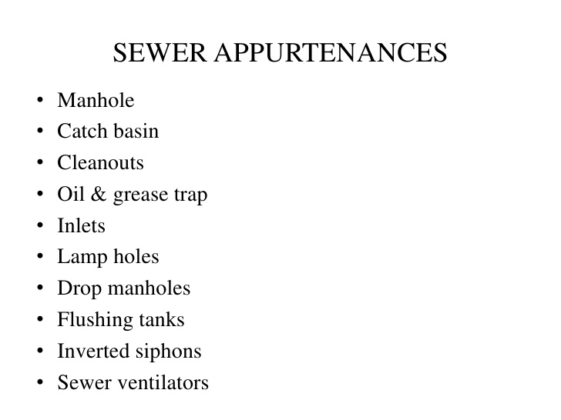

Slide 5
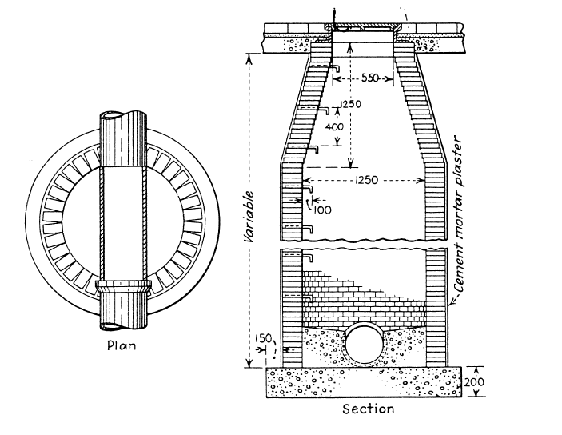

Slide 6
Manhole…
Objective
Permit entry of person inside the sewer for inspection, cleaning and maintenance
Dividing sewer line into smaller length called blocks facilitating easy location and opening of chokes
Ventilating the sewer line
Allow joining of sewers or change in the direction or alignment or both
Components
Working chamber
Access shaft
Cover
Classification (depth)
Shallow (75 to 90 cm)
Normal (about 150 cm)
Deep (> 150 cm)

Slide 7
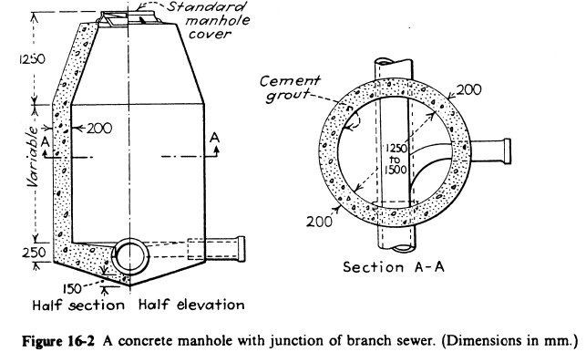

Slide 8
Centre to centre distance between subsequent manholes
No. | Size (D) of the sewer line (cm) | Distance (m)
1 | D<= 60 | 75
2 | 60 < D<= 90 | 125
3 | 90 < D<= 120 | 190
4 | 120 < D<= 150 | 250
5 | > = 150 | 300 to 400

Slide 9
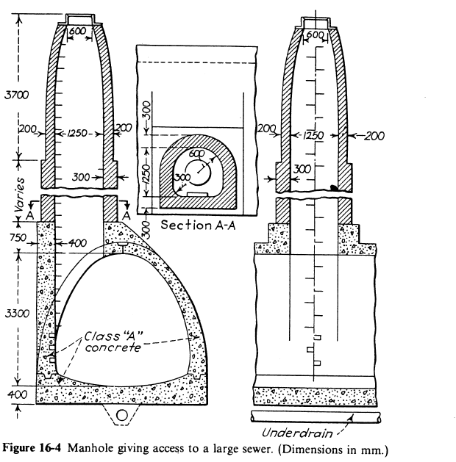

Slide 10
Depth and recommended manhole chamber size
Depth (d) of Manhole (m) | Recommended Size (mxm)
<= 0.8 | 0.75 x 0.75
0.8< d<= 2.1 | 1.2 x 0.9
> 2.1 | Circular chamber with minimum diameter of 1.4 m or rectangular chamber with minimum internal dimension of 1.2x0.9 m

Slide 11
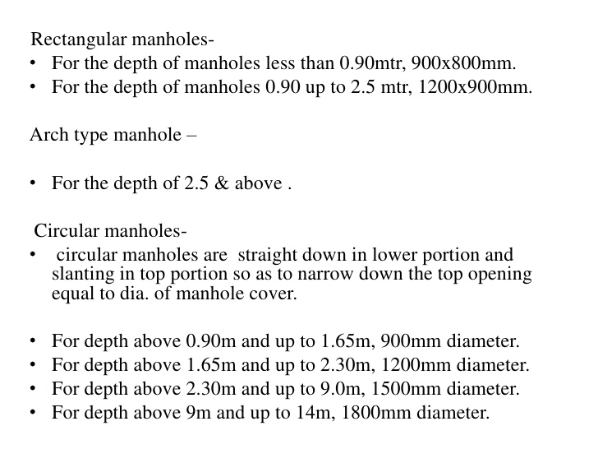

Slide 12
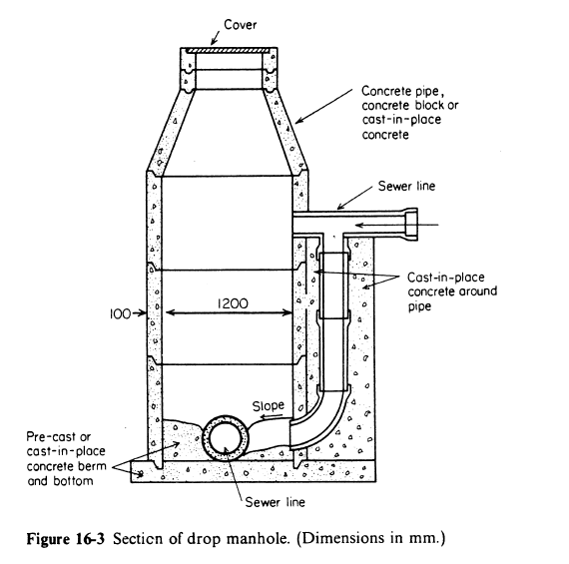

Slide 14
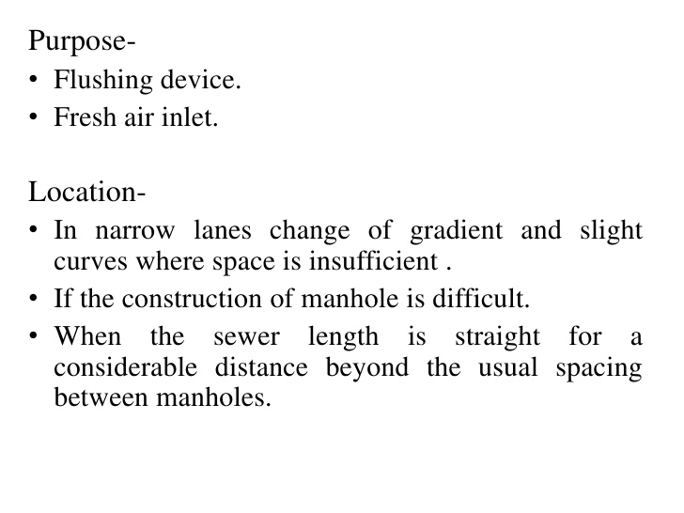

Slide 17
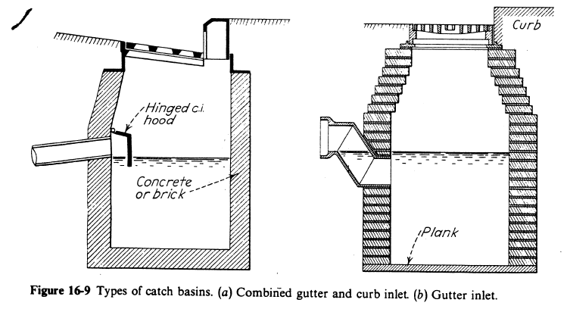

Slide 19
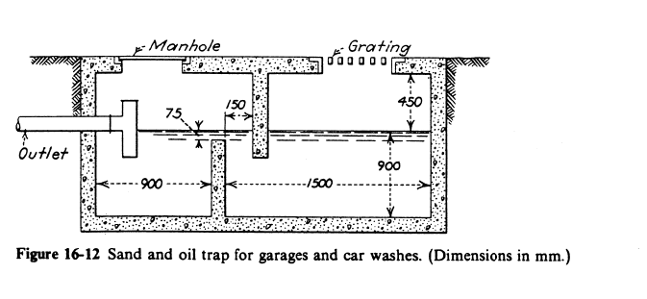

Slide 21
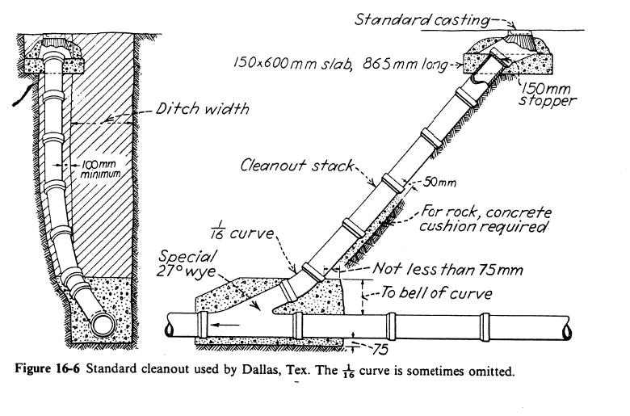

Slide 24
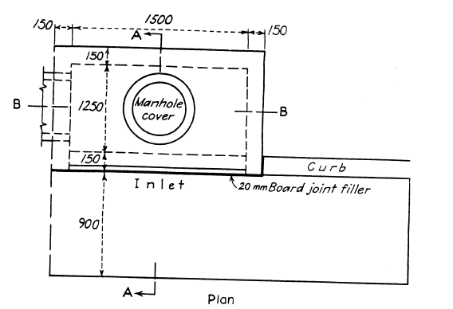

Slide 25
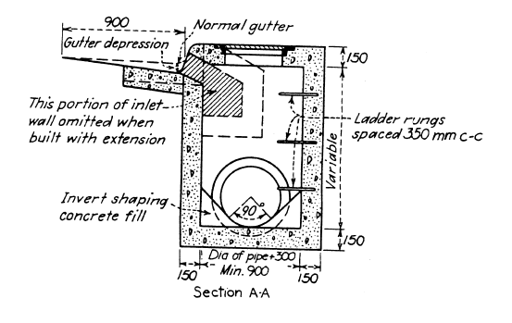
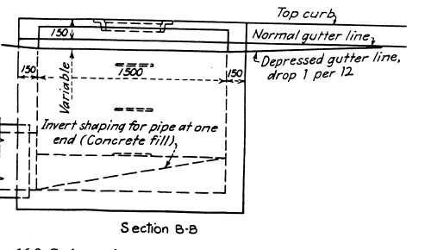

Slide 28
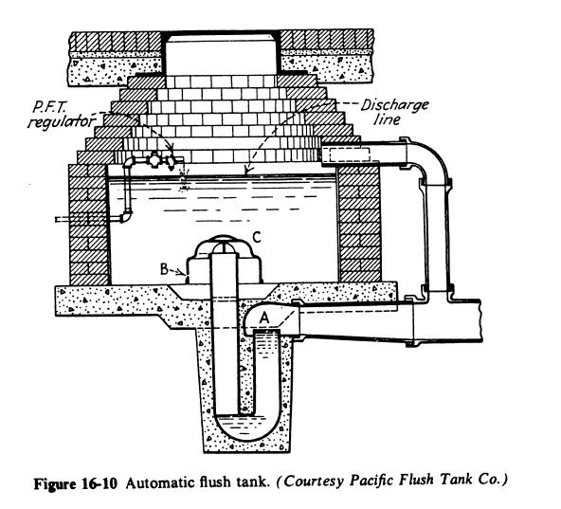

Slide 36
