Slide 1
PN junction diode

Slide 2
We will study
Electrostatic and band structure
The effect of bias
The ideal diode equation
Some example of diode

Slide 3
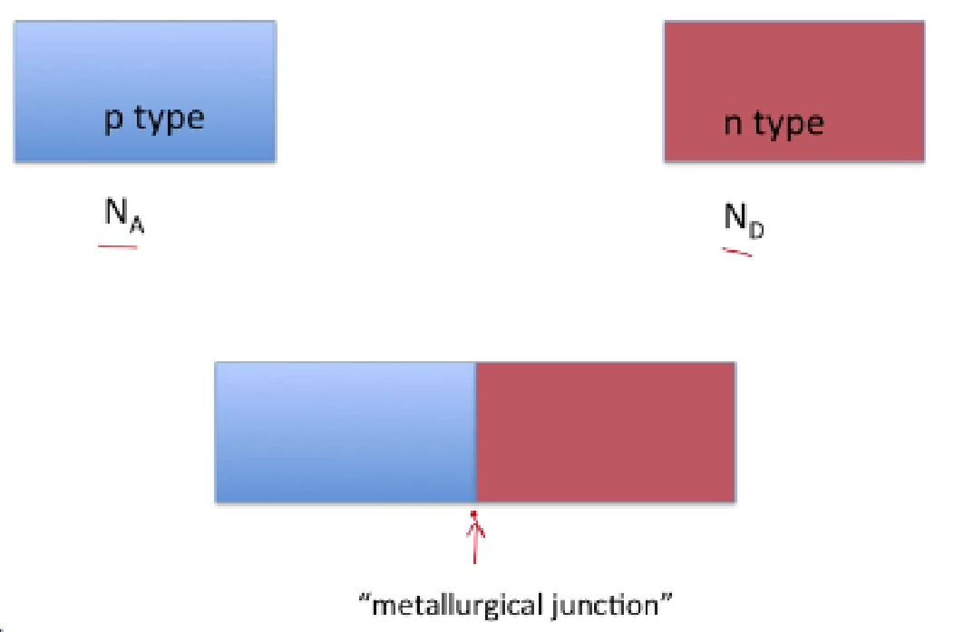
What diffusion and drift do you expect at pn junction

Slide 4
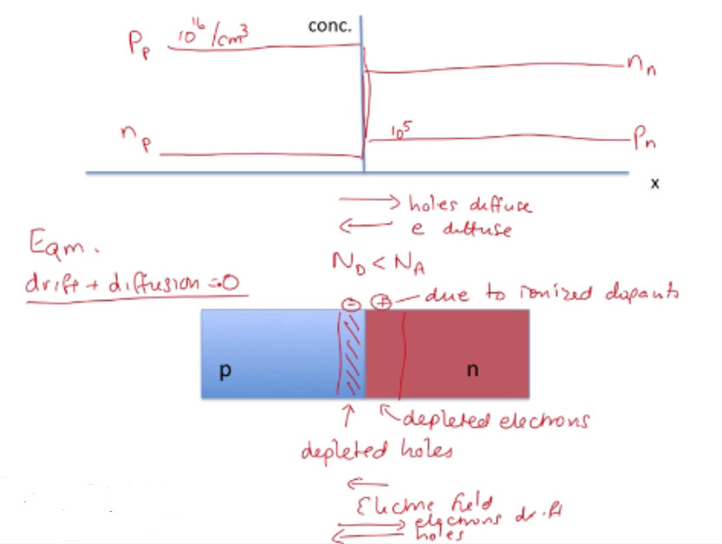
Carrier concentration

Slide 5
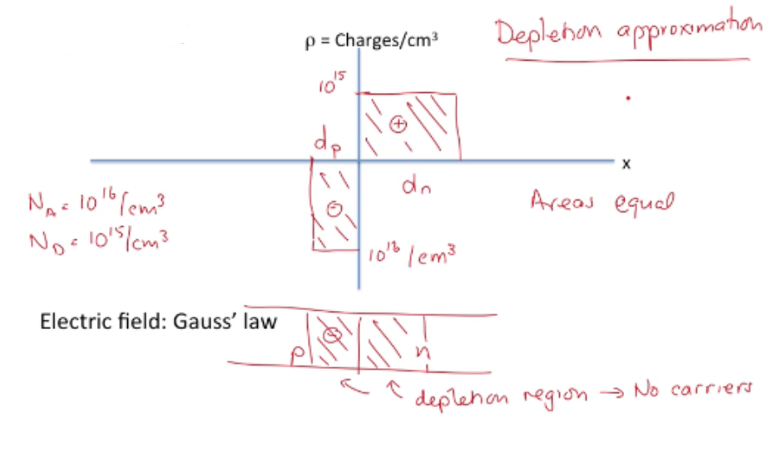
Charge density

Slide 6
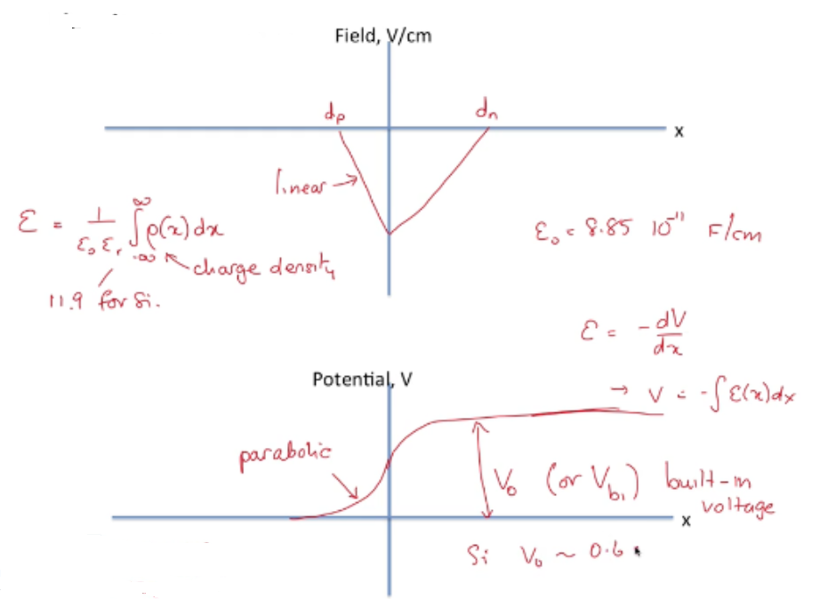
Electric field: Gauss’ Law

Slide 7
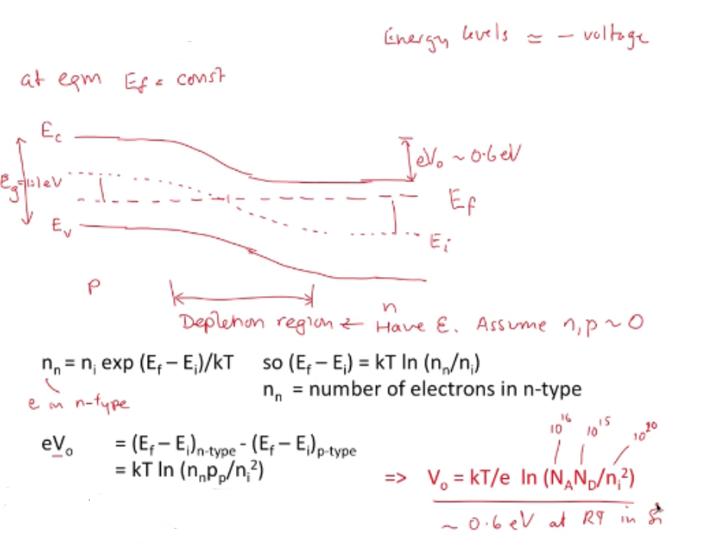
Band diagram of a pn junction

Slide 8
The depletion approximation

Slide 9
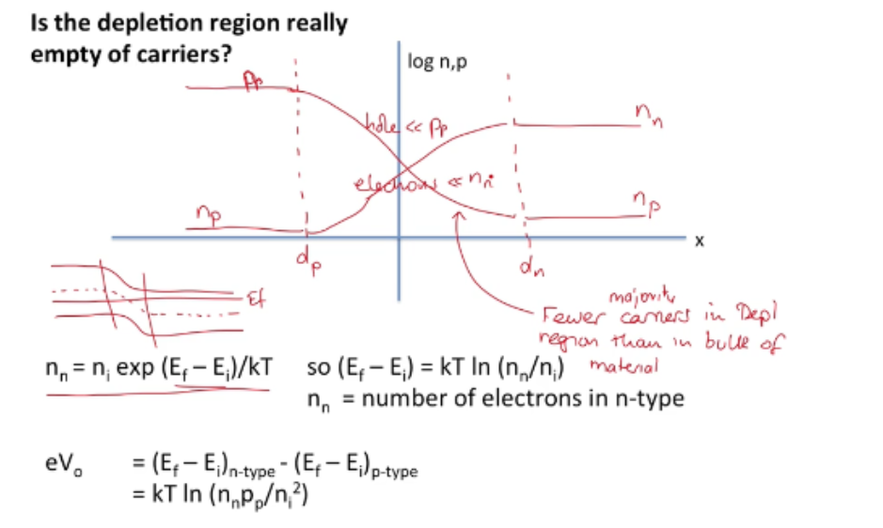

Slide 14
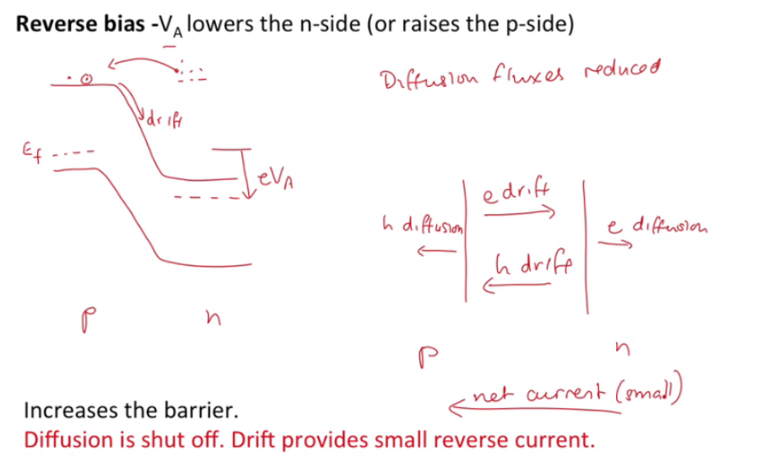

Slide 19
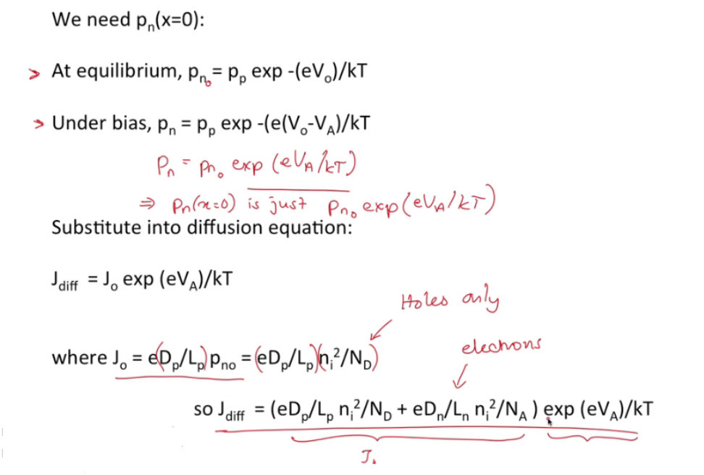

Slide 20
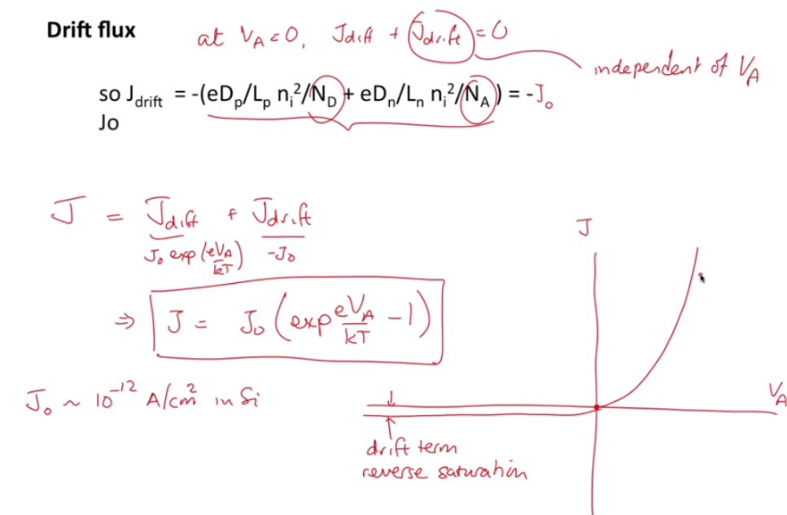

Slide 27
