Slide 1
PN Junction
Diffusion
  The constant random motion of carriers can lead to a net movement of carriers if one particular region has a higher concentration of carriers than another region (a concentration gradient between the high carrier-concentration region and the low carrier-concentration region).
  When carriers are bouncing around randomly, there are more places for them to go where that are low-concentration carrier areas than high.
The net movement of carriers is therefore from areas of high concentration to low.
The rate at which diffusion occurs depends on the velocity at which carriers move and on the distance between scattering events. It is termed diffusivity and
measured in cm²s⁻¹.
Since raising the temperature will increase the thermal velocity of the carriers, diffusion occurs faster at higher temperatures.
One major effect of diffusion is that, with time, it evens out the carrier concentrations in a device, such as those induced by generation and recombination, without an external force being applied to the device.

Slide 2
PN Junction
Drift
As noted in the movement of carriers page, in the absence of an electric field, carriers move a certain distance at a constant velocity in a random direction.
However, in the presence of an electric field, superimposed on this random direction, and in the presence of thermal velocity, carriers move in a net direction.
There is an acceleration in the direction of the electric field if the carrier is a hole
or opposite to the electric field if the carrier is an electron.
The direction of the carrier is obtained as a vector addition between its direction and the electric field.
The net carrier movement in the presence of an electric field is characterized by
mobility, which varies between different semiconductor materials.

Slide 3
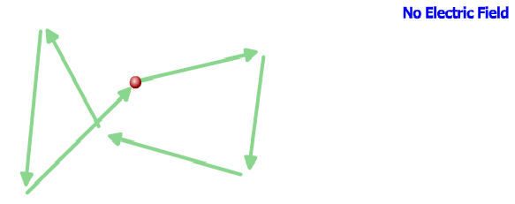
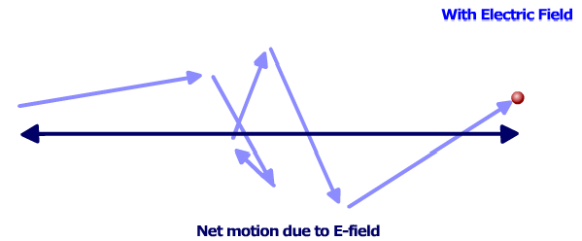
PN Junction
Drift

Slide 4
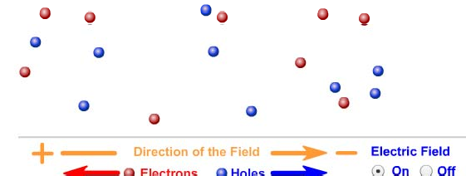
PN Junction
Drift
  Transport due to the movement of carriers due to the presence of an electric field is called "drift transport". Drift transport is the type of transport that occurs not only in semiconductor material, but also in metals.
  Since the electron has a negative charge, it will tend to move in the direction opposite to the electric field. Notice that in the majority of cases, the electron moves in the direction opposite to the electric field.
  When the field is turned on the electrons and holes drift in opposite directions.

Slide 5

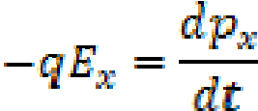
PN Junction
Drift Equation (Conductivity and Mobility)
  One-dimensional drift equation is given by the following formula.
  where J_{x} is the current density in the x-direction, E_{x} - electric field applied in the x-direction, q - electron charge, n and p - electron and hole concentrations, µ_{n} and
µ_{p} - electron and hole mobilities.
  To derive the drift equation let's consider the bulk of semiconductor.
  If the electric field E_{x} is applied in the x-direction each electron experiences a net force which leads to additional acceleration in the direction opposite to the direction of the field.
The net acceleration in the case of steady state current flow is balanced by the decelerations of the collision processes. If N(t) is the number of electrons that have not undergone a collision by time t, then the rate of decrease N(t) is proportional to the number left unscattered at t.

Slide 6





PN Junction
Drift Equation (Conductivity and Mobility)
Where τ represents the mean time between scattering events.
The probability that an electron has a collision in dt is , then the differential change in p_{x} due to collisions in dt is
where n is the electron concentration.
And average momentum per electron is
The net drift speed is equal to

Slide 7
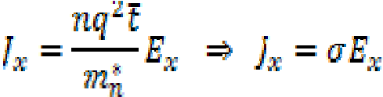




PN Junction
Drift Equation (Conductivity and Mobility)
  The current density is the number of electrons crossing the unit area per unit time
Where
is the conductivity of a semiconductor and
is the mobility of carriers.
Rearranging gives
Finally considering both hole and electron conduction

Slide 8
PN Junction
Formation of a PN-Junction
P-n junctions are formed by joining n-type and p-type semiconductor materials.
Since the n-type region has a high electron concentration and the p-type a high hole concentration, electrons diffuse from the n-type side to the p-type side. Similarly, holes flow by diffusion from the p-type side to the n-type side.
If the electrons and holes were not charged, this diffusion process would continue until the concentration of electrons and holes on the two sides were the same, as
happens if two gasses come into contact with each other.
However, in a p-n junction, when the electrons and holes move to the other side of the junction, they leave behind exposed charges on dopant atom sites, which are fixed in the crystal lattice and are unable to move.
On the n-type side, positive ion cores are exposed. On the p-type side, negative ion cores are exposed.
An electric field Ê forms between the positive ion cores in the n-type material and negative ion cores in the p-type material.
This region is called the "depletion region" since the electric field quickly sweeps
free carriers out, hence the region is depleted of free carriers.

Slide 9
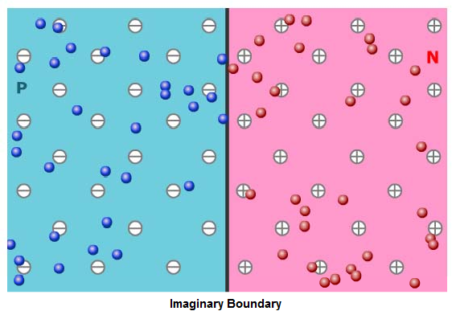
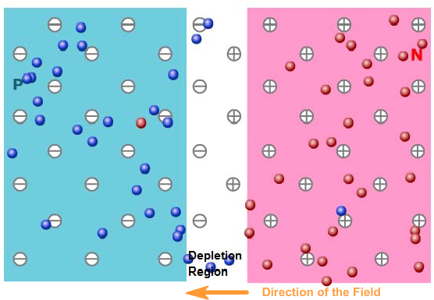
PN Junction
Formation of a PN-Junction
  A "built in" potential V_{bi} due to Ê is formed at the junction.
  The schematic diagram below shows the formation of the Ê at the junction between n and p-type material

Slide 10
PN Junction
PN-Junction Diodes
  P-n junction diodes form the basis not only of solar cells, but of many other electronic devices such as LEDs, lasers, photodiodes and bipolar junction transistors (BJTs).
  A p-n junction aggregates the recombination, generation, diffusion and drift effects.
Carrier Movement in Equilibrium
  A p-n junction with no external inputs represents an equilibrium between carrier generation, recombination, diffusion and drift in the presence of the electric field in the depletion region.
  Despite the presence of the electric field, which creates an impediment to the diffusion of carriers across the electric field, some carriers still cross the junction by diffusion.
  Most majority carriers which enter the depletion region move back towards the region from which they originated. However, statistically some carriers will have a high velocity and travel in a sufficient net direction such that they cross the junction.

Slide 11
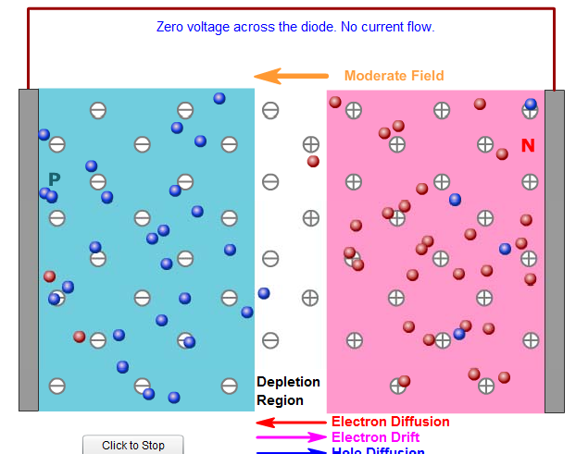
PN Junction
Carrier Movement in Equilibrium

Slide 12
PN Junction
Carrier Movement in Equilibrium
  Once a majority carrier crosses the junction, it becomes a minority carrier.
It will continue to diffuse away from the junction and can travel a distance on average equal to the diffusion length before it recombines.
The current caused by the diffusion of carriers across the junction is called a
diffusion current.
Minority carriers which reach the edge of the diffusion region are swept across it by the electric field in the depletion region.
This current is called the drift current. In equilibrium the drift current is limited by the number of minority carriers which are thermally generated within a diffusion length of the junction.
In equilibrium, the net current from the device is zero. The electron drift current and the electron diffusion current exactly balance out (if they did not there would be a net buildup of electrons on either one side or the other of the device).
Similarly, the hole drift current and the hole diffusion current also balance each other out.

Slide 13
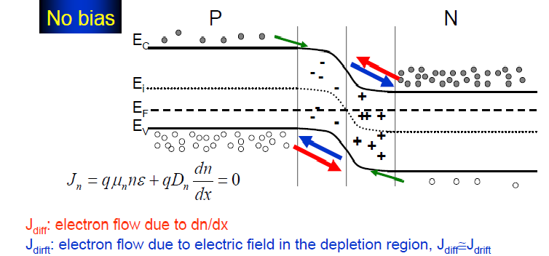
PN Junction
Carrier Movement in Equilibrium

Slide 14
PN Junction
Carrier Movement in Equilibrium
  Semiconductor devices have three modes of operation:
    Thermal Equilibrium: At thermal equilibrium there are no external inputs such as light or applied voltage. The currents balance each other out so there is no net current within the device.
    Steady State: Under steady state there are external inputs such as light or applied voltage, but the conditions do not change with time. Devices typically operate in steady state and are either in forward or reverse bias.
    Transient: If the applied voltage changes rapidly, there will be a short delay before the solar cell responds. As solar cells are not used for high speed operation there are few extra transient effects that need to be taken into account.
Diodes under forward bias
  Forward bias refers to the application of voltage across the device such that the electric field at the junction is reduced.
  By applying a positive voltage to the p-type material and a negative voltage to the n-type material, an electric field with opposite direction to that in the depletion region is applied across the device.

Slide 15
PN Junction
Diodes under forward bias
  Since the resistivity of the depletion region is much higher than that in the remainder of the device (due to the limited number of carriers in the depletion region), nearly all of the applied electric field is dropped across the depletion region.
  The net electric field is the difference between the existing field in the depletion region and the applied field (for realistic devices, the built-in field is always larger than the applied field), thus reducing the net electric field in the depletion region.
  Reducing the electric field disturbs the equilibrium existing at the junction, reducing the barrier to the diffusion of carriers from one side of the junction to the other and increasing the diffusion current.
  While the diffusion current increases, the drift current remains essentially unchanged since it depends on the number of carriers generated within a diffusion length of the depletion region or in the depletion region itself.
  Since the depletion region is only reduced in width by a minor amount, the number of minority carriers swept across the junction is essentially unchanged.

Slide 16
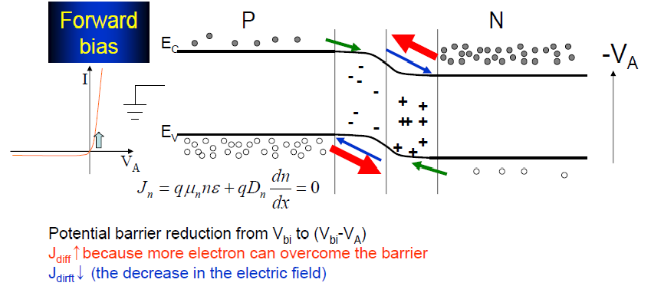
PN Junction
Diodes under forward bias

Slide 17
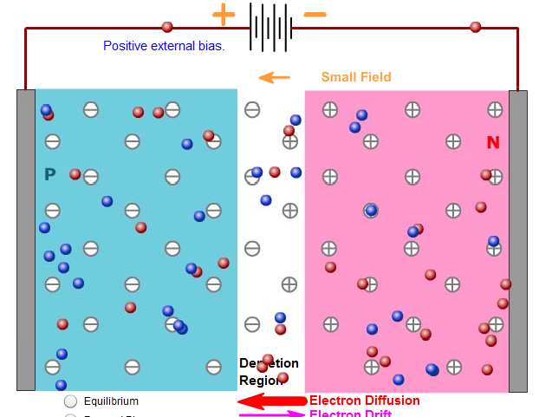
PN Junction
Diodes under forward bias

Slide 18
PN Junction
Carrier Injection and Forward Bias Current Flow
The increased diffusion from one side of the junction to the other causes minority
carrier injection at the edge of the depletion region.
These carriers move away from the junction due to diffusion and will eventually recombine with a majority carrier. The majority carrier is supplied from the external circuit and hence a net current flows under forward bias.
In the absence of recombination, the minority carrier concentration would reach a new, higher equilibrium concentration and the diffusion of carriers from one side of the junction to the other would cease.
In a semiconductor however, the injected minority carriers recombine and thus more carriers can diffuse across the junction. Consequently, the diffusion current which flows in forward bias is a recombination current. The higher the rate of recombination events, the greater the current which flows across the junction.
The "dark saturation current" (I₀) is an extremely important parameter which differentiates one diode from another. I₀ is a measure of the recombination in a device. A diode with a larger recombination will have a larger I₀.

Slide 19
PN Junction
Reverse Bias
In reverse bias a voltage is applied across the device such that the electric field at
the junction increases.
The higher electric field in the depletion region decreases the probability that carriers can diffuse from one side of the junction to the other, hence the diffusion current decreases.
A small increase in the drift current is experienced due to the small increase in the width of the depletion region, but this is essentially a second-order effect in silicon solar cells.
In many thin film solar cells where the depletion region is around half the thickness of the solar cell the change in depletion region width with voltage has a large impact on cell operation.

Slide 20
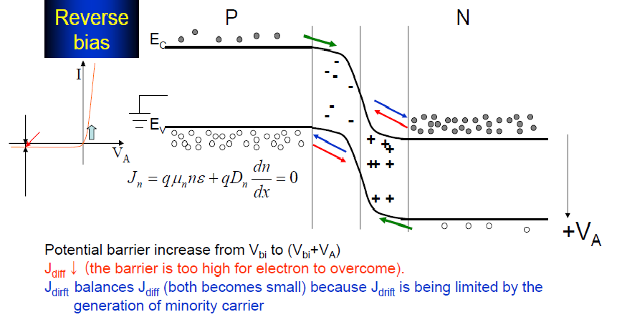
PN Junction
Diodes under reverse bias

Slide 21
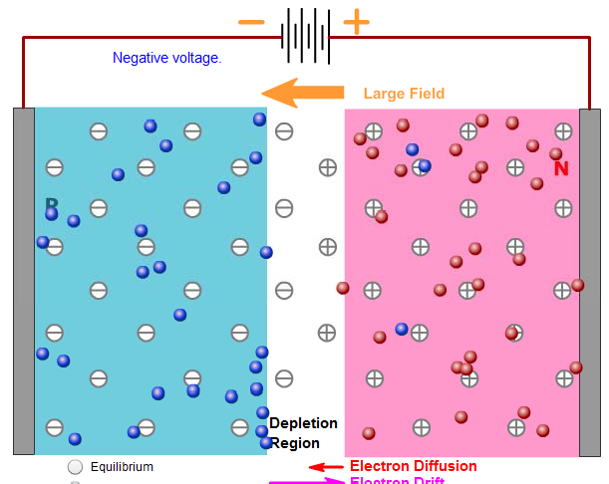
PN Junction
Diodes under reverse bias

Slide 22

PN Junction
Non-Ideal Diodes
  The diode equation gives an expression for the current through a diode as a function of voltage. The Ideal Diode Law, expressed as:
In real devices, the saturation current is strongly dependent on the device temperature. Similarly, mechanisms that change the ideality factor also impact the saturation current.

