Slide 1
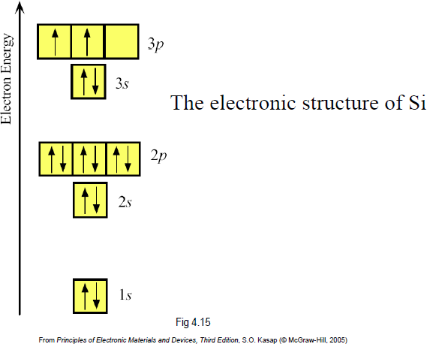
Semiconductors

Slide 2
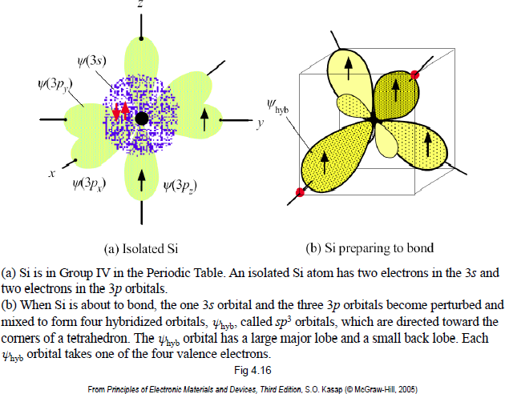
Semiconductors

Slide 3
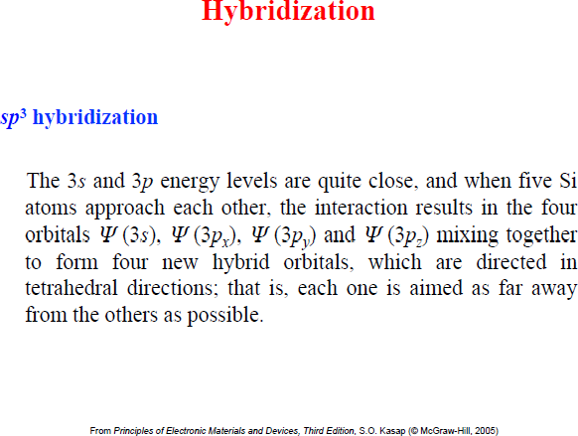
Semiconductors

Slide 4
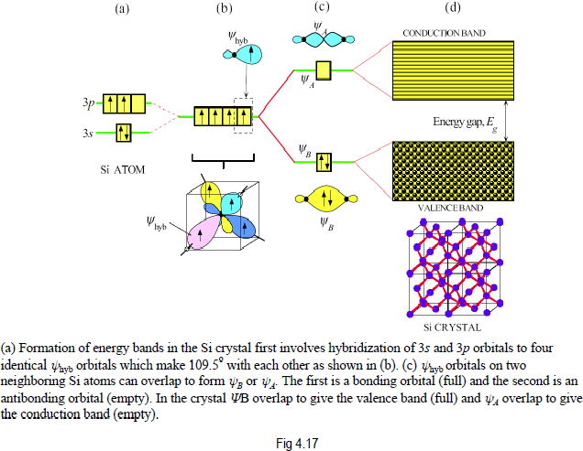
Semiconductors

Slide 5
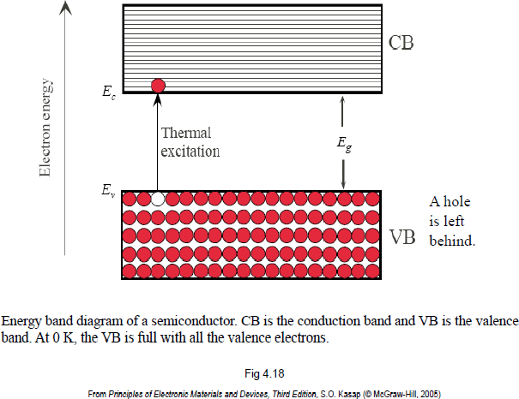
Semiconductors

Slide 6
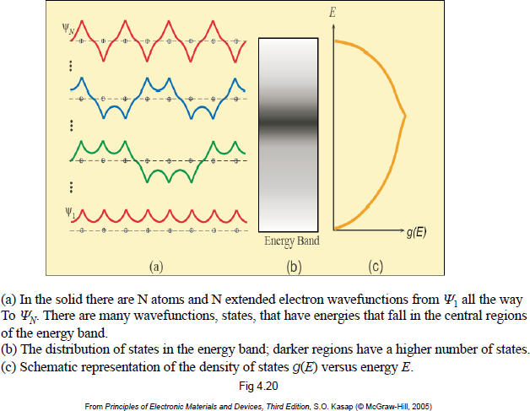
Density of States in an Energy Band

Slide 7
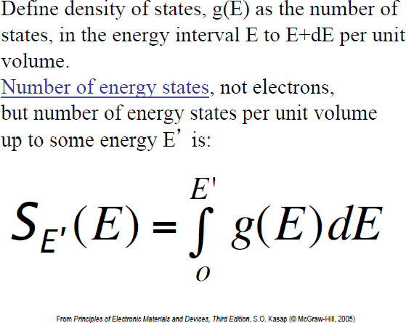
Density of States in an Energy Band

Slide 8
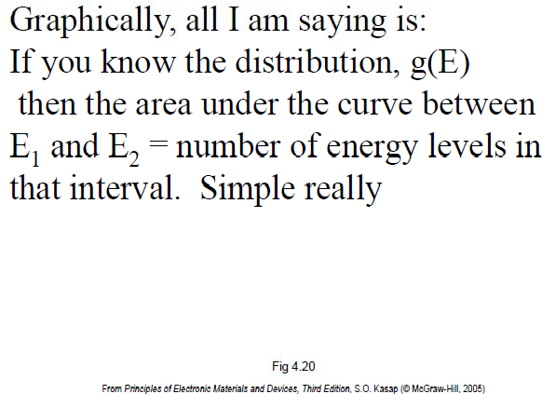
Density of States in an Energy Band

Slide 9
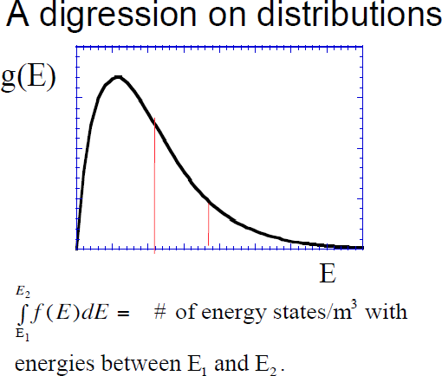
Density of States in an Energy Band

Slide 10
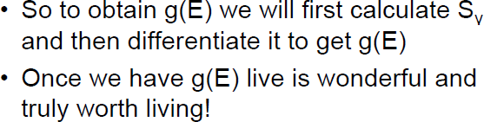
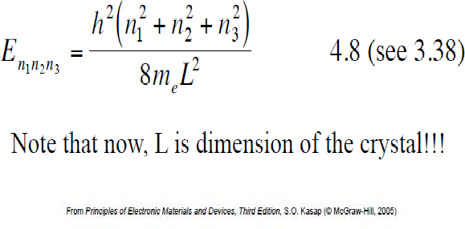
Density of States in an Energy Band

Slide 11
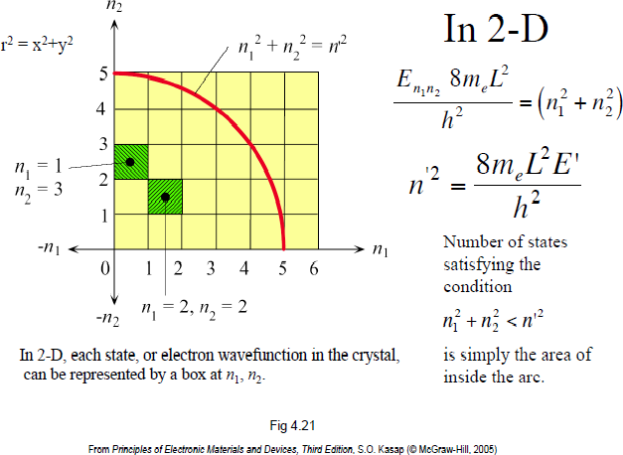
Density of States in an Energy Band

Slide 12
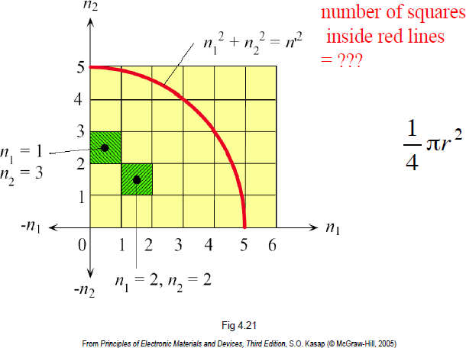
Density of States in an Energy Band

Slide 13
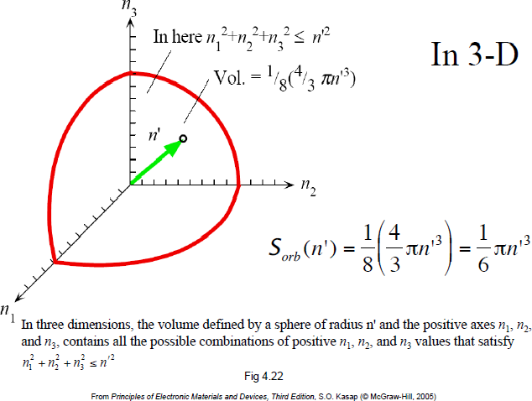
Density of States in an Energy Band

Slide 14
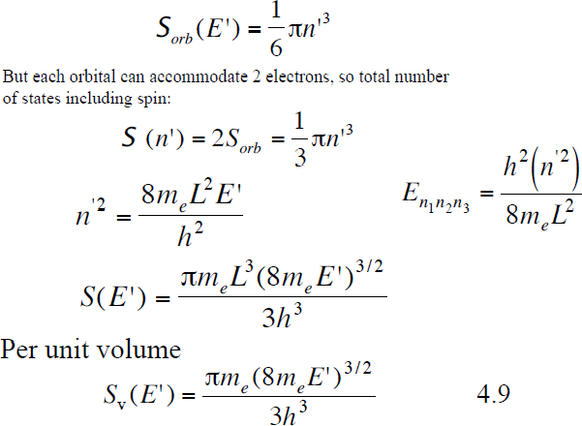
Density of States in an Energy Band

Slide 15
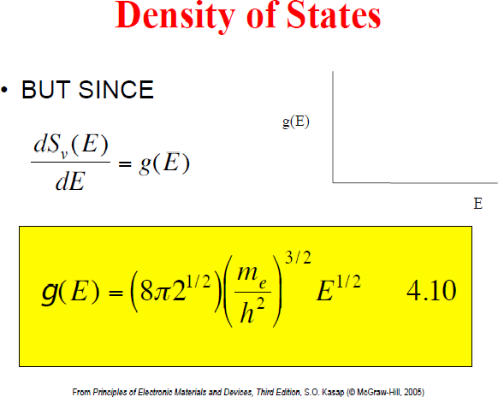
Density of States in an Energy Band

Slide 16
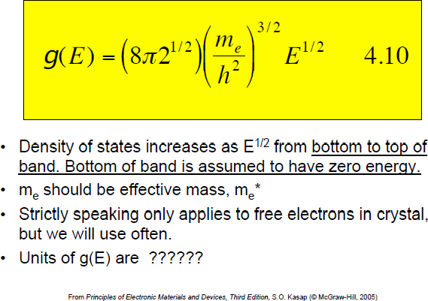
Density of States in an Energy Band

Slide 17
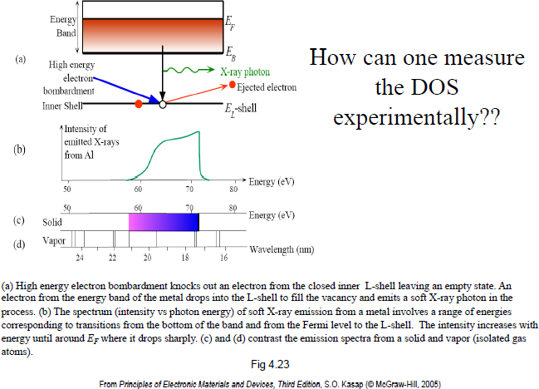
Density of States in an Energy Band

Slide 18
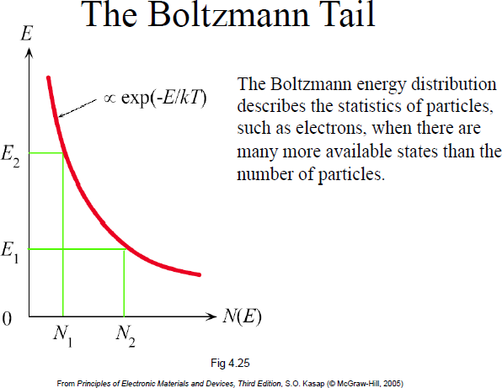
Boltzmann Statistics

Slide 19
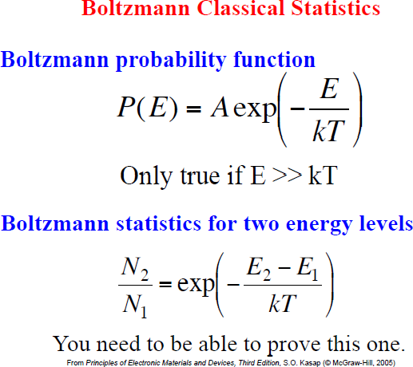
Boltzmann Statistics

Slide 20
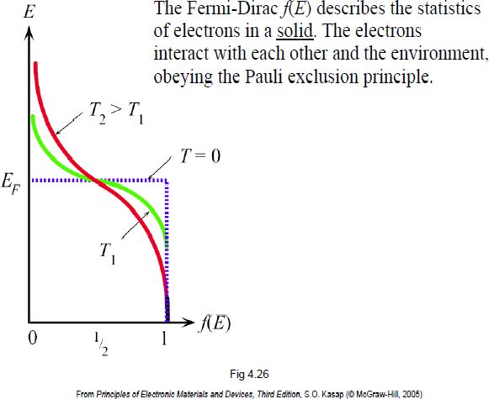
Fermi-Dirac Statistics

Slide 21
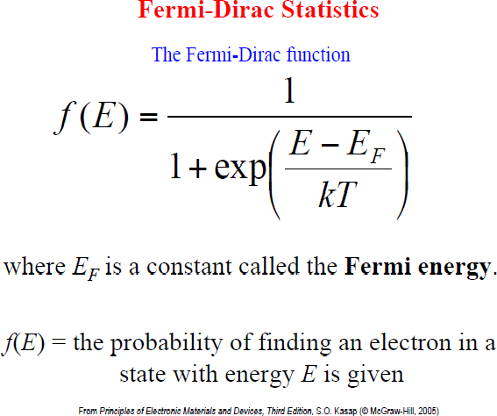
Fermi-Dirac Statistics

Slide 22
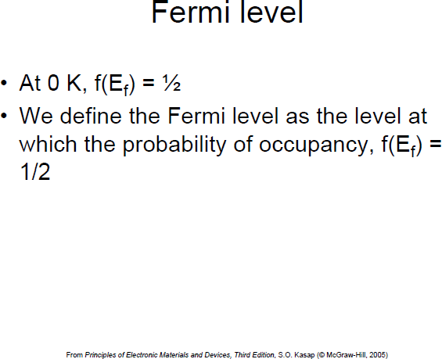
Fermi-Dirac Statistics

Slide 23
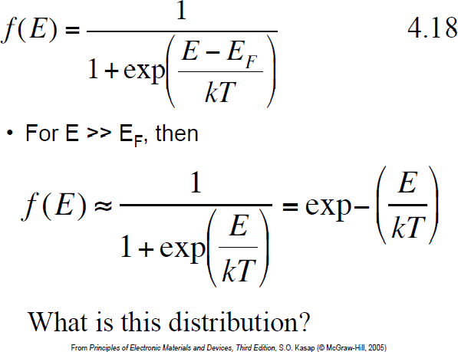
Fermi-Dirac Statistics

Slide 24
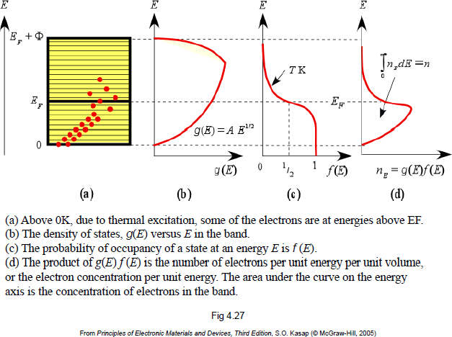
Free Electron Model

Slide 25
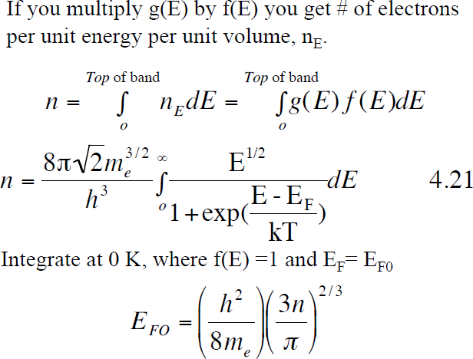
Free Electron Model

Slide 26
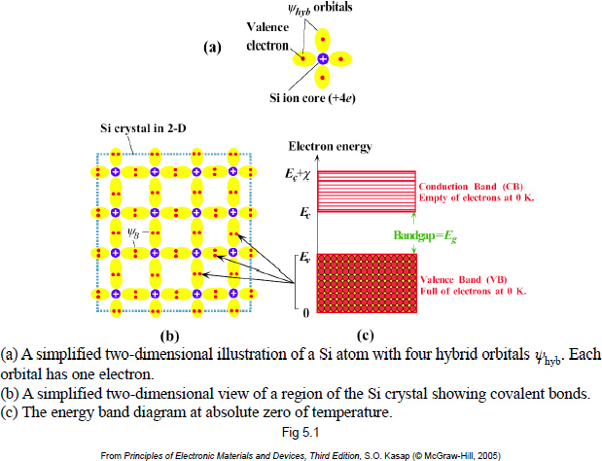
Silicon Crystal and Energy Band Diagram

Slide 27
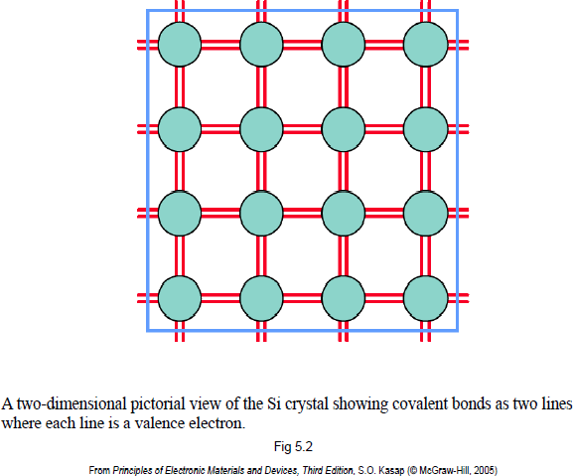
Silicon Crystal and Energy Band Diagram

Slide 28
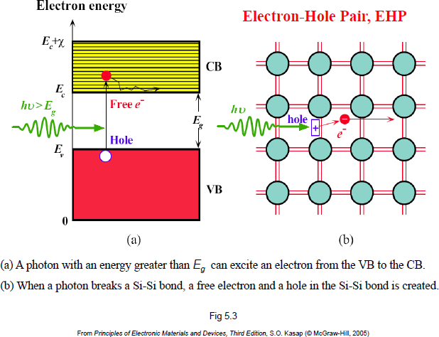
Electrons and Holes

Slide 29
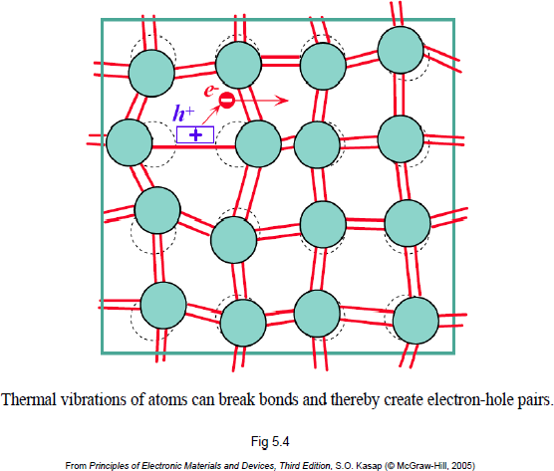
Electrons and Holes

Slide 30
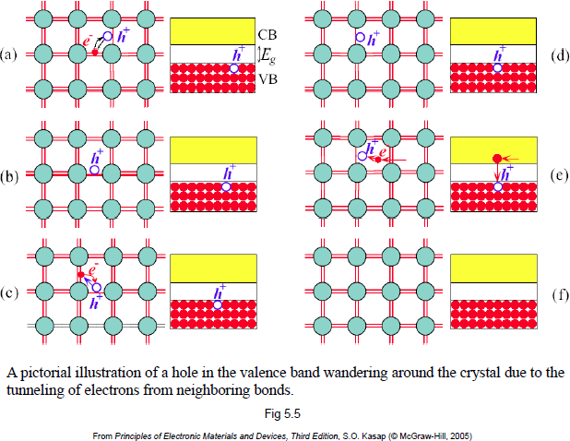
Electrons and Holes

Slide 31
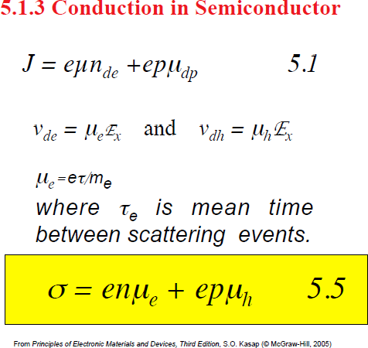
Conduction in Semiconductor

Slide 32
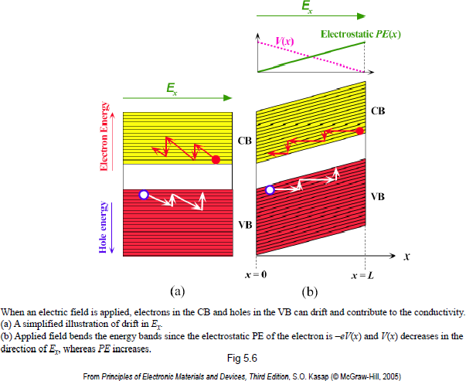
Conduction in Semiconductor

Slide 33
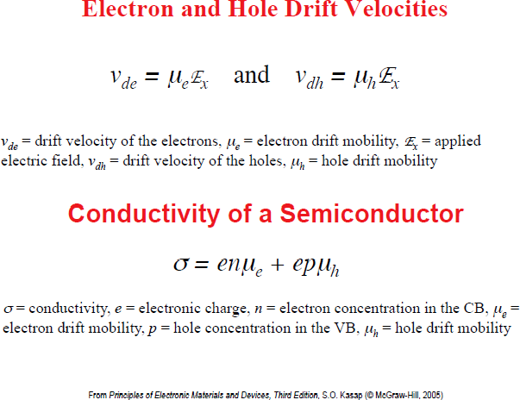
Conduction in Semiconductor

Slide 34
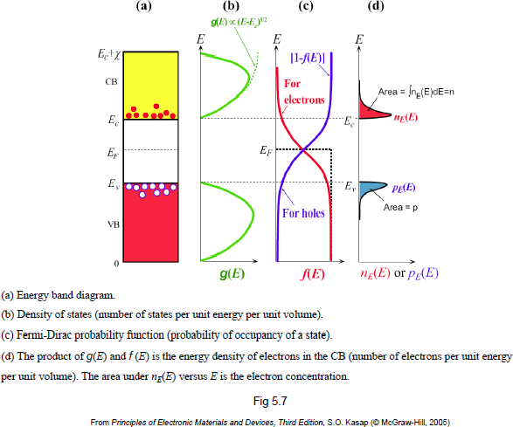
Electron and Hole Conduction

Slide 35
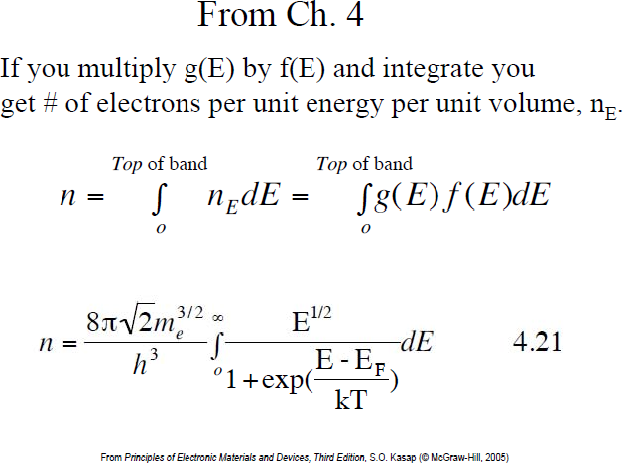
Electron and Hole Conduction

Slide 36
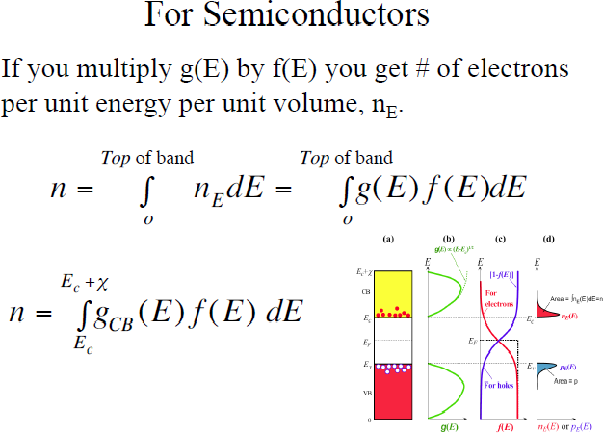
Electron and Hole Conduction

Slide 37
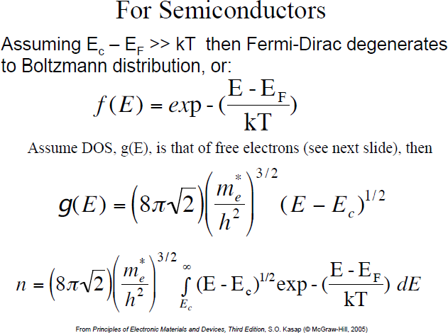
Electron and Hole Conduction

Slide 38
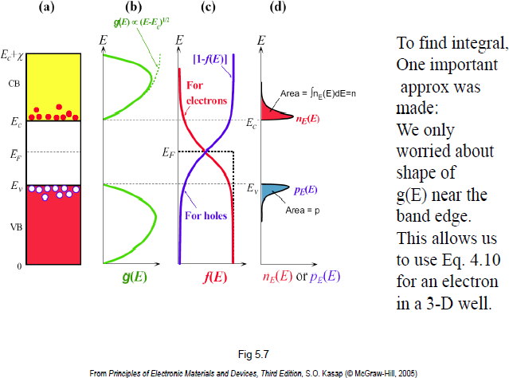
Electron and Hole Conduction

Slide 39
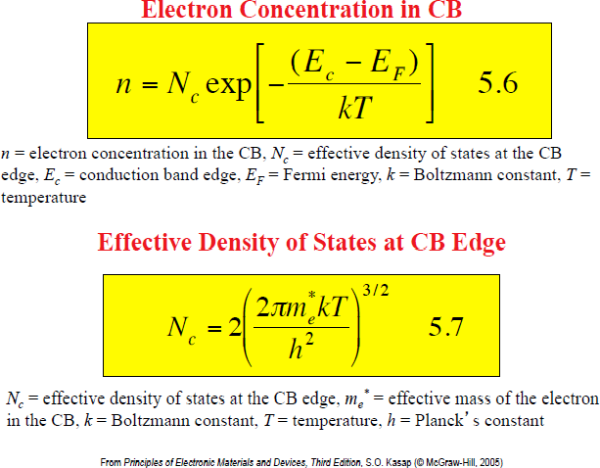
Electron and Hole Conduction

Slide 40
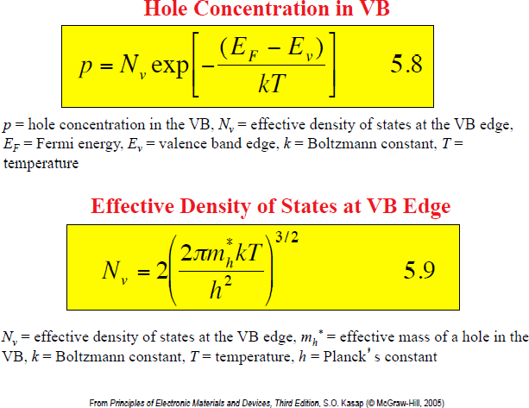
Electron and Hole Conduction

Slide 41
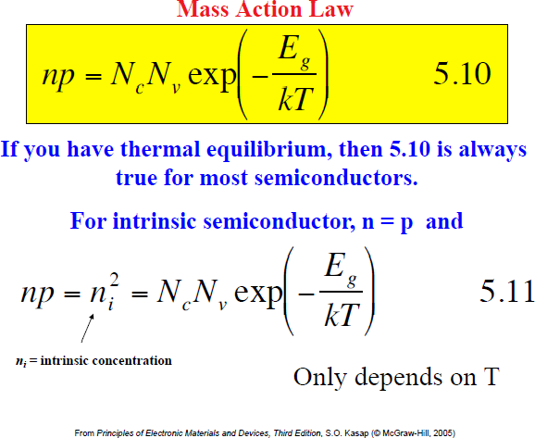
Electron and Hole Conduction

Slide 42
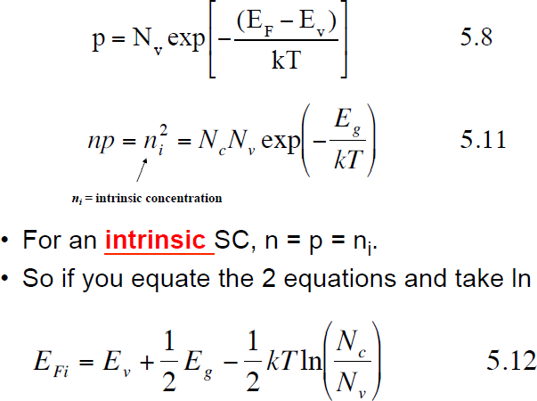
Electron and Hole Conduction

Slide 43
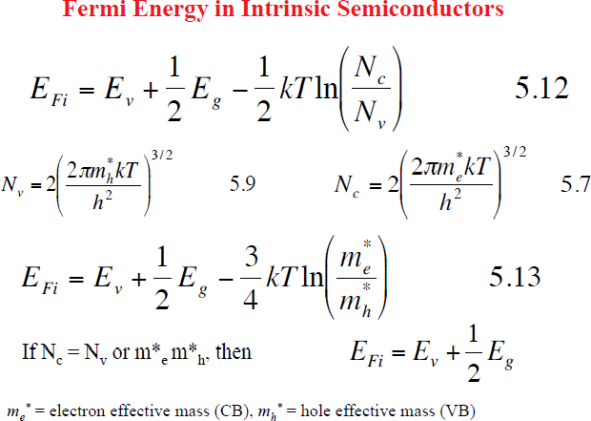
Electron and Hole Conduction

Slide 44
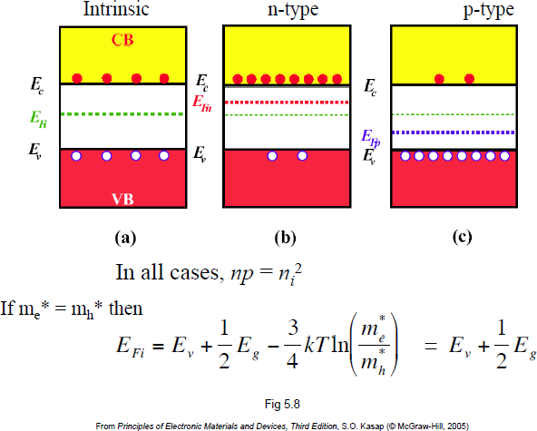
Electron and Hole Conduction

Slide 45
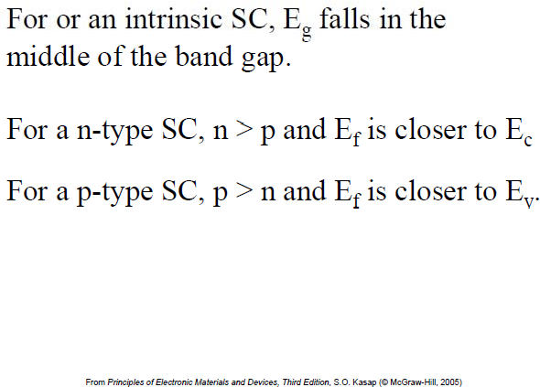
Electron and Hole Conduction

Slide 46
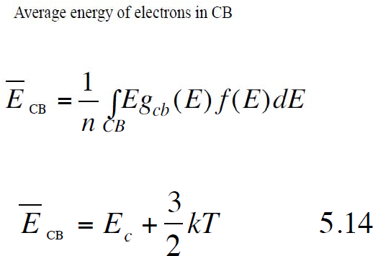
Electron and Hole Conduction

Slide 47
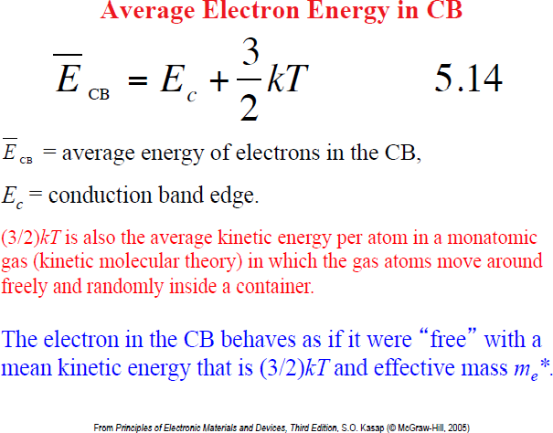
Electron and Hole Conduction

Slide 48
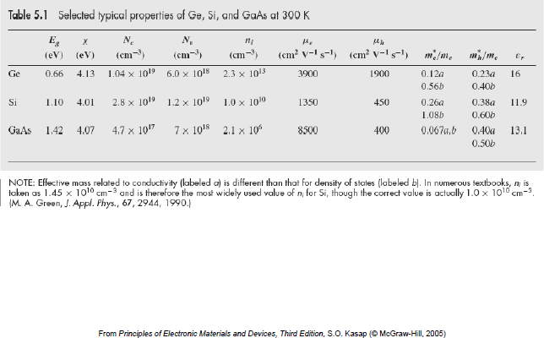
Electron and Hole Conduction

