Slide 1
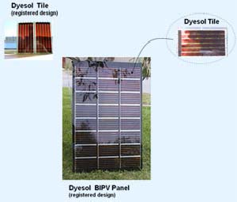
Photoelectrochemical Cell
Dye-Sensitized Solar Cell

Slide 2
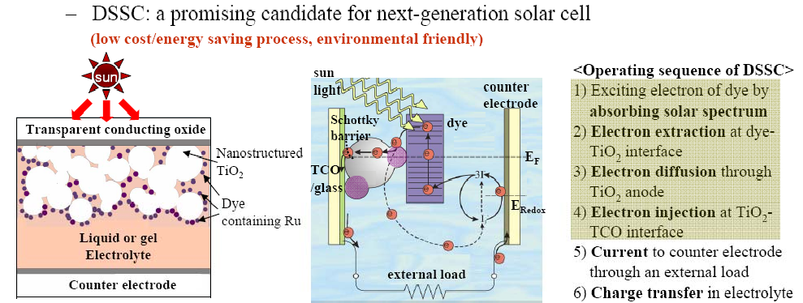
Photoelectrochemical Cell
Dye-Sensitized Solar Cell

Slide 3






Photoelectrochemical Cell
Dye-Sensitized Solar Cell

Slide 4
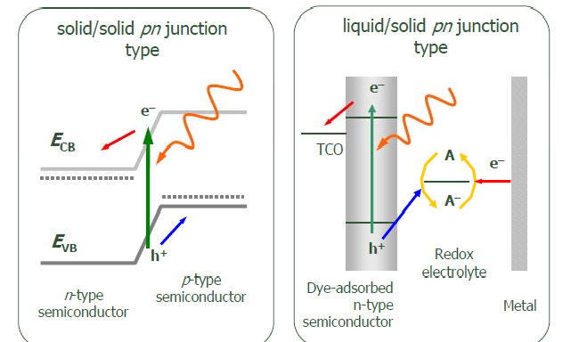
Photoelectrochemical Cell
Dye-Sensitized Solar Cell

Slide 5
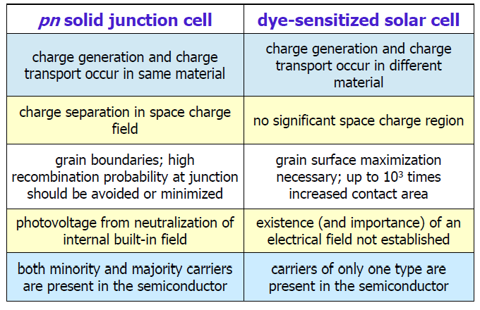
Photoelectrochemical Cell
Dye-Sensitized Solar Cell

Slide 6
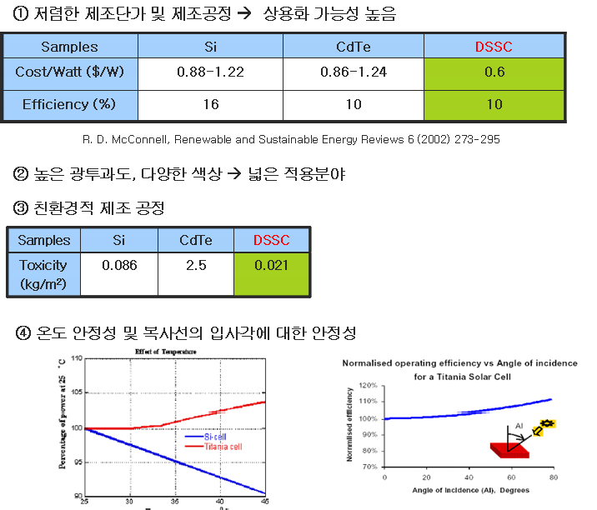
Photoelectrochemical Cell
DSSC

Slide 7
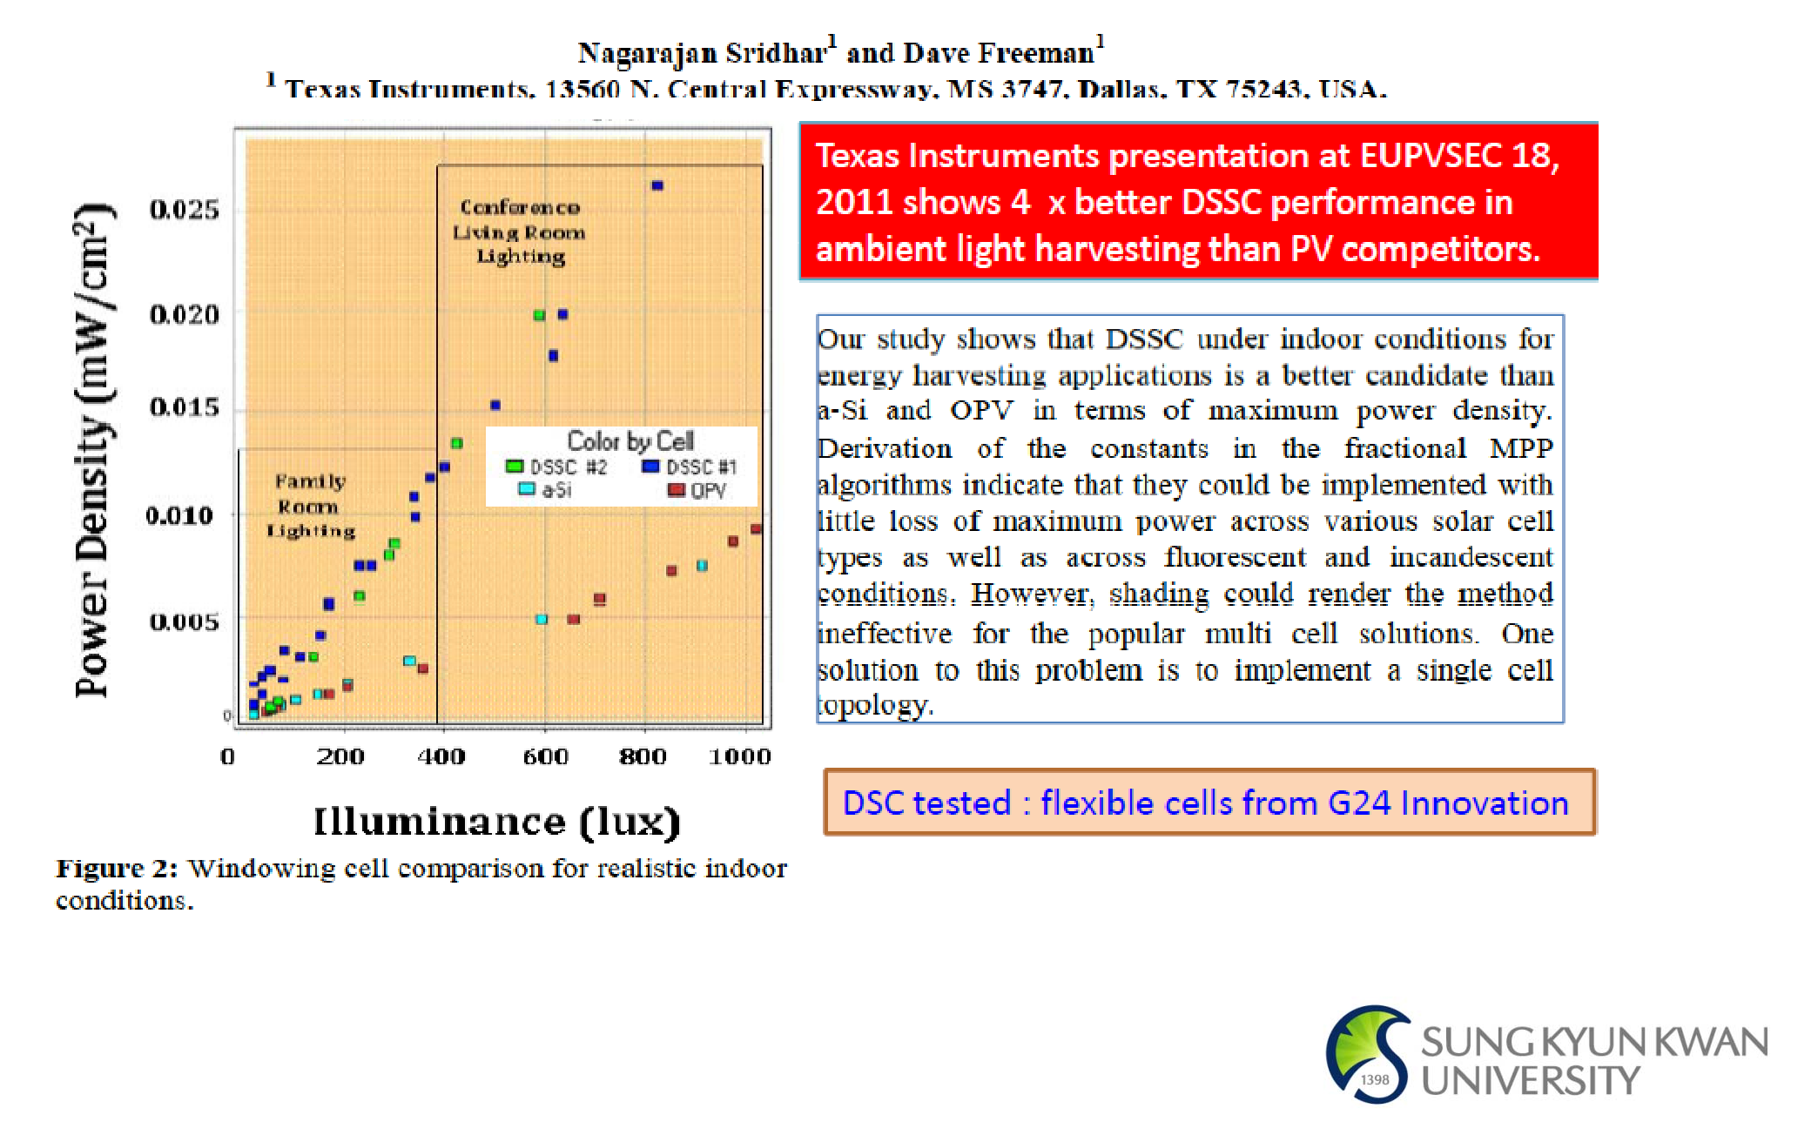
Photoelectrochemical Cell
DSSC

Slide 8
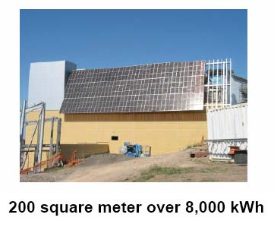
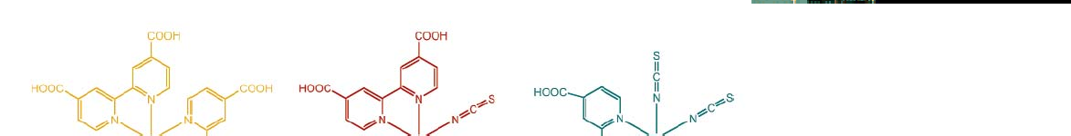

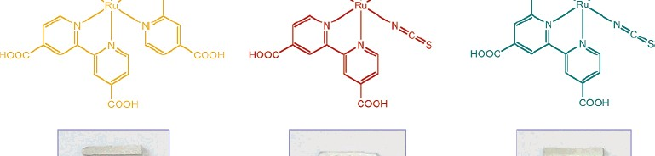

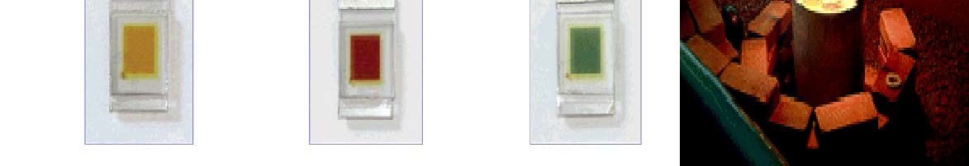
Dye-Sensitized Solar Cells
DSSC
  Cost-effective materials & process
  Low toxicity
  Transparent & Colorful
TOYOTA DYE SOL
BIPV, Building Integrated Photovoltaic System

Slide 9
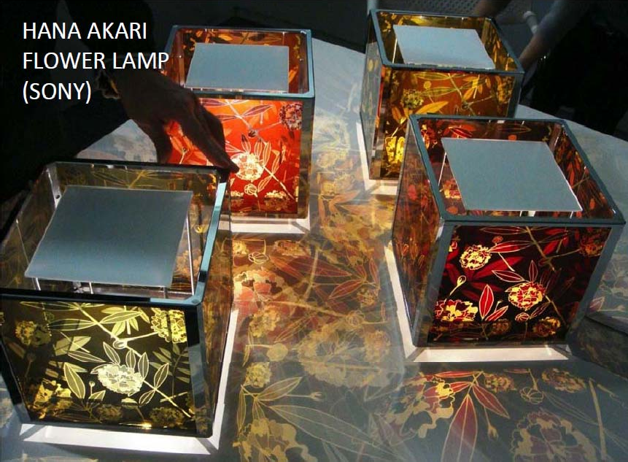
Photoelectrochemical Cell
DSSC

Slide 10
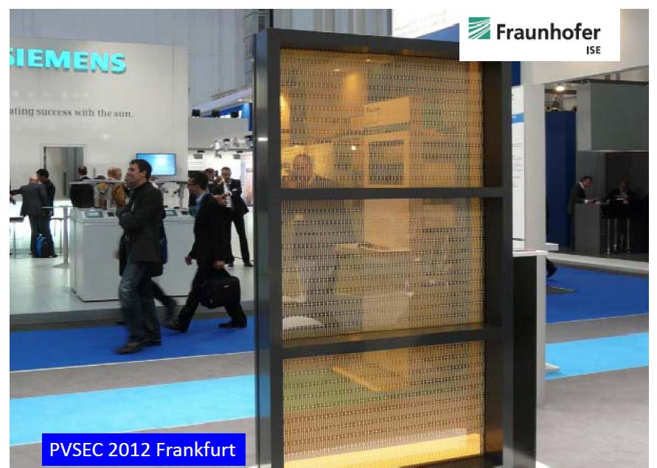
Photoelectrochemical Cell
DSSC

Slide 11
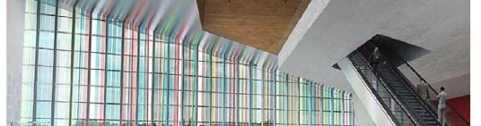




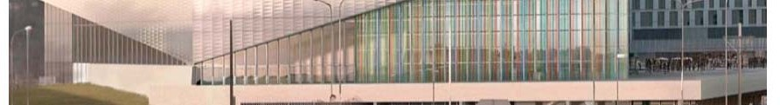
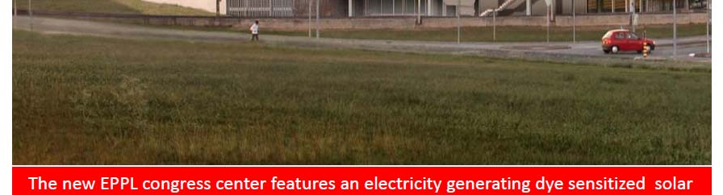
Photoelectrochemical Cell
DSSC

Slide 12
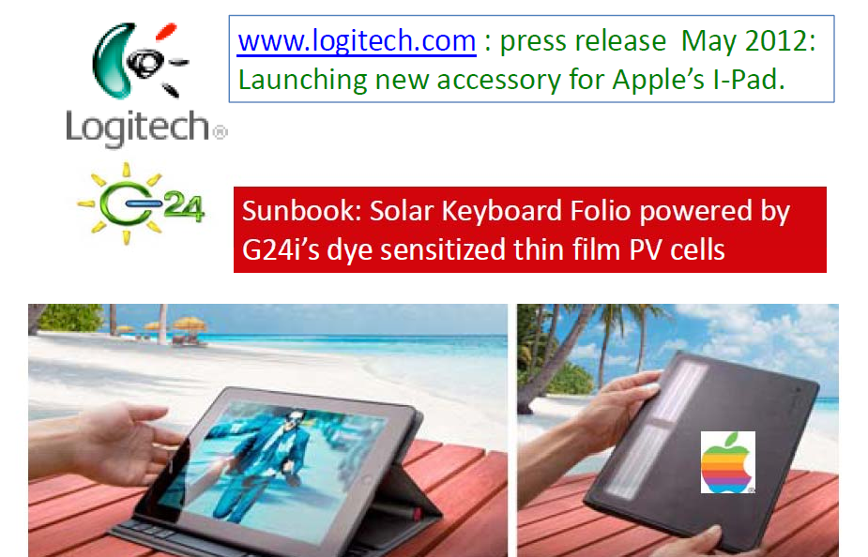
Photoelectrochemical Cell
DSSC

Slide 13
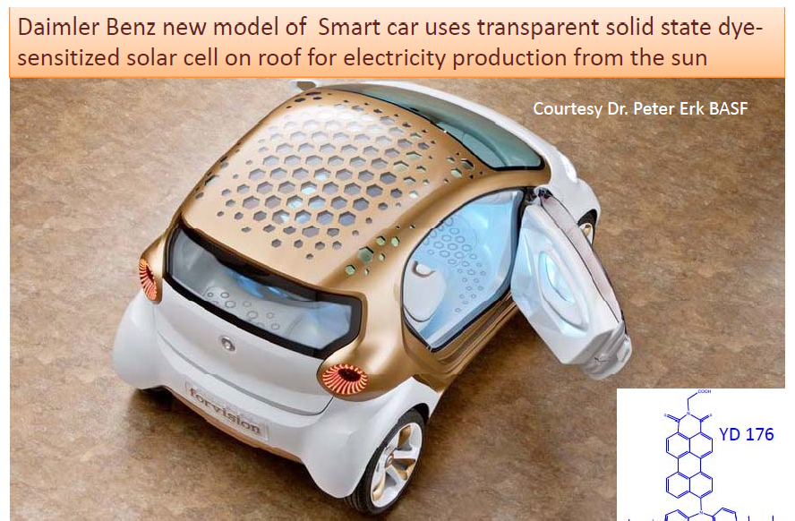
Photoelectrochemical Cell
DSSC

Slide 14
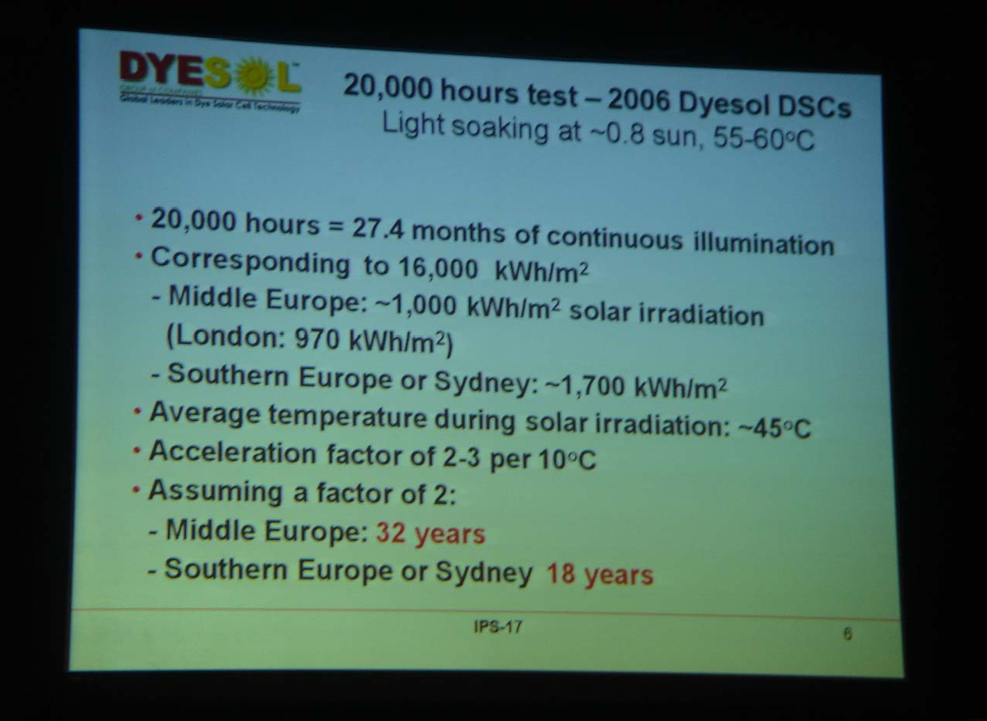
Long Term Stability (LTS)
IPS-17, Sydney, Australia, July 27-August 1, 2008

Slide 15




Photoelectrochemical Cell
DSSC
Photoexcitation of the sensitizer (S) is followed by electron injection into the conduction band of a semiconductor oxide film.
The dye molecule is regenerated by the redox system, which itself is regenerated at the counter electrode by electrons passed through the load.
The energy levels drawn match the redox potentials of the N3 sensitizer ground state and the iodide/triiodide couple.
The voltage generated under illumination corresponds to the difference between the Fermi level of the electron in the solid and the redox potential of the electrolyte.

Slide 16
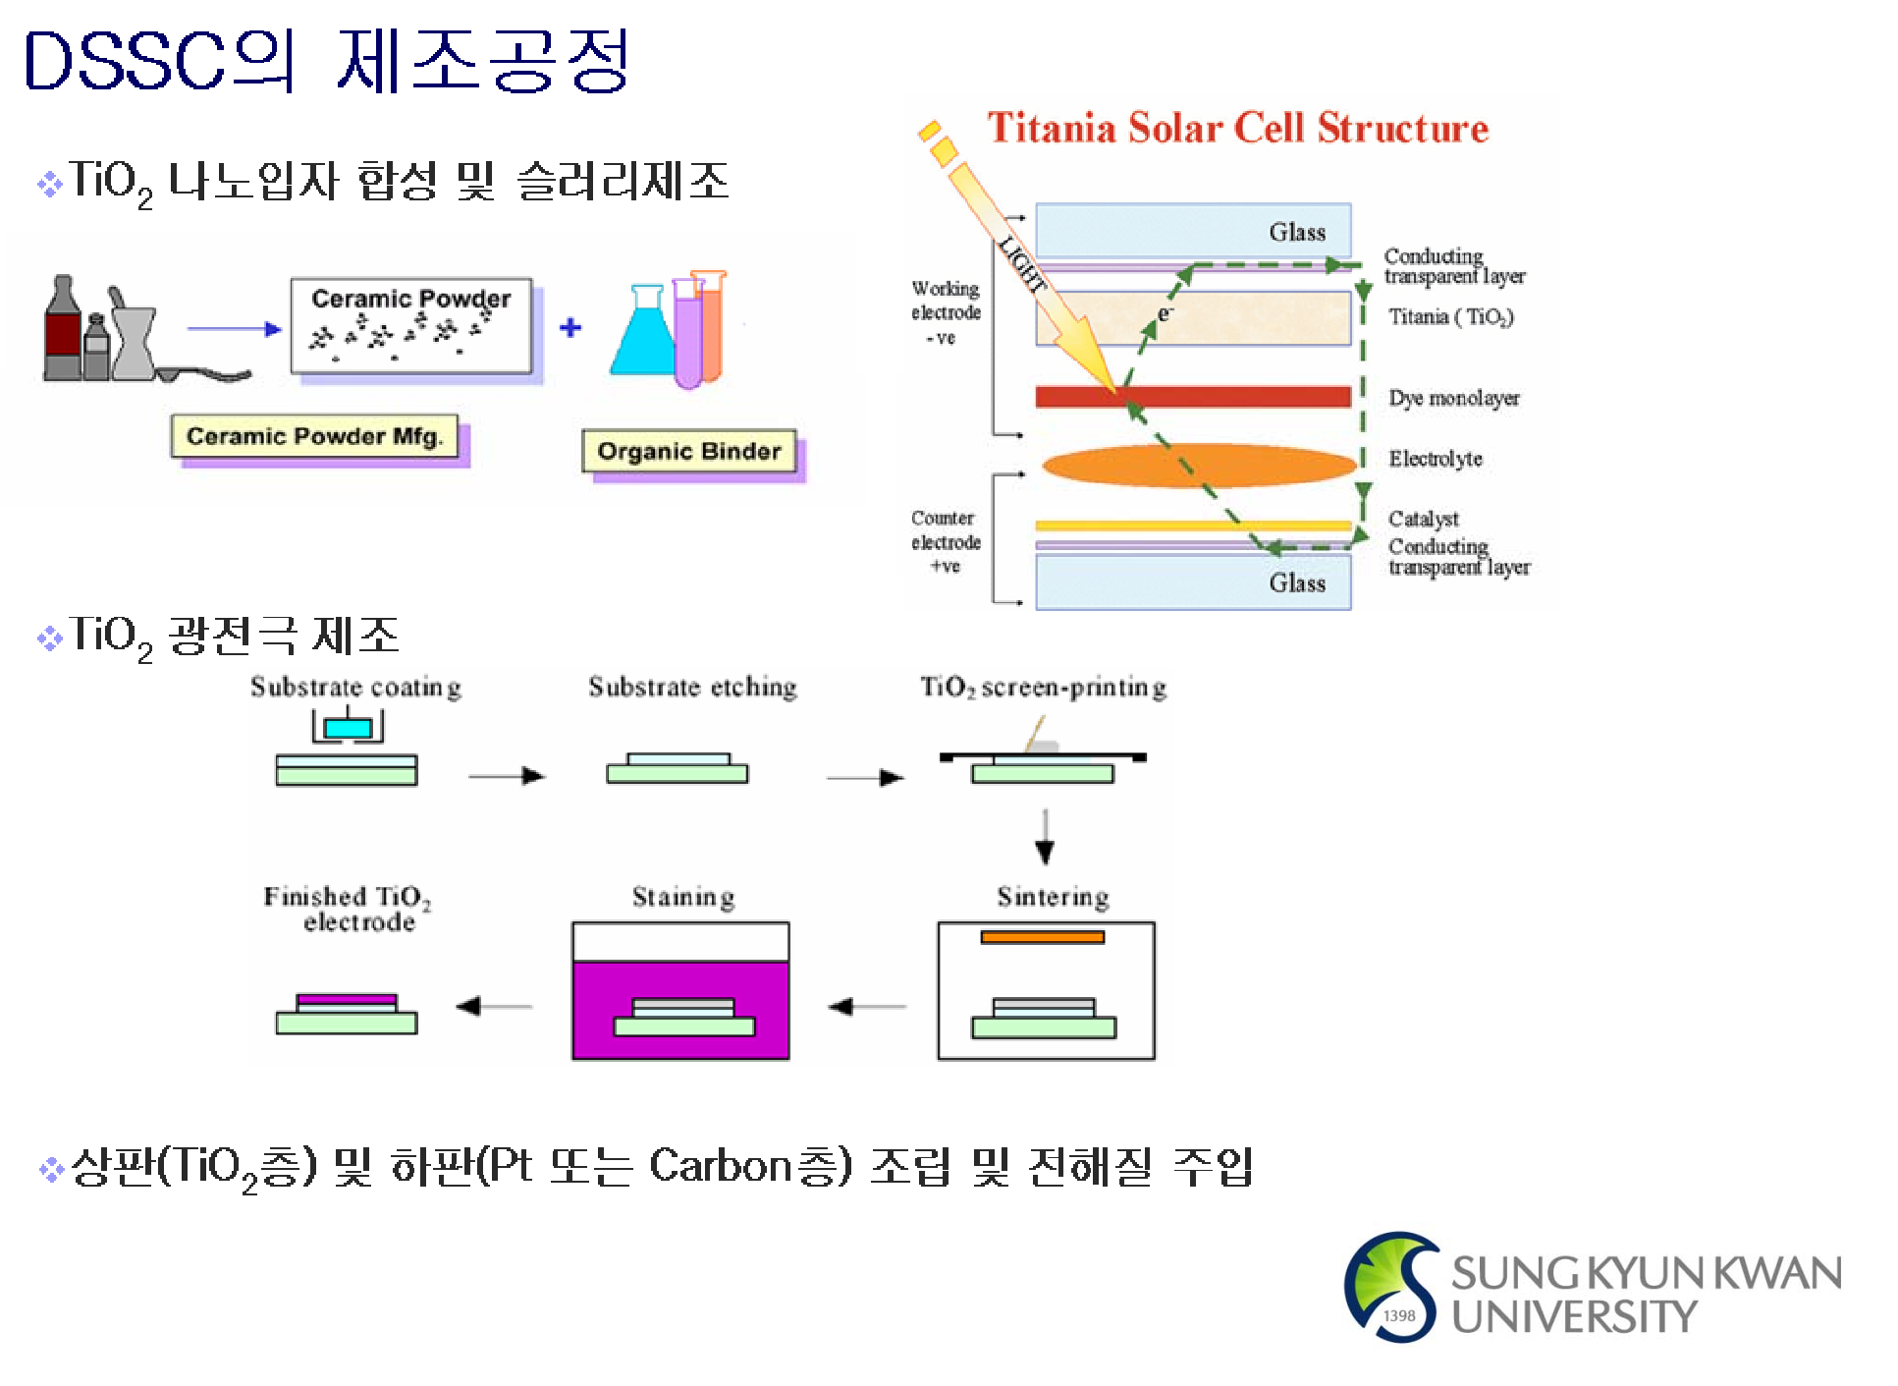
Photoelectrochemical Cell

Slide 17
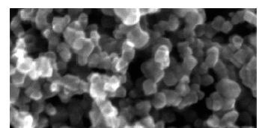
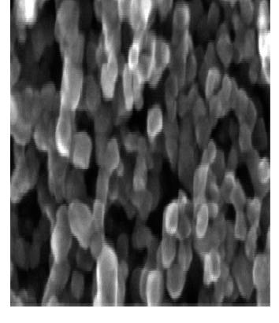
Photoelectrochemical Cell
Film Morphology
The most widely used oxide material is TiO2
Other wide-band semiconductor oxides such as ZnO, SnO2, or Nb2O5 have also been employed.
Nanoparticles of the oxide are deposited by screen printing onto a glass covered with a transparent conducting layer of fluorine-doped tin dioxide (FTO) or tin doped indium oxide (ITO).
Each particle is coated with a monolayer of sensitizer or a QD formed by self-assembly from a staining solution.

Slide 18

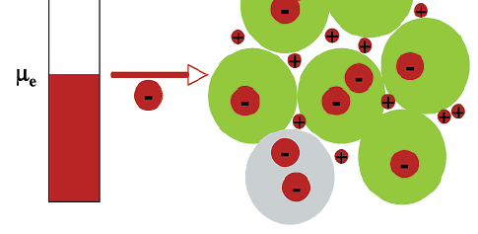
Photoelectrochemical Cell
Charge Transfer
A 20-nm-sized particle contains an electron concentration of 2.4*10¹⁷ cm⁻³.
This corresponds to a specific conductivity of 1.5*10⁻⁴ S cm⁻¹ if a value of 10⁻⁴ cm² s⁻¹ is used for the electron diffusion coefficient. (Let’s calculate it!)
Charges injected in the nanoparticles can be screened on the mesoscopic scale by the surrounding electrolyte.
The electron charge is screened by the cations in the electrolyte, which eliminates the internal field. No drift term appears in the transport equation.

Slide 19
Photoelectrochemical Cell
Light Harvesting
  Consider, for example, a 10-ím-thick mesoscopic oxide film composed of 20-nm-sized particles whose real surface area is over 1000 times greater than the projected one.
  Beer-Lambert’s law can be applied to describe the light absorption in terms of the reciprocal absorption length
=σc
where σ and c are the optical absorption cross section of the sensitizer and its concentration in the mesoporous film, respectively.
  σ = 1*10⁷ ~ 2*10⁷ cm² mol⁻¹ & c = 2*10⁻⁴ mol cm⁻³
  α = 2~4*10³ cm⁻¹ hence, absorption length 1/ α of these sensitizer is 2.5~5 μm.
  Light-harvesting efficiency, LHE, is derived from the reciprocal absorption length via
LHE( ) =1−10⁻
d
d=6 μm, yielding LHE values over 90% in the wavelength range near the absorption maximum of the dye.

Slide 20
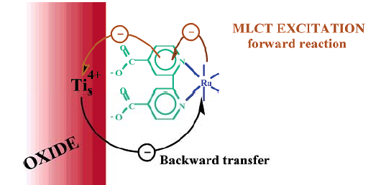
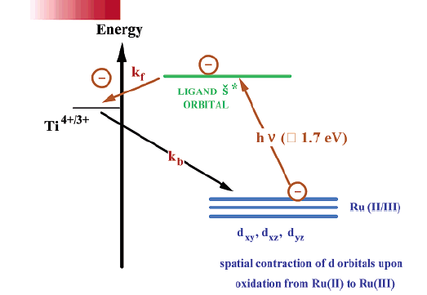
Photoelectrochemical Cell
Incident Photon to Current Conversion Efficiencies
  Incident Photon to Current Conversion Efficiencies (IPCE)
is the number of electrons measured as photocurrent in the external circuit divided by the monochromatic photon flux that strikes the cell.
Here
LHE(ì)
is the light-harvesting efficiency for photons of
wavelength i s the quantum yield for electron injection from the excited sensitizer in the conduction band of the semiconductor oxide, and is the electron collection efficiency.
The lowest energy electronic transition is of metal-to- ligand charge-transfer (MLCT) character.
Injection times are in the pico- or femtosecond range and the quantum yield of charge injection generally exceeds 90%.
ì,
nj i

Slide 21
Photoelectrochemical Cell
Light-Induced Charge Separation
  As the step of the conversion of light into electrical current, a complete charge separation must be achieved.
  For the N-719 ruthenium sensitizer, the forward injection is an extremely rapid process
occurring in the femtosecond time domain.
  Backward reaction with ruthenium dye is 1-2 orders of magnitude smaller for the back electron transfer as compared to injection.
  Charge recombination is, furthermore, inhibited by the existence of an electric field at the surface of the titanium dioxide film.
  A surface field is established spontaneously by proton transfer from the carboxylic acid groups of the ruthenium complex to the oxide surface, producing a charged dipole layer.
  In aprotic media, Li⁺ or Mg²⁺ are potential determining ions for TiO2 and they may be used to charge the surface positively.

Slide 22
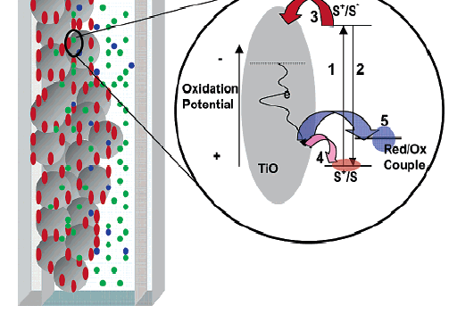

Photoelectrochemical Cell
Charge-Carrier Collection
Apart from recapture by the oxidized dye, the electrons can be lost to the electrolyte by reaction with the oxidized sensitizer from of the redox mediator.
Mastering the interface to impair the unwanted back reaction remains a key target of current research.

Slide 23


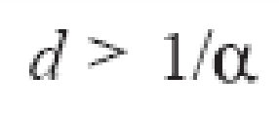
Photoelectrochemical Cell
To reach a high efficiency
  IPCEs should be close to unity over the near-UV, visible, and near-IR wavelength domain.
  A key parameter is the electron diffusion length
where and are the diffusion coefficient and lifetime of the electron, respectively.
Quantitative collection of charge carriers can be achieved only if the electron diffusion length is greater than the film thickness (d)
The film, in turn, needs to be significantly thicker than the light absorption length (1/α) in order to ascertain nearly quantitative harvesting of the light in the spectral absorption range of the molecular sensitizer
De

Slide 24
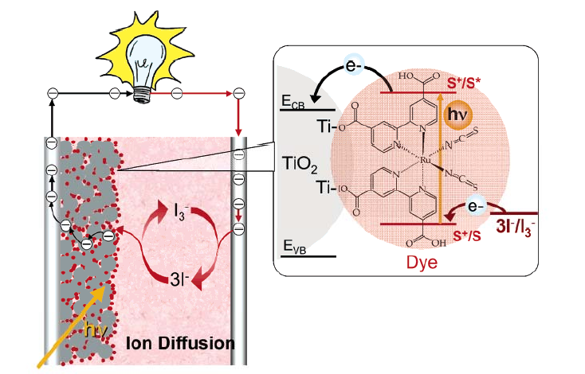
Photoelectrochemical Cell
The redox system employed to regenerate the dye and transport the positive charges to the counter electrode is the iodide/triiodide couple dissolved in an organic electrolyte or in a room- temperature ionic liquid.

Slide 25
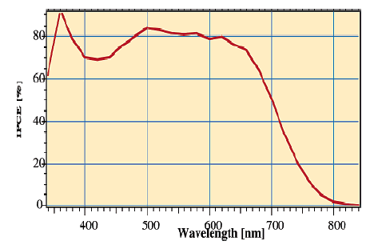
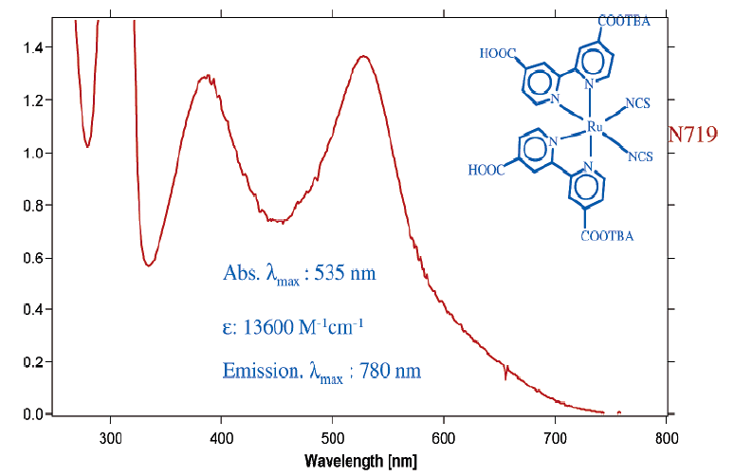
Photoelectrochemical Cell
The IPCE values exceed 80% in the wavelength range near the absorption maximum of the sensitizer, which is located around 530 nm.
At 700 nm, where the absorption of light by the dye is weak however, the IPCE value is still about 50%.
The titania film contained 400-nm-sized light scattering particles, which enhance the optical path length and harvesting of light in the red wavelength region.

Slide 26
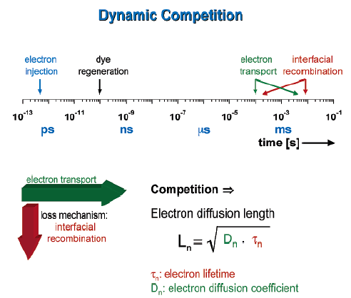
Photoelectrochemical Cell

Slide 27
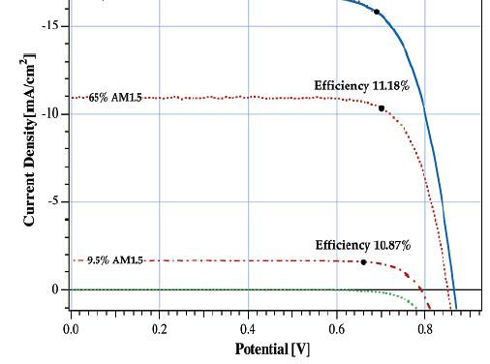
Photoelectrochemical Cell
Photovoltaic Performance
_{η =} V_{m} I_{m =} FF V_{oc} I_{sc}
^{P}light ^{P}light
Under full sunlight (air mass 1.5 global, intensity 1000 W cm⁻²), short-circuit photocurrents ranging from 16 to 22 mA cm⁻² are reached with state-of-the-art ruthenium sensitizers, while Voc is 0.7-0.86 V and FF values are 0.65-0.8. A certified overall power conversion efficiency of 10.4% was attained in 2001.
A new record efficiency of over 11% was achieved recently

Slide 28
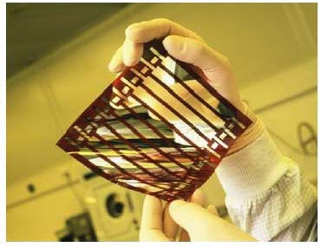
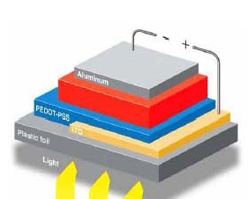

Organic Photovotaic Cell
Advantages
  High absorption coefficient -> Thin film
  Low-cost, lightweight, large-area, flexible
  Colour, semi-transparency
  Insensitivity to temperature
  The ability to control HOMO and LUMO levels

Slide 29
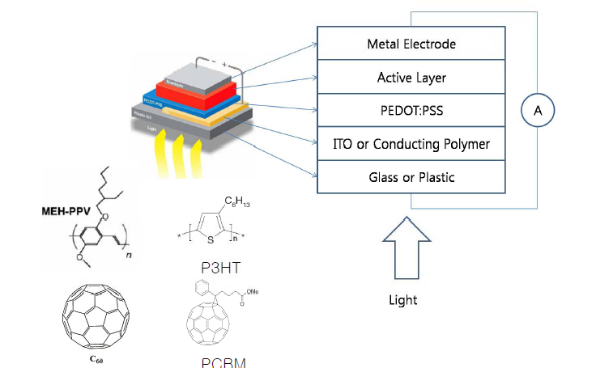
Organic Photovotaic Cell
Device Structure

Slide 30
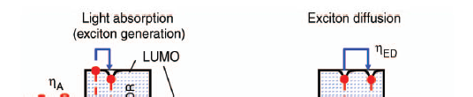



Organic Photovotaic Cell
Operation Sequence
where η_{A} is the absorption efficiency of light within the active region of the solar cell; η_{ED} is the exciton diffusion efficiency to a dissociation
site; η_{CT} is the charge transfer efficiency, which is the efficiency for dissociation of an exciton into a free electron and hole pair
P-N
at that site; and η_{CC} is the charge collection efficiency.

Slide 31
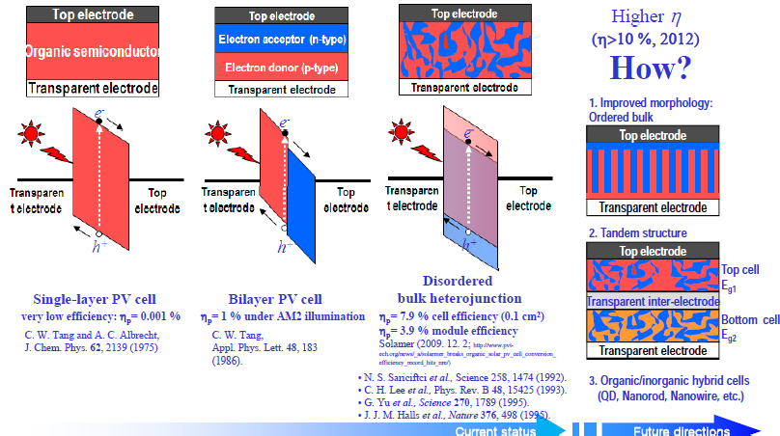
Organic Photovotaic Cell

Slide 32
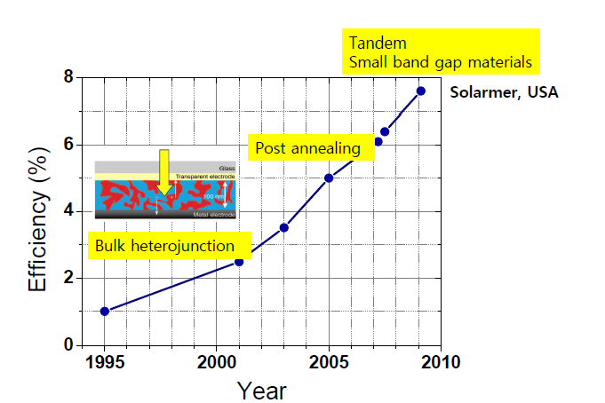
Organic Photovotaic Cell

Slide 33
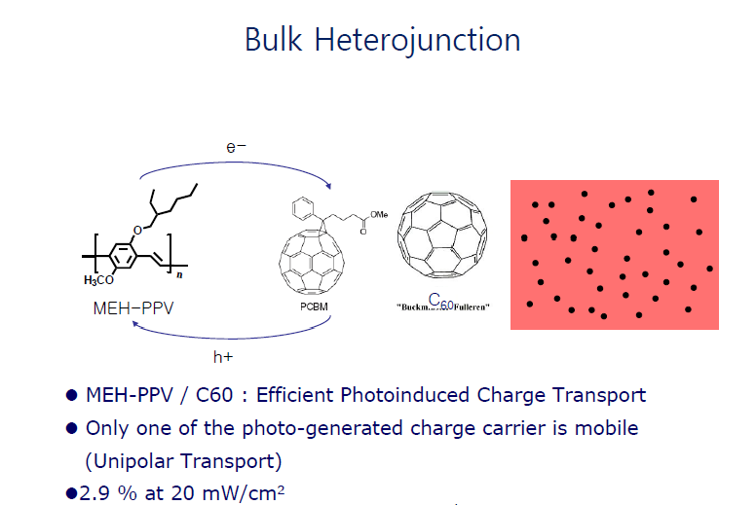
Organic Photovotaic Cell

Slide 34
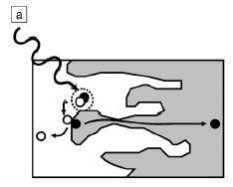
Organic Photovotaic Cell
Bulk and Mixed Heterojunctions
Form a heterojunction (HJ) between the donor and acceptor materials with a very large surface area.
By entangling the regions containing the two constituents, a region is formed whereby photons can be absorbed over a very long distance, creating all excitons within a diffusion length of a DA interface where photoinduced charge transfer can occur.

Slide 35

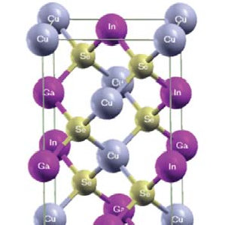
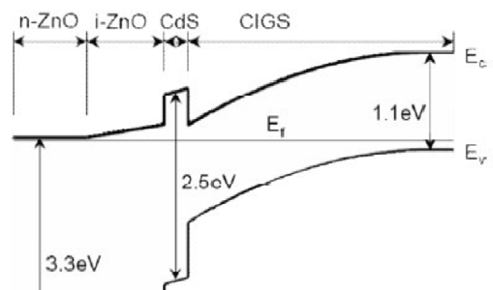


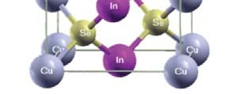
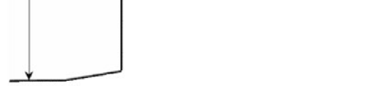
CIGS Structure and Working Principle
CIGS : CuInSe₂ (CIS) doped by Ga as an interstitial
Light absorption 10⁵cm⁻¹, Good Chemical Stability
p type : CuInSe2 thin film, n-type: ZnO thin film
pn junction
Why CdS?: To compensate large difference in lattice parameter and band gap energy between each material (Buffer layer)
ZnO CdS
CIGS
Mo
Substrate
CIGS solar cell structure
Crystal structure of chalcopyrite CIGS
Band diagram

Slide 36




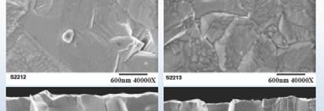



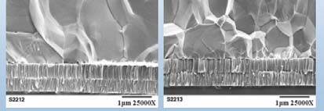


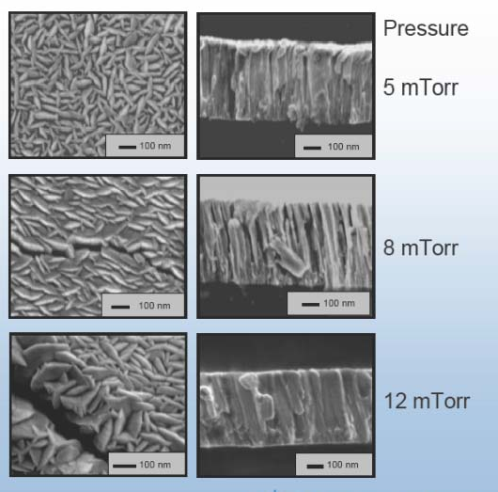
GIGS Solar Cell Process
CIGS solar cell
Sputtering
ZnO, ITO : 250 nm
Chemical bath deposition or Sputtering
CdS : 70 nm
Ga/(In+Ga) :0.26 to 0.31
Cu/(In+Ga) :0.95 to 0.82
Absorber band gap → Efficiency, ^{V}oc
➔ Efficiency 17.5~19.5%
CIGS : 1~2.5 um
Ga/(in+Ga) ratio
Mo : 0.5~1 um
Glass, Metal Foil, plastics
Sputtering
CIGS Deposition Method
Sputtering (vacuum)
Evaporator (vacuum)
Nanoparticle_Ink (Printing)
CVD (low vacuum)
Flexible substrate
→Stainless steel, Ti, polyimide

Slide 37
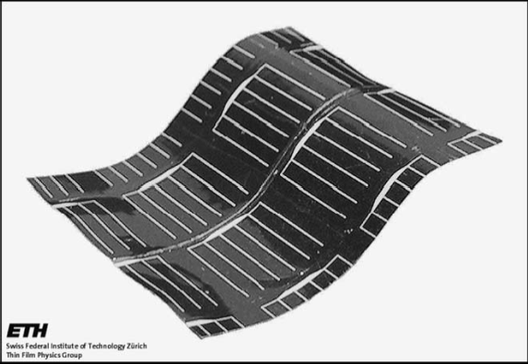
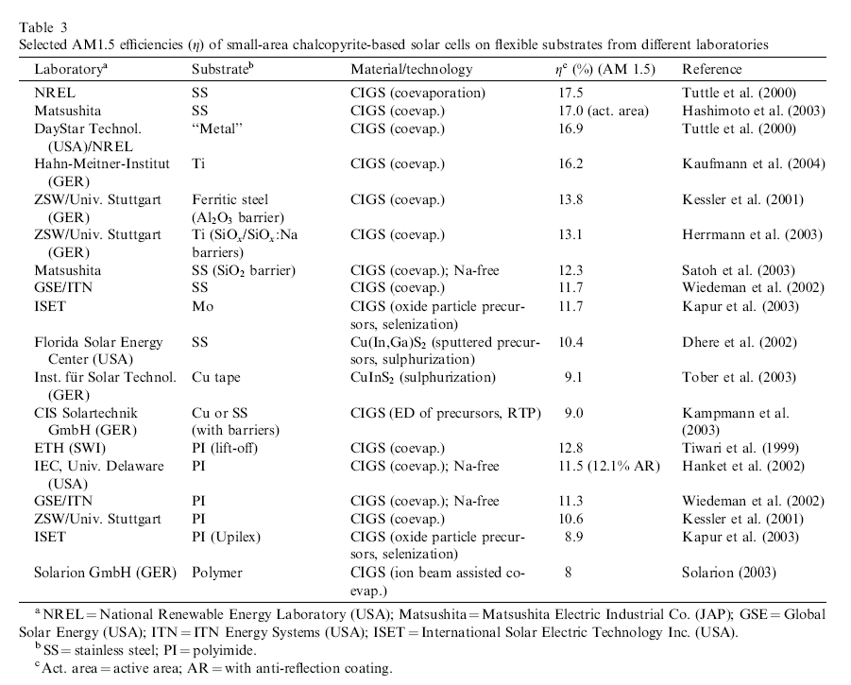
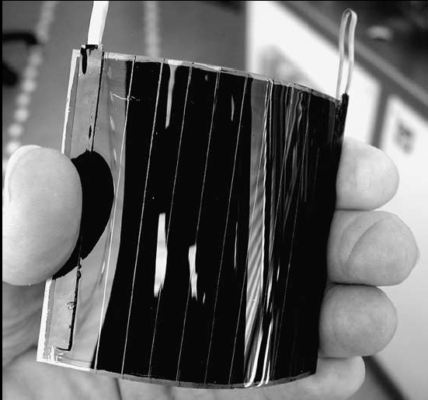
Flexible GIGS
F. Kessler, D. Rudmann Solar Energy 77 (2004) 685–695

Slide 38
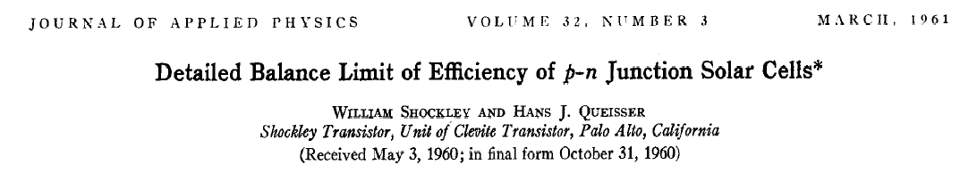










Limit of Efficiency of Solar Cells
P-N Junction Solar Cell
AM1.5 (100mW/cm2)
1 photon: e-h pair (IPCE = 100 %)
no nonradiative recombination
Band gap 1.1 eV: 31 % maximum efficiency (geometric factor 및 impedance matching)
Vg=1.1ev
η= 31 %
tandem cell: 66 %, reported as 42 %, and very expensive

Slide 39

Carrier Multiplication
IPCE>100 % (more than 1 exciton per 1 photon)?
In 1950s, first observed in bulk semiconductor
As first proposed by Nozik (NREL), nanosize semiconductor crystals [nanocrystals(NCs)] might provide a regime where carrier multiplication could be greatly enhanced through impact ionization (II).(energy quantization)
Impact Ionization (II)
  Reverse process of Auger recombination
  utilizing photons more than 2 Eg
  for 1 photon, more than 2 excitons.

Slide 40







Multiple Exciton Generation
Multiple Exciton Generation (not Carrier Multiplication)
Free charge carriers do not exist in isolated QDs
They can only form upon dissociation of the excitons and subsequent separation of the electrons and holes in a device architecture.
M_{max}= maximum from solar spectrum
M₂=2e-h pairs/photon
M₁=e-h pair/photon

Slide 41


























Multiple Exciton Generation
NREL (2008)
PbSe NC Schottky Junction Solar Cell
LANL (2004)
PbSe NCs (0.9 eV)
QY (218%) at 3.8 Eg
NREL (2005, 2006)
PbSe & PbTe NCs
LANL (2006)
QY (300%) at 4 Eg
PbSe NCs
QY (700%) at 7.8 Eg
NREL (2007)
PbSe NC films
QY (164%) at 4 Eg
NREL (2007) Si NCs (1.2 eV)
QY (260%) at 3.4 Eg
LANL (2009)
CdSe NC-a Si Hybrid Solar Cell

Slide 42








QD-based Solar Cells for MEG
QD array as the i-region of a p-i-n photovoltaic cell
QD dispersed in a blend of e and h conducting polymers
QD-sensitized Solar Cells

Slide 43




QD Solar Cell
Sensitized cell
Junction cell (Schottky & Hetero)
large absorption coefficient (more than 10,000 cm⁻¹): absorption capability (more than 90 % - QD:1 μm vs Si:100 μm)
easy to control band gap: by using various QD composition or varying particle size (QD size effect)
Multi Exciton Generation (MEG): IPCE more than 100 %

Slide 44







Multiple Exciton Collection

Slide 45

Junction Type QD Solar Cell

Slide 46




Junction Type QD Solar Cell
The device was composed of a ZnO fi lm made using rf magnetron sputtering; a layer-by-layer dip-coated PbSe CQD film treated using EDT;
electron-blocking layer α -NPD [ N, N - bis(1-naphthalenyl)-N, N ′ -bis(1- phenylbenzidine))]
AM1.5G efficiency of 1.6%
′

Slide 47



Junction Type QD Solar Cell
Under 0.94 sun illumination, the best devices showed a Voc of 0.51 V, a Jsc of 16.2 mA cm⁻² , and FF of 58%, corresponding to an efficiency of 5.1%.

Slide 48



Peroveskite Thin Film Solar Cells
16 %

Slide 49

Peroveskite Thin Film Solar Cells

Slide 50

Peroveskite Thin Film Solar Cells

Slide 51

Peroveskite Thin Film Solar Cells
Light Absorption Coefficient : more than 1.5 x 10⁻⁴ cm-1
Wave length : up to ~ 800 nm

Slide 52

Peroveskite Thin Film Solar Cells

Slide 53

Peroveskite Thin Film Solar Cells

Slide 54


Peroveskite Thin Film Solar Cells

Slide 55

Peroveskite Thin Film Solar Cells

Slide 56

Peroveskite Thin Film Solar Cells

Slide 57

Peroveskite Thin Film Solar Cells

Slide 58


Peroveskite Thin Film Solar Cells

Slide 59



Peroveskite Thin Film Solar Cells

Slide 60


Peroveskite Thin Film Solar Cells

