Slide 1
HEAT EXCHANGERS 1313
synthetic-phosphopeptides in the rat. Journal of Dental Research 74: 1272-1279.
Reynolds EC and Johnson IH (1981) Effect of milk on caries incidence and bacterial composition of dental
plaque in the rat. Archives of Oral Biology 26: 445-451.
Rosen S, Min DB, Harper DS et al. (1984) Effect of cheese, with and without sucrose, on dental caries and recovery
of Streptococcus mutans in rats. Journal of Dental Research 63: 894-896.
Silva MFdeA, Burgess RC, Sandham HJ and Jenkins GN (1987) Effects of water-soluble components of cheese
on experimental caries in humans. Journal of Dental Research 66: 38-41.
Thylstrup A and Fejerskov O (1986) Textbook of Cariology. Copenhagen: Munksgaard.
HEAT EXCHANGERS
U Bolmstedt, Tetra Pak Processing Components AB, Lund, Sweden
Copyright 2002, Elsevier Science Ltd. All Rights Reserved
of 72 ºC, held at that temperature for 15 s and then chilled again to 4 ºC. The heat of the pasteurized milk is utilized to warm the cold milk. The process takes place in a heat exchanger and is called regenerative heat exchange or, more commonly, heat recovery. As much as 94-95% of the heat content of the pasteur- ized milk can be recycled.
Control of Product Temperature
One of the most important requirements of modern dairying is to be able to control the temperature of products at every stage in the process. Heating and cooling are therefore very common operations in the dairy.
Heat Transfer
Theory
Heat can be transferred in three ways: by conduction, convection and radiation.
Heating
Milk is heated by a heating medium such as low- pressure steam (very seldom used nowadays) or hot water, so that the temperature of the product rises and the temperature of the water drops corres- pondingly (see Services in Processing Plants: Heat Generation).
Conduction means transfer of thermal energy through solid bodies or through layers of liquid at rest (without physical flow or mixing in the direction of heat transfer).
Convection occurs when fluids (gases or liquids) at a high temperature are mixed with colder fluids and transfer their heat to the latter by conduction; hence, convection involves mixing.
Radiation is the emission of heat from a body that
has accumulated thermal energy. The thermal energy is converted to radiant energy, emitted from the body and absorbed by other bodies, which it strikes. Almost all substances emit radiant energy.
Cooling
On arrival at the dairy the milk is cooled to 5 ºC or lower, to limit microbiological growth. Following pasteurization, the milk is cooled to about 4 ºC using chilled water, brine solution or an alcohol solution such as propylene glycol.
Regenerative Heating and Cooling
In many processes, a product must first be heated and then cooled. During pasteurization, milk is heated from, perhaps, 4 ºC to a pasteurization temperature
Principles
Heat transfer in dairies occurs by convection and conduction. Two principles are used: direct and indirect heating.

Slide 2


1314 HEAT EXCHANGERS
Direct heating Direct heating means that the heating medium is mixed with the product. This tech- nique is used:
to heat water; steam is injected directly into the water and transfers heat to the water
to heat products such as curd in the manufacture of certain types of cheese (by mixing hot water with the curd), and to sterilize milk or milk products by steam injection or infusion of the product into steam.
The direct method of heat transfer is efficient for rapid heating. It offers certain advantages, especially in long-life, ultra-heat-treated (UHT) milk production, where heating is followed by rapid flash-cooling. It does, however, involve mixing the product with the heating medium, which necessitates certain steps in the subsequent process. It also makes strict demands on the quality of the steam. Direct heating is forbidden by law in some countries on the grounds that it introduces foreign matter into the product.
layer on the other side is almost entirely by conduc- tion, while further transfer to the milk in the central zone of the channel is accomplished by both con- duction and convection.
The Heat Exchanger
A heat exchanger is used to transfer heat by the indirect method. The temperature profiles of the heating medium and milk in a typical tubular heat exchanger are shown in Figure 2.
Dimensioning Data for a Heat Exchanger
The size and configuration of a heat exchanger depend on many factors. The calculation is intricate and is normally done with the aid of a computer. The factors that must be considered are:
product flow rate
physical properties of the liquids
temperature programme
permitted pressure drop
heat exchanger design
cleanability requirements
running time requirement.
The formula for calculating the heat transfer area of a heat exchanger is:
Indirect heating Indirect heat transfer is therefore the most commonly used method in dairies. With this method, heat is transferred from the heating medium through a partition into the product (Figure 1). In a plate heat exchanger, the plate is the partition. The velocity of the liquids is reduced by friction to almost zero at the boundary layer in contact with the partition. The velocity increases progressively and is highest at the centre of the channel. The temperature of the hot water is highest in the middle of the channel. The closer the water is to the partition, the more it is cooled by the cold milk on the other side. Heat is transferred, by convection and conduc- tion, to the boundary layer. Transfer from the boundary layer through the wall to the boundary
A =
Q x p x c_{p} x � t
�t_{m} x k
[1]
where A = required heat transfer area, Q = product flow rate, p = density of the product, c_{p} = specific heat
°C
^{t}i2
t °C
^{t}o1
Heat flow
t
o2
^{t}i1
Time
^{t}o1
^{t}i1
^{t}i2
^{t}o2
Figure 1 Heat transfer from a heating medium to a cold product on the other side of the partition. (Courtesy of Tetra Pak.)
Figure 2 Temperature proiles for heat transfer in a heat exchanger with countercurrent low. (Courtesy of Tetra Pak.)

Slide 3
HEAT EXCHANGERS 1315
of the product, �t = temperature change of the prod- uct, �t_{m} = logarithmic mean temperature difference (LMTD), and k = overall heat transfer coefficient.
Countercurrent flow The temperature difference between the two liquids is best utilized if they flow in opposite directions through the heat exchanger (Figure 2). The cold product then meets the cold heating medium at the inlet and a progressively warmer medium as it passes through the heat ex- changer. During its passage, the product is gradually heated so that the temperature is always only a few degrees below that of the heating medium at the corresponding point. This type of arrangement is called countercurrent flow.
Product flow rate The flow rate Q is determined by the planned capacity of the dairy. Other factors being constant, the size of the heat exchanger is directly proportional to the flow rate.
Physical properties of the liquids These include dens- ity, p, specific heat, c_{p} and viscosity, µ. The values depend on product and temperature.
Temperature programme Several aspects of the operating temperature must be considered, including the change of temperatures, the differential tem- perature between the liquids and the flow direction of the liquids.
Co-current flow With the opposite arrangement, co-current flow (Figure 3), both liquids enter the heat exchanger from the same end and flow in the same direction. In co-current flow it is impossible to heat the product to a temperature higher than that which would be obtained if the product and the heating medium were mixed. This limitation does not apply in countercurrent flow; the product can be heated to within 2-3 ºC of the inlet temperature of the heating medium.
Temperature change Inlet and outlet temperatures of the product are determined by preceding and subsequent process stages. The change of product temperature (�t in the general formula above) can be expressed as (Figure 2):
�t₁ = t_{o1} - t_{i1} [2]
The inlet temperature for the service medium is determined by processing conditions. The temperat- ure of the outgoing service medium can be calculated by an energy balance calculation. For a modern heat exchanger, the energy losses to the surrounding air can be neglected. Thus, the heat lost by the hot liquid is equal to the heat gained by the cold liquid. It can be expressed as:
Q₁ x p₁ x c_{p1} x �t₁ = Q₂ x p₂ x c_{p2} x �t₂ [3]
Overall heat transfer coefficient This factor, k, is a measure of the efficiency of the heat transfer. It in- dicates how much heat passes through 1 m² of the partition per 1 ºC of differential temperature. In a heat exchanger, k should be as high as possible. The heat transfer coefficient depends on the following:
permitted pressure drops for the liquids
viscosities of the liquids
shape and thickness of the partition
material of the partition
presence of fouling matter.
°C
^{t}i2
Logarithmic mean temperature difference There must be a difference in temperature between the two media for heat transfer to take place. The differential temperature is the driving force. For sensitive prod- ucts there are, however, limits to how great a difference can be used. The differential temperature can vary through the heat exchanger. A mean value, LTMD or �t_{m}, is used for calculation.
Δt_{m}
^{t}o2 ^{t}o1
^{t}i1
Time
( - ) - ( - )
^{t}i1
^{t}o1
�t =
ti2 to1 to2 ti1
[4]
m
ln ((t_{i2} - t_{o1})/(t_{o2} - t_{i1}))
An important factor in determining the mean tem- perature differential is the direction of the flow in the heat exchanger. There are two main options: coun- tercurrent or co-current flow.
^{t}i2
^{t}o2
Figure 3 Temperature proiles for heat transfer in a heat exchanger with co-current low. (Courtesy of Tetra Pak.)

Slide 4
1316 HEAT EXCHANGERS
Permitted pressure drop To increase the value of k, and improve heat transfer, it is possible to reduce the size of the channel through which the product flows. This reduces the distance over which heat must be transferred from the partition to the centre of the channel. At the same time, however, the cross- sectional area of flow is reduced.
As a result:
the flow velocity through the channel increases, which in turn
makes the flow more turbulent
increases the pressure drop.
The greater the allowed pressure drops for product and service media, the more heat is transferred and the smaller the heat exchanger needed. Products that are sensitive to mechanical agitation (e.g. milk fat) may, however, be damaged by violent treatment. The product pressure before the heat exchanger must be increased to force the product through the nar- rower channels. It may then be necessary to install a booster pump. In some countries, installation of a booster pump is specified in legal requirements, basically to secure a higher pressure on the product side and thus prevent leakage of unpasteurized product into pasteurized product.
Presence of fouling matter Most dairy products are sensitive to heating, which must therefore be done very carefully to avoid product damage. If the sur- face is too hot in relation to the product, there is a risk that proteins in the milk will coagulate and be deposited in a thin layer on the partitions. The dif- ferential temperature between heating medium and product should therefore be as small as possible, normally 2-3 ºC above the pasteurization temperat- ure. Heat must be transferred through the deposit, reducing the value of the overall heat transfer coef- ficient, k. The temperature differential between the heating medium and product will then no longer be sufficient to transfer the same amount of heat as before, and the product outlet temperature will drop. This can be compensated for by increasing the temperature of the heating medium, but this also raises the temperature of the heat transfer surface so that more protein coagulates on the surface, the thickness of the crust increases and the value of k drops still further.
The value of k is also affected by the flow rate through the heat exchanger. Increasing the flow rate makes the flow more turbulent and increases the value of k. Throttling the flow reduces the turbulence and hence also reduces the value of k. In modern pasteurizers and sterilizers the possibility of variable capacity is often included. In addition, multipurpose
plants, i.e. plants designed for processing of various products in combination, are today common. As an
example, a modern milk sterilizer for 10 000 l h⁻¹ of whole milk may be capable of also processing milk-
based vanilla pudding at 5000 l h⁻¹.
In calculating the heat transfer area, the sensitive nature of the product and the process demands must also be considered. Two such factors, not included in the formula, are the requirements for cleanability and running time.
Heat exchanger design
Viscosity of media The viscosity of the product and the service medium are important to the dimen- sioning of a heat exchanger. A liquid with high vis- cosity develops less turbulence when it flows through the heat exchanger compared to a product with lower viscosity. This means that a larger heat exchanger is needed, everything else being constant. Special atten- tion must be paid to products with non-Newtonian flow behaviour. For these products, the apparent viscosity depends not only on the temperature but also on the shear rate. A product that seems rather thick in a tank may flow much more readily when it is pumped through pipes or a heat exchanger.
Cleanability requirements A heat exchanger in a dairy must be cleaned at the end of a production cycle, by circulating detergents. To achieve efficient cleaning, the heat exchanger must be designed not only to meet the temperature requirements, but also with cleaning in mind. If some passages in the heat exchanger are very wide, i.e. have several parallel channels, the turbulence during cleaning may not be enough to remove fouling deposits effectively. On the other hand, if some passages are very narrow, i.e. few parallel channels, the turbulence may be so high that the pressure drop will be very great. Such a high pressure drop may reduce the flow velocity of the cleaning solution, thereby reducing its effectiveness. A heat exchanger must therefore be designed for effective cleaning.
Shape and thickness of the partition The partition is often corrugated to create a more turbulent flow, which results in better heat transfer (Figure 4). The thickness is also important; the thinner the partition, the better the heat transfer. However, this must be balanced against the need for the partition to be strong enough to withstand the pressure of the liquids. Modern design and production techniques allow thin- ner partitions than were possible only a few years ago.
Material of the partition For food processing, the normal material is stainless steel, which has fairly good heat transfer characteristics.

Slide 5
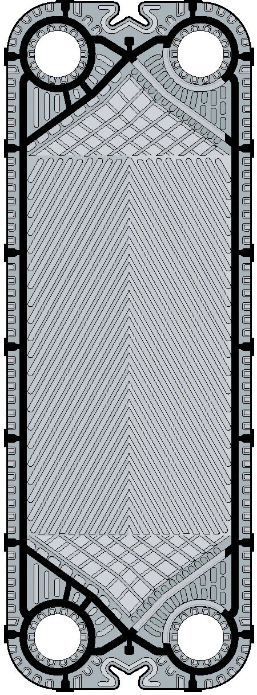
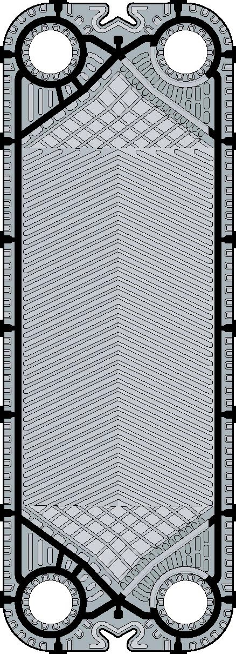
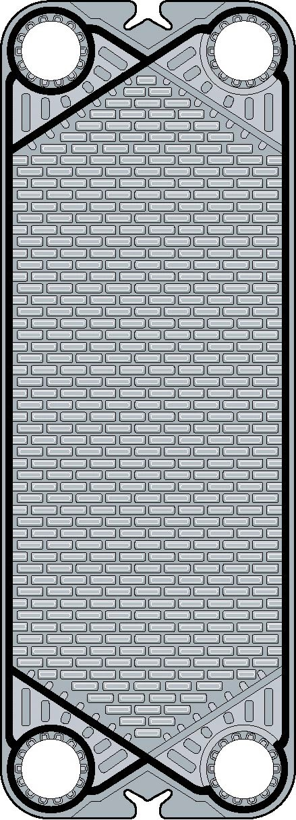
HEAT EXCHANGERS
1317
(A)
(B)
(C)
Figure 4
The shape of the partition in a plate heat exchanger may differ depending on the product to be treated and thermal
eficiency requirements. (A) and (B) herringbone pattern; (C) washboard pattern. (Courtesy of Tetra Pak.)
Running time requirement Some fouling always oc- curs when milk products are heated to a temperature above 65 ºC. Hence, the pasteurizer must be stopped periodically for cleaning. The length of the running time is difficult, not to say impossible, to predict, as it is determined by the degree of fouling which depends on factors such as:
This is, however, rare; when it occurs it is usually related to the pretreatment of the milk.
Hence it is important to allow for cleaning at regular intervals when making production plans for pasteurizers.
Regeneration
Using the heat of a hot liquid, such as pasteurized milk, to preheat cold incoming milk is called regeneration. The cold milk also serves to cool the hot milk, thus economizing on water and energy. Regeneration effi- ciencies of up to 94% or 95% can be achieved in efficient modern pasteurization plants.
The percentage of regeneration is calculated as:
temperature difference between product and heat- ing medium
milk quality
air content of the product
pressure conditions in the heating section.
It is especially important to keep the air content as low as possible. Excess air in the product will greatly contribute to increased fouling. Under certain con- ditions, the running time may also be limited by the growth of microorganisms in the downstream part of the regenerative section of a plate heat exchanger.
R =
( t_{r} - t_{i} ) x 100
(t_{p} - t_{i})
[5]
where R = regenerative efficiency (%), t_{r} = milk temperature (ºC) after regeneration, t_{i} = temperature

Slide 6
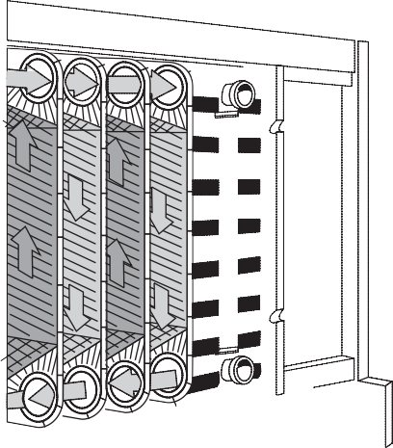
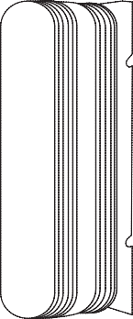

1318 HEAT EXCHANGERS
(ºC) of raw incoming milk, and t_{p} = pasteurization temperature (ºC).
of treatment, such as preheating, final heating and cooling, take place. The heating medium is hot water, and the cooling medium cold water, ice water or propylene glycol, depending on the required product outlet temperature.
The plates are corrugated in a pattern designed for optimum heat transfer. Formerly, the so-called washboard pattern (Figure 4C) was predominant but today the herringbone pattern is normally used for all types of plates, also within the dairy industry (Figure 4A and 4B). The main advantages with the herringbone pattern are increased thermal efficiency
and increased mechanical strength, the latter allow- ing the plates to be made thinner, which reduces cost
and weight of the plate. The increased thermal efficiency reduces the necessary number of plates, which in turn reduces the cost of the unit and also product hold-up volume.
The plate pack is compressed in the frame. Sup- porting points on the corrugations hold the plates
apart so that narrow channels are formed between them. The liquids enter and leave the channels
through holes in the corners of the plates. Varying patterns of open and blind holes route the liquids from one channel to the next. Gaskets around the edges of the plates and around the holes form the boundaries of the channels and prevent external leakage and internal mixing. Figure 5 shows a typical arrangement.
Holding
Correct heat treatment requires that the milk is held for a specified time at the pasteurization temperature. This is done in an external holding cell, which usually consists of a pipe arranged in a spiral or zigzag pattern and often covered by a metal shroud to protect operators against burns. The length of the pipe and the flow rate are calculated to provide the required holding time. Accurate control of the flow rate is essential to achieve the specified holding time. The holding time changes in inverse proportion to the flow rate.
Calculation of holding time The appropriate tube length can be calculated when the hourly capacity and the inner diameter of the holding tube are known. As the velocity profile in the holding tube is not uniform, some milk molecules will move faster than the average. To ensure that even the fastest molecule is pasteurized sufficiently, an efficiency factor, r,, must be used. This factor depends on the design of the holding tube, but is often in the range of 0.8-0.9.
The length, L, of the holding cell is calculated as follows:
Q x H
dm
3
[6]
^{V =} 3600 r,
x
L = _{1r}
V x 4
m
[7]
_{d}2
x x 10
where Q = flow rate at pasteurization
(l h⁻¹),
H = holding time (s), L = length (m) of holding
tube, d = inner diameter (dm) of holding tube, V = volume (l or dm³) of milk, and r, = efficiency factor, dimensionless.
Types of Heat Exchangers
The following three types of heat exchanger are most widely used in the dairy industry:
plate heat exchangers
tubular heat exchangers
scraped-surface heat exchangers.
Plate heat exchangers Most heat treatment of dairy products is carried out in plate heat exchangers. The plate heat exchanger (often abbreviated PHE) con- sists of a pack of stainless-steel plates clamped in a frame. The frame may contain several separate plate packs - sections - in which different stages
Figure 5 Principles of low and heat transfer in a plate heat exchanger. (Courtesy of Tetra Pak.)

Slide 7
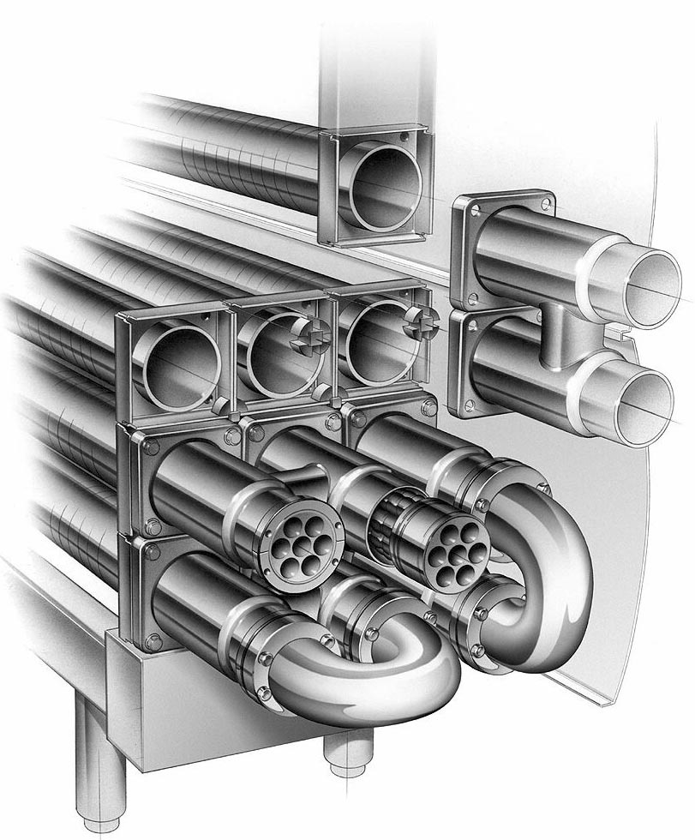
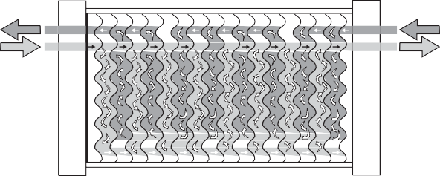
HEAT EXCHANGERS 1319
Flow patterns The arrangement of the plates is such that the product flows through alternate chan- nels in the plate pack. The service (heating or cool- ing) medium is introduced at the other end of the section and passes through alternate plate channels. Each product channel consequently has service medium channels on both sides. For efficient heat transfer, the channels between the plates should be as narrow as possible, but both flow velocity and pressure drop will be high if a large volume of product must pass through these narrow channels. Neither of these effects is desirable and, to eliminate them, the passage of the product through the heat exchanger may be divided into a number of parallel flows. In Figure 6, the product flow is divided into two parallel flows which change direction four times in the section. The channels for the heating medium are divided into four parallel flows which change direction twice. This combination is written as 4x2/ 2x4, i.e. the number of passes multiplied by the number of parallel flows for the product over the number of passes multiplied by the number of par- allel flows for the service medium. This is called the grouping of the plates.
principle, with the product flowing through a group of parallel tubes and the service medium between and around the tubes. Turbulence for efficient heat transfer is created by helical corruga- tions on the tubes and shell. The heat transfer sur- face consists of a bundle of straight corrugated or smooth tubes welded into tube plates at both ends. The tube plates are in turn sealed against the outer shell by a double O-ring construction (floating design). This design allows the product tubes to be taken out of the shell by unscrewing the end bolts and this makes the unit strippable for inspection. The floating design absorbs thermal expansion and the product tube bundles in the shell can be changed, allowing different combinations to be used for different applications. The monotube is a ver- sion with only one inner tube, which will permit particles with a diameter up to 50 mm to pass. Multi/ mono tubes are well suited for processes operating at very high pressures and high temperatures.
Concentric tubes The heat transfer surface of a concentric tubular heat exchanger consists of straight tubes of different diameters concentrically located on a common axis by headers at both ends. The product flows in the gap between two concentric tubes and the service medium on both sides of these
Tubular heat exchangers Tubular heat exchangers (THE) are today normally used for UHT treat- ment of dairy products. The tubular heat exchanger (Figure 7), unlike plate heat exchangers, has no contact points in the product channel and can thus handle products with particles, the maximum particle size depending on the diameter of the tube. The tubular heat exchanger can also run longer between cleanings than the plate heat exchanger in UHT treatment. From the standpoint of heat transfer, the tubular heat exchanger is less efficient than a plate heat exchanger. Tubular heat exchangers are avail- able in two fundamentally different types; multi/ mono tube and concentric tube.
Multi/mono tubes The multitube tubular heat ex- changer operates on the classic shell-and-tube
Figure 6 The system of parallel low pattern for both product and heating/cooling medium channels. In this example the combination is written 4x2 / 2x4. (Courtesy of Tetra Pak.)
Figure 7 The tubular heat exchanger tubes are assembled in a compact unit. (Courtesy of Tetra Pak.)

Slide 8
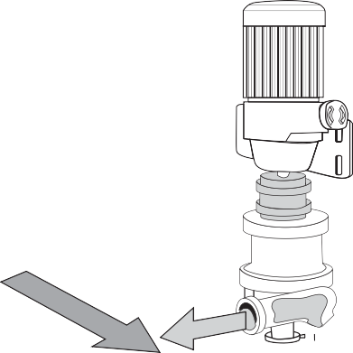

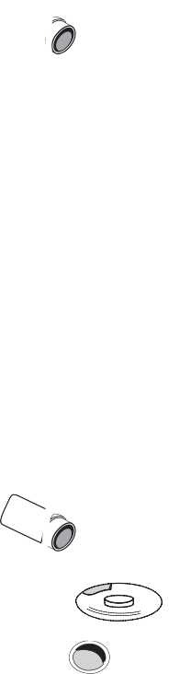
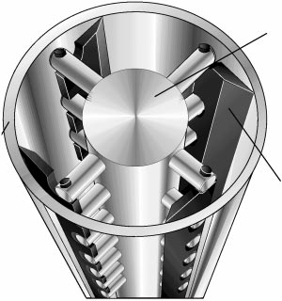
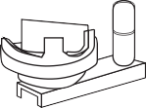
1320 HEAT EXCHANGERS
tubes. The floating design as described above is also applied to the concentric tubes. In addition, the multi/ mono tube inserts and the concentric tube inserts are interchangeable for maximum flexibility. The concentric tube is especially suited for processing viscous products, such as dessert puddings. Due to the thin product layer in the annular channel, very efficient heat transfer is achieved. Also, due to the single product channel design, the risk of maldis- tribution across parallel tubes on viscous products is eliminated.
The product exits the cylinder via the upper port. Product flow and rotor speed are varied to suit the properties of the product flowing through the cylinder. At shutdown, thanks to the vertical design, the product can be displaced by water with minimum intermixing, which helps assure product recovery at the end of every run. Follow- ing this, complete drainage facilitates cleaning- in-place (CIP) and product changeover. As men- tioned above, rotor and blades are exchangeable, an operation which is possible owing to the auto-
Scraped-surface heat exchangers The scraped-surface heat exchanger (Figure 8) is designed for heating and cooling viscous, sticky or lumpy products and for crystallization of products. The operating pressures on the product side are high, often as much as 4 MPa. All products that can be pumped can therefore be treated. A scraped-surface heat exchanger consists of a cylinder through which the product is pumped in countercurrent flow to the service medium in the surrounding jacket. Exchangeable rotors of various diameters, from 50.8 to 127 mm, and varying pin/ blade configurations allow adaptation to different applications. Smaller diameter rotors allow larger particles (up to 25 mm) to pass through the cylinder, while larger diameter rotors result in shorter resid- ence time and improved thermal performance. The product enters the vertical cylinder through the lower port and continuously flows upward through the cylinder. At process start-up, all the air is completely purged ahead of the product, allowing complete and uniform product coverage of the heating or cooling surface.
The rotating blades continually remove the product from the cylinder wall (Figure 9), in order to ensure uniform heat transfer to the product. In addition, the surface is kept free from deposits.
matic hydraulic lift that facilitates raising and lowering the rotor/blade assembly (Figure 10).
Heating or cooling medium
Cylinder Rotor Blade
Rotor
Cylinder
Blade
Product
Figure 8 Vertical type of scraped-surface heat exchanger. (Courtesy of Tetra Pak.)
Figure 9 Section through a scraped-surface heat exchanger. (Courtesy of Tetra Pak.)

Slide 9
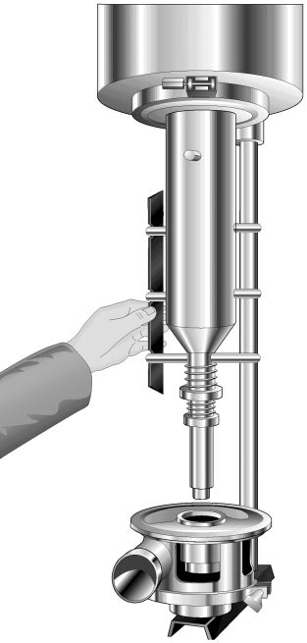
HEAT STABILITY OF MILK 1321
of margarine and shortenings. The scraped-surface heat exchanger is also available in versions designed for aseptic processing. Two or more ver- tical-type scraped-surface heat exchangers can be linked in series or parallel to give a greater heat transfer surface depending on the processing capacity required.
See also: Liquid Milk Products: Pasteurized Milk; Super-Pasteurized Milk; Sterilized Milk. Pasteurization of Liquid Milk Products: Pasteurizers, Design and Operation. Process and Plant Design. Services in Processing Plants: Heat Generation. Ultra-High Temperature Treatment (UHT): Heating Systems.
Further Reading
Bylund G (1995) Dairy Processing Handbook. Lund, Sweden: Tetra Pak Processing Systems.
Coulson JM and Richardson JF (1990) Chemical Engin- eering, vol. 1. Oxford: Butterworth-Heinemann.
Eastop TD and McConkey A (1993) Applied Thermo- dynamics for Engineering Technologists. Harlow:
Longman.
Heldman DR and Lund DB (eds.) (1992) Handbook of Food Engineering. New York: Marcel Dekker.
McCabe WL, Smith JC and Harriott P (2000) Unit Operations of Chemical Engineering, 6th edn. New York: McGraw-Hill Kogakusha Ltd.
Sneeden J-BO and Kerr SV (1969) Applied Heat for Engineers, 4th edn. London: Blackie Academic and Professional.
Figure 10 Removal of blades from the rotor assembly in lowered position. (Courtesy of Tetra Pak.)
Typical products treated in the scraped-surface heat exchanger are ice cream and dairy spread, but fruit preparations, such as yoghurt, are also treated. It is also used for fats and oils for crystallization
HEAT STABILITY OF MILK
J E O'Connell and P F Fox, University College Cork, Cork, Ireland
Copyright 2002, Elsevier Science Ltd. All Rights Reserved
subjected to at least one heat treatment. The objective for the heat treatment of milk varies considerably, from being part of the manufacturing process for specific products, e.g. coprecipitates and yoghurt, to enabling the production of stable and safe products through the reduction or elimination of spoilage and pathogenic microbes. Accordingly, heat treatments vary considerably from mild (thermization at 65 ºC for 15 s), to very severe (in-container sterilization at 110-115 ºC for 10-15 min). Milk is extremely heat stable, owing principally to the ill-defined ter- tiary structure of the caseins, and can tolerate most
Heat Stability of Milk
Since the first heat treatment of milk by Pasteur in c.1860, thermal processing of milk has become an integral step in dairy processing and today the majority of milk, regardless of its ultimate use, is

