Slide 1
Chapter 9
ADVANCED IMAGING

Slide 2
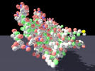
Domains of Medical Imaging
Cellular
Organs
Vascular
Body
Basic Clinical
Intra-cellular
Molecular
10⁻⁹ 10⁻⁸ 10⁻⁷ 10⁻⁶ 10⁻⁵ 10⁻⁴ 10⁻³ 10⁻² 10⁻¹ 1
Physical scale (m)

Slide 3
History of Medical Imaging
Began in Nov. 1895 with Wilhelm Conrad Roentgen's discovery of the X-ray: used commonly for evaluating the chest and bone fractures.
Then fluoroscopy: cancers of the esophagus, stomach, and bowel as well as ulcers, diverticulitis, and appendicitis.
Mammography: breast cancer; lower x-ray dose that normal x-ray.

Slide 4
X-ray Tomography (1940’s):allowing "tomograms" or slices to be obtained through tissues without the over- or under-lying tissue's being seen. This was achieved by rotating the X-ray tube so that only the desired slice of tissue stayed in focus during tube rotation. Now replaced by CT and MRI (both CT and MRI are tomographic techniques that display the anatomy in slices rather than through and through projections (like an X-ray)).

Slide 5
X-ray is also the basis of "angiography," or the imaging of blood vessels (suspected stroke (narrowing of the carotid artery), heart attack (narrowing of the coronary arteries), brain tumor, or vascular malformation).
Nuclear Medicine (1950’s): gamma rays with radioactive compounds as source (compounds, which typically emit gamma rays as they decay): PET (positron emission tomography), scanning in which case instead of emitting gamma rays, these isotopes emit positrons (positively charged electrons) when they decay. Most PET is based on a positron-emitting isotope of fluorine (F-18) that is incorporated into a glucose analog called fluorodeoxyglucose (FDG). Since glucose uptake is increased in most cancers, FDG PET has become a mainstream technique to diagnose both primary and metastasized cancers. Now a-days we have PET-CT that combines the metabolic (albeit low resolution) information of PET with the high spatial resolution of CT, facilitating localization of the cancer for biopsy, radiation therapy, or surgery; SPECT (single photon emission computerized tomography

Slide 6
Ultrasound (1970’s): Unlike X-ray and nuclear medicine, ultrasound uses no ionizing radiation - just sound waves. As the sound waves pass through the tissue and are reflected back, tomographic images can be created and tissues can be character- ize: For example, a mass found on a mammogram can be further characterized as solid (possibly cancer) or cystic (most likely benign); maging the fetus during pregnancy.

Slide 7
CT (computed tomography) (1973): In CT an X-ray tube rotates around the patient and various detectors pick up the X-rays that are not absorbed, reflected, or refracted as they pass through the body.
MRI (1970s): uses no ionizing radiation like X-ray based CT, uses radio waves.

Slide 8
Over the 1980s and 1990s, superconducting magnets became common, initially at 1.5 Tesla and now at 3 Tesla. (Tesla is a measure of magnetic field strength. The earth's magnetic field, for example, is .00005 Tesla. Thus a 1.5 T magnet has a field strength 30,000 times stronger than that of the earth.)

Slide 9
Most clinical MRI today uses the hydrogen nucleus because it is so abundant in water and because its nucleus has a property known as spin. Hydrogen nuclei (single protons) resonate at frequencies in the radio- frequency range. The exact resonance frequency depends on the local value of the magnetic field. When a proton resonates, it emits a radio- frequency signal that can be detected by a radio antenna (usually in the form of an RF coil around the body part being imaged).

Slide 10
MR Spectroscopy (MRS): It gives us the ability to perform chemical analysis of the brain noninvasively.
Functional MRI: fMRI is a technique that images intrinsic blood signal change with magnetic Resonance imagers. Changes in neuronal activity are accompanied by focal changes in cerebral blood flow (CBF), blood volume (CBV), blood oxygenation and metabolism. These physiological changes can be used to produce functional maps of mental operations.

Slide 11
Two relaxation rates are measured in fMRI T₁ and T₂* (represents the rate of decay of MRI signal due to magnetic field in-homogeneities and changes in used to measure blood oxygenation change). T₂* changes reflect the interplay between changes in cerebral blood flow, volume and oxygenation.

Slide 12
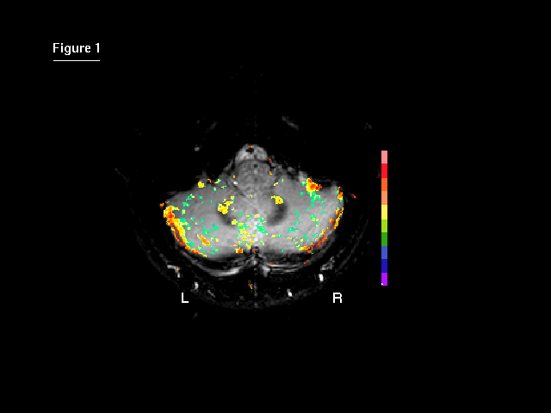

Slide 13
Synopsis of MRI
Put subject in big magnetic field
2. Transmit radio waves into subject (2~10 ms]
3. Turn off radio wave transmitter.
4. Receive radio waves re-transmitted by subject
5. Convert measured RF data to image.

Slide 37
Hybrid Techniques
Reading assignment!

