Slide 1
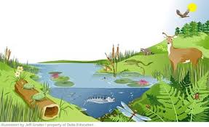
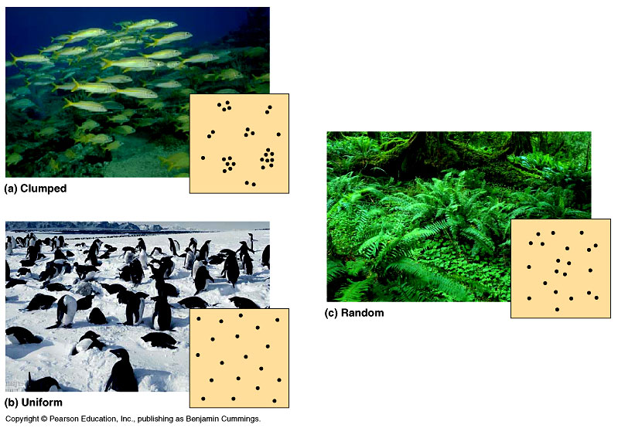
UNIT THREE
POPULATION ECOLOGY

Slide 2
Objectives
At the end of this unit you will be able to:
Define the term population
Discuss population characteristics
Explain population growth, regulation & competition
Define population interaction
Differentiate different types of population interactions
Define and discuss human population

Slide 3
Definition and Concepts of Population Ecology
The term population is derived from the Latin word ‘populous’ = People
In Ecology, a population is defined as a group of organisms of the same species that:
Can be interbreed
Produce fertile offspring
Have high degree of morphological similarity
Live together in the same place
Thus, if the organisms belong to a single population (species), they mostly compete each other for food, water, space, light and for other resources in a short supply
This is b/c, they need similar resources for survival

Slide 4
Con’t…
Population ecology: is the study of populations in relation to their environment. OR
It is the study of interactions within a population & their environment (i.e. the interaction is intraspecific)
In general, population ecology addresses the following five main aspects of population
Namely:
Population Characteristics
Population Dynamics/Growth
Population Regulation
Population Interactions
Human Population

Slide 5
Con’t…
Population Characteristics
A population has various group of characteristics, which are statistically measured
These are: a) Population size & density
b) Population distribution and
c) Population structure
Population size & density:
Size of population (N) is expressed as number of individuals in a population
At any given place, it is determined by the processes of:
Birth (B)
Death (D)
Immigration (I) – new arrivals of species from outside
Emigration (E) – species going out from the group

Slide 6
Cont…
Density of population is explained as the average number of individuals of a species per unit of area (or volume)
Density may be:
Numerical density/number of individuals per unit area or volume
e.g. 600 trees per hectare
Biomass density/biomass per unit area or volume
e.g. 100 kilograms of fish per hectare of water surface
In a given area population density declines with increasing organism body size

Slide 7
Cont…
Due to different pattern of organism’s distribution in nature, there are two types of density
i) Crude density is the density (number or biomass) per unit total space
ii) Ecological density (specific density) is the density /number or biomass) per unit of habitual space
For example, some shade loving plant species are found more crowded in shady patch, and few in other parts of same area
Thus, density calculated into total area (shady as well as exposed) would be crude density
Whereas the density value for only shady area (where the plants actually grow) would be ecological density

Slide 8
Cont…
b) Population distribution/ Dispersion/
It is spatial arrangement of individuals in a given geographical range is know as population dispersion
There are three basic population distribution patterns in the habitat
These are:
Random distribution
Uniform distribution
Clumped distribution

Slide 9
Cont…
Random distribution
Such type of dispersion is favored when a given habitat has:
Similar environmental conditions
Evenly distributed resources
Therefore, organisms have the chance of being anywhere unevenly in the environment
In random distribution pattern, the individuals (members the population) are neither attracting nor repelling each other

Slide 10
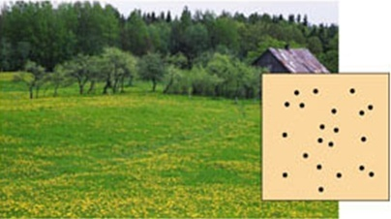
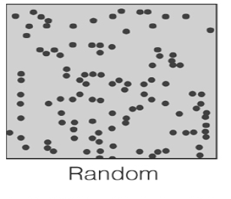
Cont…
Figure: Shows a Random distribution pattern

Slide 11
Cont…
ii)Uniform distribution
It alternatively called as regular or even distribution
It is a kind of dispersion where:
The organisms are uniformly spaced
They have private use of areas
Individual has a tendency to avoid other individuals
It is a result of fierce competition for very limited resources
The result is that individuals are more evenly spaced than expected by chance
However, it is rare in nature

Slide 12
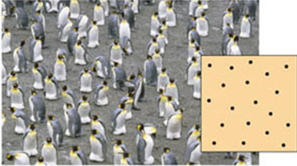
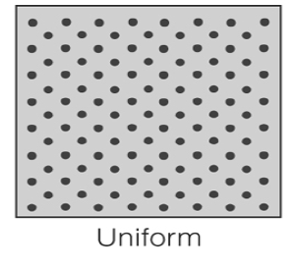
Cont…
Figure: Shows a Uniform distribution pattern

Slide 13
Cont…
iii) Clumped distribution
It alternatively called as aggregate of organisms dispersion
In such kinds of dispersion, suitable physical, chemical & biological conditions are patchy, not uniform
It occurs when individuals tend to be attracted to a particular parts of the environment or to other individuals
In this distribution pattern, organisms have less chance of being anywhere
The result is that individuals are closer together than expected by chance & mutual attraction between individuals is high

Slide 14
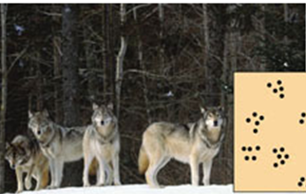
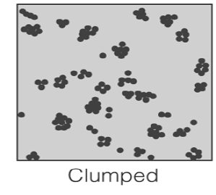
Cont….
Figure: Shows a Clumped distribution pattern

Slide 15
Cont….
c) Population structure/ sex ratio and age structure /
It refers the sex ratio and age structure
The proportion of individuals, i.e. males and females, in each age group is called as sex ratio of the population
Population age structure is the summary of the number of individuals of each age in the population
Age structure influences birth and death rates of a population
It also determine the reproductive status of the population and help to predict future population growth

Slide 16
Cont…
From an ecological point of view there are three major age groups in any population
Pre-reproductive age - is a juvenile or dependent phase of a population
Contains a lot of new birth that are not matured for reproduction
ii) Reproductive – is an adult phase of the population
Contains a lot of population capable of reproduction.
iii) Post-reproductive –is an old phase of the population
Contains a population that are too old to reproduce

Slide 17
Cont….
Age Pyramids
It is a geometric model used to represent the proportion of different age groups in the population of any organism
It summarize age structure which is differ for increasing, steady, and declining populations
It expresses:
The relative sizes of age groups
The status of populations (Stability, declining, increasing
Sex ratios (proportion of male and female)
In nature, population might have one of the three types of age pyramids

Slide 18
Cont…
Bell shaped pyramids
It indicates an equal number of young (pre reproductive) and middle (reproductive) aged individuals, but the post reproductive age group remains small
It shows a stable population
ii) Triangular shaped Pyramids
It indicates a rapidly expanding population with higher young but lower old individuals
It shows an increasing population
iii) Urn shaped pyramids
It indicates a lower young age groups, higher middle age groups and lower old age individuals
It always shows a declining population

Slide 19
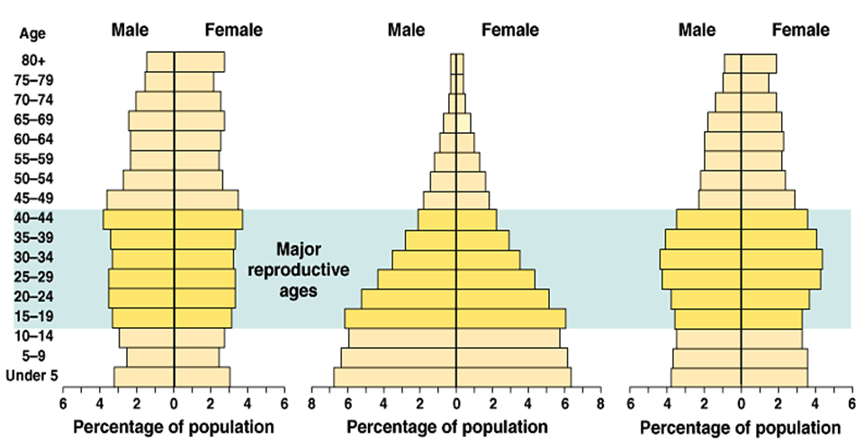
Urn like
Triangle like
Bell like
Declining Population Expanding population Stable population
Sex ratio
In most sexually reproducing organisms the sex ratio tends to be 1:1(one male for one female

Slide 20
Class Work
Among basic characteristics of population list and explain the size or density of any population
Give the definition of the term population?
List and discuss three major age groups in any population
What is population distribution? List and discuss all types of population dispersion.
What is age pyramid? List and discuss all of them?

Slide 21
Population Dynamics/Growth
Population dynamics refers to the change (fluctuation) of population size in a given period of time
The population changes (ΔN) is determined by:
I)Natality - is the term that refers the production of new individuals in the population. or
It expressed as the number of organism born per female per unit time (new birth per female per unit of time)
Example, 5 individuals of dogs born per female per 1 year.
Natality has the following two components:
Fertility: indicates an organism which is capable of producing offspring
Fecundity: indicates the number of offspring produced by a female during a period of time

Slide 22
Con…
Two types of fecundity:
Potential fecundity–is a natural and unaffected number of offspring produced per female.
Example: human can give 1 birth per 9 months per female.
Realized fecundity- is the affected number of offspring produced per female.
Example: human may give only 1 birth per 5 years per female.
II) Mortality - refers the death rate (deaths per unit time).
It is a negative factor for population growth.
III) Migration - refers the Immigration (I) and Emigration (E) rate of an individuals in a population
Which population factors cause population increment or decrement?

Slide 23
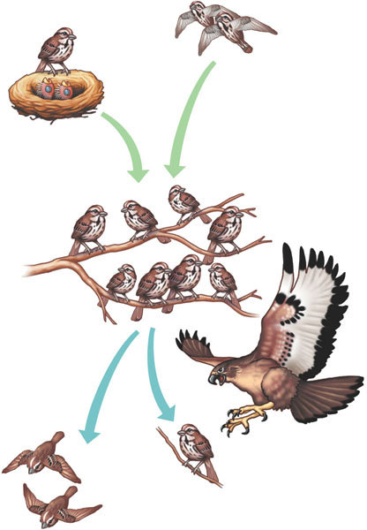
Cont…
Births and immigration add individuals to a population
Births
Immigration
Population size
Emigration
Deaths
Deaths and emigration minus individuals from a population

Slide 24
Cont…
Thus, Population Change (ΔN) can be calculated by:
ΔN = (B+I) - (D+E) or
= (B-D) + (I-E)
If B and I = D and E the population stay stable (constant).
If B and I < D and E the size of population is decreasing.
If B and I > D and E the size of population is increasing.
is a natural growth or
decline.
affected by natural & human pop/n factors
it can be +ve or –ve.
is a mechanical growth or
decline.
affected by social factors
For human pop/n.
is +ve for developed country
is -ve for developing country

Slide 25
Cont…
There are two main types of population growth forms.
Exponential Growth & Logistic growth form
It is a growth at which the population density increase rapidly in an exponential manner, then crashed suddenly due to effective environmental resistance
It shows a ‘J’ shaped growth curve
when there is limited resources
Exponential growth cannot continue because resources are limited
It mostly seen in an environment that has all the needed resources. e.g. Bacterial growth

Slide 26
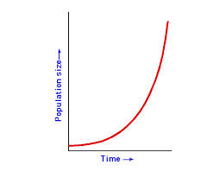
Con’t…
Q1. Why many exotic species often grow at exponential rates for some time following their introduction into a new environment?
Fig.:- Exponential growth

Slide 27
Con’t…
ii) Logistic growth form
It is a growth form in which the population grows rapidly with enough resources
When the resources become limited, its growth rate slows down gradually and levels off
The effect of the environment on population growth is reflected in the shape of population growth curves
The growth rate slows down hence levels off as the population size increases.
This pattern of growth produces a sigmoidal or S-shaped population growth curve
The population size at which growth stops is generally called carrying capacity, K

Slide 28
Con’t…
K is the number of individuals of a particular population that the environment can support
At carrying capacity, population size is approximately constant, birth rates and death rates are equal and population growth is zero
Populations are expected to reach a carrying capacity (rather than continuing to grow exponentially) because birth rates and death rates are density dependent (i.e., depend on population size)
For example, as population sizes increase the population birth rates (the number of births/individual/time) will decline, because of increased competition for resources.
As population sizes increase the per capita death rates (the number of deaths/individual/time) will increase, because of competition for resources and the influence of predators and disease
The carrying capacity is reached at the population size at which the per capita birth rate equals the per capita death rate

Slide 29
Con’t…
Fig.:- Logistic population growth curve

Slide 30
Con’t…
Populations are expected to reach a carrying capacity (rather than continuing to grow exponentially) because birth rates and death rates are density dependent (i.e., depend on population size)
For example, as population sizes increase the population birth rates (the number of births/individual/time) will decline, because of increased competition for resources.
As population sizes increase the per capita death rates (the number of deaths/individual/time) will increase, because of competition for resources and the influence of predators and disease
The carrying capacity is reached at the population size at which the per capita birth rate equals the per capita death rate

Slide 31
Con’t…
(K)
Fig:-Carrying capacity

Slide 32
Population Regulation
Population regulation is a density dependent process, meaning that population growth rates are regulated by the density of a population
It is the process by which the density dependent factors returns the population to an equilibrium when the population size is disturbed
(the population is neither increasing nor decreasing)
It is the control of population density not to increase indefinitely or not to decrease to extinction
Thus, no population continuous to grow indefinitely
In a population which drops below the density that the environment can support, mortality decreases, natality increases and the population grows
Population regulation depends on population density which in turn is determined by the resources available
Determined by environmental factors such as biotic and abiotic factors

Slide 33
Con’t…
Competition
Competition results only when a needed resource is in short supply relative to the number seeking it
Competition is an interaction between individuals of the same species or different species in which the fitness of one is lowered by the presence of another
Competition among members of the same species is known as intraspecific competition while competition between individuals of different species is known as interspecific competition
Competition is not always a straight forward, and can occur in both direct and indirect fashion

Slide 34
Con’t…
In evolutionary theory, this competition within and between species for resources plays a critical role in natural selection.
Types of competition
The following terms describe mechanisms by which competition occurs, which can generally be divided into direct and indirect.
Broadly: two types of competition
1.Intra-specific (b/n the same species) and
2. Interspecific competitions (b/n different species)

Slide 35
Con’t…
Intra-specific competition (b/n same species)
When resources are limited, a population may exhibit either scramble or contest completion
In scramble completion, all the individuals of a population can share the available resources equally
In this completion none of them gets enough resource that enable them for growth, reproduction etc., but the population density remains high and competition remains intense
In contest completion some individuals claim enough resources for survival and reproduction denying the share of others for the resource.
In the habitat with stress of limited resources a species exhibit only one type of completions (scramble or contest)
Some species experience scramble completion while other exhibit contest competition

Slide 36
Con’t…
Both scramble and contest completions have different effects.
The scramble competition results in chaotic oscillations in the population over time
It limits the average density of the population below the carrying capacity of the resource
In contest completion the res11ource is confined to a fraction of a population
This eliminates the waste of resources, permits the maintenance of a relatively high population density and maintains some numerical constancy

Slide 37
Con’t…
Intraspecific competition occurs when members of the same species vie for the same resources in an ecosystem (food, light, nutrients, and space).
For example, two trees growing close together will compete for light above ground, and water and nutrients in the soil.
Adaptations to such an environment include growing taller, (where the specific prediction provided by the competition model is that all species in such a situation will grow as tall as possible). or developing a larger root system (where the specific prediction is that all species in the system will develop very deep root systems).

Slide 38
Con’t…
Inter-specific competition
Individuals of two different species sharing the same resource in the same area may compete for it.
If the resource cannot support both populations, then lowered fecundity, growth, or survival may result in at least one species.
Interspecific competition has the potential to alter populations, communities and the evolution of interacting species.
Interspecific competition, like intraspecific competition, involves the seeking of a scarce resource, but more than one species involve in the competition.
Both intraspecific and interspecific completions may happen simultaneously.
Interspecific competition is of two types.
1. Interference competition
2. Exploitation competitions

Slide 39
Con’t…
Interference competition equates with contest competition.
It involves direst or aggressive interactions (in animals) between competitors.
In this competition there is a direct interaction between competitors in which one denies the access to the resources by another.
Exploitation competition is similar to scramble competition.
In this type of competition, the species use the same resources such as food. This depletes the availability of the resources for another.
The outcome is determined by how efficiently each of the competitors uses the resources.
This results in reduced growth of all competitors.

Slide 40
Population interaction
Interaction is the situation in which two or more organisms act up on one another to produce a new effect.
The new effect (situation) produced by organisms interaction my be beneficial (+ve) or harmful (-ve).
There are five general types of organisms interaction in the habitat.
These are:
Mutualism
Commensalism
Exploitation
Amensalism
Competition

Slide 41
Cont…
1) Mutualism
It is the interaction of organisms for the benefit of both spp.
The effect of this interaction is (+/+)
It classified in to the following:
Obligate mutualism – the interaction is necessary (must) for the survival of both species.
Neither of the species can persist with out interaction
Example, the association fungus & algae (Lichen) to survive on bare rock surface
b) Facultative mutualism – the interaction is good for the wellness of both species.
Both species can persist on their own.
Example, Crocodile & tooth cleaning birds

Slide 42
Cont…
C) Facultative-obligate mutualism
In this type of interaction, only one species can persist with out the obligate mutualist.
Thus, the obligate mutualist will go to extinict if this interaction is too weak.
2) Commensalism
It is the interaction in which two or more species are associated and at least one species derives a benefit where as the other is neither benefited nor harmed.
The effect of this interaction is (+ / 0).
Example, Climber and tree

Slide 43
Cont…
3) Exploitation
It is the action of utilizing (eating) one another.
The effect of this interaction is (+ / -).
The exploitation interaction is of two types.
Parasitism:-is the interaction in which one organism(the parasite) is benefited and the other organism (the host) is harmed.
Example, Tapeworm & human being
b)Predation:-is the interaction in which one organism (predator) is benefited by eating the other organism (prey).
Example, Cat & rat
Explain the difference between parasitism and predator.

Slide 44
Cont…
4) Amensalism
It is the interaction in which one species is harmed and the other species remain unaffected.
It is rare in nature.
The effect of this interaction is (- / 0)
5)Competition
It is the interaction that affects both species negatively.
The effect of this interaction is (- / -)
It mostly observed in a habitat with a limited resources.

Slide 45
Table: summary on different types of interaction.
Type of interaction | Effect on species 1 | Effect on species 2
Neutralism | 0 | 0
Commensalism | + | 0
Amensalism | - | 0
Mutualism | + | +
Competition | - | -
Predation | - | +
Parasitism | - | +
Herbivory | - | +

Slide 46
Human population
Let us consider the human population growth from 10,000,000 B.C to 2018 G.C
Year Total human population
10,000,000 B.C >5-10 million
1AD >170,000,000
1800 >1,000,000,000 (1 billion)
1930 >2,000,000,000 (2 billion)
1960 >3,000,000,000 (3 billion)
1975 >4,000,000,000 (4 billion)
1987 >5,000,000,000 (5 billion)
1999 >6,000,000,000 (6 billion)
2018 >7,600,000,000 (7.6 billion)

Slide 47
Cont…
Human populations exhibit the same fundamental characteristics as do populations of all other organisms
The vital statistics & changes of human population over time is studied by demography
Demography is the study of human populations – their size, composition & distribution across space and the process through which populations change
Births, deaths and migration are the 'big three' of demography, jointly producing population stability or change
Currently, the human population size of the world reach about 7.6 billion, b/c the birth rate is more greater than the death rates

Slide 48
Con’t…
The Demographic Transition
The transition of human population from high birth rates and high death rates to the low birth rates and death rates is referred to as demographic transition.
Demographic transition has three stages
Stage 1:- Both birth rates and death rates are high resulting in little growth
Stage 2:- The death rates fall as a result of improved living standards and the birth rates remain high. In the second phase population growth is high
Stage 3:- In the third phase fertility falls and closes the gap between birth and death rates and these results in a slower pace of population growth.
The more developed countries went through all the stages and entered the third stage

Slide 49
Cont…
Factors Affecting Human Population Size
Birth rate and fertility rates
These are affected by:
Availability of pension systems
Education for women
Infant mortality rate
Average marrying age
Abortion
Availability of birth control

Slide 50
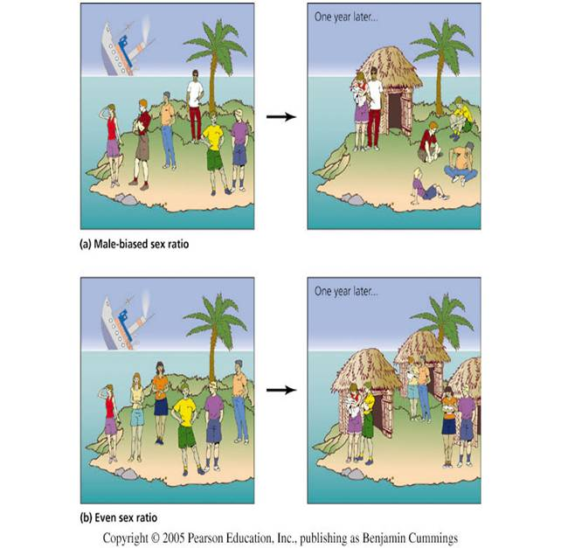
Cont…
Sex ratios
A population’s sex ratio can affect its growth rate

Slide 51
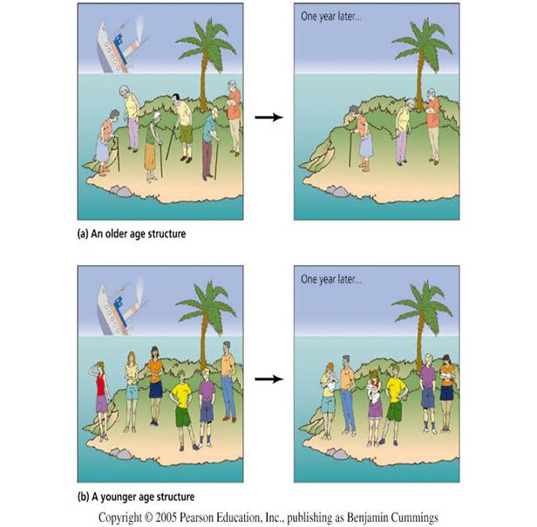
Age structure Cont…
Age structure can influence population growth rates

Slide 52
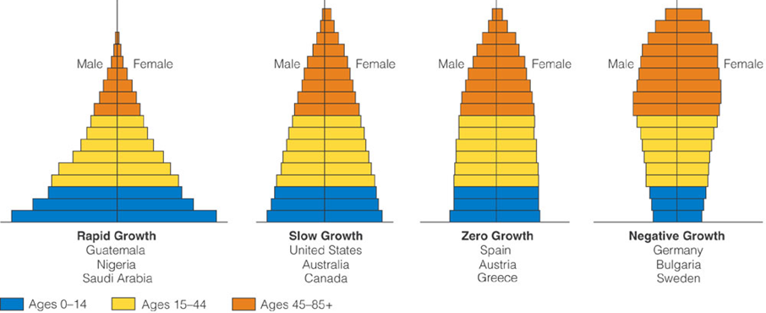
Population structure of some world countries
Developing countries Developed countries
Old aged
Middle
Young
Ethiopia
72

Slide 53
The impact of human population growth on global environment
Improvements in agriculture health and medicine have produced a dramatic rise in the human population
This increase in population size leads to an increase in pollution and higher demand for the world’s resources
Humans are using up the earth’s resources, including fossil fuels.
Burning fossil fuels in cars and power stations produces carbon dioxide, sulphur dioxide and other greenhouse gases
Carbon dioxide traps heat in the atmosphere and causes the temperature of the earth to rise.
This leads to disruption of the weather patterns eg drought, floods
Some weeds may thrive on the extra carbon dioxide while other plants are killed

Slide 54
Con’t…
Sulphur dioxide will dissolve in rain producing Acid Rain
Acid rain damages trees and pollutes rivers and lakes.
Acid rain causes erosion of buildings and statues particularly if they are made of limestone
Deforestation
In may countries people are chopping down forests to provide timber or space for agriculture for the growing population
This causes several problems
Burning the timber increases the level of carbon dioxide in the air
Less trees means less carbon dioxide absorbed for photosynthesis
Soil is eroded as it is exposed to the wind and rain
Less water is transpired into the atmosphere
Many animal and plant habitats are destroyed causing extinction of species

Slide 55
Con’t…
Intensive Farming
Farming has become more intensive to provide a higher % yield from land
Many people regard intensive farming of animals to be cruel
In order to produce more food from the land farmers have to use more fertilisers and pesticides
Problems with Fertilisers
Fertilisers enable farmers to grow more food as they are replacing the nutrients removed from the soil by plants
However, if too much fertiliser is added and it then rains, the fertiliser finds its way into rivers and lakes
This causes the water plants to grow and as there is competition for light, some will die

Slide 56
Con’t…
Bacteria decay the dead plants and in so doing use up oxygen from the water
This means the fish suffocate and die
This process is called Eutrophication
Raw sewage pumped into rivers has the same effect
Pesticides
Pesticides kill insects that will damage crops
They also kill harmless insects or can get washed into rivers and pollute the water
They may even end up in the food chain
In the 1960s, DDT in the food chain threatened bird populations. Many birds of prey came close to extinction

Slide 57
END OF UNIT THREE
THANK YOU

