Slide 1
Chapter 2
Production Relationship

Slide 2
Definition of Production
Production is the process by which inputs are transformed into output in output producing units.
Economist does not restrict production to the manufacture of commodities; but the provision of services such as those of lawyer, accountant, actor, musician, or market women.
The central aim of all production is to satisfy people’s wants and increase the economic welfare of a people to raise their standard of living
Agricultural production involves many controllable and uncontrollable inputs.
The controllable inputs include land, labor, capital, irrigated water and management and their various disaggregated forms to give as more specific set of factors.
The uncontrollable inputs include rainfall, other weather variables and many variables such as animal and plant nutrition or photosynthesis which are not completely understood.

Slide 3
Agricultural Resources (Inputs)
The major resources used in agriculture are free and economic resources.
Free resources are termed free because they are relatively abundant in supply and hence have no cost elements attached to them but they are highly essential in agricultural production. Eg. air, heat, water (rain) and so on.
B) Economic resources are scarce in supply and limiting in production.
They possess high economic value (land, labor, capital and management)
The economic resources come into agricultural production in different disaggregated forms for example, land of different types, different categories of capital expenditure and labor of different categories (hired labor, family labor, skilled or unskilled labor).

Slide 4
Economic Agricultural Resources
Land: Land is the most important resource in agricultural production.
Its supply is relatively fixed
Land (farm size) is measured in hectares but local farmers measure their farm differently.

Slide 5
Labor: Labor is the effort of human being.
second most important resource next to land in agricultural production.
is a function of the economically active proportion of the population released for agricultural activities.
labor on peasant farms could be from both family or hired sources depending on the size of the farm and type of operation to be performed, but in large commercial farms, farm labor is purely hired and categorized as casual,unskilled, semiskilled and skilled labor.
The quality of labor in use is a function of the level of education and training in relevant agricultural production, that is, the higher the level of training in the cultivation and management of any crop the higher the productivity and efficiency.
is measured in terms of the adult male equivalents, where (one man day is the work done by one adult male in eight hours), and one woman is equivalence of 2/3 of a man-day while a juvenile is 1/2 of a man-day.

Slide 6
Capital: Capital resources come into farm production in three forms, namely,
Farm machinery, such as, tractors and various farm tools
Biological capital such as fertilizers, pesticides, herbicides, improved seeds and breeding stock
Feed for Livestock.

Slide 7
Management/entrepreneur/co-ordination is the most important factor of production.
In this, input resides the decision making power in farm business.
It is concerned with efficient mixing of resources in the production process.
Management is therefore concerned with
planning,
implementation and
control of the farm business.

Slide 8
Production Functions
A production function specifies:
the relationship between quantities of inputs used and the maximum quantity of output that can be produced
given current knowledge about technology and organization.
For example, q = f(L, K)

Slide 9
cont…
It’s a physical or technical relationship between inputs and output in any given production processes.
In an implicit form, the production function is defined as
Y = f(x) -output Y is a function of input X.
Where Y = output of product, X = input used,

Slide 10
The production function can be expressed in three ways:
Tabular form
Graphical form
Algebric (Mathematical) form
Tabular form: Production function can be expressed in the form of a table, where one column represents input, while another indicates the corresponding total output of the product.
The two columns constitute production function.

Slide 11
3) Algebraic Form:
Algebraically production function can be expressed as Y= f(X)
Where , Y = dependent variable, output (yield of crop, livestock enterprise) and X = independent variable, input (seeds, fertilizers, manure etc),
When more number of inputs are involved in the production of a product, the equation is represented as
Y=f(X1, X2, X3, X4……….Xn)

Slide 12
BASIC PRODUCTION RELATIONSHIPS
Production of farm commodities involves numerous relationships between resources and products.
Major production relationships are:
Factor-Product relationship
Factor-Factor relationship
3)Product-Product relationship

Slide 13
Factor-product r/n ship
This r/n ship sometimes called Input – Output Relationship
Objective- to determine the optimum quantity of the variable input that will be used in combination with fixed inputs in order to produce optimal level of output

Slide 14
Cont..
Optimization of production is the goal of this relationship.
Known as input-output relationship by farm management specialists
It describes the transformation of a given input into a product.
Guides the producer in making the decision ‘how much to produce?’
Helps the producer in the determination of optimum input to use and optimum output to produce.
We are interested in the effect of variation of only one input such as labor or fertilizer while other inputs are fixed.

Slide 15
There are three types of input-output relationships in producing a commodity where one input is varied and the quantities of other inputs are fixed.
Constant Marginal Rate of Returns or Law of Constant Returns.
ii) Increasing Marginal Rate of Returns or Law of Increasing Returns.
iii) Decreasing Marginal Rate of Returns or Law of Decreasing Returns

Slide 16
Cont…
Law of Constant Returns: The level of output increases by an equal amount for each additional units of the variable input
i.e., the relationship between the input and the output is linear.
Law of Increasing Returns. when every successive unit of the variable input results in a larger increase in the output
Law of Diminishing Marginal Returns: each additional unit of the variable input results in less and less addition to the total output

Slide 17
Production Function Parameters of Interest for Factor-Product R/ship
The following productivity measurements are derived from the analysis of the production function.
They include:
TOTAL PHYSICAL PRODUCT (TPP)
AVERAGE PHYSICAL PRODUCT (APP)
MARGINAL PHYSICAL PRODUCT (MPP)

Slide 18
Total Physical Product (TPP)
Total physical product (TPP) is the amount of production expected from using each input level.
it illustrates the technological or physical relationship that exists between output and one variable input, ceteris paribus
Output or yield is often called total physical product.

Slide 19
Total Physical Product (TPP)
Starts increasing at an increasing rate.
Continues to increase but at a decreasing rate
Reaches the maximum, then decreases
The functional form of a production function is:
Y = f (X),
where Y is the quantity of output and X is the quantity of input

Slide 20
X | TPP=Y
0.00 | 0.00
1.00 | 10.00
2.00 | 25.00
3.00 | 50.00
4.00 | 70.00
5.00 | 85.00
6.00 | 95.00
7.00 | 100.00
8.00 | 101.00
9.00 | 95.00
10.00 | 85.00
Y
TPP
X1

Slide 21
TPP
The point where TPP changes from increasing at an increasing rate to increasing at a decreasing rate is called the Inflection Points.
Points A, B, and C Indicate total amount of output produced at each level of input use
Maximum Point
Y
Y3
C
TPP
Y2
B
Inflection Point
Y1
A
X1
X2
X3
X

Slide 22
Average Physical Product
Average physical product (APP) is the average amount of output produced per unit of input used.
APP =
TPP
Input level

Slide 23
Average Physical Product (APP)
Shows how much production, on average, can be obtained per unit of the variable input with a fixed amount of other inputs
APP = Y / X

Slide 24
Average Physical Product (APP)
X | TPP=Y | APP
0.00 | 0.00
1.00 | 10.00 | 10.00
2.00 | 25.00 | 12.50
3.00 | 50.00 | 16.67
4.00 | 70.00 | 17.50
5.00 | 85.00 | 17.00
6.00 | 95.00 | 15.83
7.00 | 100.00 | 14.29
8.00 | 101.00 | 12.63
9.00 | 95.00 | 10.56
10.00 | 85.00 | 8.50
Y
TPP
Y
X
APP
X

Slide 25
Marginal Physical Product
It is the change in output resulting from a unit change in the variable input.
is the additional TPP produced by using an additional unit of input.
Measures the amount that total output increases as input increases
It reaches zero at the maximum point of TPP
The MP is the slope of the production function curve.
Mathematically it is derived thus: If Y = f(X)
MP = dY / dX = f(X).

Slide 26
Law of Diminishing Marginal Returns
“As successive units of a variable input are added to a production process with the other inputs held constant, the marginal physical product (MPP) eventually declines”

Slide 27
Marginal Physical Product (MPP)
X | TPP=Y | MPP
0.00 | 0.00
1.00 | 10.00 | 10.00
2.00 | 25.00 | 15.00
3.00 | 50.00 | 25.00
4.00 | 70.00 | 20.00
5.00 | 85.00 | 15.00
6.00 | 95.00 | 10.00
7.00 | 100.00 | 5.00
8.00 | 101.00 | 1.00
9.00 | 95.00 | -6.00
10.00 | 85.00 | -10.00
Y
TPP
Y
X
APP
X
MPP

Slide 28
TPP, APP and MPP
X | TPP=Y | APP | MPP
0.00 | 0.00
1.00 | 10.00 | 10.00 | 10.00
2.00 | 25.00 | 12.50 | 15.00
3.00 | 50.00 | 16.67 | 25.00
4.00 | 70.00 | 17.50 | 20.00
5.00 | 85.00 | 17.00 | 15.00
6.00 | 95.00 | 15.83 | 10.00
7.00 | 100.00 | 14.29 | 5.00
8.00 | 101.00 | 12.63 | 1.00
9.00 | 95.00 | 10.56 | -6.00
10.00 | 85.00 | 8.50 | -10.00
Y
TPP
Y
X
APP
X
MPP
MPP is negative

Slide 29
Relationships between TPP, APP and MPP
When TP increase at increasing rate ,MP increase
When TP increase at diminishing rate MP decline
When TP reaches its MAX,MP becomes zero
When TP begins to decline, MP become negative
Drawing a line from the origin which is tangent to the TPP curve gives APP max
At point where APP is max, MPP crosses APP (MPP=APP)
When MPP > APP, APP is increasing
When MPP = APP, APP is at a max
When MPP < APP, APP is decreasing
The relationship between TPP, APP, & MPP is very specific.

Slide 30
Stages of Production Function
State I
Stage II
Stage III

Slide 31
Stages of Production – TP, AP and MP
Stage 2
Stage 1
Stage 3
Stage 1: average product rising.
Stage 2: average product declining (but marginal product positive).
Stage 3: marginal product is negative, or total product is declining.
TP Q
Pt of Marginal Returns
TP
Increasing Returns
Negative Returns
Decreasing Returns
L1
L2
L3
L
AP,MP
AP
L1
L2
L3
MP
L

Slide 32
Stages of the Production
There are three stages of the production function.
Stage I
MPP> APP
TP-initially increase at increasing rate &subsequently at diminishing rate
MP- increase first and reaches its max
AP- increase throughout the stage and reaches the maximum
MP equals AP at the boundary of stages I and II
It is a stage of increasing marginal returns. b/c it doesn’t make sense to stop increasing input if its efficiency is increasing (Y/x)
It is an irrational zone of production
The input use and output to produce should be continued until stage II is reached.

Slide 33
Stage-2
TP- continuous to increase at diminishing rate and eventually reaches the max
MP-starts to decrease and eventually become zero
AP-from Max begin to decrease
it is a stage of rational production where output and profit are maximized and input use is optimized.
Stage 3
TP-diminishes
MP-negative
AP-continuous to decrease but always positive
AP is greater than MP.
Production is not advisable in this stage because increase in input use leads to reduction in total product.

Slide 34
Law of Diminishing Returns
Increase in one factor of production, Holding one or other factors fixed, AFTER SOME POINT, Marginal Product Diminishes.
MP
point of diminishing returns
A Short-Run Law
Variable input
Notes:
7

Slide 35
The law of diminishing marginal productivity
Law of diminishing marginal productivity [or the law of diminishing returns or the law of variable proportions or the principle of added costs and added returns.]
States that if a _________ factor is added continuously to a given amount of _________ factors, the marginal product (and the average product) of the _________ factor must finally decrease, ceteris paribus.
variable
fixed
variable

Slide 36
Implications of the law (if the law is violated)
By adding a units of fertilizer or worker continuously to a given plot of land, no matter how small its size is,
TP can be increased continuously.
→Enough food can be produced to feed all the people in the world.
A small piece of land is adequate to supply the amount of food required by the growing world population.
Hence the supply of land is no longer scarce. → Land price would drop to zero.

Slide 37
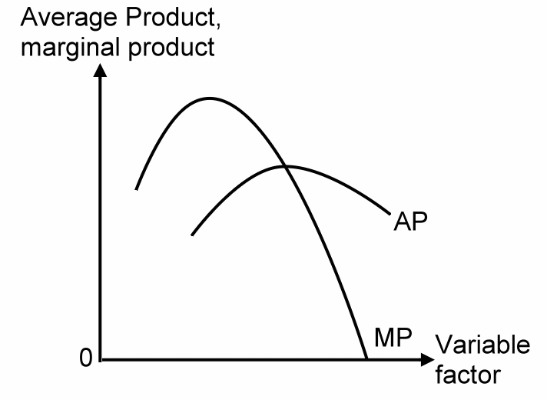
Graphical illustration:
Variable factors
Fixed factor
>
MP↓
MP↑
>
>
>
AP↓
AP ↑
>
>

Slide 38
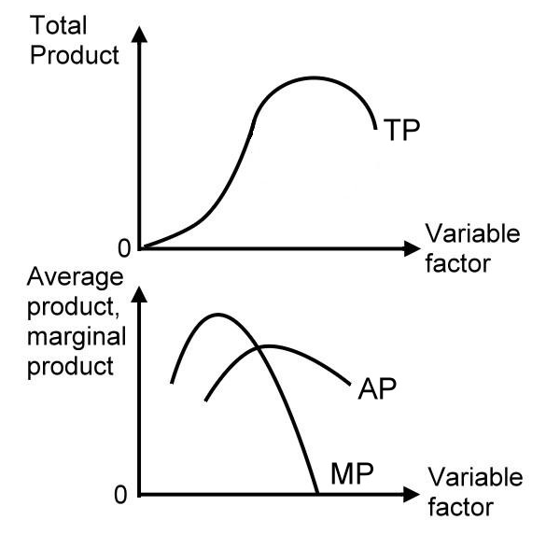
The slope of TP curve is MP.
The slope of the line joining the origin and a point on TP is AP.

Slide 39
Stages of Production: Rational & Irrational
The stage I of the production function is between 0 and X1 units of X.
In stage I:
TPP is increasing
APP is increasing
MPP increases, reaches a maximum & decreases to APP
Stage I is an irrational stage because APP is still increasing
Y
I
TPP
Y
X
APP
0
X
X1
MPP

Slide 40
Stages of Production: Rational & Irrational
The stage II of the production function is between X1 and X2 units of X.
In Stage II:
TPP is increasing
APP is decreasing
MPP is decreasing and less than APP, but still positive
RATIONAL STAGE BECAUSE TPP IS STILL INCREASING
Y
I
TPP
II
Y
X
APP
0
X2
X
X1
MPP

Slide 41
Stages of Production: Rational & Irrational
Stage III of the production function is beyond X2 level X
In Stage III:
TPP is decreasing
APP is decreasing
MPP is decreasing and negative
IRRATIONAL STAGE BECAUSE TPP IS DECREASING
Y
I
TPP
II
III
Y
X
APP
0
X2
X
X1
MPP

Slide 42
How Much Input to Use
Do not produce in Stage III, because more output can be produced with less input.
Do not normally produce in Stage I because the average productivity of the inputs continues to rise in this stage.
Stage II is the “rational stage” of production.

Slide 43
Marginal Value Product
Δ total value product
MVP =
Δ input level
TVP = TPP × product selling price
If output price is constant:
MVP = MPP × product selling price

Slide 44
Marginal Input Cost
Δ total input cost
MIC =
Δ input level
TIC = amount of input × input price
If input price is constant: MIC = input selling price

Slide 45
Marginal Value Product, Marginal Input Cost and the Optimum Input Level
input price = Birr 12; output price = Birr 2

Slide 46
The Decision Rule
Optimum input level is achived when;
MVP = MIC
If MVP > MIC, additional profit can be made by using more input.
If MIC > MVP, less input should be used.

Slide 47
How Much Output to Produce
An alternative way to find the profit-maximizing point is to find directly the amount of output that maximizes profit.

Slide 48
Marginal Revenue
Δ total revenue
MR =
Δ total physical product
Total revenue = Total value product
If output price is constant: MR = output selling price

Slide 49
Marginal Cost
Δ total input cost
MC =
Δ total physical product

Slide 50
The Decision Rule
The optimum level of output is achieved when
MR=MC
The decision rule, MR=MC, leads to the same point as the decision rule
MVP=MIC.

Slide 51
Marginal Revenue, Marginal Cost and the Optimum Output Level
input price = Birr 12; output price = Birr 2

Slide 52
At each point we can multiply the MPP by the price of the output to derive the;
Marginal value product (MVP).
MVP = MPP x PY
where PY is the price of the output.
Similarly,
B) Average value product (AVP)
AVP= APP x PY
C) Total value product (TVP)
TVP= TPP x PY

Slide 53
Thus,
In Stage II, the rational state of production, the quantity of variable input to use is determined at the point where the value of marginal product equals the marginal cost of the input, that is
MVP = MIC.
The marginal cost of the variable input X is actually its unit price Px.
Profit is therefore maximized where MVP = Px
i.e. when input price is constant.

Slide 54
A Hypothetical Production Function; A Mathematical Example
Consider a Production Function
TP = X² – 1/30X³,
where TP (Y) is quantity of output and X is the quantity of input.
AP = TP/X = X – (1/30)X²
MP = ∂TP/∂X
= 2X – (3/30)X²
= 2X – (1/10) X²
Y
I
TPP
II
III
Y
X
APP
0
X
MPP

Slide 55
A Hypothetical Production Function, A Mathematical Example
Given
TP = X² – (1/30)X³,
AP = TP/X = X – (1/30)X²
MP = ∂TP/∂X = 2X – (1/10)X²
At what levels of X does the MP
reach its maximum?
MP reaches its maximum
where ∂MP/∂X = 0
That is, where
2 – (2/10)X = 0
Or, 0.2 X = 2
Or, X = 10
Y
I
TPP
II
III
Y
X
APP
0
10
X
MPP

Slide 56
A Hypothetical Production Function, A Mathematical Example
Given
TP = X² – (1/30)X³,
AP = TP/X = X – (1/30)X²
MP = ∂TP/∂X = 2X – (1/10)X²
At what levels of X does the AP
reach its maximum?
AP reaches its maximum
where ∂AP/∂X = 0
That is, where
1 – (2/30)X = 0
Or, (1/15) X = 1
Or, X = 15
Y
I
TPP
II
III
Y
X
APP
0
10
15
X
MPP

Slide 57
A Hypothetical Production Function, A Mathematical Example
Given,
TP = X² – (1/30)X³,
AP = TP/X = X – (1/30)X²
MP = ∂TP/∂X = 2X – (1/10)X²
At what levels of X does the TP
reach its maximum?
TP reaches its maximum
where ∂TP/∂X = MP = 0
That is, where
MP = 2x – (1/10)X² = 0
Using the quadratic
formula of
X = 20
Y
I
TPP
II
III
Y
X
APP
0
10
15
20
X
MPP

Slide 58
A Hypothetical Production Function, A Mathematical Example
Given
TP = X² – (1/30)X³,
AP = TP/X = X – (1/30)X²
MP = ∂TP/∂X = 2X – (1/10)X²
What is the range of X values for
Stage II?
Stage II is the stage that
begins where AP is at its
maximum and ends where TP
is at its maximum.
Thus, the range of X values or
Stage II is 15 and 20.
Y
I
TPP
II
III
Y
X
APP
0
10
15
20
X
MPP

Slide 59
A Hypothetical Production Function, A Mathematical Example
Given
TP = X² – (1/30)X³,
AP = TP/X = 2X – (1/30)X²
MP = ∂TP/∂X = 2X – (1/10)X²
At what level of X does the Law
of Diminishing Returns set in?
It sets in where MP reaches
its maximum.
Thus at X = 10 the law of
Diminishing returns sets in.
Y
I
TPP
II
III
Y
X
APP
0
10
15
20
X
MPP

Slide 60
Factor-Factor Relationship
In factor-product relationship, we studied the situation where only one input is varied and all other variables are held constant.
But in most real world situations, two or more inputs are often varied simultaneously.
Concerned with the determination of least cost combination of resources.
INPUT IS VARIED in quantity, while OUTPUT IS KEPT CONSTANT
The manager must choose the particular combination of inputs which would minimize the cost for a given output level.
Thus, the main objective here is MINIMIZATION OF COST at a given level of output.
Guides the producer in deciding ‘HOW TO PRODUCE’.

Slide 61
F-F R/ship
When two or more inputs are variables, a given amount of output may be produced in more than one way, (possibility of substituting one factor (X1) for another (X2) as product level (Y) is held constant).
There are many ways of combining these resources or production technology in production process.
The managerial problem here is to find out the least cost combination of inputs for producing a given level of output

Slide 62
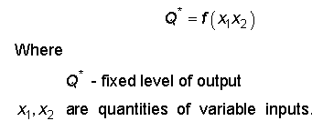
That means….

Slide 63
Factor-Factor Relationship
Q = f(X1, X2,/X3,X4, …., Xn)
Where Q = quantity of produce
X1,X2 = variable inputs
X3,X4, …., Xn = fixed inputs

Slide 64
Important Economic Parameters of F-F r/ship
ISO-QUANT:
Iso-quant is also termed as :-
Iso-product curve,
equal product curve or
product indifference curve.
Definition:
Represents all possible combinations of two resources (X1 and X2) physically capable of producing the same quantity of output.
For e.g. an output y amounting 100 units can be produced using different combinations of inputs x₁, x2.

Slide 65
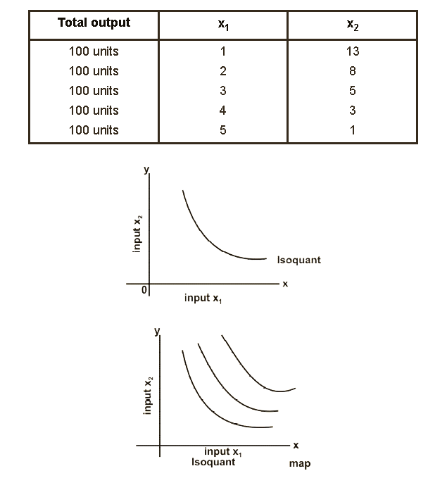

Slide 66
Properties of Iso-quant:
Iso-quant slope downward =if quantity of input x₁ is increased the quantity of other input x₂ is decreased to obtain the Same level of output y.
Iso-quants are convex to the origin. The absolute slope of Iso­quant decreases, as we move left downwards to right indicating diminishing rate of technical substitution. Because diminishing MRTS each added unit of one input replaces less and less than the previous unit.
Iso-quants place above another represents higher output. Iso­quants place for higher level of output are placed further away from the origin.
Iso-quants are not intersecting. No two Iso-quants intersect each other because the same combination of two input cannot produce two different levels of output.

Slide 67
2) Marginal Rate of Technical Substitution (MRTS)
It is the rate of exchange between two productive resources which are equally preferred.
The quantity of one input must be sacrificed or given up in order to gain another input by one unit in process of substitution.
MRTS of x₁ for x₂ is written as;
Where ΔX1 = change in quantity of variable input X1
ΔX2 = change in quantity of variable input X2

Slide 68
Units of x₁ | Units of x₂ | ∆x₁ | ∆x₂ | MRS of x₁ for x₂
1 | 12 | 1 | -3 | -3.0
2 | 9 | 1 | -2 | -2.0
3 | 7 | 1 | -1 | -1.0
4 | 6 | 1 | -0.5 | -0.5
5 | 5.5 | 1 | -.25 | -0.25
6 | 5.25

Slide 69
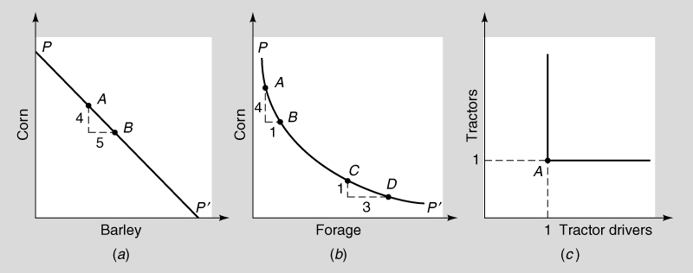
Three possible types of substitution

Slide 70
3) Iso-cost Line
Is the curve of all combinations of two inputs that cost the same amount.
represents various combinations of two inputs that can be purchased with the given outlay of funds.
Suppose you have Birr 400 fund and should spend on two inputs (x₁ and x₂)
If Px₁ is Birr 10 and Px₂ is Birr 8.
If you spent 400 birr to purchase x₁ input then you can purchase 40 units of x₁ and 50 units of x₂ to produce fixed output.

Slide 71
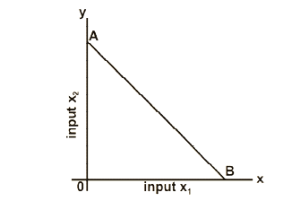
Iso-cost line

Slide 72
Least Cost Combination (LCC)
F-F concerned with determination of least cost combination of resources.
There will be many combinations of two resources that produce the same level of output.
The problem here is to find out that particular combination of inputs, which produces a given quantity of output with minimum cost.
There are different methods of finding out the LCC

Slide 73
1) Tabular Method
Given the input combinations and the prices of inputs, the total cost of each input combination can be computed.
And then, the combination which cost the least is selected.
x₁ Units | x₂ Units | x₁@Birr 4 | x₂ @ Birr 2 | Total cost =TICx1+TICx2
50 | 219 | 200 | 438 | 638
55 | 206 | 220 | 412 | 632
60 | 194 | 240 | 388 | 628
65 | 182 | 260 | 364 | 624
70 | 171 | 280 | 342 | 622
Thus, 70 units of x₁ and 171 units of x₂ is the least cost combination.

Slide 74
2) Algebraic Method
Step 1 = Compute marginal rate of technical substitution

Slide 75
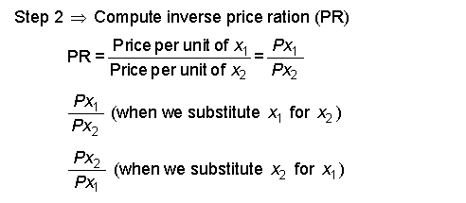

Slide 76
Input price ratio =
price of input being added
price of input being replaced

Slide 77
Feed Ration | Protein (x1) | Concentrate (X2) | Substitution Ratio (SR) | Price Ratio (PR)
 |  |  | (∆X2/(∆X1) | (Px1/Px2)
A | 30 | 325
 |  |  | 3.0 | 2.0
B | 35 | 310
 |  |  | 2.0 | 2.0
C | 40 | 300
 |  |  | 1.2 | 2.0
D | 45 | 294
 |  |  | 0.8 | 2.0
E | 50 | 290
Given: PX₁ = 0.10 per unit, and PX₂ = 0.05 per unit

Slide 78
Decision Rule
The least cost combination is where SR equals PR, or when we move from ration B to ration C for a Px1 of Birr 0.10 per unit and a Px₂ of Birr 0.05 per unit.
Because SR and PR are equal for the change from ration B to ration C, rations B and C also have the same cost.

Slide 79
Decision Rule
Input Substitution Ratio = Input Price Ratio
SR=PR
If they cannot be exactly equal because of the choices available in the table,
Get as close as possible without letting the price ratio exceed the substitution ratio.

Slide 80
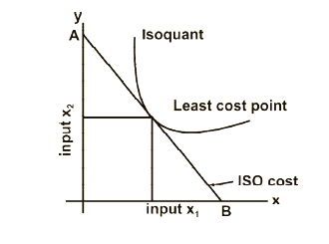
3) Graphic Method
To find out optimum combination both Iso-quant and Iso-cost are drawn on same graph.
The point of tangency between Iso­quant line and Iso-cost line indicates least combination tangency slope (MRTS) of Iso-quant equals.

Slide 81
Homework
Assume a Cobb – Douglas production function of ;
Y = 1/2 X1^{1/2}X2^{2/5} and
Prices Px1 = Birr5, Px2 = Birr 4 and
Py = Birr 40.
Find the least cost combination of inputs at which profit is maximized.
Compute the output level at optimal inputs combination.

Slide 82
Product-Product Relationship
Also called - enterprise combination
Deals with the allocation of resources among different crop and livestock enterprises.
In p-p r/ship , resources are kept constant and product varies
The objective of p-p r/ship is profit maximization
Thus, the farmers are faced with the management problem of “WHAT TO PRODUCE”.
i.e they decide whether to produce crops alone or livestock alone or their combinations that maximizes profits.

Slide 83
P-P R/ship
Algebraically the product-product relationship can be shown as:
Y1=f(Y2,Y3,Y4……….Y n )
This expression reveals that a farmer is having an option of growing four or more crops in the same season in his operational holding.
Then, acreage proposed to be allocated under crop Y₁ is a function of acreage under crops _{Y2,Y3,Y4} and Y_{n}.

Slide 84
P-P R/ship
Two products are produced by using one variable input.
The relationship is often represented mathematically as:
(Y1,Y2) = f (X1/X2, X3, …..,Xn) or
X1 =f(Q1,Q2)
Where X1= variable inputs
X2,X3,…..,Xn =fixed inputs
Y1, Y2= products.

Slide 85
Economic Parameters for P-P r/ship
Again we would have required a three-dimensional space to represent the above relationship graphically,
But it is instead represented in a two-dimensional space known as production possibility curve (PPC)

Slide 86
1) Production Possibility Curve/Frotier
PPC- is also known as Iso-resource curve or Iso-factor curve,
It is a curve in which all the combinations of two products require the same amount of resources.

Slide 87
Example: PPC/PPF
Suppose a farmer has a limited input i.e. 5 acres of land.
He has two alternatives i.e., the production of Y₁ and Y₂.
The problem here is as to how to allocate this limited input between two alternatives.
The alternatives are using the entire 5 acres of land for the production of Y₁ alone or for production of Y₂ alone.
In between these to extreme possibilities, we have different options like allocation of ;
1 acre forY₁ and 4 acres forY₂,
2 acres for Y₁ and 3 acres for Y₂ etc.

Slide 88
If the entire area of 5 acres is allotted to Y₂, 300 units of Y₂, while Y₁ is zero
Analogously, if the total area of 5 acres is allotted to product Y₁, 300 units of Y₁ but Y₂ would be zero.
If 1 acre is allotted to Y₁, 100 units of Y₁ and the remaining 4 acres for Y₂ yielding 250 units.
If 2 acres is allotted to Y₁ and 3 acres to Y_{2 ,}
It yields an output of 150 and 190 units respectively.

Slide 89
Possible Production Levels from the given acreage of Land
Area allotted between two products in acres |  | Output
Y₁ | Y2 | Y₁ | Y₂
0 | 5 | 0 | 300
1 | 4 | 100 | 250
2 | 3 | 150 | 190
3 | 2 | 200 | 100
4 | 1 | 250 | 50
5 | 0 | 300 | 0

Slide 90
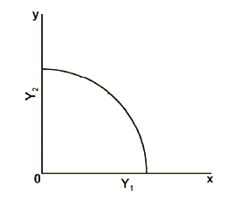
PPC/PPF/PTC

Slide 91
2) Marginal Rate of Product Substitution (MRPS)
Is the slope of the PPC
Shows the trade off between the two products.
The rate at which one product is transformed into another product. As a result, it is called transformation curve.
It is also a frontier because the limited resources cannot help to produce anything beyond PPC.
It demarcates what is possible given the available quantity of inputs.

Slide 92
Characteristics of Production Possibility Curve
It is concave to the origin.
slope of production possibility curve indicates the marginal rate of product substitution (MRPS), and
Change in input levels, shifts the production possibility curve.

Slide 93
ISO-REVENUE LINE
It is a line, which defines all possible combinations of two products, which would yield equal revenue.

Slide 94
Characteristics of ISO-revenue Line
Iso-revenue line is a straight line, as the output prices do not change with the quantity of the output sold.
2. As the total revenue increases, the Iso-revenue line shifts upwards and moves away from the origin.
3. The Iso-revenue lines are parallel to each other, since price ratio remains constant, and;
4. The slope of the Iso-revenue line indicates the inverse price ratio of the products. The slope is affected by price changes.

Slide 95
Example: Iso-revenue
Suppose we wish to obtain total revenue of Br. 5,000, when price of Y1 (PY1) is Br. 10 and price Y2 (PY2) is Br. 20, then;
The expected revenue of Br. 5,000 could be earned by producing
500 units of Y1 or 250 units of Y2 .
300 units of Y1 and 100 units of Y2 or
100 units of Y1 and 200 units of Y2 would help to earn the same revenue.
By plotting these two extreme points of 500 units of Y1 and 250 units of Y2 and by joining these two points, we get the Iso-revenue line

Slide 96
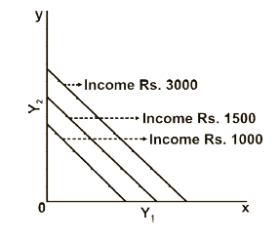
Fig: Iso-revenue line

Slide 97
Determination Of Optimum Product Combination
To get the revenue maximizing combinations of two products, two relevant questions need to be answered viz.,
what combinations should be produced and
how can that combination be determined.
To answer these questions, the following methods need to be examined.

Slide 98
1) Algebraic method

Slide 101
2) Graphic Method
To determine the optimum combination of products through graphic method, PPC and Iso-revenue line are depicted on the same graph.
The slope of PPC indicates the MRPS and the slope of Iso-revenue line represents the inverse price ratio of the products.
The optimum combination products are at the point where the Iso-revenue line is tangent to the PPC.

Slide 102
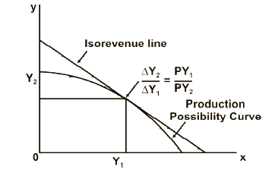
Fig: Optimum Combination of products

Slide 103
RELATIONSHIP AMONG THE PRODUCTS (types of p-p r/n ship)
Joint products,
Complementary products,
Supplementary products,
Competitive products and
Antagonistic products.

Slide 104
1) Joint Products
Produced/resulted from the same production process
The production of one implies the production of the other
Production of one without the other is not possible.
In agriculture almost all products are joint products.
The proportion of the joint products can be altered or manipulated through research break­through in the long run.
The examples are : paddy and straw, cotton lint and cotton seed, meat and wool, etc.

Slide 105
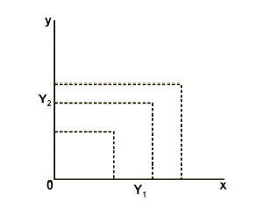
Production possibilities for joint product

Slide 106
2) Complementary Products:
The products are complementary, if an increase in one product causes an increase in the other product, when the total quantity of inputs used on the two products are held constant and vice versa.
They do not compete for the resources.
One of the products contributes an element of production required by another thereby helping each other in production.
An example; rice succeeding a legume crop. The legume fixes nitrogen thereby improving the soil fertility for the next crop.
Similarly, paddy and livestock are complementary as paddy crop provides straw to livestock and livestock in turn makes the availability of farmyard manure to the paddy crop.

Slide 107
Compliment…
Here these two contribute to their mutual production.
The complementary products would become competitive, when large quantities of resources are diverted to one product, affecting the production of the other.
The marginal rate of product substitution is POSITIVE.
Y₁ is complementary to Y₂ between A and B, while Y₂ is complementary to Y ₁ between C and D, but points B and C, they become competitive.
Thus, the farmers should produce both the products till they become competitive.

Slide 108
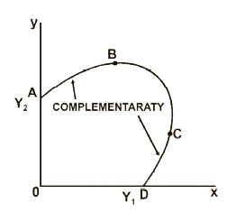
Fig: Complementary Product

Slide 109
3) Supplementary Products
If the quantity of one product can be increased without increasing or decreasing the quantity of the other product.
They are independent of one another. They do not compete for the resources.
Instead they make better utilization of resources, which are being unutilized by one enterprise.
Crop production is seasonal in nature, and during off-season the resources are slack.
They can be better utilized by adding supplementary enterprises viz., a small dairy unit or poultry unit.
A farmer should take best advantage of the products by producing both of them till they become competitive.

Slide 110
Supplement…
The marginal rate of product substitution is zero.
The product Y ₁ can be increased up to AB without affecting the production Y₂.
If it is further increased the two become competitive.
It can be seen in the diagram that the two products are competitive between the points B and C.

Slide 111
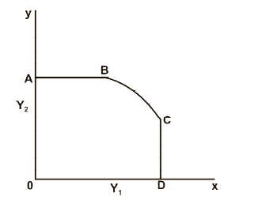
Fig: Supplementary Enterprise

Slide 112
Output Substitution Ratio
Output Substitution Ratio =
quantity of output lost
quantity of output gained

Slide 113
Output Price Ratio
Output Price Ratio =
price of output gained
price of output lost

Slide 114
Decision Rule
output substitution ratio = output price ratio
If no available combination makes these
exactly equal, get as close as possible
without letting the price ratio drop below
the substitution ratio.

Slide 115
4) Competitive Products
When increase or decrease in the level of production of one results in decrease or increase in the level of production of another, given the fixed amount of resources.
The MRPS between the products is therefore, negative.
Most of the decisions regarding the selection of products involve competing products.
The examples are maize and teff, barley and groundnut etc.
In general, crops grown in the same season are competitive because of limited resources.

Slide 116
MARGINAL RATE OF PRODUCT SUBSTITUTION
Like factors, products also substitute each other.
The absolute amount, by which one product is decreased in order to gain another product by a unit is called marginal rate of product substitution.
MRPS of Y₁ for Y₂ implies that the amount of Y₂ to be given up in order to gain Y₁ by one unit.

Slide 117
Combination number | Units of Output (Y1) | Units of Output (Y2) | Substitution Ratio (SR) ∆Y2/∆Y1 | Price Ratio (PR) Py1/Py2
1 | 0 | 4,600
 |  |  | 0.75 | 2.00
2 | 800 | 4,000
 |  |  | 1.00 | 2.00
3 | 1,400 | 3,400
 |  |  | 1.40 | 2.00
4 | 1,900 | 2,700
 |  |  | 2.00 | 2.00
5 | 2,300 | 1,900
 |  |  | 3.00 | 2.00
6 | 2,600 | 1,000
 |  |  | 5.00 | 2.00
7 | 2,800 | 0

Slide 118
Decision Rule
The optimal combination of enterprises occurs as we move from combination 4 to combination, where SR = PR.
Because SR and PR are equal, combination numbers 4 and 5 would be equally profitable.
Moving from 4 to 5, the same amount of income is given up from Y₂ to get more of Y₁.
In many cases, there will not be an exact equality of SR and PR.
Thus, you should continue substituting Y₁ for Y₂ as long as PR >SR.
i.e. the additional income will exceed the lost income, and the substitution will increase income.

Slide 119
Constant Rate of Substitution
Two products substitute at constant rate when a unit increase in the production of one replaces the same amount of another product throughout the process of substitution.
In other words, a constant amount of replaced product is sacrificed in order to gain added product by one unit.
The PPC is linear when products substitute at constant rate.

Slide 120
Two Competitive Products Substituting at Constant Rate
Combination | Y₁ | Y₂ | ∆ Y₁ | ∆Y₂ | MRPS of Y₁ for Y₂
A | 0 | 60
B | 1 | 54 | 1 | 6 | 6/1=6
C | 2 | 48 | 1 | 6 | 6/1=6
D | 3 | 42 | 1 | 6 | 6/1=6
E | 4 | 36 | 1 | 6 | 6/1=6
F | 5 | 30 | 1 | 6 | 6/1=6

Slide 121
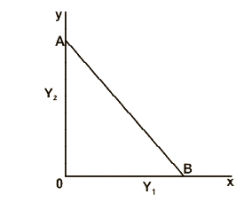
Constant Rate of product substitution

Slide 122
Increasing Rate of Substitution
Two products substitute at increasing rate when increase in one product requires larger and larger sacrifice in terms of another product.
This type of substitution occurs when the production function of each independent product exhibits decreasing returns.
Substitution of this nature is more common in agricultural production as the diminishing marginal resource productivity is a general situation in agriculture.
PPC is concave to the origin when products substitute at increasing rate.

Slide 123
Two Competitive Products Substituting at Increasing Rate
Combination | Y₁ | Y₂ | ∆ Y₁ | ∆Y₂ | MRS of Y₁ for Y₂
A | 0 | 75
B | 8 | 60 | 8 | 15 | 1.88
C | 16 | 44 | 8 | 16 | 2.0
D | 24 | 26 | 8 | 18 | 2.25
E | 32 | 0 | 8 | 26 | 3.25

Slide 124
Increasing cont…
Shifting from combination A to combination B, results in increase in Y₁ by 8 units and decrease in Y₂ by 15 units.
MRPS is 1.88.
It means 1.88 units of Y₂ are to be sacrificed to gain Y ₁ by one unit.
When we shift from B to C, C to D, and D to E, the amount of Y₂ to be foregone is successively increasing as indicated by the increasing MRPS

Slide 125
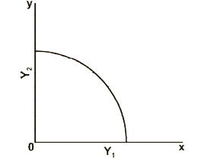
Fig. Increasing rate of product substitution

Slide 126
Decreasing Rate of Substitution
Two products substitute at decreasing rate when increasing in one product requires lesser and lesser reduction in another product.
This type of substitution is observed when the production functions of both the products exhibit increasing returns.
This type of substitution is very rare in production process, because increasing returns are seen in the 1st stage of production which is irrational.
The PPC is convex to the origin.

Slide 127
Two Competitive Products Substituting at Decreasing Rate
Combination | Y₁ | Y₂ | ∆ Y₁ | ∆Y₂ | MRS of Y₁ for Y₂
A | 0 | 43
B | 2 | 27 | 2 | 16 | 8
C | 4 | 15 | 2 | 12 | 6
D | 6 | 6 | 2 | 9 | 4.5
E | 8 | 0 | 2 | 6 | 3

Slide 128
Decreasing MRPS….
Shifting from combination A to combination B results in increase in Y₁ by 2 units and decrease in Y₂ by 16 units.
It means 8 units of Y₂ are to be sacrificed to gain Y₁ by one unit.
When we shift from B to C, C to D and D to E, the amount of Y₂ to be forgone is successively decreasing as indicated by the decrease in marginal rate of product substitution.

Slide 129
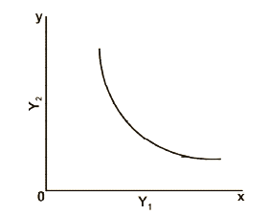
Fig: Decreasing Rate of Product Substitution

Slide 130
Chapter 2
The End!

