Slide 1
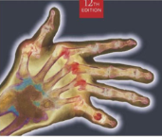
Radiographic Positioning
MeRT2122
(10 ECTS)
Hailegebriel Shiferaw, (MRT, PH, MSc)
Department of Medical Radiology Technology
Hawassa University
3/10/2020

Slide 2
Chapter 9
Dental radiography
Dental radiography
3/10/2020

Slide 3
Objectives
At the end of these lesson you should have to able to;
Discus the various projection used in dental radiograph as used, in extra- oral & intraoral- radiography
Describe dental formula
Differentiate the essential features of the various projections used applied in dental radiography
Discus about shadow forming principle in dental radiographic technique
3/10/2020

Slide 4
Introduction
Dental radiography is the radiographic examination of the teeth & the bone surrounding them.
It involves either;
Intra-oral radiography (inside the mouth) or
Extra-oral radiography (outside the mouth)
3/10/2020

Slide 5
Intra-oral radiography
Bitewing radiography; is a lateral view of the posterior regions of the jaws.
Periapical radiography; is a lateral projection displaying both the crown and the root of the tooth and the surrounding bone.
Occlusal radiography; comprises a number of views in which the film is positioned in the occlusal plane.
3/10/2020

Slide 6
Extra-oral radiography
Dental panoramic radiography; is a projection that produces an image of both jaws and their respective dentitions on a single extra-oral film.
Oblique lateral radiography; demonstrates large areas of the maxilla and mandible.
Cephalometry: employs techniques to produce standardized and reproducible films of the facial bones.
3/10/2020

Slide 7
Dental anatomy
Types of Dentitions
Primary (deciduous)
Secondary (permanent)
3/10/2020

Slide 8
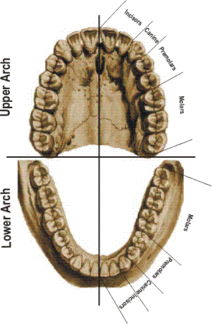
Quadrants: right & left quadrants
Maxillary right
and left.
Mandibular right
and left.
4 Quadrants
3/10/2020

Slide 9
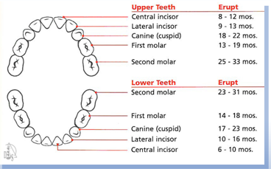
Dental anatomy …cont’d
Primary (deciduous)
Consist of 20 teeth
Begin to form during the first trimester of pregnancy
Typically begin erupting around 6 months
Most children have a complete primary dentition by 3 years of age
3/10/2020

Slide 10
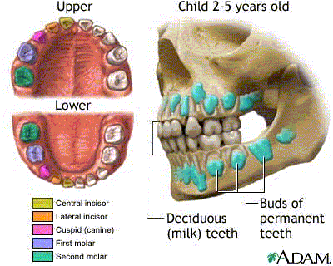
Types of Dentitions
I-Primary Dentition
Deciduous ,baby, milk teeth:
Twenty ( 20)
primary teeth.
10 in each arch
5 in each quadrant
In function:
2 years - 12 years
3/10/2020

Slide 11
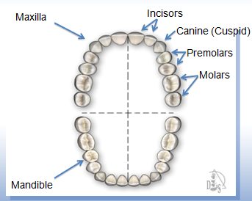
Dental anatomy …cont’d
Secondary (permanent)
Consist of 32 teeth in most cases
Begin to erupt around 6 years of age
Most permanent teeth have erupted by age 12
Third molars (wisdom teeth) are the exception; often do not appear until late teens or early 20s
3/10/2020

Slide 12
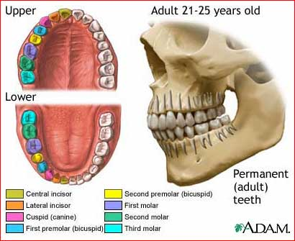
II-Permanent Dentition
In function:
12 years
through out life
3/10/2020

Slide 13
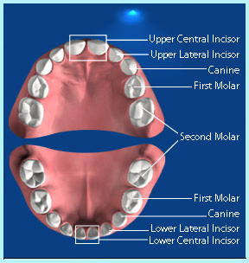
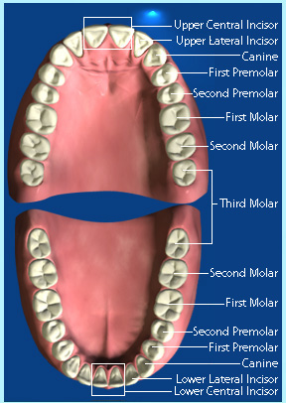
Types of Dentitions Primary Permanent Dentition
3/10/2020

Slide 14
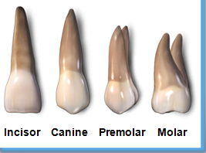
Dental anatomy …cont’d
Classification of Teeth:
Incisors (central and lateral)
Canines (cuspids)
Premolars (bicuspids)
Molars
3/10/2020

Slide 15
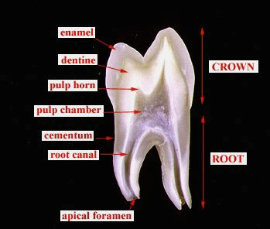
Macro & Micro-anatomy of Teeth
crown
neck
neck
3/10/2020

Slide 16
Tooth surfaces
Facial- toward the lips or cheeks
Lingual- toward the tongue
3/10/2020

Slide 17
Surfaces
Occlusal- come in contact with those of the opposing jaw, molars and premolars only
Incisal- Those surfaces on the incisors and canines coming into contact with the opposing teeth
3/10/2020

Slide 18
Proximal Surfaces
Surfaces coming into contact with the adjacent teeth
Mesial- toward the midline
Distal- away from the midline
3/10/2020

Slide 19
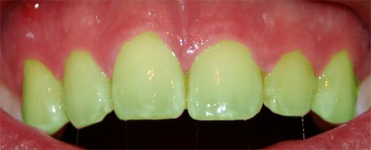
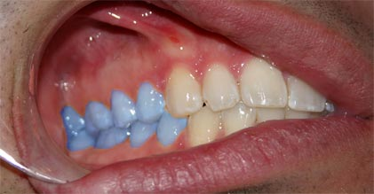
FACIAL SURFACE any surface on the outside (towards the face)
LABIAL is facial surface of the anterior teeth (green)
BUCCAL is the facial surface of the posterior teeth (blue).
3/10/2020

Slide 20
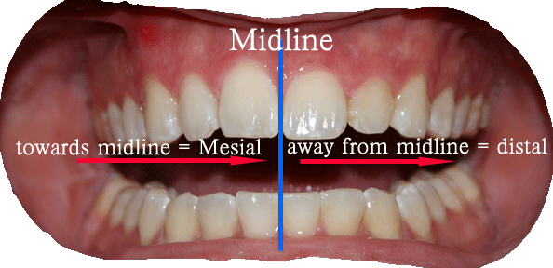
Inter-proximal surfaces:- Surfaces in between two teeth
Facing towards the midline:-MESIAL
Facing away from the midline:-DISTAL
3/10/2020

Slide 21
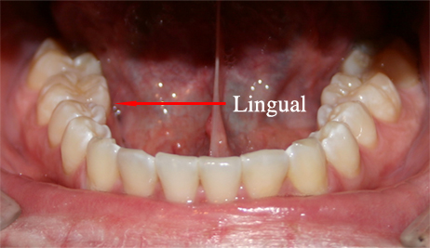
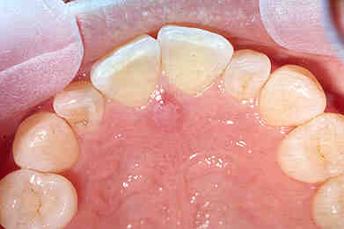
LINGUAL:- the surfaces facing the tongue
PALATAL:- on the maxilla
palatal
3/10/2020

Slide 22
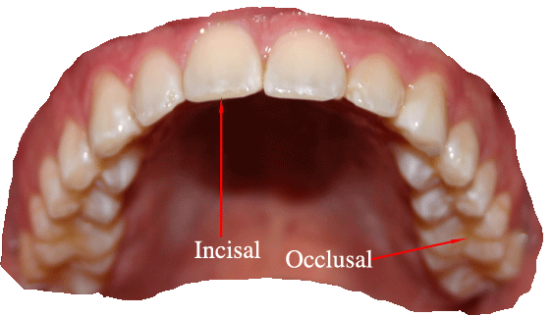
Functioning Surfaces:- chewing/biting surfaces of teeth
OCCLUSAL: chewing surfaces of posterior teeth
INCISAL: the anteriors’ biting surface
3/10/2020

Slide 23
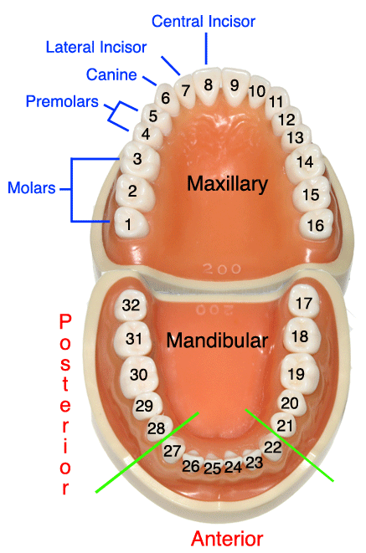
Tooth Identification Systems Numbering or Coding Systems
Palmer Notation System
Universal System
International FDI System (two digit system)
3/10/2020

Slide 24
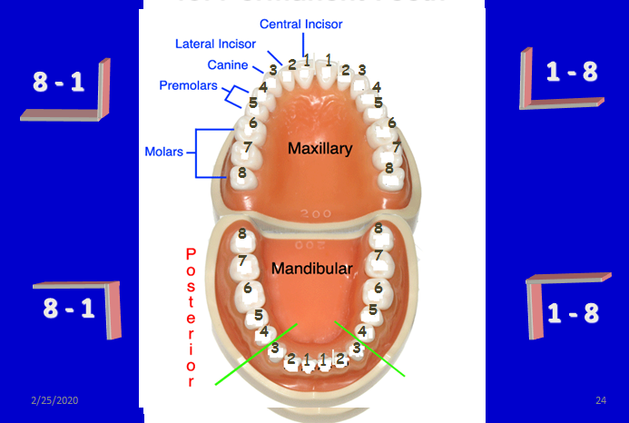
Palmer Notation System for Permanent Teeth
3/10/2020

Slide 25
It represents the four quadrants of the dentition as if you are facing the patient. In upper right In upper left In lower right In lower left
Horizontal and vertical lines = symbol for the quadrant
The permanent teeth are numbered from 1-8 on each side from the midline.
Upper right Upper left
8 7 6 5 4 3 2 1 1 2 3 4 5 6 7 8
8 7 6 5 4 3 2 1 1 2 3 4 5 6 7 8
Lower right Lower left
3/10/2020

Slide 26
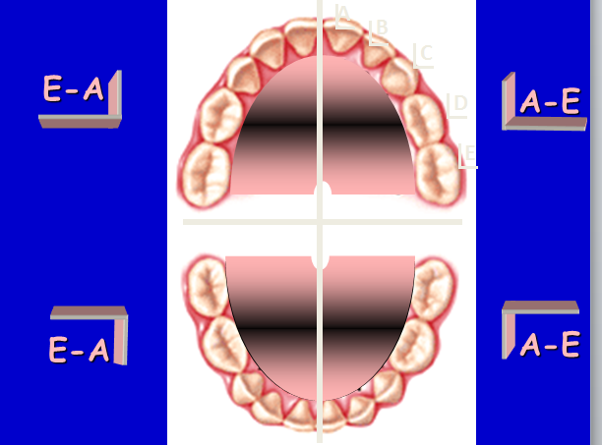
Palmer Notation System for Primary Teeth
3/10/2020

Slide 27
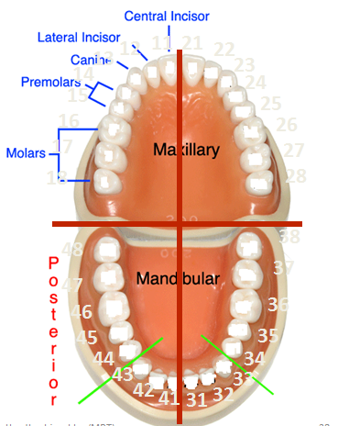
International System (Two Digit System) For permanent Teeth “FDI” Federation Dentaire International
First Digit = quadrant
1
2
4
3
3/10/2020

Slide 28
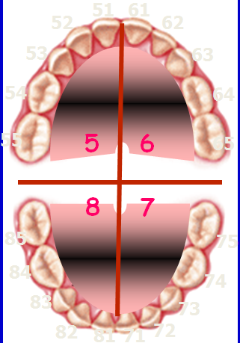
International System (Two Digit System) For Primary Teeth “FDI” Federation Dentaire International
First Digit = quadrant
5
6
8
7
3/10/2020

Slide 29
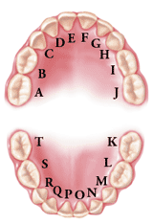
Universal System for Primary Teeth
3/10/2020

Slide 30
X-ray equipment features
Dental equipment for intra-oral radiography have the following features;
X-ray tube potential: 60-70 Kvp
X-ray tube filtration: 1.5 mm Al for up to 70 Kvp
X-ray beam dimensions; not > 60 mm, rectangular collimination
Minimum focus-to-skin distance:
200 mm for dental units of 60 kVp or greater;
100 mm for dental units less than 60 kVp.
3/10/2020

Slide 31
Components of dental x-ray machine
Dental equipment have 3 significant parts.
The tube head;
The tube stand;
The timer: has maximum exposure interval of 5 sec.
3/10/2020

Slide 32
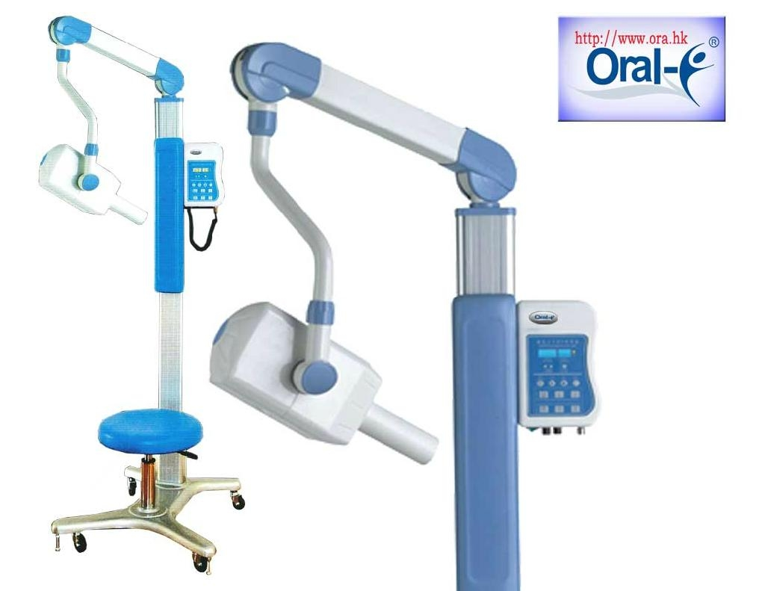
Dental x-ray machine
3/10/2020

Slide 33
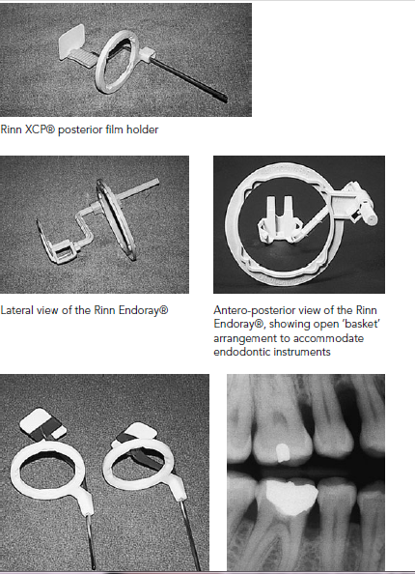
Film-holding instrument & Film-holding beam-alignment instrument
3/10/2020

Slide 34
Image receptors
Intra-oral radiography
Direct or non-screen film;
Digital receptors.
Extra-oral radiography
Film-screen (usually rare-earth);
Digital receptors: storage phosphor
3/10/2020

Slide 35
Intra-oral film sizes
Size 0 – 22 x 35 mm; used for periapical in small children.
Size 1- 24 x 40 mm; ;Bitewing in small children
Size 2 – 31 x 41 mm; used for bitewing in adult.
Size 4- 57 x 76 mm; used for occlusal projections of the maxilla and mandible.
3/10/2020

Slide 36
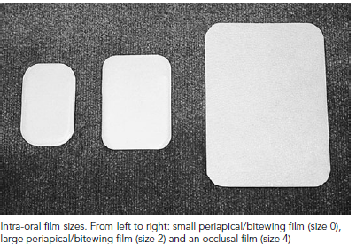
Intra-oral film sizes…cont’d
3/10/2020

Slide 37
Principles for optimal image geometry
The focal spot should be as small as possible.
The focal spot-to-object distance should be as great as possible.
The object-to-film distance (OFD) should be as small as possible.
The film should be parallel to the plane of the object.
The central ray should be perpendicular to both the object and the film.
3/10/2020

Slide 38
Intraoral Radiographic Techniques
Paralleling Technique
Bisecting Angle Technique
3/10/2020

Slide 39
The Paralleling Technique: Basic Rules
Is the most accurate intraoral radiographic technique, meeting four of the five shadow-casting principles(1,2,4 &5).
Film placement: Position the film so that it will cover the teeth.
Film position: Position the film parallel to the long axis of the tooth. The film in the film holder must be placed away from the teeth and toward the middle of the mouth.
Vertical angulation: Direct the central ray of the x-ray beam perpendicular to the film and the long axis of the tooth are exposed.
3/10/2020

Slide 40
The Paralleling Technique …cont’d
Horizontal angulation: Direct the central ray of the x-ray beam through the contact areas between the teeth.
Central ray: Center the x-ray beam on the film to ensure that all areas of the film are exposed.
3/10/2020

Slide 41
The Bisecting Technique
Three of shadow casting is met by using this technique(1,2 &3)
The central ray of the x-ray beam should be directed perpendicular to an imaginary line that bisects the angle formed by the long axis of the tooth and the plane of the receptor.
Principle three of shadow casting is met by using
this technique.
The angle formed by the long axis of the teeth and the film is bisected, and the x-ray beam is directed perpendicular to the bisecting line.
Bisecting angle images are not anatomically accurate & prone to shape distortion.
3/10/2020

Slide 42
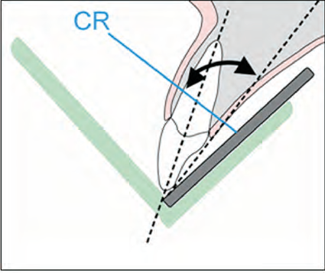
The Bisecting Technique
3/10/2020

Slide 43
PID Angulations: Bisecting Technique
In the bisecting technique, the angulation of the PID is critical.
Angulation is a term used to describe the alignment of the central ray of the x-ray beam in the horizontal and vertical planes.
Angulation can be changed by moving the PID in either a horizontal or vertical direction.
BAIs with aiming rings dictate the proper PID angulation.
3/10/2020

Slide 44
Horizontal Angulation
Horizontal angulation refers to the positioning of the tubehead and direction of the central ray in a horizontal, or side-to-side, plane.
The horizontal angulation remains the same whether you are using the paralleling or bisecting technique.
3/10/2020

Slide 45
Vertical Angulation
Vertical angulation refers to the positioning of the PID in a vertical, or up-and-down, plane.
The vertical angulation differs depending on the radiographic technique being used:
With the paralleling technique, the vertical angulation of the central ray is directed perpendicular to the film and the long axis of the tooth.
With the bisecting technique, the vertical angulation is determined by the imaginary bisector; the central ray is directed perpendicular to the imaginary bisector.
3/10/2020

Slide 46
Bite-Wing Examinations
A bite-wing radiograph shows the crowns and interproximal areas of the maxillary and mandibular teeth and the areas of crestal bone on one film.
Highlight the crowns of the back teeth ( one or two)
Bite-wing radiographs are used to detect interproximal caries (tooth decay) and are particularly useful in detecting early carious lesions that are not clinically evident.
Bite-wing radiographs are also useful in examining the crestal bone levels between the teeth.
3/10/2020

Slide 47
Basic Principles of the Bite-Wing Technique
The film is placed in the mouth parallel to the crowns of both the upper and lower teeth.
The film is stabilized when the patient bites on the bite-wing tab or bite-wing film holder.
The central ray of the x-ray beam is directed through the contacts of the teeth, using a +10-degree vertical angulation.
3/10/2020

Slide 48
Bite-Wing Film Placement
The film is positioned (with either a bite tab or a film-holding device) parallel to the crowns of both upper and lower teeth, and the central ray is directed perpendicular to the film.
The premolar bite-wing radiograph should include the distal half of the crowns of the canines, both premolars, and often the first molars on both the maxillary and mandibular arches.
The molar bite-wing should be centered over the second molars.
3/10/2020

Slide 49
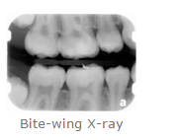
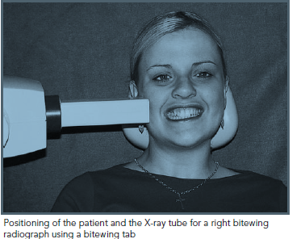
Bite-wing radiography
3/10/2020

Slide 50
Periapical Radiographic Techniques
Highlight only one or two teeth at a time
The paralleling technique(long cone tech) or Right angle technique
C.R is perpendicular to both film &tooth
The film is placed in mid of oral cavity to get parallism between tooth&film>>>image magnification&unsharpness.
Source-object distance is increased to avoid unsharpness(16 inches)>>>increase KV,mA,s and fast film(increase exposure time 4times)
Film holders are used.
3/10/2020

Slide 51
Periapical Radiographic …cont’d
Advantages of paralleling technique
Standerdized>>>used in research
Accurate images
Avoids superimposition on apices
H.A&V.A detrmined by positioning devices
No overbending of films
3/10/2020

Slide 52
Periapical Radiographic …cont’d
Disadvantages of paralleling technique
Difficult to image all parts of the mouth
Increased exposure time
Need long cones &film holders
Cannot image apical area in shallow palate
Discomfort of film holder
Time consuming
3/10/2020

Slide 53
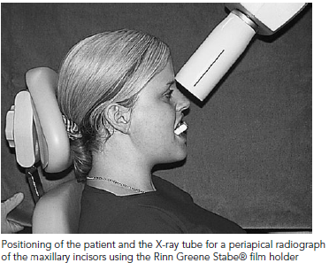
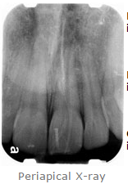
Periapical- radiography
3/10/2020

Slide 54
The Occlusal Technique
The occlusal technique is used to examine large areas of the upper or lower jaw.
Each X-ray shows nearly the full arch of teeth in either the upper or lower jaw.
In the occlusal technique, size 4 intraoral film is used. The film is so named because the patient bites, or “occludes,” on the entire film.
In adults, size 4 film is used in the occlusal examination.
In children, size 2 film can be used.
3/10/2020

Slide 55
Basic Principles of the Occlusal Technique
The film is positioned with the white side facing the arch exposed.
The film is placed in the mouth between the occlusal surfaces of the maxillary and mandibular teeth.
The film is stabilized when the patient gently bites on the surface of the film.
3/10/2020

Slide 56
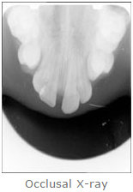
Occulusal radiography
3/10/2020

Slide 57
Extra-oral radiography
Extraoral radiographs (outside the mouth) are taken when large areas of the skull or jaw must be examined or when a patient is unable to open his or her mouth for film placement.
Extraoral radiographs do not show the details as well as intraoral films do.
Extraoral radiographs are useful in evaluating large areas of the skull and jaws but are not adequate for detection of subtle changes such as the early stages of dental caries or periodontal disease.
3/10/2020

Slide 58
Extra-oral radiography …cont’d
There are many types of extraoral radiographs. Some types are used to view the entire skull, whereas other types are focused on the maxilla and mandible.
3/10/2020

Slide 59
Panoramic Radiography
Panoramic radiographs show the entire dentition and related structures on a single film.
Some types of panoramic units operate with the patient in a seated position, and other types require the patient to be in a standing position.
Regardless of the type of machine, you must follow the manufacturer’s instructions carefully.
Because the images on a panoramic film are not as clear or as well defined as the images on intraoral films, bite-wing films are used to supplement a panoramic film to detect dental caries or periapical lesions.
3/10/2020

Slide 60
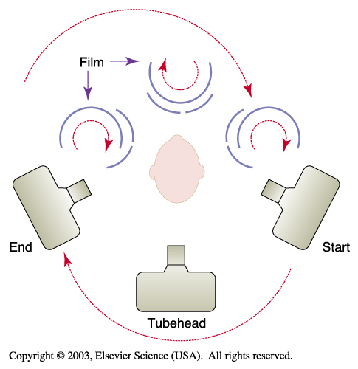
Panoramic Radiography …cont’d
The film and x-ray tubehead move around the patient in opposite directions in panoramic radiography.
3/10/2020

Slide 61
Thank You !
3/10/2020

