Slide 1
session outline
Film functions
Type of film
Structure of duplitized film in x ray dept.
Structure of single sided fim in x ray dept.
Stages in production of film
Resolving power of film materials
Grainess of film
Spectral sensitivity of film materials

Slide 2
Session objectives
At the end of the lesson, the student should be able to:-
Explain functions of film
Describe types of medical imaging films
Describe the usage and difference of films
Explain the structure of different film types used in radiography department
Describe the stages in the production of film
Analyze the resolving power of film materials

Slide 3
Cont.....
Explain the emulsion formation process and
film packing
Describe the type of grains in emulsion
Explain spectral sensitivity of film emulsion

Slide 4
Chapter two Film Materials in X –ray Department

Slide 5
Radiographic Film
X-ray films for general radiography consist of emulsion-gelatin containing radiation sensitive silver halide crystals, such as silver bromide or silver chloride, and a flexible, transparent, blue-tinted base.
Putting emulsion on both sides of the base doubles the amount of radiation- sensitive silver halide, and thus increases the film speed.
The emulsion layers are thin enough so developing, fixing, and drying can be accomplished in a reasonable time.

Slide 6
FILM FUNCTIONS
Film performs several functions in the medical imaging process.
Knowledge of these functions and how they are affected by the characteristics of different types of film aids in selecting film for a specific clinical procedure and in optimizing radiographic techniques.

Slide 7
❖ Image Display
Most filmed medical images are recorded as transparencies
In this form they can be easily viewed by trans-illumination on a viewbox

Slide 8
Image Storage
Film has been the traditional medium for medical image storage and archiving.
If a film is properly processed it will have a lifetime of many years and will, in most cases, outlast its clinical usefulness.
The major disadvantages of storing images on film are bulk and inaccessibility.

Slide 9
❖ Image Recording
In principle, film is an image converter.
It converts radiation, typically light, into various shades of gray or optical density values.
An important characteristic of film is that it records, or retains, animage.
An exposure of a fraction of a second can create a permanent image.

Slide 10
Film Materials in x-ray departments
❖ Two main groups
1. Films which are to be exposed to x-rays only or to a combination of x- rays and light are
called x-ray films
2. films which are to be exposed to light only and are to receive no exposure to x-rays are called fluorography films

Slide 11
❖ Techniques of exposure
exposing the film in a light tight pack to x- rays only
exposing the film b/n a pair of
intensifying screens which are activated by
x-rays and as a result produce light.

Slide 12
Types of film
Direct exposure or Non screen Film
exposed to x ray photons only ----greater radiation dose-----limited for medical application
justified for extremely fine detail diagnosis
Has -Single emulsion
-Extremely fine grain silver halide crystals
-A much greater silver content
-Require manual processing
Application
#Dental radiography
#Reconstructive surgery
#Biopsy specimen radiology
#Forensics

Slide 13
Intensifying screen film (screen film)
Available in a wide variety of speed, contrast ranges, latitudes and resolutions(speed by the size of the crystals and the thickness of emulsion layer)
Use Intensifying screens in cassette
Film is sandwiched between a pair of intensifying screens
IS are irradiated by X ray, light is emitted from IS----- emulsion exposed to visible light -----image is formed
less detail than direct exposure film
Reduce patient exposure
Increase x-ray tube life
Thinner emulsion layer is used
Notes:
IS-intensifying screen;-direct exposure film(non screen film)
- intensifying screen(screen film)
-single sided x-ray film

Slide 14
Single sided x ray film
Use Single emulsion, medium speed, high-contrast, blue tinted base film for all video cameras and imaging modalities
Fine grain emulsion and the opposing side anti halation coating ensure very high definition and brightness
Film exposed to light

Slide 15
Special Application films
Mostly single emulsion
Some have a pure gelatin coating on one side to avoid shrinking and curling
Duplication film
Designed for duplication
produces a negative from negative
capable of copying the density of original faithfully
Diagnostic radiograph are actually negative------white bone
Fluoroscopy produces a positive image-------------black bone

Slide 16
Subtraction film
Subtraction is technique to remove the obstructive part of the image
employed for making the positive radiograph
used to obtain the film copy
Cineradiography film
35 mm roll film
sensitive to the green light emitted by the fluoroscopic unit
Primary application is for cardiac catheterization angiography
high patient dose
Fluoroscopic spot film
70 mm roll film or 105 mm film chips
Sensitive to the green light from fluoroscopy

Slide 17
Subtraction film
Subtraction is technique to remove the obstructive part of the image
employed for making the positive radiograph
used to obtain the film copy
Cineradiography film
35 mm roll film
sensitive to the green light emitted by the fluoroscopic unit
Primary application is for cardiac catheterization angiography
high patient dose
Fluoroscopic spot film
70 mm roll film or 105 mm film chips
Sensitive to the green light from fluoroscopy

Slide 18
Films for special procedures
Mammography
Radiation monitoring film
Radiotherapy
Kidney surgery

Slide 19
Structure of Duplitized film
Films with sensitive layer on both sides of base
Construction

Slide 20
1. Film base
a transparent substrate acts as a support medium for the photosensitive emulsion lies at the top of it
Does not participate in the image forming process
accounts for vast majority of the thickness of any given film stock
Contains a light blue dye
Made of substances derived from cellulose
Must be sufficiently rigged to avoid kinking
major types of film base in use
Cellulose nitrate
Cellulose acetate
Polyester

Slide 21
Nitrate
first transparent flexible plasticized base commercially available.
Its drawback
extremely flammable
Its ignition can be very difficult to extinguish
It also disintegrated on prolonged storage
Acetate
Acetate film does not burn under intense heat, rather melt, causing a bubbling burn out effect
Acetate film is safer than nitrate but not as strong as polyester bases

Slide 22
Polyester
the most recent film base to have been developed
Impermeable to water and processing solution
Low risk of contamination
Chemical purity
Withstand mechanical stress(help on automatic processing)

Slide 23
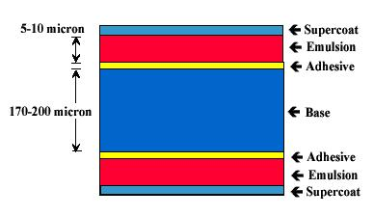
2.Substratum layer
Partition between emulsion and base
Adherence of emulsion to base
mainly gelatin

Slide 24
3.Sensitive emulsion layer
active image forming component
Consists of many small silver halide crystals suspended in gelatin (gelatin supports, separates, and protects the crystals)
Under go changes when exposed to light or x ray
It must be
Sufficiently flexible
Rapid and uniform dispersion of chemical through the emulsion

Slide 25
4.super coat
Thin layer of Protective gelatin over emulsion
Provides shinny surface for the film which improves both its appearance and its durability
Anti abrasion layer
Advantage of two emulsion layer
Increase in sensitivity
Increase in contrast
Production of image in two layer

Slide 26
Structure of single sided film
contains: base emulsion layer, and super coat but only in one side
On single sided film when the film dries it shrinks the emulsion side inward
Coating a layer of gelatin of the same thickness as the emulsion layer (Anti-curl layer) in opposite side to the emulsion layer prevent curling of the film to one side

Slide 27
No curling in double sided films (both shrink equally)
Application
to be used with one intensifying screen (x ray film)
for fluoroscopy, making copies of radiograph, subtraction, miniaturization (photographic film)

Slide 28
Irradiation
Is the sideways scattering of light within the emulsion itself as a result of the light striking the grains of silver halide
This light contributes nothing to the image proper but becomes a source of image unsharpness.
The use of thin emulsion layers produce less irradiation.

Slide 29
Halation
Separated image from the proper one produced by reflection of light at boundaries between film emulsion, film base, intensifying screens and cassette surface
Single-emulsion films have a light absorbing layer coated on the other side of the base to prevent halation
By adding suitable dye to the gelatin of the non-curling backing on flat and roll film
Source of un sharpness
more noticeable when the base is thick

Slide 30
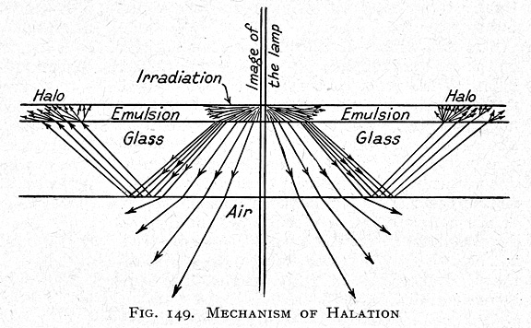

Slide 31
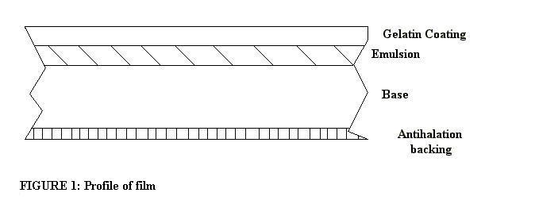
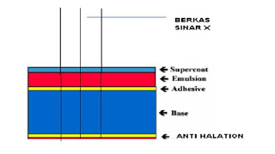

Slide 32
Four stages in radiographic film manufacturing
Crystal production
Ripening
Mixing
Coating

Slide 33
Crystal Production
AgNO₃ + KBr AgBr + KNO₃
Gelatin must be present:
Tabular grain:
Larger more evenly dispersed
Absorption of a greater portion of the exposing photons
Reduced light crossover from one emulsion to the other
Reduced silver coating requirements

Slide 34
Crystal Structure
Structure permits both free silver atoms and free electrons to drift through the lattice- key to the formation of the latent image.
Negatively charged surfaces
Positively charged exteriors
Sensitivity speck: must be present to provide film sensitivity
Serve as electrodes to attract the free silver ions
Bromide: serve as ion pumps to assist in the deposition of silver.

Slide 35
Ripening
Period during which silver halides are allowed to grow
Size of the crystal determines their total sensitivity.
At the proper time, emulsion is cooled, shredded, and washed to remove KNO₃ (potassium nitrate)

Slide 36
Mixing
Colored dyes: improve the sensitivity of the silver halides to match the wavelengths of photons that will be striking the emulsions during exposure.
Panchromatic: sensitive to all colors
Orthochromatic: not sensitive to the red spectrum
Hardeners: to prevent physical trauma
Bactericides and fungicides
Antifogging agents: to decrease sensitivity to environmental factors, such as heat.

Slide 37
The Resolving Power of Film Material
Resolving power
Ability of a photographic emulsion to record fine details
Expressed as the number of line pairs per millimeter which can be distinguished in the image as separate entities (one black and one white)
high resolving power --- lines seen as separate entities even when they are very close together
low resolving power (not resolved) each separate line spreads to occupy the intervening space
Resolving power of emulsion depend on
Grain size
Contrast
Degree of absorbing and scattering lines

Slide 38
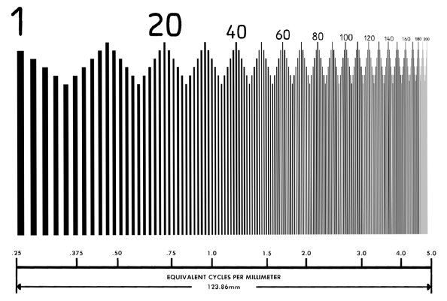

Slide 39
Radiographic emulsions show 8 – 20 LP/mm
Photographic Fast emulsions 40 – 50 LP/mm
Medium emulsions 70 – 100 LP/mm
Slow emulsions over 1000 LP/mm

Slide 40
Graininess of film materials
Grain:-clumps of silver on image after processing from developed crystals
Grain size is directly related to film speed
Slow films have a fine grain structure than fast films
Finer grained slow films able to resolve more detail than faster, coarse grained films.

Slide 41
Graininess in photographic negatives is influenced
Grain size of film material used
Fast/slow emulsion versus grain size graininess
Type of developing solution used
Exposure and degree of development
Graininess is insignificant in negatives which it is not intended to enlarge

Slide 42
TWO TYPES OF GRAIN
Globular Grain - spherical in shape and has a bigger volume. Use for blue sensitive film.
Tabular grain - has a table-top like structure that provides bigger surface are but smaller volume.

Slide 43
Advantages of tabular grain
Increased resolution due to reduction in cross-over
Reduction in silver coating weight
Crossover is when the exposure of the emulsion by light is from the opposite side of the intensifying screen
Causes increased blur on the image

Slide 44
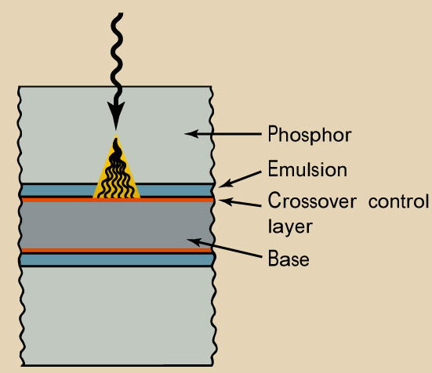
CROSSOVER
Reducing crossover by adding a dye to the base

Slide 46
Grain size and distribution affects the following
Speed. The bigger the average grain size , the higher the speed of the film.
Contrast. Affected by size distribution. The more sizes available in the film, the lower the contrast.
Graininess. Graininess is the apparent clumping of the crystal as seen on the radiograph. The bigger the crystal, the higher the graininess of the film.

Slide 47
Spectral sensitivity of film material
Spectral sensitivity is the range of wavelength of the electromagnetic radiation that the film will respond
The light that our eyes can see is part of the electromagnetic spectrum
This visible part consists of the colors that we see in a rainbow each colors corresponds to a different wavelength of light

Slide 48
Film materials are very sensitive to parts of the light spectrum in short wavelength range to which the eye is relatively insensitive
we use x ray and gamma ray for radiography because they have short wave length and photographic emulsions are highly sensitive for them

Slide 49
Human eye sees a spectrum of color ranging from violet-blue through green, yellow and orange to red
Human eye most sensitive to green yellow
Maximum sensitivity of photographic emulsion is in the blue part of the spectrum
Sensitivity of film determines the amount of exposure required to produce an image (High sensitivity(speed)-------less exposure)
Notes:
High sensitivity (speed) films are chosen when the reduction of patient exposure and heat loading of the x-ray equipment are important considerations.
Low sensitivity (speed) films are used to reduce image noise. The relationship of film sensitivity to image noise is considered in the section titled, "Image Noise."
The basic sensitivity characteristic of a film is determined by the composition of the emulsion. The size and shape of the silver halide grains have some effect on film sensitivity. Increasing grain size generally increases sensitivity. Tabular-shaped grains generally produce a higher sensitivity than conventional grains. Although grain size may vary among the various types of radiographic film, most of the difference in sensitivity is produced by adding chemical sensitizers to the emulsion.

Slide 50
Sensitivity described as “half speed,” “medium speed,” and “high speed” not in numerical values
High sensitivity (speed) films are chosen
Reduction of patient exposure
Heat loading of the x ray equipment

Slide 51
Low sensitivity (speed) films are used: to reduce image noise
sensitivity characteristics of a film is determined by
composition of the emulsion
Size and shape of the silver halide grains
Increasing grain size generally increases sensitivity
Tabular-shaped grains generally produce a higher sensitivity than conventional grains
Addition of chemical sensitizers to the emulsion
Notes:
Film is not equally sensitive to all wavelengths (colors) of light. The spectral sensitivity is a characteristic of film that must be taken into account in selecting film for use with specific intensifying screens and cameras. In general, the film should be most sensitive to the color of the light that is emitted by the intensifying screens, intensifier tubes, cathode ray tubes (CRTs), or lasers.
Blue Sensitivity
A basic silver bromide emulsion has its maximum sensitivity in the ultraviolet and blue regions of the light spectrum. For many years most intensifying screens contained calcium tungstate, which emits a blue light and is a good match for blue sensitive film. Although calcium tungstate is no longer widely used as a screen material, several contemporary screen materials emit blue light.
Green Sensitivity
Several image light sources, including image intensifier tubes, CRTs, and some intensifying screens, emit most of their light in the green portion of the spectrum. Film used with these devices must, therefore, be sensitive to green light.
Silver bromide can be made sensitive to green light by adding sensitizing dyes to the emulsion. Users must be careful not to use the wrong type of film with intensifying screens. If a blue-sensitive film is used with a green-emitting intensifying screen, the combination will have a drastically reduced sensitivity.
Red Sensitivity
Many lasers produce red light. Devices that transfer images to film by means of a laser beam must, therefore, be supplied with a film that is sensitive to red light.

Slide 52
The film must be most sensitive to the color of the light that is emitted by the
Intensifying screen
Intensifier tubes
Cathode ray tubes (CTRs)
Or lasers
Film is not equally sensitive to all wavelengths(color) of light

Slide 53
Four main groups--------photographic material
Blue sensitive film
Orthochromatic film
Panchromatic film (sensitive to all color)
Infra-red film

Slide 54
Blue sensitivity
maximum sensitivity in the ultraviolet and blue region of the light spectrum
Known as blue sensitive, ordinary, or non-color sensitive.
Green sensitivity (ORTHOCHROMATIC FILM)
Several image light sources emit most of their light in the green portion of the spectrum
Film using intensifier tubes, CRTs, and some intensifying screens must be sensitive to green light
Silver bromide can be made sensitive to light by adding sensitizing dyes to the emulsion

Slide 55
Red sensitivity
Many lasers produce red light
Devices that transfer images to film by means of laser beam must, therefore, be supplied with a film that is sensitive to red light
Color sensitivity of photographic films can be extended in to the region of the visible spectrum of the wavelengths longer than the violet- blue range by adding dyes (dye sensitizing optical sensitizing or color sensitizing)

Slide 60
Size and packing of screen type x-ray films
Available sizes
13 cm x 18cm
15cm x 30cm
15cm x 40 cm
20 cm x40 cm
18 cm x 24 cm
24 cm x 30 cm
30 cm x 40 cm
35 cm x 35 cm
35 cm x 43 cm

Slide 61
Cont....
Film packing
In preparation for use, each sheet must be loaded in to a cassette or film holder in the darkroom to protect it from exposure to light
The sheets are available in a variety of sizes and can be purchased with or without interleaving paper
Interleaved packages have a layer of paper that separates each piece of film
Interleaving paper is removed before the film is loaded the film holder

Slide 62
Thank you

