Slide 1
Chapter five Intensifying screen and cassette

Slide 2
Introduction
The fluorescing materials which are used to increase the photographic response of silver halide emulsion
The main function of the intensifying screen is to reinforce the action of x-ray by subjecting the sensitive emulsion to the effect of light
When x-ray falls on certain substances light is emitted
The emission of light from a substance bombarded by radiation termed as luminescence.

Slide 3
Luminescence
The x-ray photon is absorbed by the target atom.
The outer shell electron is raised to an excited state.
It returns to a ground state with emission of a light photon.
Luminescence has two types:-
Fluorescence
Phosphorescence

Slide 4
Fluorescence:-
luminescence is excited only during the period of irradiation and will terminate at completion of the X-ray exposure. The phosphors in intensifying screens produce fluorescence.

Slide 5
Phosphorescence:-
It is afterglow; The irradiated material continues to emit light for a time after cessation of exposure and will continue to produce an image which you do not want

Slide 6
Intensifying screen
An intensifying screen is a plastic sheet coated with fluorescent material called phosphors.
Phosphors are materials which convert photon energy to light.
The x-ray energy is absorbed by the intensifying screen material, and a portion of it converted into light. The light, in turn, exposes the film

Slide 7
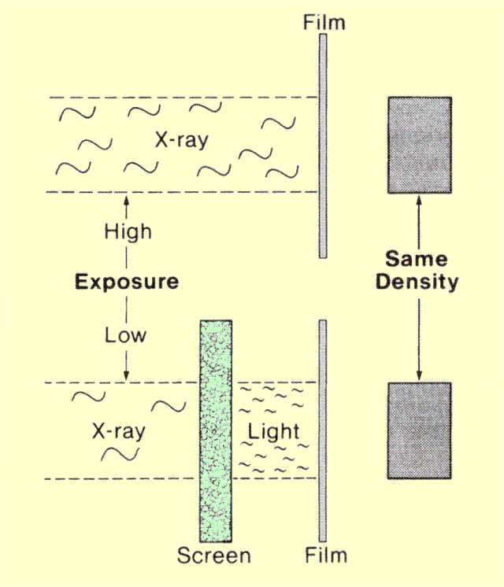
Light production

Slide 8
Conversion of X-Ray Energy in an Intensifying Screen
Intensifying screens are used because film is much more sensitive to light than x-radiation.
Approximately 100 times as much x-radiation would be required to expose a film without using intensifying screens

Slide 9
The more light a screen produces for a given input of x-radiation, the less x-ray exposure and thus shorter exposure time are needed to expose the film.

Slide 10
Advantages of using intensifying screens
Reduce patient exposure by converting few x-ray photons into many light photons.
Shorten exposure time
Reduce movement Unsharpness
Increase x-ray tube life

Slide 11
Construction of intensifying screen
Intensifying screen consists of
Polyester plastic base – support layer
Phosphor layer – active layer
Reflective layer – increases screen efficiency by redirecting light headed in other directions
Protective coating

Slide 12
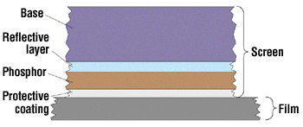
Intensifying screens

Slide 13
A Base
Provides mechanical support for phosphor layer
Usually made of polyester of cellulose acetate
Has strength, flexibility and is chemically inert

Slide 14
A Reflective layer
Its function is to direct the emitted light to film
Made of magnesium oxide or titanium dioxide
Ensures that any light produced in the phosphor that moves towards the base is reflected back towards the film

Slide 15
A Phosphor Layer
Active layer which converts x-ray energy into light
Consists of fluorescent particles suspended in a binding substance.
Compounds of rare earth element gadolinium (Gd), lanthanum (La) and yttrium (Y) are widely used as phosphors.

Slide 16
Formerly, calcium tungstate
Currently, rare earth mixtures
Screen phosphors should have
A high atomic number
High conversion efficiency
Light matched to film used
Minimal afterglow

Slide 17
Protective coat
Closest to film
Thin layer usually made of cellulose acetate
Protects phosphor layer from abrasion and damage
It is transparent to allow the light produced in the phosphor to reach the film
Minimize damage to screen from handling and dirt
Reduce static electricity

Slide 18
The Fluorescent Material
X-ray phosphors
Phosphor possess two characteristics
Absorbing x-rays
Converting the absorbed x-ray energy to light
Phosphor in use for IS
Calcium tungstate
Barium fluorochloride
Gadolinium oxysulphide
Lanthanum oxysulphide Rare earths
Lanthanum oxybromide
Yttrium oxysulphide

Slide 19
The phosphor must be transport to its own luminescence and most allow the luminescent radiation easily to leave the affected crystal.

Slide 20
Calcium Tungstate
First substance to be used
Luminesces in pure state and requires no activator
Spectrum extension is from ultra-violet to yellow-green bands of the spectrum
Regions of maximum fluorescence is about 420 nanometers that is the color of emitted light violet or violet blue

Slide 21
Barium fluorochloride
Activated by europium
Emits ultraviolet and blue …..narrow band
Region of maximum emission is about 380 nanometers
Some intensifying screens include a substance
The substance……..UV light …………..blue light
Broaden emission spectrum (400 nanometer)

Slide 22
The Rare Earth
Four groups
Gadolinium oxysulphide, activated by terbium……….blue emission
Lanthanum oxysulphide, activated by terbium………..blue light emission
Lanthanum oxybromide, activated by thulium and terbium
Yttrium oxysulphide, activated by terbium………….white light
Combination of phosphor number 1 and 2……….green light is produced (540 nanometer). These phosphors nearly always used together

Slide 23
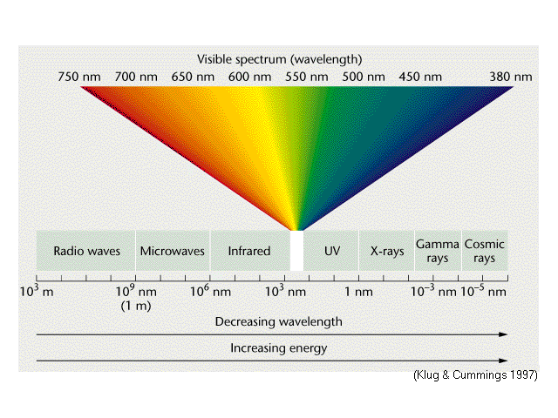
Notes:
Red orange yellow green blue vilolet

Slide 24
Screen characteristic
Three primary characteristics
Screen speed
Image noise
Spatial resolution
Screen speed
relative number that describes how efficient x-ray are converted into usable light
Speeds range from 100 (slow, detail) to 1200 (very fast)
A measure of screen speed is intensification factor

Slide 25
Factors determining screen speed
Thickness of the phosphor layer
Size of the phosphor crystal
Presence or absence of light-absorbing dye in the phosphor layer
Phosphor conversion efficiency

Slide 26
Image noise
Appears on radiograph as a speckled background.
Occurs more often when fast screens and high KVp are used.
Reduces image contrast
Spatial resolution
Refers to how small an object can be imaged
Screens reduce spatial resolution.

Slide 27
The Intensification factor (IF)
The IF of a screen is the ratio of the x-ray exposure needed to produce the same density on a film with and without the screen
IF=I without screen
I with screen
When a screen that is used to produce a pre-determined film density require lees exposure (i.e. fast exposure), IF will have large value.
When a screen that is used to produce the film density requires more exposure (i.e. slow exposure), IF will be a smaller value.
Intensification screens are classified as fast, medium (par speed), and slow (detail), with IFs in the range of 100, 50, and 25, respectively

Slide 28
If a screen has an IF 15 .. & a film is exposed without screen 60 KV & 150mAS
Without screen it requires…60KV & 50mA for 3 sec
i.e. 50X3=150
With screen it requires …60KV for 0.2 sec
i.e. 50X0.2x15=150

Slide 29
Factor affecting IF
The amount of x-ray absorbed by screens
The efficiency of its conversion to visible light
How much of this light reach the film &its affect on film

Slide 30
Speed of intensifying screen
Ability to produce light i.e. conversion of invisible rays to the visible spectrum
We can increase the speed of screen by increasing
Thickness of fluorescent layer
Crystal size
Types of fluorescent material used
But increasing crystal size it lead to unsharpness of the image
It is overcome by manufacturer by
Use of crystalline powder
Use of dye especially yellow or red

Slide 31
Types of screens with respect to speed
Ultra fast
High speed
Medium or par speed
Detail or slow speed
Ultra detail

Slide 32
Factor affecting the speed of screen
Intrinsic factors
Phosphor
Thickness of layer
Size of phosphor crystal
Reflectance of backing
Extrinsic factors
Kvp
temperature

Slide 33
Types of Intensifying Screens
A standard intensifying screens
Described as standard or regular or par speed
Calcium tungstate is used as florescent material
Gives adequate speed with satisfactory detail
Suitable for general radiographic

Slide 34
High speed intensifying screen
‘Fast’ or ‘high speed’
Calcium tungstate screen which have speed as their special features
Since it is fast there will be loss of sharpness & detail of the image
Used where there is a risk of motion Unsharpness---- particularly from involuntary movement

Slide 35
High definition intensifying screen
‘slower’ than other calcium tungstate screens
May entail exposure doses larger than those required in the case of regular screen
Applicable to those radiographic subjects which contain small detail
Designed in such a way that it gives fine detail & sharpness
Used for immobilized parts as it takes long exposure

Slide 36
Graduated intensifying screens
Designed with progressively decreasing intensifying factors
Available in large sizes & are intended for long scale of radiation intensities

Slide 37
Other intensifying screens
These are rare earth screens
Increase in speed while maintaining the details & sharpness
Requires less exposure
Are used where there is risk of radiation to the patient & in rapid film changer

Slide 38
High KV screens
Also called as lead intensifying screen
Barium lead sulphide is used as fluorescent material
Never used at low Kv range but are used with 250 Kv x-rays or cobalt gamma ray

Slide 39
Mounting Intensifying screen
Screen should be mounted in permanent position within the cassette
IS should not be fastened
Screens should be handed gently, being held by pressure from the palms of the house along their edges ---------- finger marks
Front screen is mounted first

Slide 40
Care of Intensifying Screen
Cassette should not be stored or opened and reloaded in the vicinity of chemicals
There is no means of removing the contamination of chemical splashes
Leave cassette closed, on a bench or anywhere else.
Protect them from exposure to damaging agents such as chemicals or any sorts of physical assault of any kind
Cassette should not be left lying close to radiation or stored near hot pipes
Film emulsions gain speed with increasing temperature but screens lose it
Finger them as low as possible
Proper and regular cleaning of screens

Slide 41
Method of cleaning screens
Un dust with soft brush
Wipe with cotton wool swab
Scentless soap or detergent can be used but never use any kinds of organic agents
Lukewarm water can be used
Finally wipe with dry soft cloth

Slide 42
X-ray film cassettes
Cassette design
Cassette: a small flat box used for transporting a film
Cassette
Provides support for screens
Provides light tight environment for film
Aluminum
Plastic: Carbon fiber
Cardboard
Closure: flat verses bowed panels

Slide 43
Cassette are used in association with intensifying screens and they have three related proposes
To maintain the film in close uniform contact with each of the film in close uniform contact with each of the screens during exposure
To exclude light
To protect the IS from physical damage

Slide 44
Consists of two flat rectangular plates hinged at one long edge
Front of the cassette :- one aspect of the cassette which faces the x-rays tube
Back of the cassette :- the side which is turned away from the x-ray tube during exposure

Slide 45
Front of the cassette
Must be trans radiant
May be made from aluminum of 1.2 mm gauge
Also from plastic laminate
Often riveted to the frame
Back of the cassette
Almost always it is metal--------heavier gauge Al
Usually lined with
On inside it there if fixed black felt or plastic foam pad, to which it is attached the back of IS
Clips at the back of the cassette

Slide 46
Types of x-ray film cassettes
Curved cassette
House the front convexly curved in a shallow arc
Parallel near relationship between subject and film
Smaller size (18 X 24 cm)
Cassette in a film changer
Angiography cassette
Group of three to five, one behind the other
The top most in the pipe is exposed and withdrawn in series
Gridded cassette
Cassette incorporated in the front a secondary radiation grid as an integral component of the cassette
Deeper, heavier and much more expensive
Practical advantage

Slide 47
Flexible cassettes
Designed for adaptation to rounded surfaces
Arc has small radius
Simple envelop of plastic material
Folded at one end and fastened with press buttons
Multi section cassette
Deep enough to hold at any one time a group of films varying in number from 3to 7.
Tomography
between films 1 cm or 0.5cm

Slide 48
Care of cassettes
Avoided rough handing
The following further points should be noted
Regular inspection
Testing procedures

Slide 49
Loading and unloading a cassette
Unloading
Cassette in place face downwards and opened the back
It is then turned over and the front of the cassette tipped so that the film falls from the well of the cassette away from the front screen
The film is removed with the free hand and the cassette is closed

Slide 50
Loading
Cassette is placed face downwards on the bench and opened from the back
A film in its paper folder is removed from the box or hopper and held vertically at the folded margin
The film is then be lowered gently in to the well of the cassette and in smooth contact with the front screen
The cassette is closed by brining over the back and then locking the clips or bars.

Slide 51
QQQQQQQQQQ

