Slide 1
Instrumental
(Operative ) Vaginal Delivery

Slide 2
Operative vaginal delivery
Definitions-
Delivery in which the operator uses forceps or vacuum device to assist the mother in transitioning the fetus to extrauterine life.
It includes also Destructive deliveries, which are procedures undertaken to reduce the bulk of a dead fetus in obstructed labor to facilitate delivery.

Slide 3
Introduction
Incidence:
- 6 % of all births.
- vacuum done 4x than forceps.
- success rate for operative vaginal
deliveries, if properly conducted, is 99%

Slide 4
FORCEPS
Obstetric forceps is a pair of instruments designed to effect delivery of the fetus by applying traction to the fetal head.
Types of forceps
Classical
Simpson
Tucker-McLane
Specialized
Kielland
Piper

Slide 5
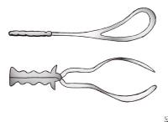
Classic forceps

Slide 6
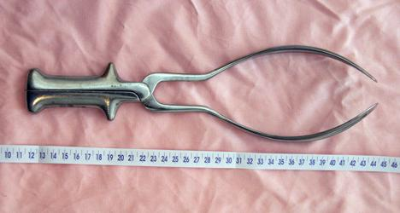
Simpson

Slide 7
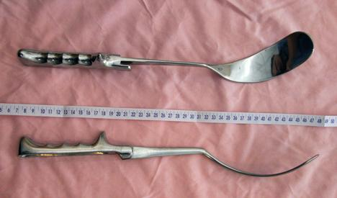
Tucker-McLane

Slide 8
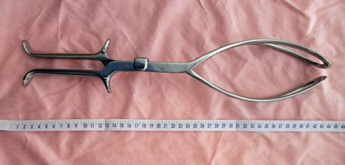
Kielland

Slide 9
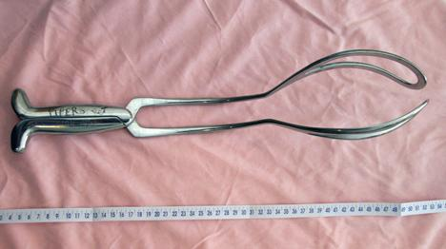
Piper

Slide 10
Classification of forceps deliveries
Outlet forceps:
The scalp is visible at the introitus, without separating the labia.
The fetal skull has reached the pelvic floor
The sagittal suture is in anteroposterior diameter, or right/left occipito anterior, or occipito posterior position
The fetal head is at or on the perineum
Rotation does not exceed 45° !!

Slide 11
Low forceps:
The leading point of the fetal skull is 2 cm or more beyond the ischial spines (at least +2 cm station or below), but not on the pelvic floor;
Low forceps have two subdivisions:
a) rotation is 45 degrees or less (left or right
occiput anterior to occiput anterior, or left or
right occiput posterior to occiput posterior), &
b) rotation more than 45 degrees.

Slide 12
Mid forceps
The station is above +2cm , but the head is engaged.
High forceps
This is not included in the classification
Obsolete and dangerous

Slide 13
Indications to use forceps
1.Prolonged second stage.
2.Suspicion of immediate or potential fetal compromise
- e.g., NRFHR pattern, abruption) where expeditious vaginal delivery can be readily accomplished.
3.Shortening the second stage of labor for maternal benefit:
- e.g., maternal cardiac disease, severe PE and Eclampsia, exhaustion.

Slide 14
Prerequisites for forceps delivery
The head must be engaged.
The cervix must be fully dilated
The position of the head must be known.
The membranes must be ruptured.
The fetus must be in a vertex or face mento anterior presentation (unless the purpose is to use forceps to assist in delivery of an after-coming head in breech presentation).

Slide 15
Prerequisite ctd.
The person in charge must be experienced in instrumental vaginal delivery.
The option of performing an immediate caesarean delivery should be possible if complications arise
No CPD.
The patient must have adequate anesthesia/analgesia. .
Bladder should be emptied

Slide 16
Contraindications
Any contraindication to vaginal delivery
Refusal of the patient to consent to the procedure
Cervix not fully dilated
Inability to determine the presentation and fetal head position or pelvic adequacy
Suspected CPD
Unsuccessful trial of vacuum extraction
Inadequate facilities and support staff

Slide 17
Functions of forceps
Traction (main job)
Rotation (e.g. occipito transverse)
Prevention (e.g. preterm fetus)

Slide 18
Maternal complications
Early (acute) complications include:
lacerations to the cervix, vagina, perineum, or bladder
extension of episiotomies, due to the added diameter of the presenting part.
increase in blood loss
intrapartum rupture of the unscarred uterus.

Slide 19
Late complications mainly are related to injury to the pelvic support tissues and organs and include
urinary stress incontinence
fecal incontinence
anal sphincter injuries
pelvic organ prolapse

Slide 20
Fetal complications
Transient facial forceps marks,
lacerations, and cephalhematomas .
Skull fractures
intracranial hemorrhage
Cerebral palsy

Slide 21
The Advantages of forceps
they are unlikely to detach from the head
can be sized to a premature cranium
may be used for a rotation

Slide 22
Failed Forceps
A failed forceps is diagnosed if:
− Fetal head does not descend with each pull
− Fetus is undelivered after three pulls with no descent or after 30 minutes
The possible causes are:
− Undiagnosed CPD
− Incomplete cervical dilatation
− Wrong diagnosis of position
− Incorrect application

Slide 23
Vacuum Extractor (Ventous)
The classic instrument consists of a disc shaped cup through which a vacuum of up to 0.8 kg/cm2 is applied to the fetal scalp

Slide 24
VE
Creates an artificial caput (chignon) through suction and application of metallic or plastic cup that holds firmly and allows adequate traction.
In general, VE operations have similar indications as operations with forceps

Slide 25
CHOICE OF INSTRUMENT
Factors that might influence choice are
The availability of the instrument
The degree of maternal anaesthesia, and knowledge of the risks and benefits associated with each instrument
Advantages of Vacuum devices are-
easier to apply
require less maternal anaesthesia
Less trauma to the mother

Slide 26
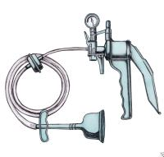

Slide 27
Contraindications to vacuum extraction
Operator inexperience
Inability to achieve a proper application
Uncertainty concerning fetal position/station
Suspicion of feto-pelvic disproportion
High fetal head
Malposition (e.g, breech, face, brow)
Known or suspected fetal coagulation defect
Prior failed forceps
Prematurity (fetuses <34 wk gestation)
Prior scalp sampling

Slide 28
Cups
Metallic (rigid) v/s Plastic or silicon (soft)
Metallic ones are mushroom shaped & soft cups are bell shaped.
Rigid cups are for bigger fetuses, deep station, Molded head, OP position which requires more force.
Soft cups for outlet vacuum or called lift out vacuum deliveries where minimal force is required.
Soft cups are less traumatic than rigid ones.

Slide 29
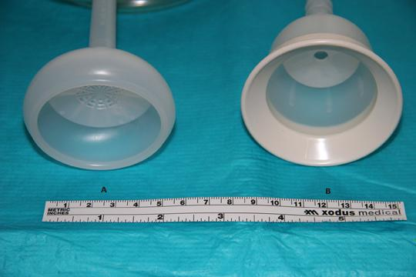
“M” shaped Bell shaped

Slide 30
Mechanism of force generation
Is by Chignon formation (artificial scalp edema)
“M” shaped cups generate more force than bell shaped cups
Cups have different sizes; 40mm, 50mm, 60mm, 70mm.
As size increases force generated increases.

Slide 31
TECHNIQUE
Patient preparation
- Bladder should be empty
- The patient is placed in the dorsal lithotomy
position and the fetal presentation, position,
& station are confirmed and documented.

Slide 32
Determine the flexion point
- is the location on the fetal head where outward traction pulls the head so as to allow flexion at the neck.
- In the normally molded fetal head FP is in the midline, over the sagittal suture, approximately 6 cm from the anterior fontanelle and 3 cm from the posterior fontanelle.

Slide 33
For a 60mm (6cm) cup, when the centre of the cup is placed over the FP, the edges of the cup should be approximately 3 cm from the anterior fontanelle and just at the edge of the posterior fontanelle.
- The anterior fontanelle is the reference point for checking the application because access to the posterior fontanelle is partially blocked once the extractor cup is in place.

Slide 34
Exert Traction:
Traction is applied gradually as the contraction builds and is maintained for the duration of the contraction,
In coordination with contraction & the mother's pushing.
Perpendicular to the plane of the cup to maintain the seal with the fetal head.
B/n contractions, check for fetal heart and cup application;

Slide 35
Both hands are employed:
- The fingertips of the dominant hand pull the device's crossbar, while the non-dominant hand monitors the progress of descent and prevents cup detachment by placing counter pressure with the thumb.
With progress and absence of fetal distress, continue traction with contraction for 30 minutes or till three successive pulls fail to advance the head;
As soon as the head is delivered, release the vacuum and proceed with the delivery of the fetus;

Slide 36
Direction of pull:
Traction is applied along the axis of the pelvic curve to guide the fetal vertex, led by the flexion point, through the birth canal.
Initially is downward (toward the floor ,then extended upwards to a 45 degree angle to the floor as the head emerges from the pelvis and crowns.
Traction is gradually discontinued as the contraction ends or the mother stops pushing.

Slide 37
Duration of Application
A maximum of two to three cup detachments,
Three sets of pulls and/or
A maximum total vacuum application time of 15 to 30 minutes.

Slide 38
Function of vacuum
Only traction is its function.
Manual rotation to the cup should be avoided as it may cause cephalohematomas

Slide 39
Failed Vacuum
Diagnosis is based on any one of the following conditions
− The head doesn’t advance with each pull;
− The fetus is not delivered with 3 pulls;
− The fetus is not delivered within 30 minutes;
− The cup that is applied appropriately & pulled
in the proper direction with maximum
negative pressures slips off the head twice

Slide 40
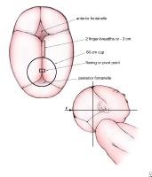

Slide 41
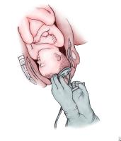

Slide 42
Complications
Neonatal injury:
Subgaleal/subaponeurotic hemorrhage
Scalp bruising/lacerations
Long-term neonatal outcomes
Maternal injury
Lacerations

Slide 43
Thanxx!!!

