Slide 1
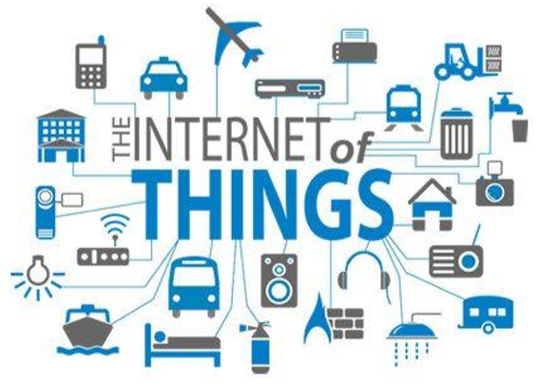
Chapter 4: Internet of Things(IoTs)
Global Network of Smart physical Things

Slide 2
Chapter 4: Objectives
At the end of this chapters students should understand:
Overview and History of IoT
Advantages of IoT
Challenges of IoT
How IoT works ( Architectures, IoT Trends, Devices and Networks, Examples of IoT Applications, Management Platform for the Internet of Things)
IoT Across Application Domains(Homes, Cities, healthcare, energy, Agriculture, transport …etc.)
IoT Tools and Application Development Platforms
IoT Tools
IoT Platforms

Slide 3
Overview of IoT
The Internet of Things, or IoT, refers to the set of devices and systems that interconnect real-world sensors and actuators to the Internet.
Internet of Things (IoT) is a network of devices which can sense, accumulate and transfer data over the internet without any human intervention.
Internet of Things (IoT) is here to change the world we know.
Smart cars, smart homes, smart cities, everything around us can be turned into a smart device with the help of Internet of Thing
IoT surely brings the coolness factor to technology.
Notes:
What makes living things alive? They can sense and communicate with each other, can’t they? Now imagine if inanimate objects could sense and interact with each other without any human intervention. Sounds amazing doesn’t it?
This is pretty much the underlying concept of Internet of Things.

Slide 4
But what is IoT Exactly? Definitions?
Definitions from,
Internet Architecture Board’s (IAB): The networking of smart objects, meaning a huge number of devices intelligently communicating in the presence of internet protocol that cannot be directly operated by human beings but exist as components in buildings, vehicles or the environment
Internet Engineering Task Force (IETF): The networking of smart objects in which smart objects have some constraints such as limited bandwidth, power, and processing accessibility for achieving interoperability among smart objects

Slide 5
But what is IoT Exactly? Definitions? Cont’d…
Definitions from….
IEEE Communications: A framework of all things that have a representation in the presence of the internet in such a way that new applications and services enable the interaction in the physical and virtual world in the form of Machine-to-Machine (M2M) communication in the cloud
Oxford dictionary: The interaction of everyday object’s computing devices through the Internet that enables the sending and receiving of useful data

Slide 6
Conceptual framework (2020) of IoT
IoT= Services+ Data+ Networks + Sensors
IoT is a system of interrelated computing devices, mechanical and digital machines, objects, animals or people that are provided with unique identifiers (UIDs) and the ability to transfer data over a network without requiring human-to-human or human-to-computer interaction
A thing in the internet of things can be a person with a heart monitor implant, a farm animal with a biochip transponder, an automobile that has built-in sensors to alert the driver when tire pressure is low or any other natural or man-made object that can be assigned an IP address and is able to transfer data over a network

Slide 7
Conceptual framework (2020) of IoT Cont’d…
IoT is also considered as a worldwide network of intelligent objects that are interconnected and uniquely representable on the basis of communication-based protocols

Slide 8
Overview of IoT Cont’d…
Internet of Thing s (IoT) is an ecosystem of connected physical objects that are accessible through the internet.
According to the Gartner report, by 2020 connected devices across all technologies will reach 20.6 billion.
And by 2025, we will have 41.6 billion connected IoT devices
The number of IoT devices surpassed the global human population in 2010.

Slide 9
Overview of IoT – Type of Systems
IoT includes many different systems, including
Internet-connected cars
wearable devices including health and fitness monitoring devices, watches, and even human implanted devices;
smart meters and smart objects;
home automation systems and lighting controls;
smartphones that are increasingly being used to measure the world around them; and
wireless sensor networks that measure weather, flood defenses, tides and more

Slide 10
IoT - Key technological enablers
The IoT four key technological enablers are: -
RFID technology used for tagging the things.
Sensor technology used for sensing the things.
Smart technology used for thinking the things.
Nanotechnology used for shrinking the things.
Generally speaking, IOT is just more than M2M communication, with technologies including:
Wireless sensor networks, sensor networks , 2G/3G/4G,GSM,GPRS,RFID, WI-FI, GPS, microcontroller, microprocessor etc.

Slide 11
How to Think about the Internet of Things (IoT)
There are four main components of an IoT system
The Thing itself (that is, the device)
The local network (this can include a gateway, which translates proprietary communication protocols to Internet Protocol).
The Internet ( the Global Network)
Back-end services (enterprise data systems, or PCs and mobile devices).

Slide 12
The Internet of Things from an embedded systems point of view

Slide 13
How to Think about the Internet of Things (IoT) Cont’d…
There are, of course, two key aspects to the IoT:
The devices themselves and
The server-side architecture that supports them.
In fact, there is often a third-category as well;
In many cases, there may be a low power gateway that performs
aggregation,
event processing,
bridging, etc.
that might be located between the device and the wider Internet

Slide 14
Types of Devices(Things)
There are three types of Devices in IoT:
The smallest devices have embedded 8-bit System-On-Chip (SOC) controllers.
Small home routers and derivatives of those devices. Commonly, these run a cut-down or embedded Linux platform, such as OpenWRT, or dedicated embedded operating systems.
Have very limited 32 bit Atheros and ARM chips
The most capable IoT platforms that are full 32-bit or 64-bit computing platforms
Systems such as the Raspberry Pi or the BeagleBone, may run a full Linux OS or another suitable Operating System, such as Android.

Slide 15
IoT Communication Mechanisms
Communication between devices and the Internet or to a gateway includes many different models
Direct Ethernet or Wi-Fi connectivity using TCP or UDP (we will look at protocols for this later)
Bluetooth Low Energy(BLE)
Near Field Communication (NFC)
Zigbee or other mesh radio networks
SRF and point-to-point radio links
UART or serial lines
SPI or I2C wired buses

Slide 16
The two major modes of connectivity ( Communication)

Slide 17
History of IoT
The term “The Internet of Things” (IoT) was coined by Kevin Ashton in a presentation to Proctor & Gamble in 1999.
He is a co-founder of MIT’s Auto-ID Lab.
He pioneered RFID (used in bar code detector) for the supply-chain management domain.
Notes:
The Auto-ID Labs network is a research group in the field of networked radio-frequency identification (RFID) and emerging sensing technologies.
Auto-ID Labs are an independent network of currently seven academic research labs that research and develop new technologies for revolutionizing global commerce and providing previously un-realizable consumer benefits.

Slide 18
History of IoT Cont’d…
Although Ashton was the first man to mention of the “internet of things”, the idea of connected devices has been around since the 1970s, under the monikers embedded internet and pervasive computing.
The first internet appliance, for example, was a Coke vending machine at Carnegie Mellon University in the early 1980s.
Using the web, programmers could check the status of the machine and determine whether there would be a cold drink awaiting them, should they decide to make the trip to the machine.

Slide 19
Evolution of the Internet
Pre-Internet
In the pre-internet era, most of the human to human communication was through fixed line and mobile telephony.
Dawn of Internet
With the origin of Internet the world changed at once. We could be continents apart and still share vital information at just the click of a button.

Slide 20
Evolution of the Internet Cont’d…
Internet of People
After the invention of blogging, social media began to explode in popularity.
Sites like MySpace, Facebook, and LinkedIn gained prominence in the early 2000s.
YouTube came out in 2005, creating an entirely new way for people to communicate and share with each other across great distances.

Slide 21
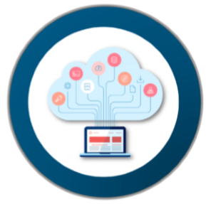
Evolution of the Internet Cont’d…
Internet of Things
Nearly all of the data available on the Internet today was first captured and created by human beings.
The problem is, people have limited time, attention, and accuracy, which means they are not very good at capturing data about things in the real world.
So, if we had computers that knew everything there was to know about things, using data they gathered without any help from us, we would be able to track and count everything and greatly reduce waste, loss and cost
This is what gave birth to “Internet of Things”.

Slide 22
History of IoT Cont’d…
IoT has evolved from the convergence of
wireless technologies,
microelectromechanical systems (MEMS),
microservices and
the Internet.
The convergence has helped tear down the silos between operational technology (OT) and information technology (IT),

Slide 23
History of IoT Cont’d…
This convergence enabled unstructured machine-generated data to be analyzed for insights to drive improvements.
IoT evolved from machine-to-machine (M2M) communication,
i.e., machines connecting to each other via a network without human interaction. M2M refers to connecting a device to the cloud, managing it and collecting data.

Slide 24
History of IoT Cont’d…
Machine-type communication (MTC), also known as machine-to-machine communication (M2M), describes any network where two or more devices exchange data directly and without user intervention.
Taking M2M to the next level, IoT is a sensor network of billions of smart devices that connect people, systems and other applications to collect and share data.
As its foundation, M2M offers the connectivity that enables IoT.

Slide 25
Why is IoT important?
Touches every industry, including healthcare, finance, retail, and manufacturing
Helps people live and work smarter
Smart homes, smart cities, smart kitchen…
Smart cities help citizens reduce waste and energy consumption
Provides businesses with a real-time look into how their companies’ systems really work
Delivering insights into everything from the performance of machines to supply chain and logistics operations
Connected sensors are even used in farming to help monitor crop and cattle yields and predict growth patterns

Slide 26
Why is IoT important? Cont’d…
Touches every industry….Cont’d…
Enables companies to automate processes and reduce labor costs
Cuts down on waste and improves service delivery
Less expensive to manufacture and deliver goods as well as offering transparency into customer transactions

Slide 27
Example of an IoT System

Slide 28
Pros and cons of IoT
Advantage
Improved(active) Customer Engagement
Technology Optimization
Reduced Waste
Enhanced Data Collection(sensors do that)

Slide 29
Pros and cons of IoT
Disadvantages
Increased Security Concern( more devices and more info created and shared)
Big Data Management issue( handling huge numbers)
The higher chance of system corruption (if there is a bug in any part of the system)
Device Interoperability( multiple, different device vendors with no accepted standard)
Notes:
Types of Interoperability
Technical Interoperability -hardware/ software components, systems and platforms that enable machine-to-machine communication to take place
Syntactical Interoperability : usually associated with data formats
Semantic Interoperability :associated with the meaning of content and concerns the human rather than machine interpretation of the content
Organizational Interoperability : the ability of organizations to effectively communicate and transfer (meaningful) data (information) even though they may be using a variety of different information systems over widely different infrastructures.

Slide 30
Key IoT Challenges
There are key challenges and implications today that need to be addressed before the mass adoption of IoT can occur that include:
Privacy and Security ( refer to the security issues at different Layers of IOT)
Trust and quality of-information in shared information models
Secure exchange of data between IoT devices and consumers of their information
Protection mechanisms for vulnerable devices

Slide 31
Key IoT Challenges – Cont’d…
Challenges Cont’d…
Cost versus Usability – reduction in cost of devices and mechanism to use devices is expected
Interoperability
With numerous sources of data and heterogeneous devices, the use of standard interfaces between these diverse entities becomes important
Data Management
the volume of the generated data and the processes involved in the handling of those data become critical

Slide 32
Key IoT Challenges – Cont’d…
Challenges Cont’d…
Device Energy Consumption Level
How to interconnect “things” in an interoperable way while taking into account the energy constraints
Communication between devices takes the most energy

Slide 33
How IoT Works
An IoT ecosystem consists of web-enabled smart devices that use
embedded processors
sensors and
communication hardware
to collect, send and act on data they acquire from their environments.

Slide 34
How IoT Works Cont’d…
IoT devices share the sensor data they collect by connecting to
an IoT gateway or
another edge device
where data is either sent to the cloud to be analyzed or analyzed locally.
Sometimes, these devices communicate with other related devices and act on the information they get from one another

Slide 35
Wireless sensor network installed in a factory, connected to the Internet via a gateway

Slide 36
How IoT Works
Remember that;
IoT is the technology that builds systems capable of autonomously sensing and responding to stimuli from the real world without human intervention
We, therefore, need to develop a process flow for a definite framework over which an IoT solution is built.
The IoT Architecture (to be discussed shortly) is generally comprised of 4 stages

Slide 37
How IoT Works Cont’d…

Slide 38
How IoT Works - the 4 stages
Stage 1 (Sensors/Actuators)
A thing in the context of “Internet of Things”, should be equipped with sensors and actuators thus giving the ability to emit, accept and process signals
Stage 2 (Data Acquisition Systems):
The data from the sensors starts in analogue form which needs to be aggregated and converted into digital streams for further processing.
This stage performs these data aggregation and conversion functions
Stage 3 (Edge Analytics)
Once IoT data has been digitized and aggregated, it may require further processing before it enters the data center, this is where Edge Analytics comes in
Stage 4 (Cloud Analytics)
Data that needs more in-depth processing gets forwarded to physical data centers or cloud-based systems.

Slide 39
How IoT Works - the 4 stages

Slide 40
IoT Architecture
Most researchers agree on a conventional architecture for IoT that includes the following layers
Perception Layer
Network Layer
Application Layer
Some other latest variants, as included in IoT’s latest architecture, add a support layer that lies between the application layer and network layer
Support layer consists fog computing and cloud computing

Slide 41
IoT Architecture
Hence, IOT architecture consists of different layers of technologies supporting IOT.
It serves to illustrate how various technologies relate to each other and to communicate the scalability, modularity and configuration of IOT deployments in different scenarios.
The latest agreed upon IoT Architecture is composed of
Smart device / sensor layer ( Perception)
Gateways and Networks Layer
Management Service Layer
Application Layer

Slide 42
IoT Layered Architecture

Slide 43
IoT Layered Architecture - descriptions
Smart device / sensor layer
Lowest layer, made up of smart objects integrated with sensors,
The sensors enable the interconnection of the physical and digital worlds allowing real-time information to be collected and processed
Various types of sensors for different purposes
sensors have the capacity to take measurements such as temperature, air quality, speed, humidity, pressure, flow, movement and electricity etc.

Slide 44
IoT- Architecture : Smart device / sensor layer
Here is a list of some of the measurement devices used in IoT:
accelerometers
temperature sensors
magnetometers
proximity sensors
gyroscopes
image sensors
acoustic sensors
light sensors
pressure sensors
gas RFID sensors
humidity sensors
microflow sensors

Slide 45
IoT- Architecture : Smart device / sensor layer cont’d…
Most sensors require connectivity to the sensor gateways.
This can be in the form of a Local Area Network (LAN) such as Ethernet and Wi-Fi connections or Personal Area Network (PAN) such as ZigBee, Bluetooth and Ultra Wideband (UWB).
For sensors that do not require connectivity to sensor aggregators, their connectivity to backend servers/applications can be provided using Wide Area Network (WAN) such as
GSM, GPRS and LTE.
Sensors that use low power and low data rate connectivity typically form networks commonly known as wireless sensor networks (WSNs)

Slide 46
IoT- Architecture : Gateways and Networks Layer
Massive volume of data will be produced by these tiny sensors and this requires a robust and high performance wired or wireless network infrastructure as a transport medium.
Current networks(IP based), often tied with very different protocols, have been used to support machine-to-machine (M2M) networks and their applications.
With demand needed to serve a wider range of IOT services and applications such as
high speed transactional services,
context-aware applications
, multiple networks with various technologies and access protocols are needed to work with each other in a heterogeneous configuration.

Slide 47
IoT- Architecture : Gateways and Networks Layer
Any protocol that carries IP packets has an advantage over all others.
The connectivity requirements for IoT devices are so diverse that a single technology cannot meet all the range, power, size and cost requirements.
The importance of IP to the Internet of Things does not automatically mean that non-IP networks are useless.
It just means that non-IP networks require a gateway to reach the Internet.

Slide 48
IoT- Architecture : Gateways and Networks Cont’d…
These networks can be in the form of a private, public or hybrid models and are built to support the communication requirements for latency, bandwidth or security.
Various gateways (microcontroller, microprocessor...) & gateway networks (WI-FI, GSM, GPRS…)

Slide 49
IoT- Architecture : Gateways and Networks Cont’d…
A smart IoT gateway is implemented to provide data processing, local web server, and cloud connection.
After the gateway receives the data from wearable sensors, it will forward the data to an IoT cloud for further data storage, processing and visualization.

Slide 50
IoT- Architecture : Gateways and Networks Cont’d…
This layer also ensures unique addressing and routing abilities to the unified integration of uncountable devices in a single cooperative network.
Various types of technologies have contributed to this phenomenon such as wired, wireless and satellite technologies.
The implementation of 6LoWPAN(Low Power Personal Area Network over IP version 6) protocol towards IPV6 for unique addressing of devices was also important development.
IPv6 is Key for IoT
IPv6’s addressing scheme provides more addresses than there are grains of sand on earth

Slide 51
IoT- Architecture : Management Service Layer
The management service renders the processing of information possible through
Analytics,
Security controls,
Process modeling and
Management of devices
Services may include application and support services)
Often provided by cloud/ fog computing technologies

Slide 52
IoT- Architecture : Management Service Cont’d…
Management Service Layer- Features
Business and process rule engines
Support the formulation of decision logic and trigger interactive and automated processes to enable a more responsive IOT system
Analytics
Various analytics tools are used to extract relevant information from a massive amount of raw data and to be processed at a much faster rate
Two types
In-memory analytics: allows large volumes of data to be cached in random access memory (RAM) rather than stored in physical disks
Streaming analytics: allows analysis of data, considered as data-in-motion, is required to be carried out in real-time so that decisions can be made in a matter of seconds

Slide 53
IoT- Architecture : Management Service Cont’d…
Management Service Features
Data management is ability to manage data information flow
With data management in the management service layer, information can be accessed, integrated and controlled.
Data filtering techniques such as
data anonymization,
data integration, and
data synchronization,
are used to hide the details of the information while providing only essential information that is usable for the relevant applications

Slide 54
IoT- Architecture : Management Service Cont’d…
Management Service Features
Security
Must be enforced across the whole dimension of the IoT architecture right from the smart object layer all the way to the application layer.
Security of the system prevents system hacking and compromises by unauthorized personnel, thus reducing the possibility of risks.

Slide 55
IoT- Architecture : Application Layer
Application covers “smart” environments/spaces in domains such as:
Transportation,
Building,
City,
Lifestyle,
Retail,
Agriculture,
Factory,
Supply chain,
Emergency,
Healthcare,
User interaction,
Culture and tourism,
Environment and Energy.

Slide 56
IoT- Trend, Devices and Networks
IoT Trends: Since 2010, industry leaders have been predicting an explosion in the number of connected devices.
Different estimates of IoT devices to be connected to the Internet
By 2020, Gartner 20.6 billion , CISCO 50 Billion….
By 2025 41.6 Billion etc.…
A wide range of fields that have been adopting IoT infrastructures includes connected and smart cities, manufacturing, energy and utilities, transport, logistics and even agriculture
i.e. IoT is being adopted in many areas of applications
IoT has no practical limit as to the number of devices deployed
IPv6…
However, the number of IoT devices is only limited by the scope of the applications themselves

Slide 57
IoT- Trend, Devices and Networks Cont’d…
IoT Devices
A wireless sensor network (WSN) is a collection of distributed sensors that monitor physical or environmental conditions, such as temperature, sound, and pressure.
Data from each sensor passes through the network, node-to-node
WSN Nodes - are low-cost devices, so they can be deployed in high volume.
They also operate at low power so that they can run on battery, or even use energy harvesting.
A WSN node is an embedded system that typically performs a single function (such as measuring temperature or pressure or turning on a light or a motor).
Energy harvesting is a new technology that derives energy from external sources (for example, solar power, thermal energy, wind energy, electromagnetic radiation, kinetic energy, and more).

Slide 58
IoT- Trend, Devices and Networks Cont’d…
IoT Devices Cont’d…
WSN Edge Nodes
A WSN edge node is a WSN node that includes Internet Protocol connectivity.
It acts as a gateway between the WSN and the IP network
It offers local processing, provide local storage, and feature a user interface

Slide 59
IoT- Trend, Devices and Networks Cont’d…
IoT Devices Cont’d….
The battle over the preferred networking protocol is far from over. There are multiple candidates
Wi-Fi
IEEE 802.15.4
6LoWPAN
Bluetooth

Slide 60
IoT- Trend, Devices and Networks-Cont’d… Wireless radio technologies comparison
Standard | IEE 802.15.4 | Bluetooth | Wi-Fi
Frequency | 868/915 MHZ, 2.4 GHz | 2.4 GHz | 2.4, 5.8 GHz
Data rate | 250 Kpbs | 723 Kpbs | 11 to 105 Mpbs
Data rate | 250 Kpbs | 723 Kpbs | 11 to 105 Mpbs
Power | Very Low | Low | High
Battery Operation | Alkaline (months to years) | Rechargeable (days to weeks) | Rechargeable (hours)

Slide 61
IoT- Trend, Devices and Networks Cont’d…
IoT Networks
As the amount of IoT devices grows, the underlying telecommunications networks that support and serve them must also adapt.
Telecommunication infrastructures must be designed to accommodate the traffic they carry.
Voice, video, and data have particular characteristics and requirements for successful transmission over the network.
IoT traffic differs significantly in its nature and thus has unique network requirements that must be taken into account when designing the network that will carry them

Slide 62
IoT- Trend, Devices and Networks Cont’d…
IoT Networks Cont’d…
An IoT network typically includes a number of devices with constrained resources (power, processing, memory, among others)
Some of those devices may be massively deployed over large areas like smart cities, industrial plants,
Whereas others may be deployed in hard-to-reach areas like pipelines hazardous zones, or even in hostile environments like war zones.
Therefore, the efficient management of IoT networks requires considering both the constraints of low power IoT devices and the deployment complexity of the underlying communication infrastructure.

Slide 63
IoT- Trend, Devices and Networks Cont’d…
IoT network requirements
The ability to connect large numbers of heterogeneous IoT elements
High reliability
Real-time awareness with low latency
Ability to secure all traffic flows
Programmability for application customization
Traffic monitoring and management at the device level
Low-cost connectivity for a large number of devices/sensors

Slide 64
Networks and Devices Management Platform for the Internet of Things
To ensure the correct functioning of those connected devices, they must be remotely accessed to configure, monitoring their status, and so forth.
Traditional management solutions cannot be used for low power devices networks given their resources limitation and scalability issues.
Therefore, efficient and autonomic management of IoT networks is needed

Slide 65
Illustration of an IoT scenario
A simplified representation of an IoT network. It encompasses end devices, gateways, communication links, IoT applications, and services.
A typical scenario involving those entities include end devices collecting data from an environment (e.g., temperature, luminosity, movement) and reporting it to a supervision entity (hosted by an IoT platform and service provider) via different communication technologies and gateways.
Must have a means to device provisioning, administration, monitoring, and diagnostics important for trouble replication and corrective measures.
An Ideal solution will provide a means for managing all devices from one dashboard.

Slide 66
IoT Across Application Domains

Slide 67
IoT Across Application Domains
There are numerous real-world applications of the internet of things, ranging from:
Consumer IoT and Enterprise IoT to
Manufacturing and Industrial IoT (IIoT).

Slide 68
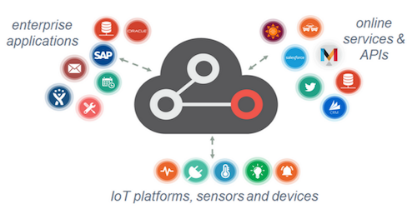
Consumer IoT, Industrial IoT, Commercial IoT and Enterprise IoT

Slide 69
IoT Across Application Domains -13 application domains have taken up IOT

Slide 70
IoT Applications - Smart Homes
For consumers, the connectivity provided by the IoT could enhance their quality of life in multiple ways, such as, but not limited to, energy efficiency and security at home and in the city.
Connected smart devices will enable a reduction in utility bills and outages, while also improving home security via remote home monitoring.
Smart Home has become a reality where all devices are integrated and interconnected via the wireless network.
These “smart” devices have the potential to share information with each other.

Slide 71
IoT Applications - Smart Homes
Smart Home Appliances:
Remote Control Appliances: Switching on and off remotely appliances to avoid accidents and save energy
Refrigerators with LCD screen telling what’s inside, food that’s about to expire, ingredients you need to buy and with all the information available on a smartphone app.
Washing machines allowing you to monitor the laundry remotely, and.
Kitchen ranges with interface to a Smartphone app allowing remotely adjustable temperature control and monitoring the oven’s self-cleaning feature,
Safety Monitoring: cameras, and home alarm systems making people feel safe in their daily life at home,
Intrusion Detection Systems: Detection of window and door openings and violations to prevent intruders
Weather: Displays outdoor weather conditions such as humidity, temperature, pressure, wind speed and rain levels with ability to transmit data over long distances
Energy and Water Use: Energy and water supply consumption monitoring to obtain advice on how to save cost and resources

Slide 72
IoT Across Application - Smart Energy Applications
Energy Applications
IoT provides a way to not only monitor the energy usage at the appliance-level but also at the house-level, grid level or could be at the distribution level.
Smart Meters & Smart Grid are used to monitor energy consumption.

Slide 73
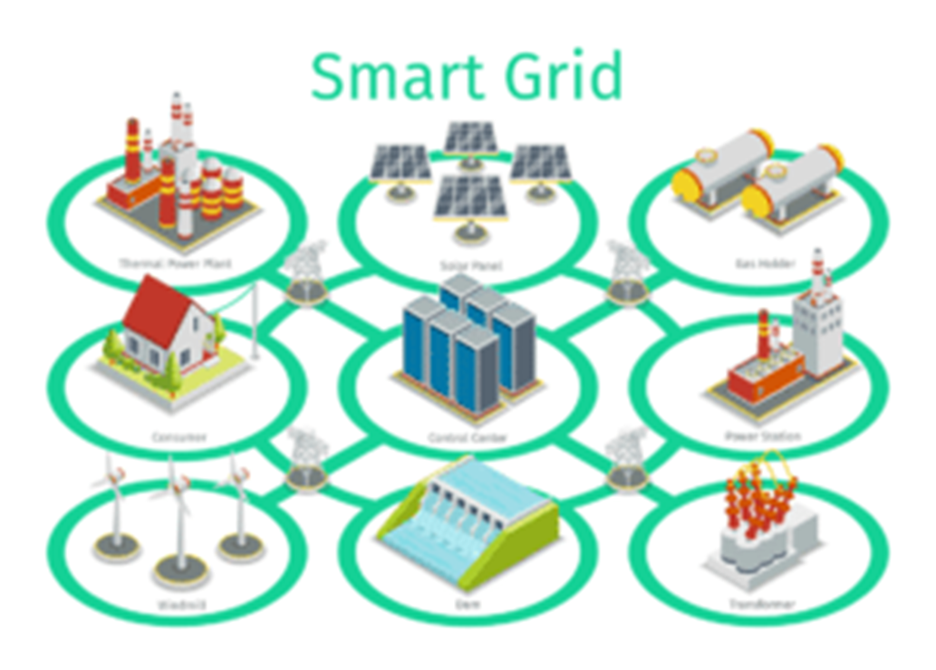
IoT Across Application - Smart Energy Applications
With smart grids energy distribution can be optimized.
These grids also keep collecting real-time data which helps in distributing electricity efficiently and also to reduce the outages.

Slide 74
IoT Across Application - Smart City Applications
Lighting : intelligent and weather adaptive lighting in street lights.
Smart Roads and Intelligent High-ways with warning messages and diversions according to climate conditions and unexpected events like accidents or traffic jams
Smart Parking: Real-time monitoring of parking spaces availability in the city making residents able to identify and reserve the closest available spaces
Waste Management: Detection of rubbish levels in containers to optimize the trash collection routes.
Garbage cans and recycle bins with RFID tags allow the sanitation staff to see when garbage has been put out

Slide 75
IoT Across Application - Smart City Applications
In Smart Cities, the development of smart grids, data analytics, and autonomous vehicles will provide an intelligent platform to deliver innovations in
Energy management,
Traffic management, and
Security,
by sharing the benefits of this technology throughout society

Slide 76
IoT- in Agriculture – Smart Agriculture
Green Houses: Control micro-climate conditions to maximize the production of fruits and vegetables and its quality,
Compost: Control of humidity and temperature levels in alfalfa, hay, straw, etc. to prevent fungus and other microbial contaminants,
Animal Farming/Tracking: Location and identification of animals grazing in open pastures or location in big stables, Study of ventilation and air quality in farms and detection of harmful gases from excrements,
Offspring Care: Control of growing conditions of the offspring in animal farms to ensure its survival and health,
Field Monitoring: Reducing spoilage and crop waste with better monitoring, accurate ongoing data obtaining, and management of the agriculture fields, including better control of fertilizing, electricity and watering

Slide 77
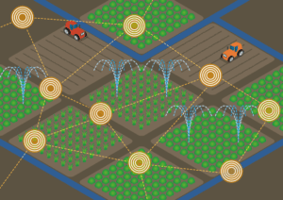
IoT-in Agriculture – Smart Agriculture
The task of irrigation can be automated with the help of IoT.
A set of sensors such as light, humidity, temperature can be used to continuously monitor the field conditions

Slide 78
IoT Application- Smart Healthcare Application
Smartwatches and fitness devices have changed the frequency of health monitoring.
People can monitor their own health at regular intervals.
Not only this, now if a patient is coming to the hospital by ambulance, by the time he or she reaches the hospital his health report is diagnosed by doctors and the hospital quickly starts the treatment.
The data gathered from multiple healthcare applications are now collected and used to analyze different disease and find its cure.
Hospitals often use IoT systems to complete tasks such as inventory management, for both pharmaceuticals and medical instruments

Slide 79
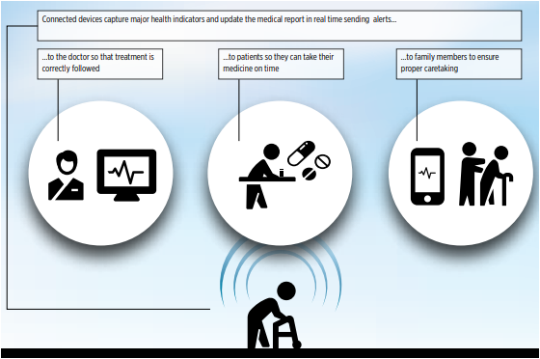
Example IoT health applications

Slide 80
IoT Application- Smart Healthcare Application Cont’d…
Wearable electronic devices are small devices worn on the head, neck, arms, torso, and feet.
Current smart wearable devices include:
Head – Helmets, glasses
Neck – Jewelry, collars
Arm – Watches, wristbands, rings
Torso – Clothing, backpacks
Feet – Socks, shoes
Wearable devices are also used for public safety
Improving first responders' response times during emergencies by providing optimized routes to a location or by tracking construction workers' or firefighters' vital signs at life-threatening sites

Slide 81
IoT Application- Smart Healthcare Application Cont’d…

Slide 82
IoT Application- Smart Education Application
IoT provides education aids which help in filling the gaps in the education industry.
It not only improves the quality of education but also optimizes the cost and improves the management by taking into consideration students response and performance.

Slide 83
IoT Application- Air and Water Pollution, Hazards etc.
Through various sensors, we can detect the pollution in the air and water by frequent sampling.
This helps in preventing substantial contamination and related disasters
The Internet of Things platform can be used to accumulate data related to a specific geographic location using remote monitoring tools and perform analytics so that early warnings of a disaster can be found out.

Slide 84
IoT Application- Air and Water Pollution, Hazards

Slide 85
IoT Tools and Application Development Platforms
IoT Platform:
IoT platform is an essential component of a huge IoT ecosystem that supports and connects all components within the system.
It helps to facilitate device management, handle hardware/software communication protocols, collect/analyze data, enhance data flow and functionality of smart applications

Slide 86
IoT Tools and Application Development Platforms
The overall IoT system includes
Hardware (devices and sensors)
Connectivity through a router, gateway, wi-fi, satellite, Ethernet, etc.
Software
User interface

Slide 87
IoT Tools and Application Development Platforms
Cloud hosting has become a wide-spread and generally appreciated method of developing and running various technology solutions,
IoT, directly depending on Internet, definitely benefits from all the advantages of cloud computing
Special cloud-based IoT platforms support the Internet-based functions of the application – running, maintenance, analytics, data storage, and security measures.

Slide 88
IoT Tools and Application Development Platforms
Below are some Cloud IoT platforms
Google Cloud IoT
Microsoft Azure IoT Suite
SAP
Salesforce IoT
Oracle Internet of Things
Cisco IoT Cloud Connect
Bosch IoT Suite
IBM Watson Internet of Things
ThingWorx IoT Platform
Huawei Cloud Core

Slide 89
IoT Tools and Application Development Platforms
IoT Development Platforms
Top-class IoT development tools that can be employed by both developers and for all those who wish to pursue IoT include
Tessel 2
Eclipse IoT
Arduino
PlatformIO
Kimono Create
IBM Watson
Raspbian (Raspberry Pi)
OpenSCADA
Node-RED
Device Hive

Slide 90
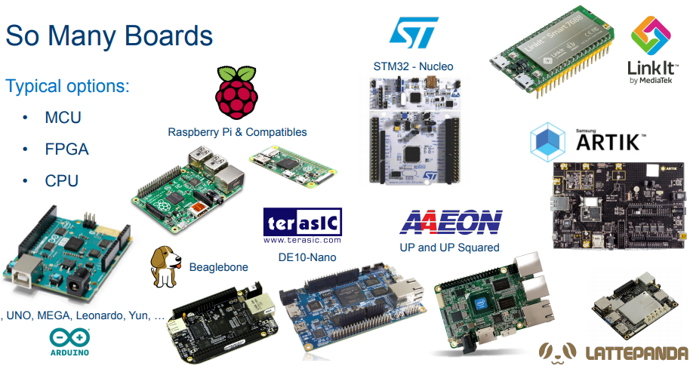
IoT hardware platforms - So many IoT Chips

Slide 91
Chapter 4 - Summary
In this chapter we have learnt
What IoT is and how it emerged as a Technology
How IoT works
The architectures for IoT( Devices, Network, Communications etc.)
The common application areas of IoT in real-life
The IoT development and Deployment Platforms

