Slide 1
SOIL MECHANICS-II(CENG 2082)
Lecture 04: SLOPE STABILITY
Programme: BSc in Hydraulic and Water Resources Engineering
Lecture by: Yonas B.(MSc.)
Faculty of Hydraulic and Water Resources Engineering Arba Minch Water Technology Institute

Slide 2
Objective
Understand the causes and types of slope failure.
Estimate the stability of slopes using limit equilibrium methods.

Slide 3
Chapter Four: 4. Slop Stability Analysis
4.1 Introduction
4.2 Types of Slope Failure
4.3 Two-Dimensional Slope Stability Analysis
4.4 Stability Analysis of Infinite Slopes.
Stability of Infinite Slopes in φ_{u} = 0, cu soil.
Stability of Infinite Slopes in c’- φ’ soil – with no seepage and with steady state seepage.
4.5 Rotational Slope Failure.
Stability of Slopes in cu, φ_{u} = 0 soil – circular failure surface.
Stability of Slopes in c’- φ’ soil – Method of Slices.
Fellenius or Ordinary or Swedish Method
Bishop Simplified Method

Slide 4
4.1 Introduction
The term slope as used in here refers to any natural or man made earth mass, whose surface forms an angle with the horizontal. Hills and mountains, river banks, etc. are common examples of natural slopes.
Examples of man made slopes include fills, such as embankments, earth dams, levees; or cuts, such as highway and railway cuts, canal banks, foundations excavations and trenches.
Natural forces (wind, rain, earthquake, etc.) change the natural topography often creating unstable slopes. Failure of natural slopes (landslides) and man made slopes have resulted in much death and destruction.

Slide 5
Cont…
In assessing the stability of slopes, geotechnical engineers have to pay particular attention to geology, drainage, groundwater, and the shear strength of the soils.
The most common slope stability analysis methods are based on simplifying assumptions and careful site investigation. In this chapter, we will examine the stability of earth slopes in two dimensional space using limit equilibrium methods.

Slide 6
Definitions of Key Terms
Slip plane or failure plane or slip surface or failure surface is the surface of sliding.
Sliding mass is the mass of soil within the slip plane and the ground surface.
Slope angle (or simply slope) is the angle of inclination of a slope to the horizontal. The slope angle is usually referred to as a ratio, for example, 2:1 (horizontal: vertical)

Slide 7
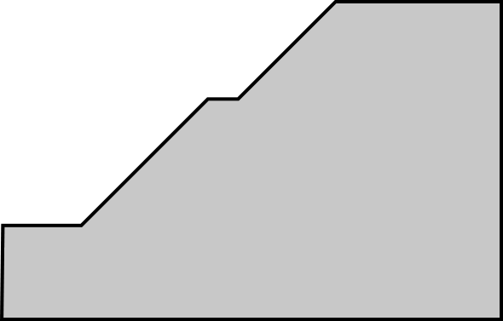
Slope Terminology
Top (Scarp)
Surcharge
Face
Terrace
Height, H
SR
1
Toe
SR = Slope Ratio (Horizontal to Vertical)
(e.g., 2:1 or 1:1)

Slide 8
4.2 Types of Slope Failure
Slope failure, also referred to as mass wasting, is the downslope movement of rock debris and soil in response to gravitational stresses.
Slope failures depend on the soil type, soil stratification, groundwater, seepage, and the slope geometry.
A few types of slope failure are shown in Figure 4.1. Failure of a slope along a weak zone of soil is called a translational slide (Fig. 4.1 a). Translational slides are common in coarse-grained soils.

Slide 9
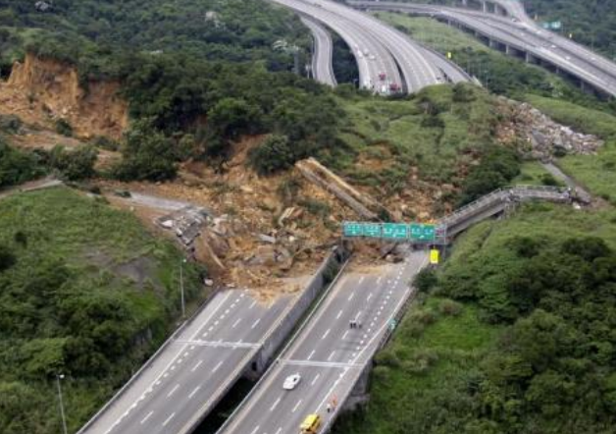
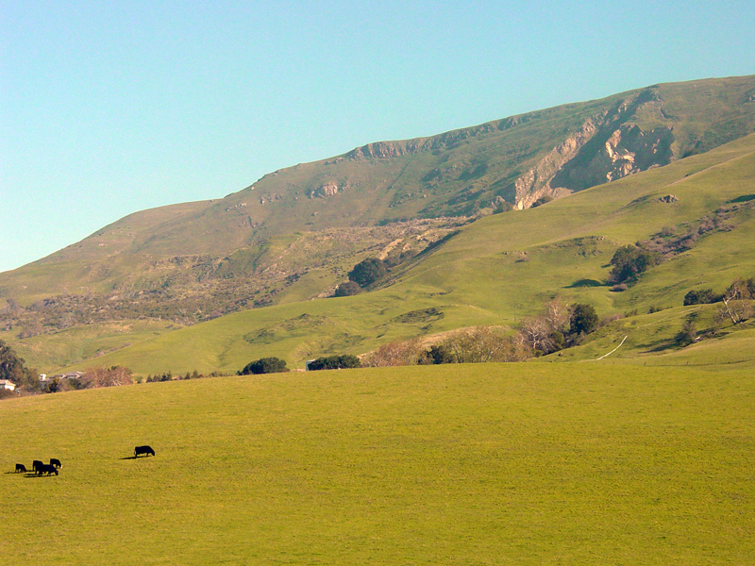
Slope failures
Landslide in Thailand
Natural slope
Natural slope failure

Slide 10
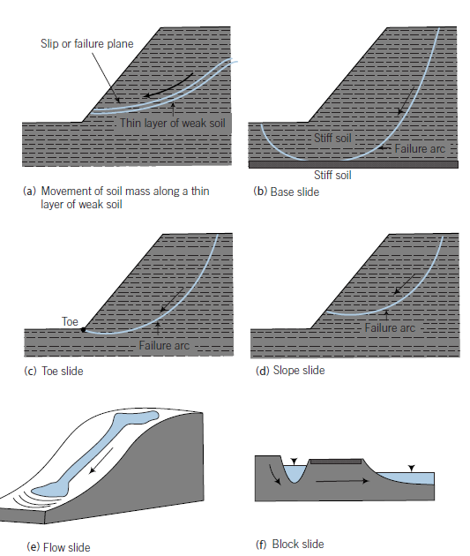
4.2 Types of Slope Failure
1) Translational slide (weak layer)
2) Rotational slide (base failure)
3) Rotational slide (“toe slide”)
4) Rotational slide (“slope slide”)
5) Flow slide (viscous fluid behavior)
6) Block slide
Figure 4.1: Some types of slope failure

Slide 11
Cont…
A common type of failure in homogeneous fine-grained soils is a rotational slide. Three types of rotational slides often occur.
Base slide: occurs by an arc enclosing the whole slope. A soft soil layer resting on a stiff layer of soil is prone to base failure (Fig. 4.1 b).
The toe slide, whereby the failure surface passes through the toe of the slope (Fig. 4.1 c).
The slope slide, whereby the failure surface passes through the slope (Fig. 4.1 d).
A flow slide occurs when internal and external conditions force a soil to behave like a viscous fluid and flow down even shallow slopes, spreading out in several directions (Fig. 4.1 e).

Slide 12
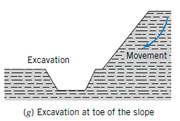
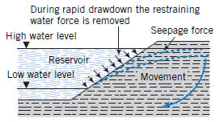
Causes of slope failures/Triggering Mechanisms
Slope failures are caused in general by natural forces, human mismanagement and activities.
The most common causes of slope failures are erosion, rainfall, earthquake, geological features, external loading, construction activities (ex. excavation & fill), and reservoir rapid drawdown.
1) Intense rainfall (role of pore pressure)
2) Erosion (removal of toe support, increased slope angle)
3) Earthquake loading (dynamic forces, liquefaction)
4) Construction activities (toe excavation)
5) Surcharge loading
6) Rapid drawdown

Slide 13
4.3 Two-Dimensional Slope Stability Analysis
Slope stability can be analyzed using one or more of the following: the limit equilibrium method, finite difference method, and finite element method.
Limit equilibrium is the most widely used method for stability analysis.

Slide 14
4.4 Stability Analysis of Infinite Slopes.
Infinite slopes have dimensions that extend over great distances. In practice, the infinite slope mechanism is applied to the case when a soft material of very long length with constant slope may slide on a hard material (e.g. rock) having the same slope. Let’s consider a clean, homogeneous soil of infinite slope αs as shown in Figure 4.3.
To use limit equilibrium method, we must first speculate on a failure of slip mechanism. We will assume the slip would occur on a plane parallel to the slope. If we consider a slice of soil between the surface of the soil and the slip plane, we can draw a free-body diagram of the slice as shown in Figure 4.3

Slide 15
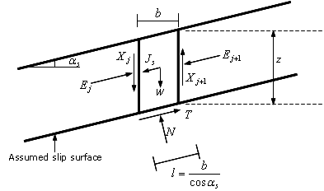
Infinite Slopes…
Figure 4.3: Forces on a slice of soil in an infinite slope.

Slide 16
The forces acting on the slice per unit thickness are the weight W=γbz , the shear forces Xj and Xj+1 on the sides, the normal forces Ej and Ej+1 on the sides, the normal force N on the slip plane and the mobilized shear resistance of the soil, T, on the slip plane. We will assume that forces that provoke failure are positive. If seepage is present, a seepage force Js=i*γw*b*z develops, where i is the hydraulic gradient.
For a uniform slope of infinite extent, Xj=Xj+1 and Ej=Ej+1. To continue with the limit equilibrium method, we must now use the equilibrium equations to solve the problem.
But before that we will define the factor of safety (FS) of a slope in the following subsection. The general objective of infinite slope stability analysis is to determine either the critical slope or critical height, or alternatively, the factor of safety of the slope.

Slide 17
The factor of safety of a slope is defined as the ratio of the available shear strength, τf, to the minimum shear strength required to maintain stability (which is equal to the mobilized shear stress on the failure surface),τm , that is:
The shear strength of the soil is governed by the Mohr-Coulomb failure criterion
Eq(4.1)

Slide 18
4.4.1 Stability of Infinite Slopes in φ=0, c_{u} soil.
For the φ=0, Cu soil, the Mohr-Coulomb shear strength is given by:
Eq(4.2)
From statics and using Figure 4.3,
Eq(4.3)
The shear stress per unit length (A=L*1) on the slip plane is given by: (shear stress =s.forece/area thus:)
Eq(4.4)

Slide 19
The factor of safety is then,
Eq(4.5)
At limit equilibrium, FS = 1. Therefore, the critical slope is(αs=αc)
Eq(4.6)
And the critical depth is:
Eq(4.7)

Slide 20
4.4.2 Stability of Infinite Slopes in c’, φ soil – without seepage.
For a c’,φ soil, the Mohr-Coulomb shear strength is given by:
Eq(4.8)
The factor of safety FS is then:
Eq(4.9)
The normal and shear stresses per unit length at the failure plane in reference to figure 4.3 are given by:
Eq(4.10)

Slide 21
For a slope without seepage, Js=0. From Eqns. (4.4, 4.9 and 4.10) we get:
Eq(4.11)
At limit equilibrium FS = 1. Therefore, the critical depth zc is given by
Eq(4.12)
For the case where αs<φ’ , the factor of safety is always greater than 1 and is computed from Eqn. (4.6). This means that there is no limiting value for the depth z, and at an infinite depth, the factor of safety approaches to tanφ/tanαs . For a coarse-grained soil with c’ = 0, Eqn. (4.6) becomes:
At limit equilibrium FS = 1. Therefore, the critical slope angle is:
Eq(4.14)
Eq(4.13)

Slide 22
Example 4.1
An infinitely long slope is resting on a rock formation with the same inclination. The height of the slope is 3.2 m. Determine
the factor of safety,
the shear stress developed on the sliding surface, and
c) the critical height. αs=25, γ=17.5 kN/m3, c’ = 12 kPa and φ’=20.

Slide 23
4.4.3 Stability of Infinite Slopes in c’, soil – steady state seepage.
We will now consider groundwater at the ground surface and assume that seepage is parallel to the slope. The seepage force is:
Eq(4.15)
Since seepage is parallel to the slope, . From statics,
And
Eq(4.16)
Eq(4.17)

Slide 24
Therefore, the shear stress at the slip plane is:
Eq(4.17)
From the definition of factor of safety (Eqn. 4.3), we get:
Eq(4.18)
At limit equilibrium, FS=1. Therefore, the critical height is:
At infinite depth the factor of safety in Eqn. (4.17) becomes:
Eq(4.19)

Slide 25
Eqn. (4.19) can also be used for calculating the factor of safety for a coarse-grained soil with c’ = 0. At limit equilibrium FS = 1, and hence, the critical slope for a coarse-grained soil with c’ = 0 is given by:
For most soils, . Thus, seepage parallel to the slope reduces the limiting slope of a clean, coarse-grained soil by about one-half.
If the groundwater level is not at the ground surface, weighted average unit weights have to be used in Eqns. (4.17 and 4.18).

Slide 26
Example 4.2
A long slope of 5.5 m deep is to be constructed of material having the following properties: γsat=20 kN/m³, γ=17.5 kN/m³, c’=10 kPa, and =32⁰. Determine the factor of safety
when the slope is dry,
there is a steady state seepage parallel to the surface with the water level 2 m above the base and
the water level is at the ground surface.

Slide 27
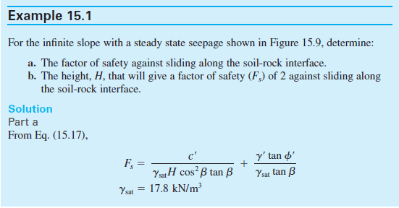

Slide 28
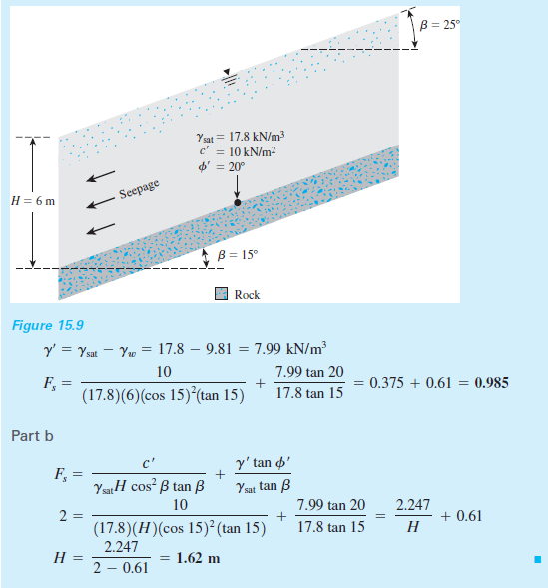

Slide 29
4.5 Rotational Slope Failure.
4.5.1 Stability of Slopes in cu, φ_{u} = 0 soil – circular failure surface.
4.5.2 Stability of Slopes in c’- φ’ soil – Method of Slices.
4.5.3 Fellenius or Ordinary or Swedish Method
4.5.4 Bishop Simplified Method

Slide 30
4.5 Rotational/finite Slope Failure
The infinite slope failure mechanism is reasonable for infinitely long and homogeneous slopes made of coarse-grained soils, where the failure plane is assumed to be parallel to the ground surface.
But in many practical problems slopes have been observed to fail through a rotational mechanism of finite extent. As shown in Fig. (4.1), rotational failure mechanism involves the failure of a soil mass on a circular or non-circular failure surface.
Again we will continue to use the limit equilibrium method assuming a circular slip surface.

Slide 31
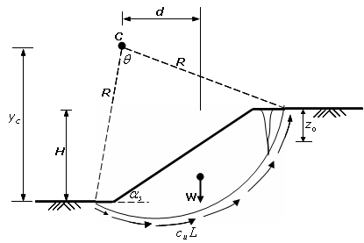
4.5.1 Stability of Slopes in cu, φ=0 soil – circular failure surface.
The simplest circular analysis is based on the assumption that a rigid, cylindrical block will fail by rotation about its center and that the shear strength along the failure surface is defined by the undrained strength cu. Figure 4.4 shows a slope of height H and angle αs. The trial circular failure surface is defined by its center C, radius R and central angleφ .
Figure 4.4: Slope failure in cu, φ=0.

Slide 32
The weight of the sliding block acts at a distance d from the center. Taking moments of the forces about the center of the circular arc, we have:
Eq(4.19)
Where L is the length of the circular arc, W is the weight of the sliding mass and d is the horizontal distance between the circle center, C, and the centroid of the sliding mass. If cu varies along the failure surface then:
Eq(4.20)
The centroid of the sliding mass is obtained using a mathematical procedure based on the geometry or the sub-division of the sliding mass into narrow vertical slices.

Slide 33
Example 4.3
Find the factor of safety of a 1V:1.5H slope that is 6 m high. The center of the trial mass is located 2.5 m to the right and 9.15 m above the toe of the slope. c_{u} = 25 kPa, and =18 kN/m³. Take d = 3.85 m.

Slide 34
Effect of Tension Cracks
Tension cracks may develop from the upper ground surface to a depth z₀ that can be estimated using Eqn. (4.13). The effect of the tension crack can be taken into account by assuming that the trial failure surface terminates at the depth z₀, thereby reducing the weight W and central angle . Any external water pressure in the crack creates a horizontal force that must be included in equilibrium considerations.
Example 4.4
Rework Example 4.3 by taking into account tension cracks. Geometric data are: =66.6⁰, area of sliding mass = 27.46 m², and d = 3.48 m.

Slide 35
4.5.2 Stability of Slopes in c’,φ soil – Method of Slices.
The stability of a slope in a c’, φ soil is usually analyzed by discretizing the mass of the failure slope into smaller slices and treating each individual slice as a unique sliding block (Fig. 4.6). This technique is called the method of slices.
In the method of slices, the soil mass above a trial failure circle is divided into a series of vertical slices of width b as shown in Fig. 4.6 (a). For each slice, its base is assumed to be a straight line defined by its angle of inclination with the horizontal whilst its height h is measured along the centerline of the slice.

Slide 36
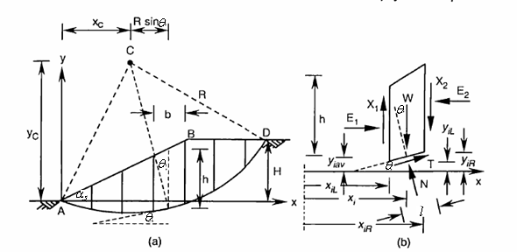
Method of slices
Figure 4.6: a) Method of slices in c’, soil, b) Forces acting on a slice.

Slide 37
The forces acting on a slice shown in Fig. 4.6 (b) are:
W = total weight of the slice = γ×h×b
N = total normal force at the base = N’ + U, where N’ is the effective total normal force and U = ul is the force due to the pore water pressure at the midpoint of the base length l
T = the mobilized shear force at the base = , where is the minimum shear stress required to maintain equilibrium and is equal to the shear strength divided by the factor of safety: .
X1, X2 = shear forces on sides of the slice and E1, E2 = normal forces on sides the slice. The sum of the moments of the interslice or side forces about the center C is zero.

Slide 38
Thus, for moment equilibrium about the center C (note the normal forces pass through the center):
Eq(4.20)
where n is the total number of slices. Replacing by the Mohr-Coulomb shear strength, we obtain:
Eq(4.21)

Slide 39
The term c’l may be replaced by . For uniform c’, the algebraic summation of c’l is replaced by c’L, where L is the length of the circular arc.
The values of N’ must be determined from the force equilibrium equations. However, this problem is statically indeterminate – because we have six unknown variables for each slice but only three equilibrium equations.
Therefore some simplifying assumptions have to be made. In this chapter two common methods that apply different simplifying methods will be discussed.
These methods are called the Fellenius method and Bishop simplified method.

Slide 40
I. Fellenius or Ordinary or Swedish Method
The ordinary or Swedish method of slices was introduced by Fellenius (1936). This method assumes that for each slice, the interslice forces X₁=X₂ and E₁=E₂. Based on this assumption and from statics, the forces normal to each slice are given by:
Eq(4.22)
Substituting N’ into Eqn. 4.21, we obtain:
Eq(4.23)

Slide 41
For convenience, the force due to pore water is expressed as a function of W:
Eq(4.24)
Where ru is called the pore water pressure ratio. Consequently, we have:
Eq(4.25)

Slide 42
The term ru is dimensionless because the term
represents the weight of water with a volume of
Furthermore, ru can be simplified as follows:
Eq(4.26)
If the height of the water and the average height of the slice are equal, the maximum value of ru becomes rw/r , which for most soils, is approximately 0.5. Note that the effective normal force N’ acting on the base is equal to or .
or
If the term is negative, N’ is set to zero because effective stress can not be less than zero (i.e. soil has no tension strength).

Slide 43
Remarks on Safety Factor
Minimum FS = 1.25 using OMS
Use FS = 1.3 to 1.5 for critical slopes such as end slopes under abutments, slopes containing footings, major retaining structures
Use FS = 1.5 for cut slopes in fine-grained grained soils which can lose strength with time soils

Slide 44
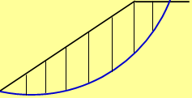
EXAMPLE 4.5
1
C
R
Given:
No. of slices = 8, b = 1.5 m.
B
D
10 kPa
29⁰
18 kN/m³
Required: FS for r_{u} = 0 & 0.4.
SOLUTION 4.5
From the calculations in Example 4.3, we have:
R = 9.48 m, x_{D} = 11.44 m, β=85.9⁰
The width of slice 8 = 11.44 – 7×1.5 = 0.94 m
Equation of the trial circle:

Slide 45
Differentiating the above equation w.r.t. x, gives:
2

Slide 46
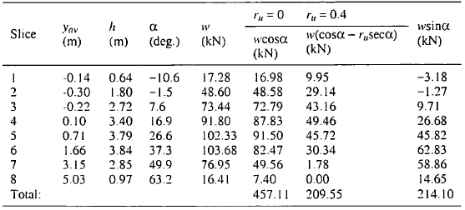
For each slice average values of y, h and θ are tabulated below:
3
W
Sample calculation for slice 6 is shown below:

Slide 47
Sample calculation:
4
Let x₆ be the x coordinate at the mid point of the arc at slice 6, then:
Substituting to the equation of circle, we get:
Thus:

Slide 48
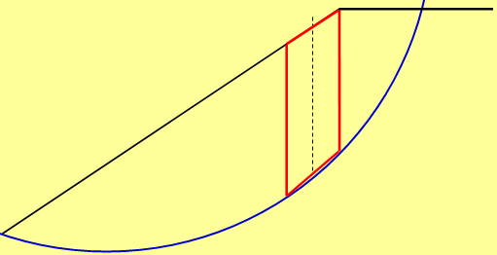
Find h:
For
For
Find the y value at the middle of the base (not arc), y_{av}, by taking the average value of y at the middle of the base:
B
H=6 m

Slide 49
For x_{6L}(x coordinate at the left side of the base):
For x_{6R}(x coordinate at the right side of the base):
Therefore
Find the weight:

Slide 50
Find the FS (Use Eqn. 4.25):
For uniform c:
For r_{u} = 0:
For r_{u} = 0.4:

Slide 51
4.5.3.2 Bishop Simplified Method
Assumption:
More accurate than Swedish method.
5 to 20% increase in FS

Slide 52
Nonlinear in FS, thus requires iteration.

Slide 53
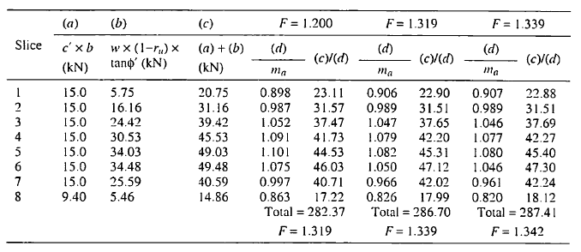
EXAMPLE 4.6
Re-work Example 4.5 for r_{u} = 0.4 using Bishop’s simplified Method.
A summary of the computations is tabulated above where three iterations have been carried out. The initial value for FS was taken as 1.2. For subsequent iterations, the initial value of FS is that computed from the previous iteration. The final factor of safety for the selected trial circle is 1.34.

Slide 54
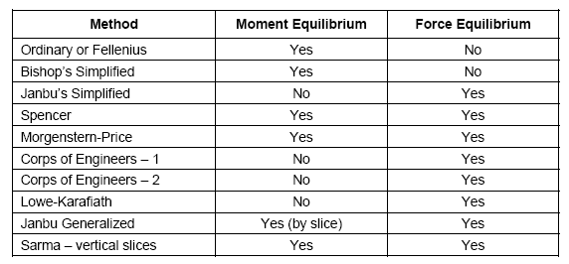

Slide 55
II. Bishop method Bishop method
Also known as Simplified Bishop method
Includes interslice normal forces(E1 ‡ E2)
Neglects interslice shear forces (X1=X2)
Satisfies only moment equilibrium
This method assumes that for each slice X₁=X₂ but E_{1 #} E₂. These assumptions are considered to make this method more accurate than the Swedish method.

Slide 56
II. Bishop Simplified Method
An increase of 5% to 20% in the factor of safety over the Swedish method is usually obtained. Referring to Figure 4.6 b, and writing the force equilibrium in vertical direction (in order to eliminate E₁ and E₂), the following equation for N’ can be found:
Eq.(4.27)

Slide 57
In addition to the force in the vertical direction, Bishop Simplified method also satisfies the overall moment equilibrium about the center of the circle as expressed in Eqn. (4.21).
Putting and , and substituting Eqn. (4.27) into Eqn. (4.21), we obtain:
Eq.(4.28)
Eq.(4.29)

Slide 58
Equation (4.29) is non-linear in FS (that is FS appears on both sides of the equations) and is solved by iteration. An initial value of FS is guessed (slightly greater than FS obtained by Fellenius’ method) and substituted to Eqn. (4.29) to compute a new value for FS. This procedure is repeated until the difference between the assumed and computed values is negligible. Convergence is normally rapid and only a few iterations are required. The procedure is repeated for number of trial circles to locate the critical failure surface with the lowest factor of safety.
Example 4.6
Re-work Example 4.5 for r_{u} = 0.4 using Bishop’s simplified Method.

Slide 59
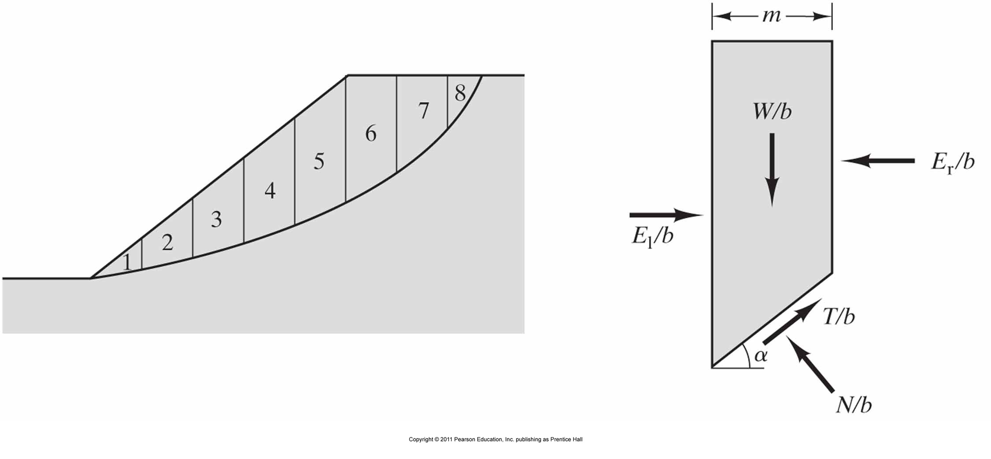
Modified Bishop’s Method
Neglecting side forces (OMS) produces FS too low (conservative)
Assume side shear forces are zero but account for side normal forces
Effective Stress Analysis (ESA)
Not a closed-form solution (FS on both sides of equation); requires iterative approach

Slide 60
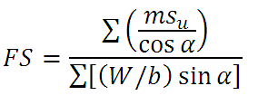
Modified Bishop’s Method
Neglecting side forces (OMS) produces FS too low (conservative)
Assume side shear forces are zero but account for side normal forces
Total Stress Analysis (TSA)

Slide 61
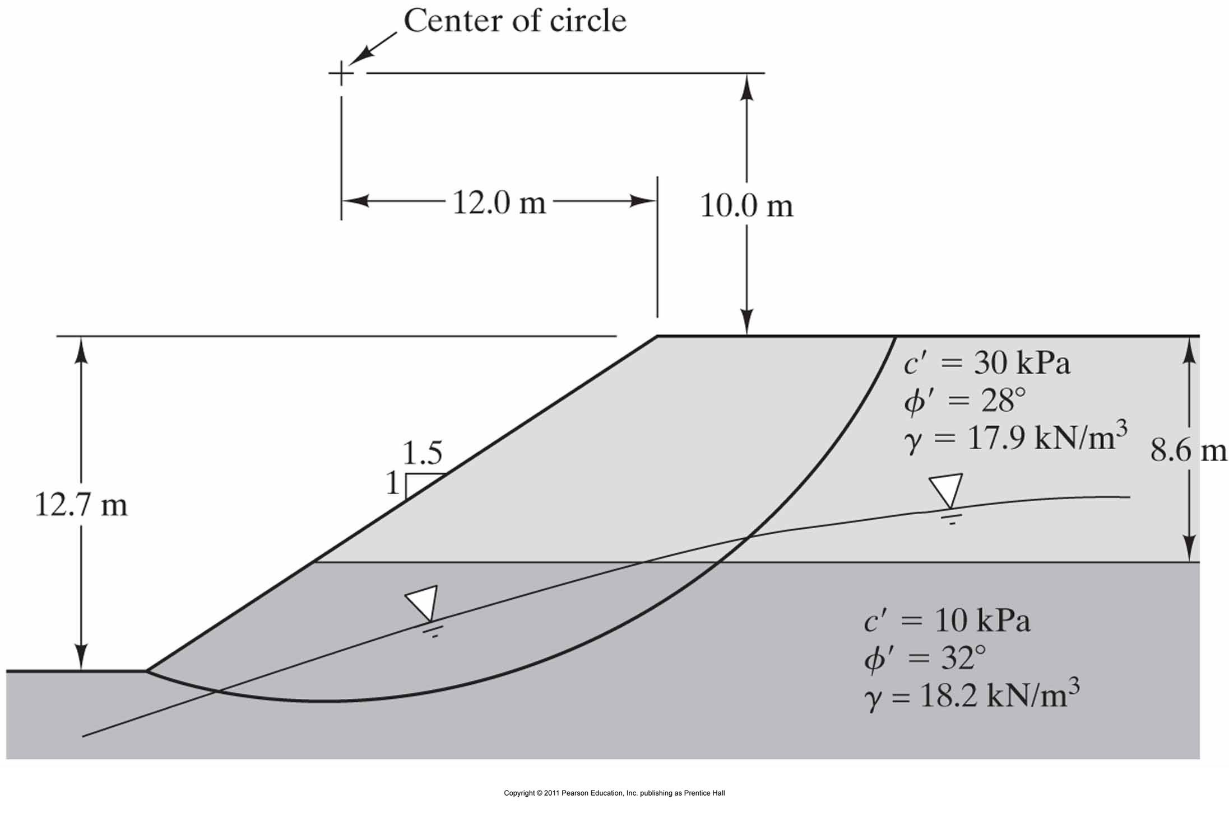
Example 2
Compute the long term FS for the failure surface using the Modified Bishops Method

Slide 62
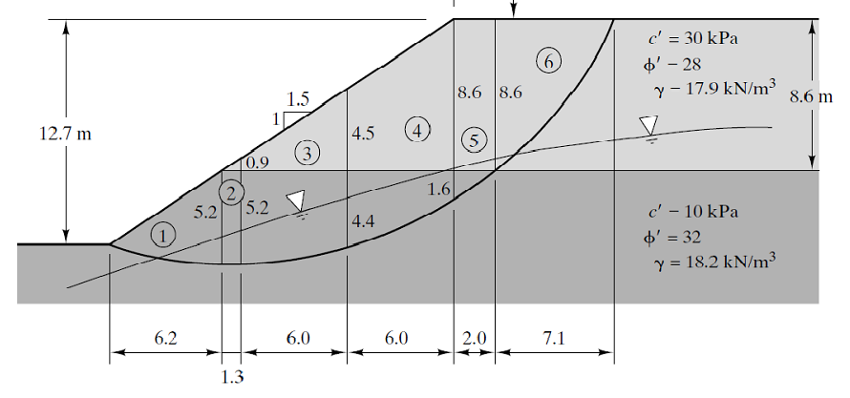
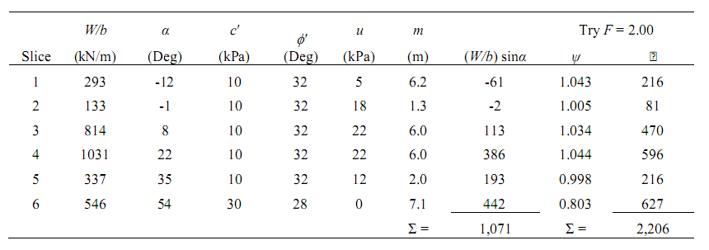
1) Divide into slices (draw to scale)
2) Trial FS = 2.0 (or from OMS)
FS = 2,206/1,071 = 2.05 (too high)

Slide 63
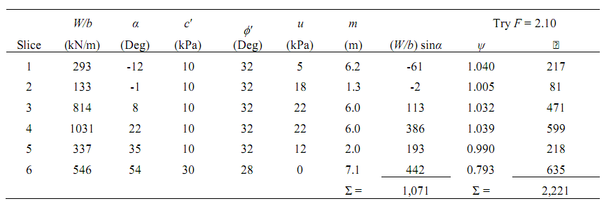
3) Trial FS = 2.10
FS = 2,221/1,071 = 2.07 (close enough? or keep iterating)

Slide 64
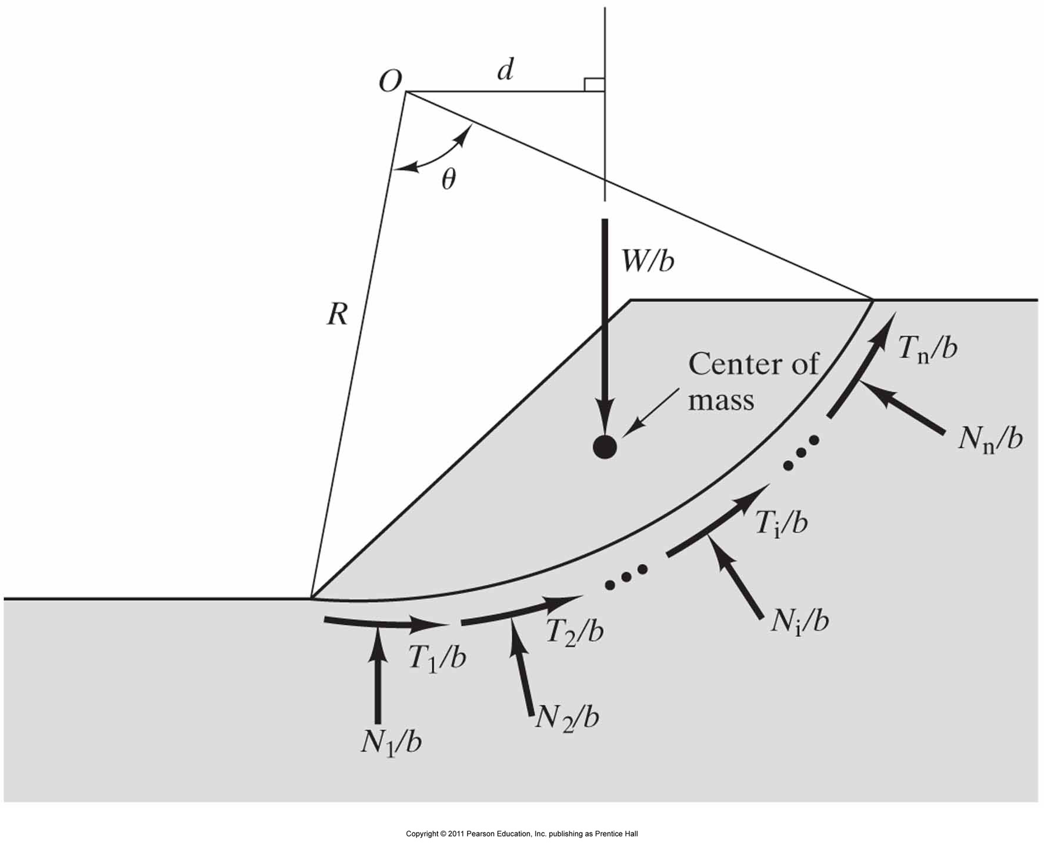
Basic Analysis Approach for Rotational Failure Surface
Limit Equilibrium:1) Assume some circular (or other shape) failure surface
2) Calculate driving forces (moment about O)
3) Calculate resisting forces (moment about O)
Issues:
Where is the center of mass?
How does resistance vary along surface?
How does normal stress vary along surface?
Water table and seepage forces?
Soil layering?
More complex geometry?

Slide 65
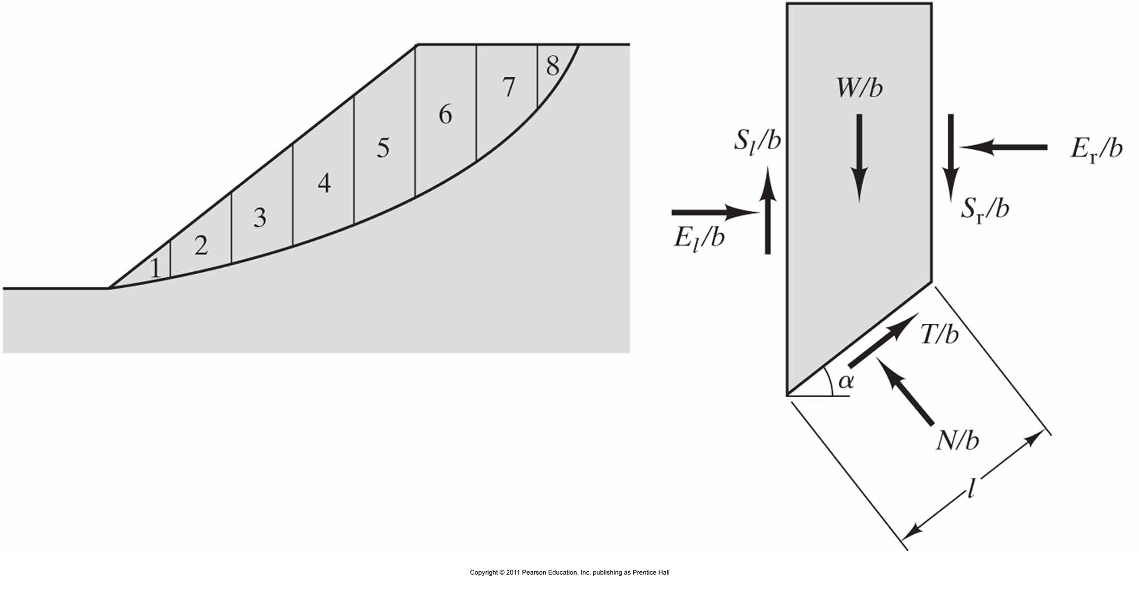
Method of Slices (General)
Assume some failure surface
Discretize failure surface into smaller elements (slices)
Bottom of each slice passes through one type of material
Curved bottom of each slice approximated as chord
More slices = more refined solution
10-40 slices typically sufficient (less for hand solutions)
Calculate factor of safety for each slice (strength/stress) and overall factor of safety
Find lowest FS for different failure surfaces
Side forces make the problem statically indeterminant

Slide 66
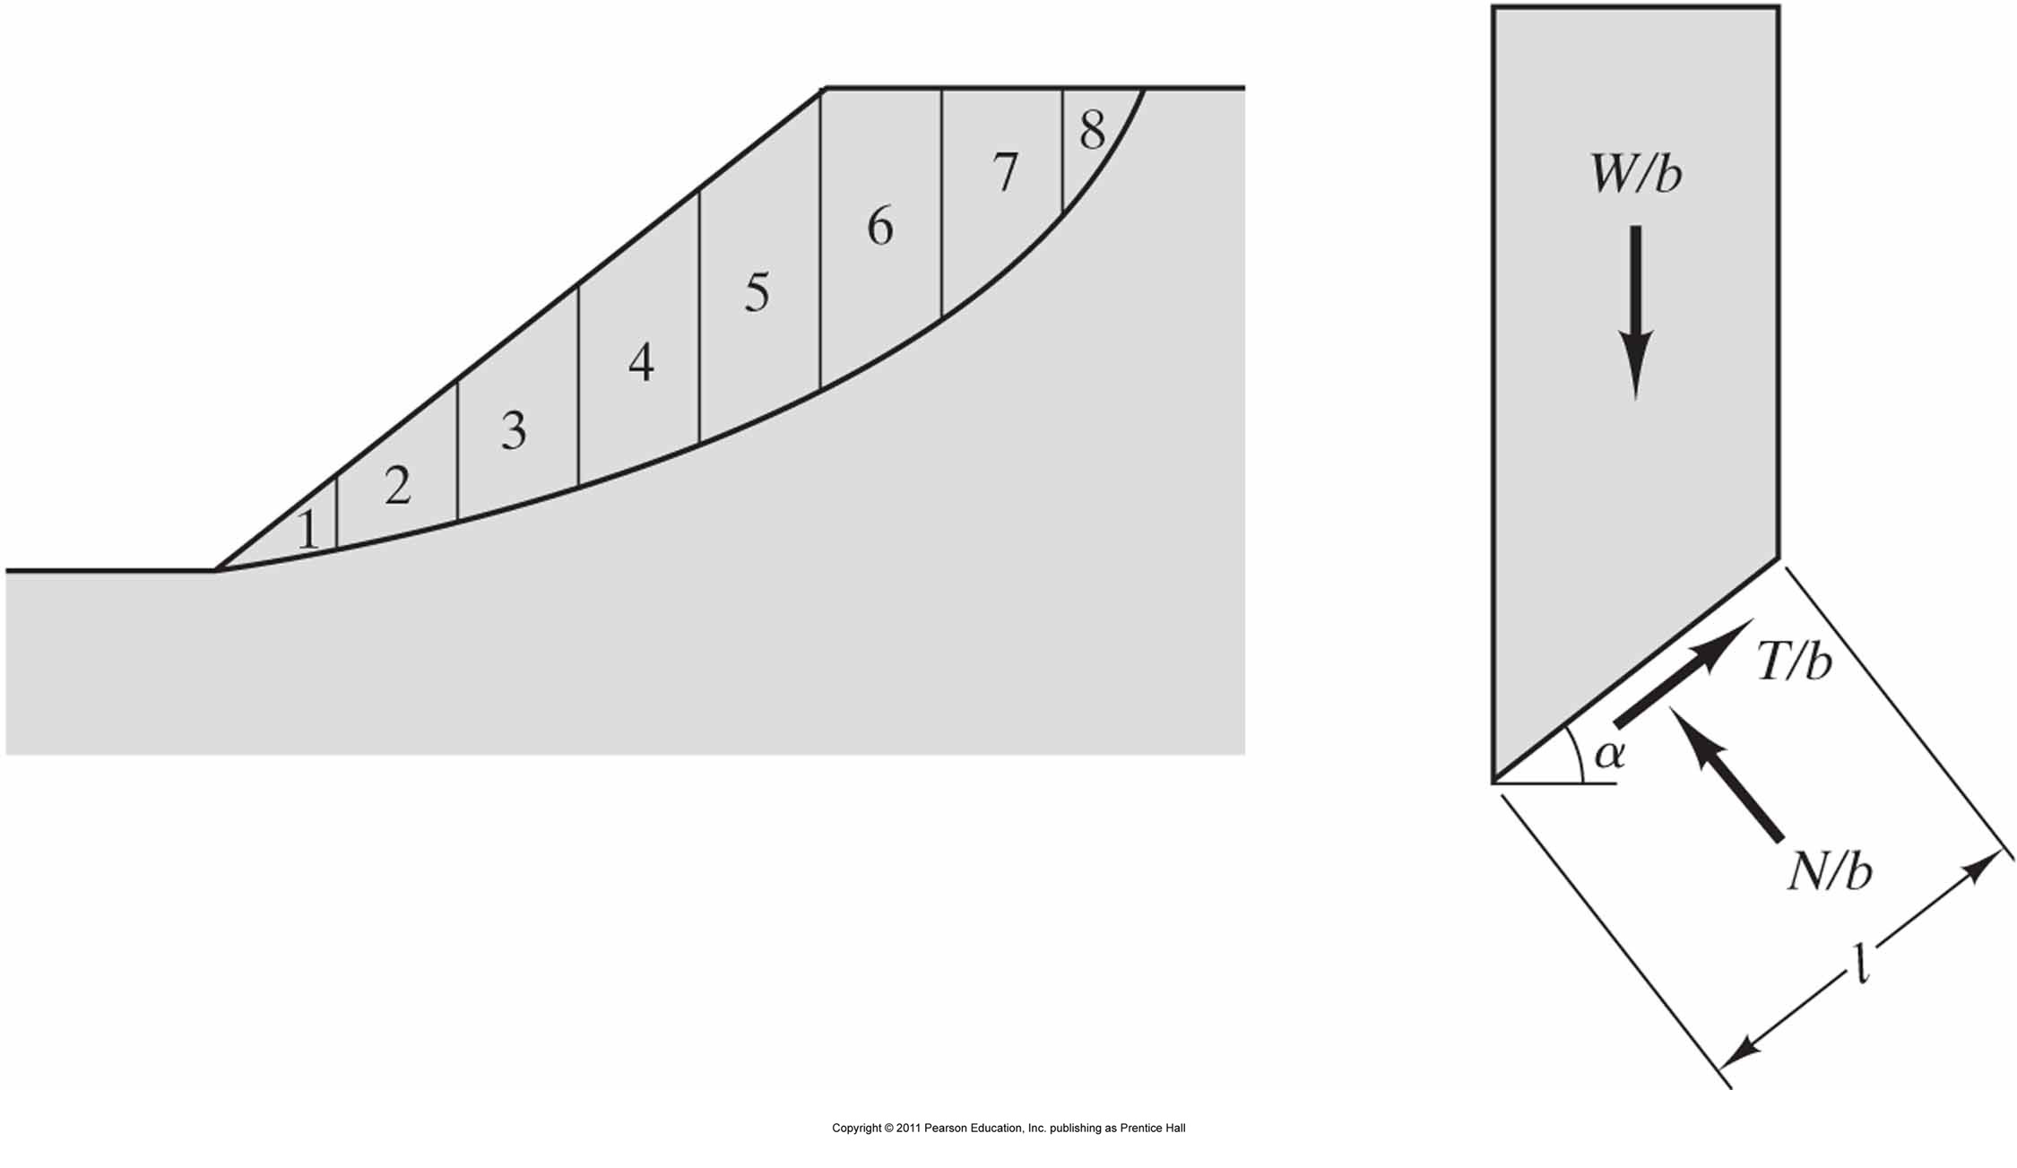
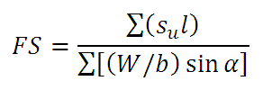
Ordinary Method of Slices (OMS)
Side forces neglected (statically determinant)
Effective Stress Analysis (ESA)
Total Stress Analysis (TSA)

Slide 67
Example 1
Compute the long term factor of safety for the failure surface using the OMS

Slide 68
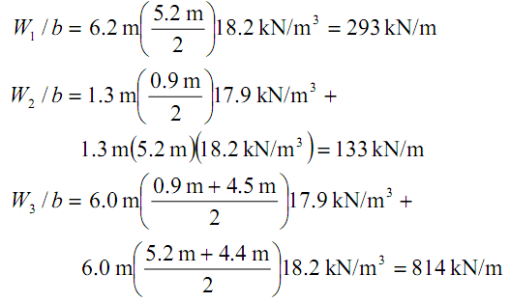
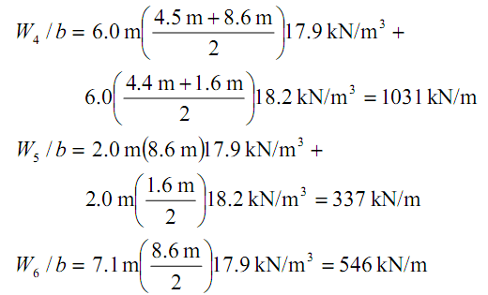
1) Divide into slices (draw to scale)
2) Compute weights

Slide 69
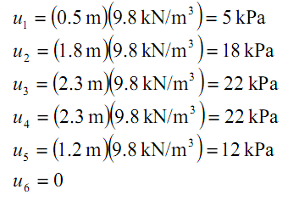
3) Compute average pore pressure at base of each slice

Slide 70
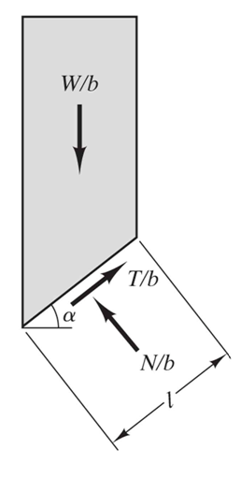
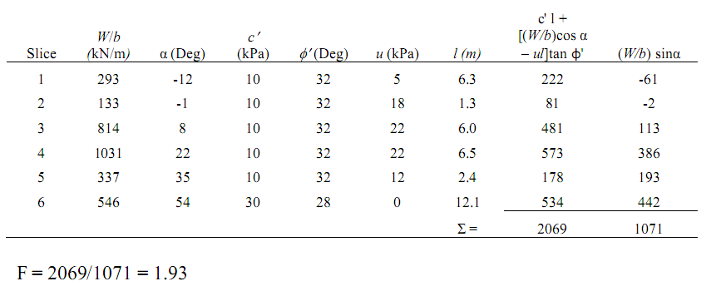
4) Solve for overall factor of safety
5) Repeat for another failure surface to find minimum FS

Slide 71
References:
1. Das, Braja, Principles of Geotechnical Engineering, 5th ed.,Brooks/Cole, 2002.
2. Budhu M. (2000), Soil Mechanics and Foundations, Wiley and Sons.
3. Lambe, T. W., Whitman, R. V. (1999), Soil Mechanics, John Wiley & Sons Inc.
4. Teferra, A. & Mesfin, L., Soil Mechanics, AAU
5. Craig, R.F. (2004), Craig's Soil Mechanics, 7th edition, Taylor & Francis.
6. Bowles, J. E., 1996. Foundation Analysis and Design, Joseph E. Bowles, McGraw-Hill.

Slide 72
THANK YOU!

